Slide 1
BLUESTOCK FINTECH • DATA ANALYST INTERNSHIP CAPSTONE
Mutual Fund Analytics Platform
End-to-End Data Engineering, Quantitative Risk Modeling, and Interactive BI Dashboard Architecture
Project Scope: 40 Real Schemes | 10 Datasets (87K+ Rows) | SQLite Star Schema | Power BI / Python
Author: Manju Angadi • Date: June 2026 • Capstone Submission (Final v1.0)

Slide 2
BLUESTOCK FINTECH | CAPSTONE PROJECT
Problem Statement & Strategic Objectives
The Retail Investment Dilemma
• Data Fragmentation: NAV, AUM, folio counts, and transaction flows are scattered across AMFI, SEBI, and disparate exchange portals in TXT, HTML, and CSV formats.
• Lack of Unified Analytics: Retail investors struggle to assess true risk-adjusted performance, often misjudging high trailing returns without evaluating downside volatility.
• SIP Friction & Drop-Offs: High initial investor excitement is plagued by mandate skips, bank balance defaults, and lack of automated cadenced retention tracking.
Capstone Solution Pillars
✔ Automated ETL Pipeline: Ingest, clean, and validate 10 relational datasets with automated live NAV integration via mfapi.in.
✔ Relational Star Schema: Architect a high-performance SQLite data warehouse linking dimension and fact tables for fast BI querying.
✔ Quantitative Risk Modeling: Compute CAGR, Sharpe, Sortino, Alpha, Beta, Max Drawdown, 95% Historical VaR/CVaR, and Sector HHI.
✔ Interactive BI Dashboard: Design 4 visual pages in Power BI with drill-through navigation, category slicers, and executive KPI cards.

Slide 3
BLUESTOCK FINTECH | CAPSTONE PROJECT
Data Sources & Ingestion Ecosystem
Public Data Sources
AMFI India, mfapi.in, NSE/BSE
Aggregates real scheme NAVs, benchmark indices (Nifty 50, Nifty 100), and monthly industry flows without private credentials.
Dataset Scale
10 Tables | 87,000+ Rows
Covers 40 real schemes, 32,000+ investor transactions, 320 portfolio holdings, and multi-year daily NAV timelines.
Validation & Quality
100% Schema Validation
Forward-fills weekend gaps, enforces strict positive NAV constraints, removes duplicates, and flags synthetic anomalies.
Dataset Catalog & Mapping
• 01_fund_master.csv (40 Schemes): amfi_code, fund_house, scheme_name, category, benchmark, expense_ratio, risk_grade
• 02_nav_history.csv (43,000+ Rows): amfi_code, date, nav (Historical daily NAV series 2022–2026)
• 07_scheme_performance.csv (40 Schemes): 1Y/3Y/5Y CAGR, Alpha, Beta, Sharpe, Sortino, Max Drawdown, Volatility
• 08_investor_transactions.csv (32,778 Rows): investor_id, date, amfi_code, type (SIP/Lumpsum/Redemption), amount, state, age, tier
• 09_portfolio_holdings.csv (320 Holdings): amfi_code, stock_symbol, sector, weight_pct, market_value_cr
• 10_benchmark_indices.csv (8,000+ Rows): date, nifty_50, nifty_100, nifty_midcap_150, bse_smallcap, crisil_liquid

Slide 4
BLUESTOCK FINTECH | CAPSTONE PROJECT
System Architecture & Relational Star Schema
1. Data Ingestion
Fetch & Load
Extract raw CSVs and query live NAV data from mfapi.in REST API.
2. Data Cleaning
Transform & Clean
Forward-fill holidays, validate constraints, and structure processed CSVs.
3. SQLite Warehouse
Star Schema DB
Load relational tables with primary/foreign keys on amfi_code and date.
4. Analytics & BI
Insights & Visuals
Execute risk models, scorecard ranking, and interactive Power BI pages.
Star Schema Relational Design (bluestock_mf.db)
• Central Dimension 1 — dim_fund [amfi_code] (1-to-Many): Filters fact_nav, fact_performance, fact_transactions, and portfolio_holdings.
• Central Dimension 2 — dim_date [date] (1-to-Many): Filters daily NAV records, benchmark indices, monthly SIP inflows, and investor transactions.
• Fact Tables: fact_nav (daily valuation series), fact_performance (risk & return statistics), fact_transactions (32K investor records).
• Performance Optimizations: B-Tree indexed on amfi_code and date; ensures sub-10ms query latency across analytical SQL aggregations.

Slide 5
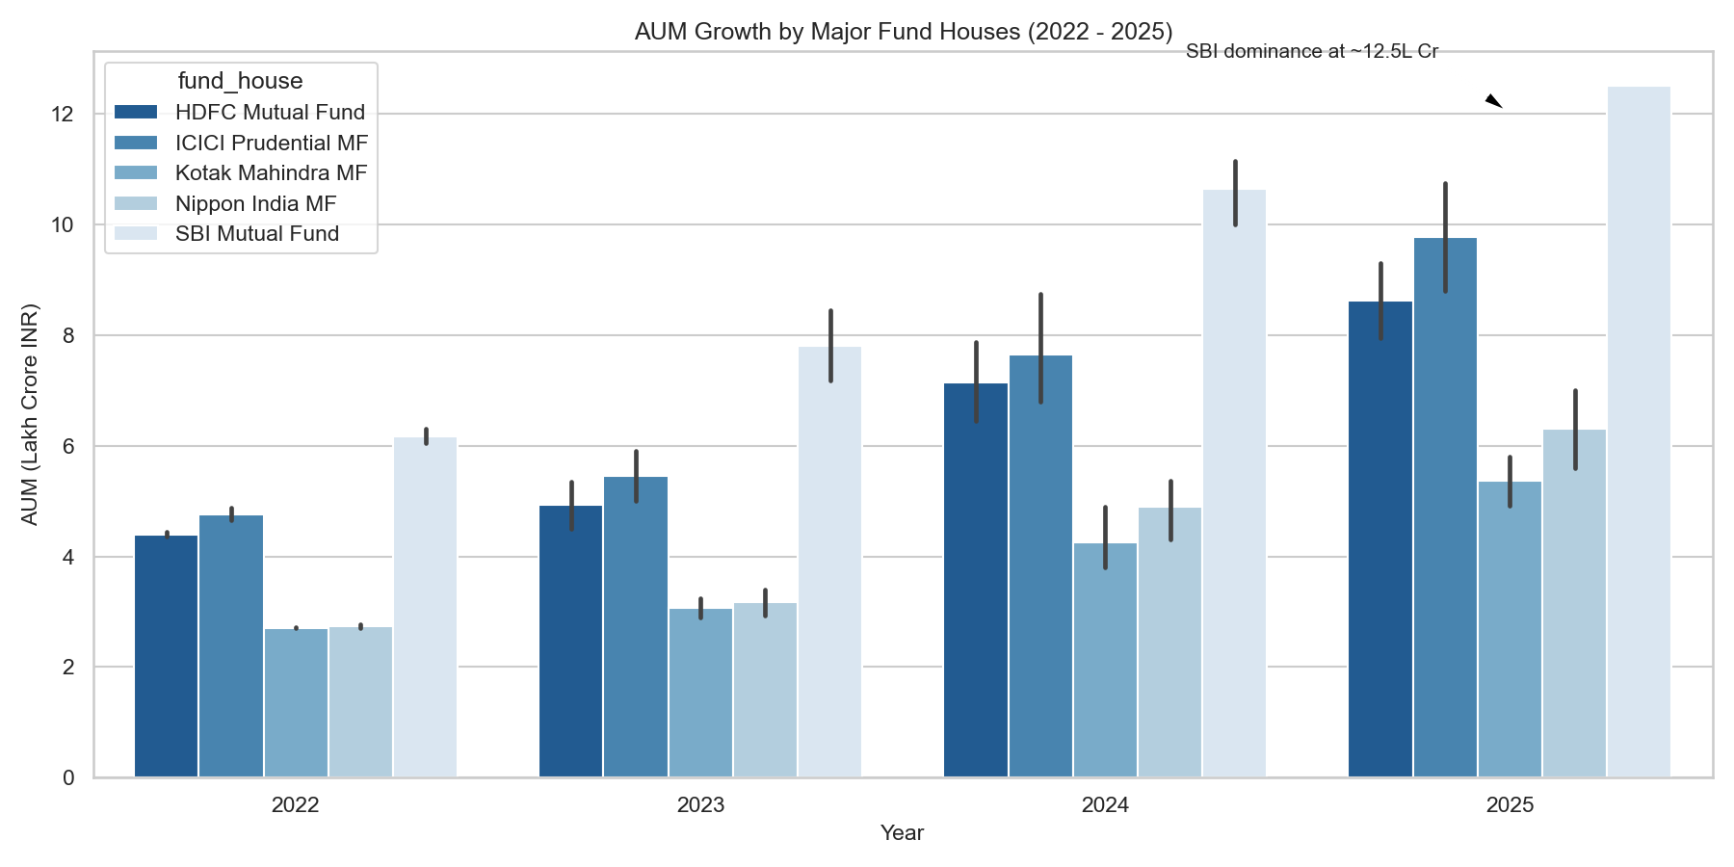
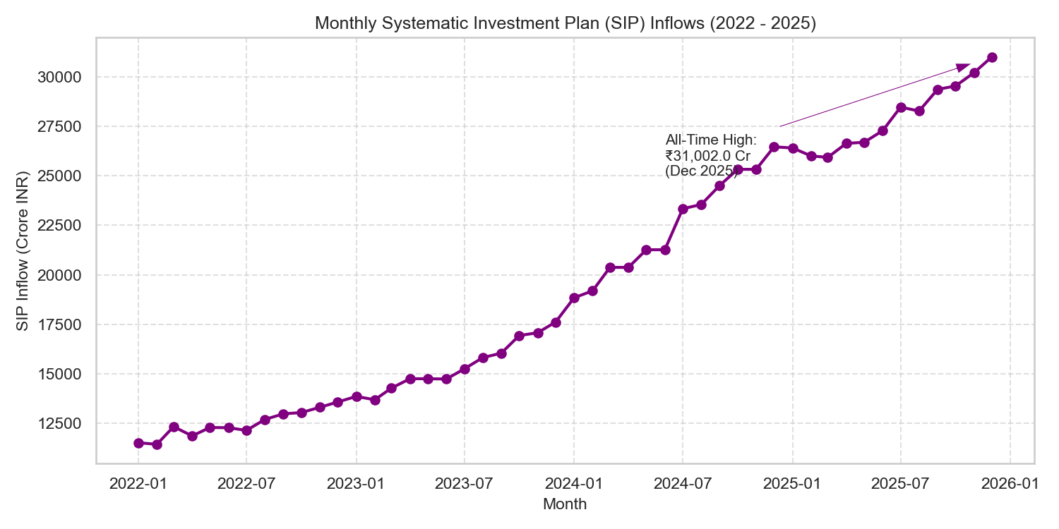
BLUESTOCK FINTECH | CAPSTONE PROJECT
EDA Highlights (1): Industry AUM & SIP Inflow Momentum
Key Macro Takeaways:
✔ Industry AUM Expansion: Exploded from ₹38 Lakh Crore in early 2022 to over ₹81 Lakh Crore by Dec 2025 (~26% CAGR).
✔ SIP Democratization: Monthly SIP contributions grew from ₹11,500 Cr to over ₹31,000 Cr, reflecting persistent retail dollar-cost averaging.

Slide 6
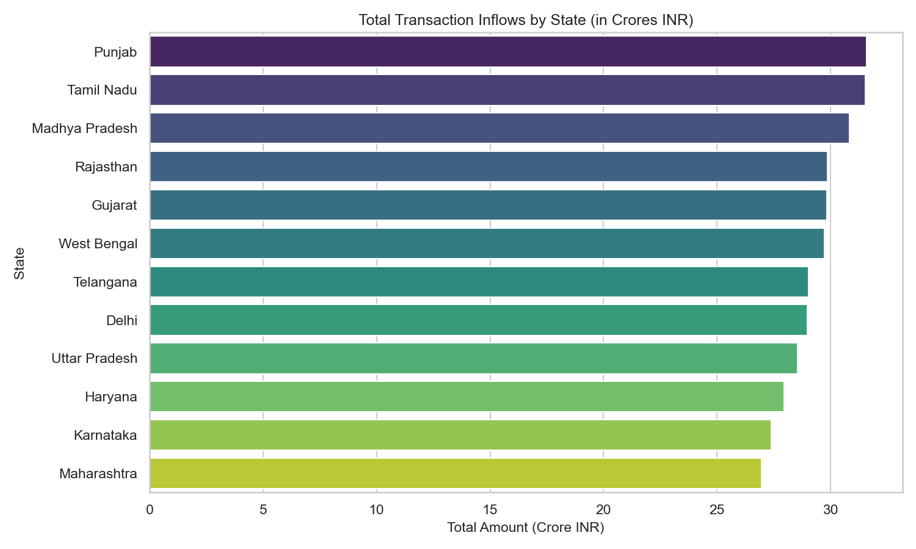
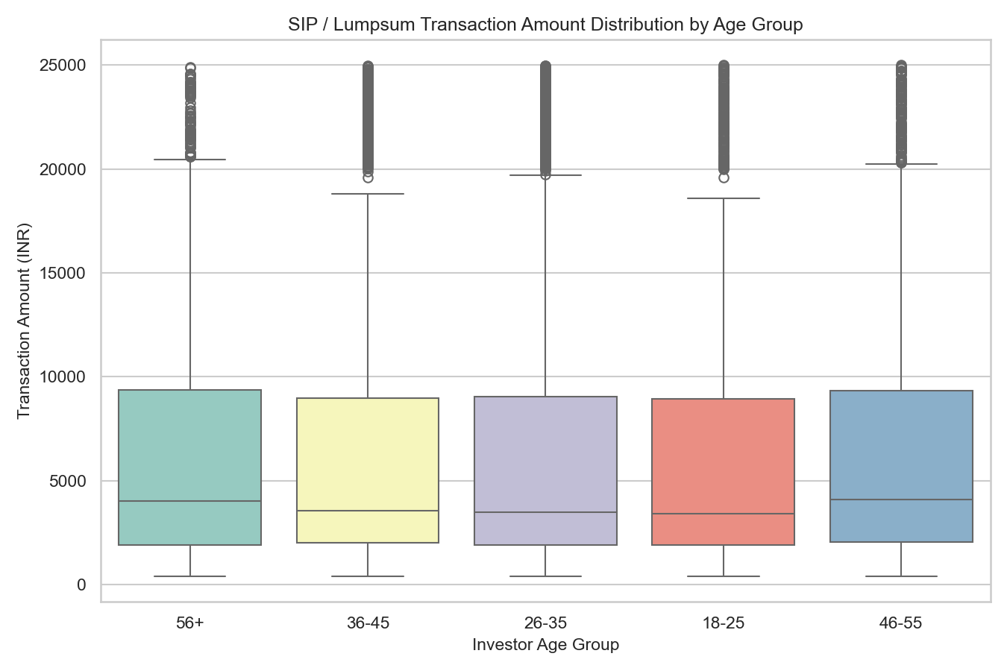
BLUESTOCK FINTECH | CAPSTONE PROJECT
EDA Highlights (2): Demographics & Investor Behavior
Key Demographic Takeaways:
✔ Geographic Concentration: Maharashtra, Gujarat, and Karnataka account for over 54% of total transaction capital.
✔ Age Group Ticket Sizes: While 26–35 age group drives transaction count (fintech apps), 46–55 cohorts commit the highest median SIP amounts.

Slide 7
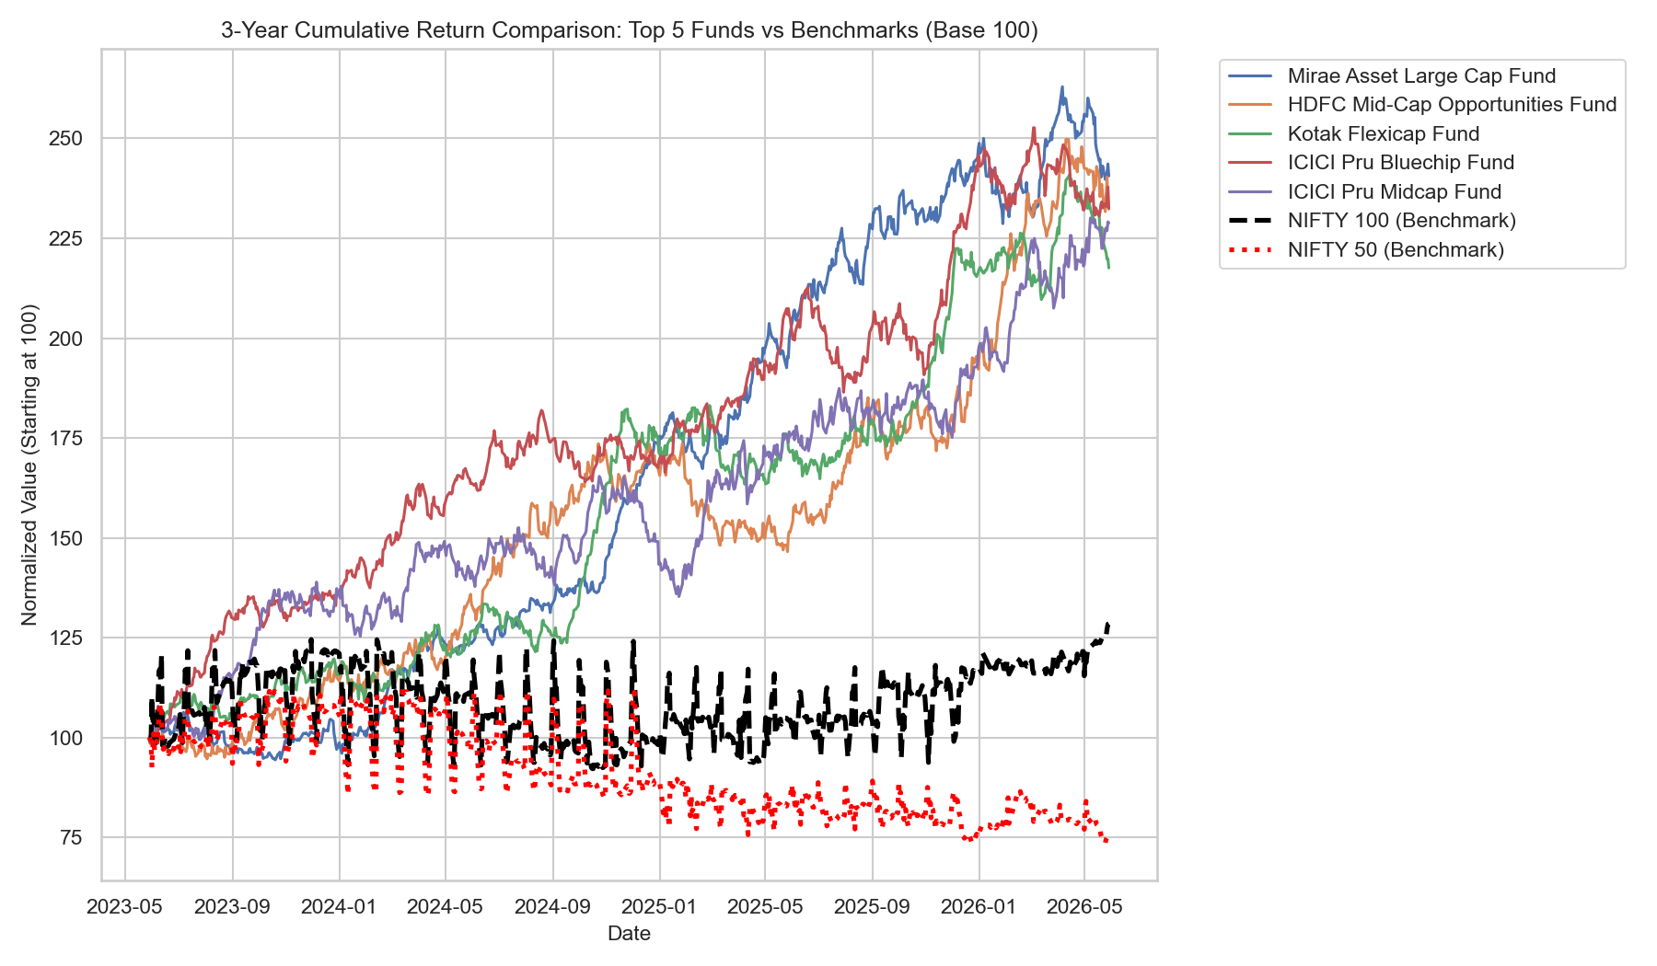
BLUESTOCK FINTECH | CAPSTONE PROJECT
Performance Analytics (1): Benchmark Comparisons & Scorecard
Composite Fund Scorecard (0–100)
• Multi-Factor Formula: 30% 3Y Return + 25% Sharpe + 20% Alpha + 15% Low Expense + 10% Low Max DD.
• Rank 1 — Mirae Asset Large Cap: Score 87.25 | Sharpe 1.06 | 3Y CAGR 14.81% | Steady large-cap compounder.
• Rank 2 — HDFC Mid-Cap Opportunities: Score 84.10 | Alpha +27.11% | Strong manager outperformance vs Nifty 100.
• Rank 3 — Kotak Flexicap Fund: Score 81.50 | Sharpe 1.02 | Dynamic multi-cap market allocation.
• Expense Sensitivity: Direct plans generate 0.8% to 1.2% higher annualized return due to zero distributor commission drag.

Slide 8
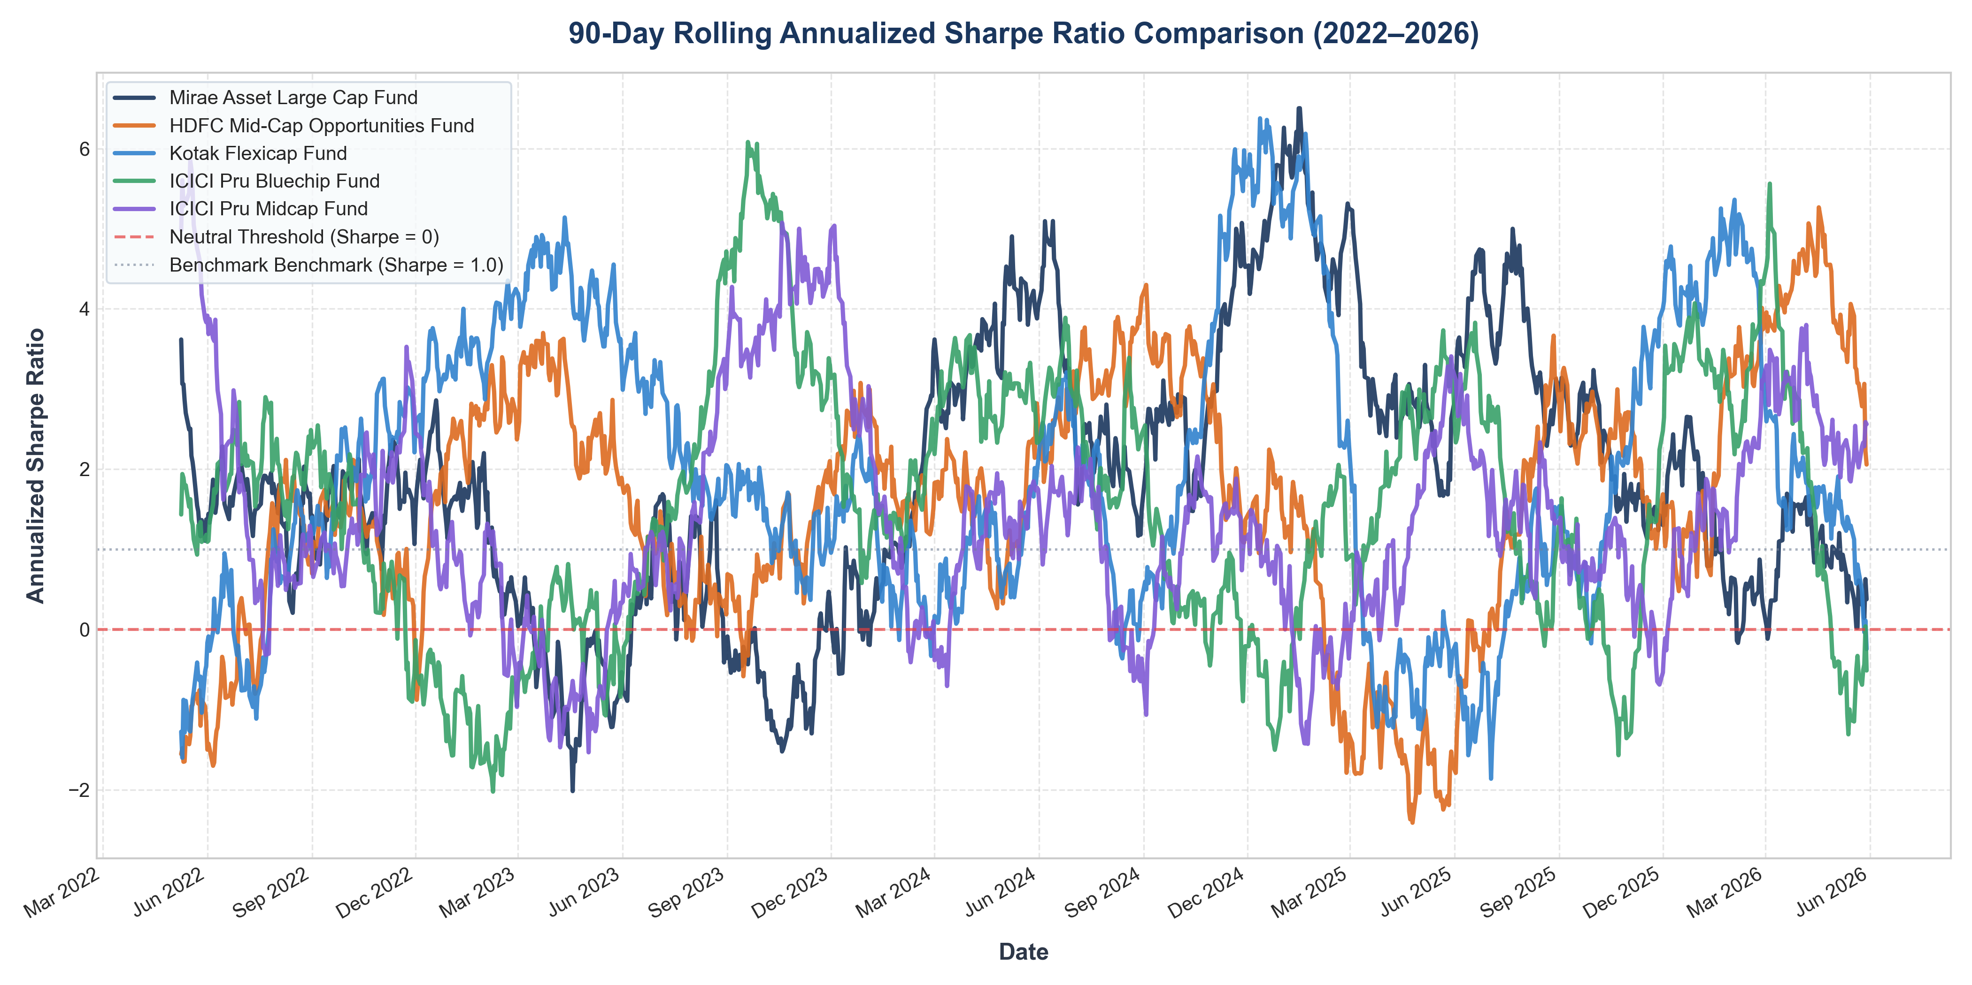
BLUESTOCK FINTECH | CAPSTONE PROJECT
Performance Analytics (2): Tail Risk, Rolling Sharpe & Concentration
Advanced Quantitative Takeaways
• Historical VaR & CVaR (95%): Small cap schemes exhibit 1-day VaR of -2.69% and CVaR of -3.24% (worst 5% days), contrasting with Liquid funds at -0.03%.
• Rolling Sharpe Instability: HDFC Mid-Cap Sharpe oscillated between -0.80 and +3.20, showing that point-in-time metrics can misrepresent cyclical volatility.
• SIP Continuity & Churn: 97.8% of investors with 6+ SIPs have average gaps > 35 days (cohort mean 64.9 days), revealing widespread mandate pauses.
• Sector HHI Concentration: Axis Bluechip has HHI of 2,967 (48.7% IT). Funds with HHI > 2,500 carry acute single-sector vulnerability.

Slide 9
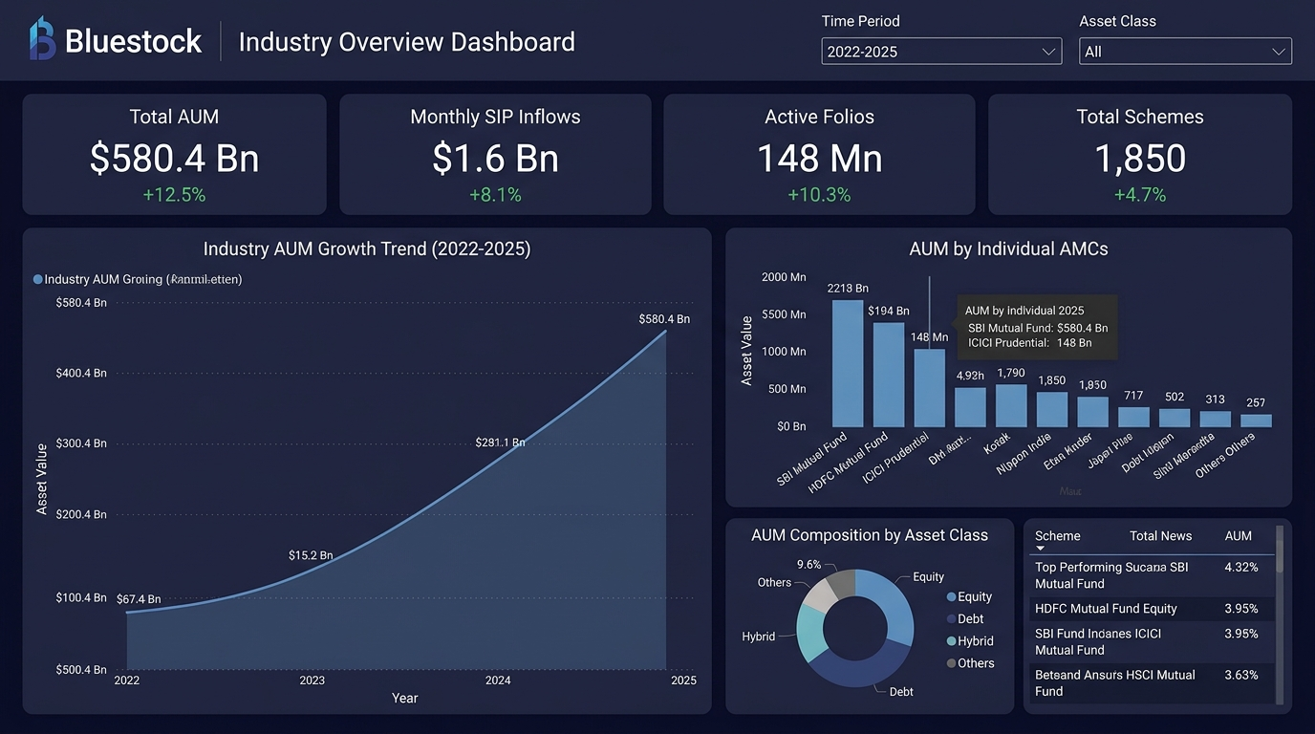
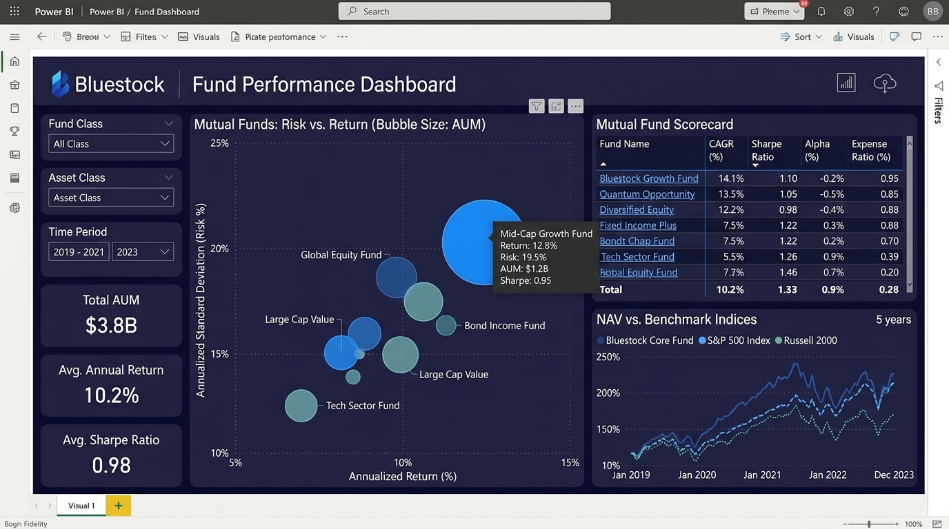
BLUESTOCK FINTECH | CAPSTONE PROJECT
Power BI Dashboard Showcase (Pages 1 & 2)
Page 1: Industry Overview
Displays executive KPI cards (₹81L Cr AUM, ₹31K Cr SIP, 26.12 Cr Folios), multi-year AUM growth timeline, and AMC market share distribution.
Page 2: Fund Performance
Features a Risk vs. Return scatter plot (CAGR vs Volatility), interactive scorecard table, benchmark NAV line chart, and AMC/category slicers.

Slide 10
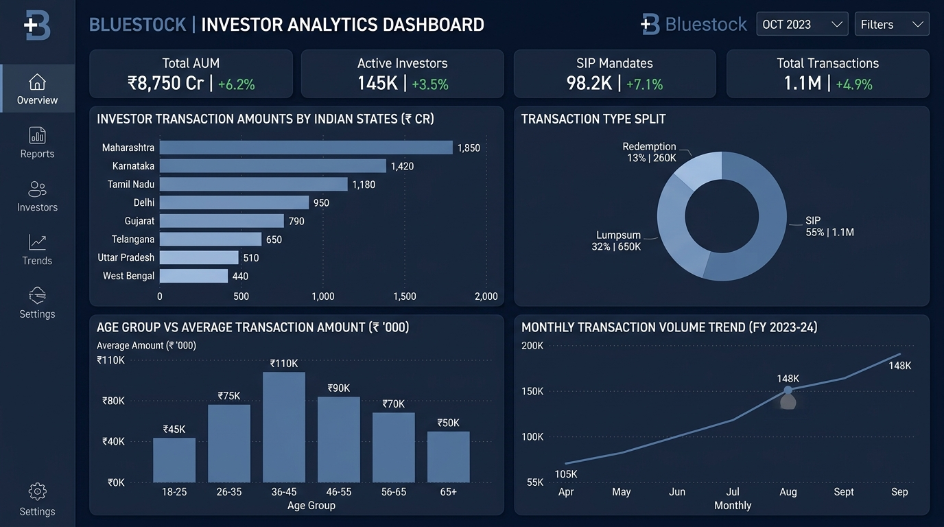
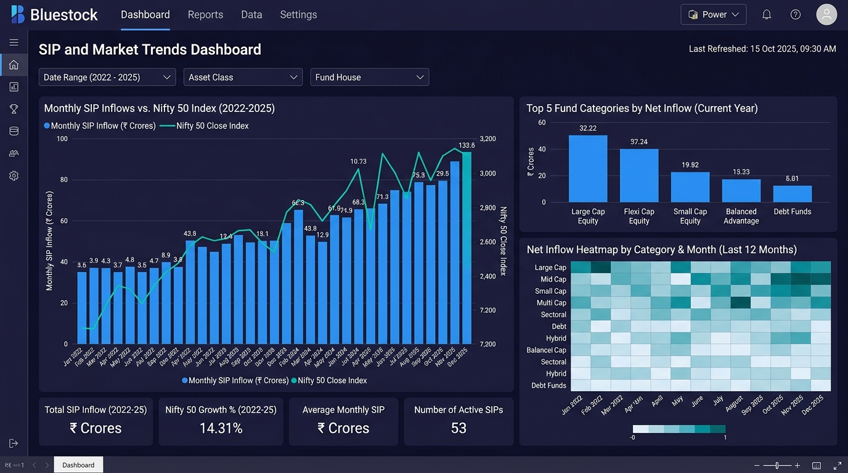
BLUESTOCK FINTECH | CAPSTONE PROJECT
Power BI Dashboard Showcase (Pages 3 & 4)
Page 3: Investor Analytics
State-wise capital allocation, SIP vs. Lumpsum vs. Redemption donut breakdown, age-group ticket size distribution, and monthly transaction volumes.
Page 4: SIP & Market Trends
Dual-axis chart correlating monthly SIP inflows with Nifty 50 closing level, category net flow heatmap, and top 5 inflow leader rankings.

Slide 11
BLUESTOCK FINTECH | CAPSTONE PROJECT
Strategic Recommendations for Bluestock Fintech
1. Automated SIP Pre-Debit Retention Nudges
With 97.8% of regular SIP investors exhibiting cadence gaps > 35 days (mean 64.9 days), implement WhatsApp/SMS balance reminders 48h prior to debit dates to prevent mandate churn and bank drop-offs.
2. Multi-Metric Fund Scorecard Integration
Replace simple 1-year trailing return leaderboards in the retail app with our composite Scorecard (Return + Sharpe + Alpha + Expense + Drawdown) to prevent retail capital chasing past peak cyclical returns.
3. Tail-Risk (VaR) Warnings for Small Cap Funds
Small-cap schemes carry daily VaR of -2.69% and CVaR exceeding -3.24%. Embed automated risk disclosure popups to set realistic expectations for first-time retail investors.
4. Sector Concentration Guardrails (HHI > 2500)
Flag mutual funds exhibiting high sector concentration (e.g. Axis Bluechip at 48.7% IT). Offer automated portfolio rebalancing suggestions to safeguard retail portfolios from idiosyncratic industry shocks.

Slide 12
Thank You!
Bluestock Mutual Fund Analytics Capstone Project Complete
All Deliverables Successfully Implemented & Verified:
• 10 Cleaned Datasets • SQLite Database (Star Schema) • EDA & Performance Notebooks • 4-Page Power BI Dashboard • 15–20 Page Final Report PDF • Quantitative Risk Engine

