Slide 1
Traffic Sign Recognition Project
Manjusha Nair
Akademia Górniczo-Hutnicza im. Stanisława Staszica w Krakowie
AGH University of Science and Technology

Slide 2

Traffic Sign Recognition
Automatically recognizing traffic signs such as speed limits
One of the important technologies for self driven cars

Slide 3
Aim
Dataset with traffic signs from real environments
Model a neural network
Train the model to identify which class the given traffic sign belongs to
Possible models

Slide 4
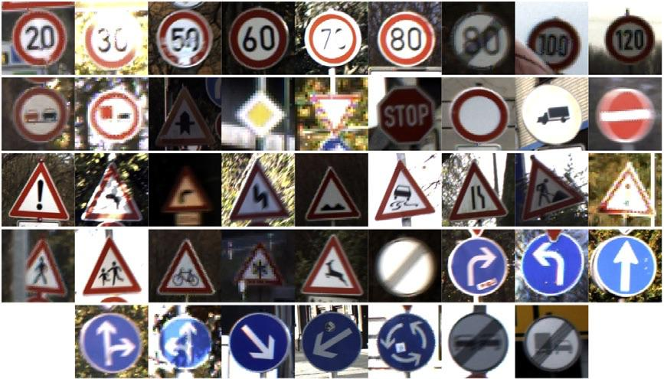
Dataset
German Traffic Sign Dataset
Real life images categorized into 43 classes

Slide 5
Model TSR-1
Create Validation and Test data from Training dataset
keras data preprocessing utilities for converting categorized data on disk to dataset object using flow_from_directory class
Data Augmentation
Build CNN, compile and train

Slide 6
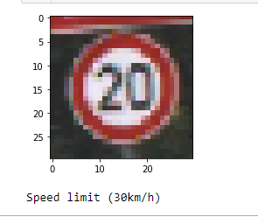
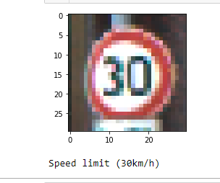
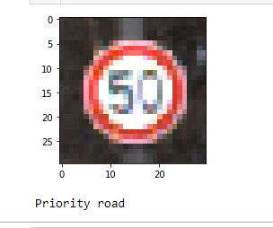
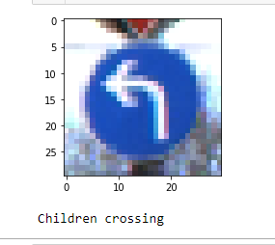
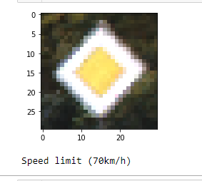
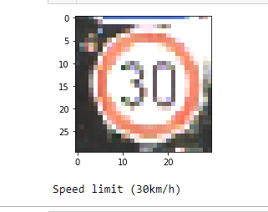
Model TSR -1 Predictions

Slide 7
Model TSR-2
Transfer Learning Technique
Pre-trained model VGG19
Reusing the convolutional base

Slide 8
Model TSR -3
Extracting data from the Train dataset
Appending images and their respective labels in the data and labels list.
Shape of data : (39209, 30, 30, 3)
Splitting training and validation data using train_test_split()
One-hot encoding of the train and validation labels

Slide 9
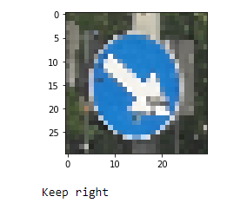
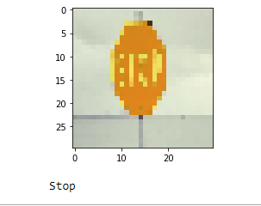
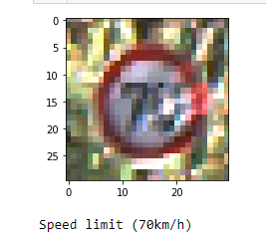
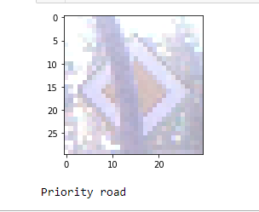
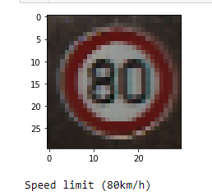
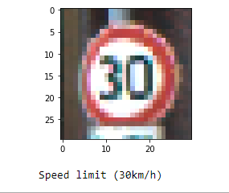
Model TSR -3 Predictions

Slide 10
Conclusions
Model 1 learns some categories well and others not much.
Issues with Model 2 and further study on the problem to be made
Model 3 predicts images well and has good accuracy and low loss
For the future, training model 1 for higher accuracy, exploring with more challenging datasets and extending to object detection

Slide 11
Thank you!

