Slide 1

AI DRIVEN SUPPLY CHAIN DISRUPTION PREDICTOR AND INVENTORY OPTIMIZATION SYSTEM
ManjushaGolla

Slide 2
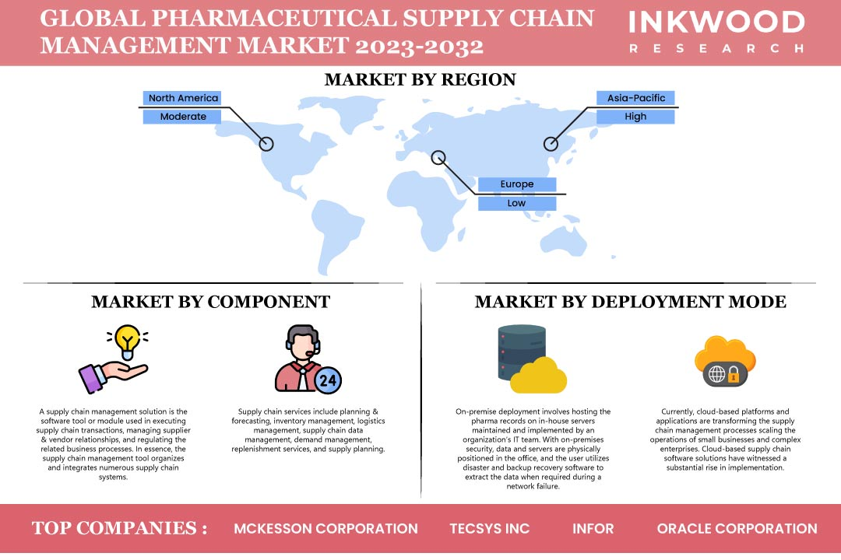

OUR MISSION:
This Application leverages advanced AI and machine learning to transform supply chain management by predicting disruptions and optimizing inventory levels. Through the integration of global data sources and real-time alert systems, it enables businesses to proactively manage risks and ensure operational continuity.
Accurate Prediction of Supply Chain Disruptions
Dynamic Inventory Level Optimization
Real-Time Notifications and ERP Integration
OUTCOMES

Slide 3
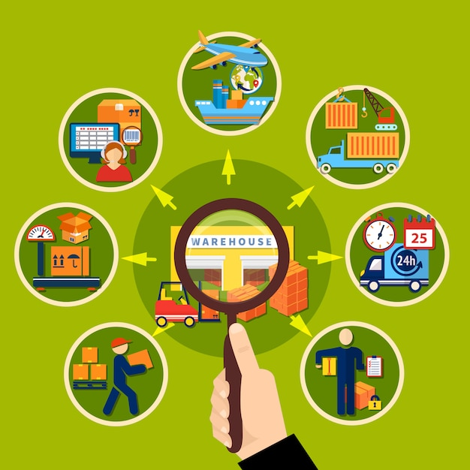
Why Medicine Supply Chain?
Public Health Impact: Timely availability of life-saving medicines is crucial for health.
Complexity: Managing regulations, demand, and perishable goods is challenging.
Global Relevance: Medicine availability impacts both developed and developing regions.
Pandemic Resilience: AI can address vulnerabilities exposed by global health crises.
Technological Advancements: AI optimizes and predicts supply chain disruptions efficiently.

Slide 4

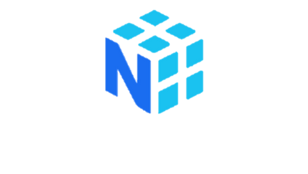

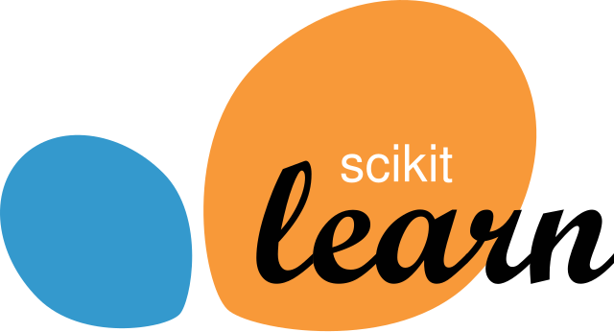

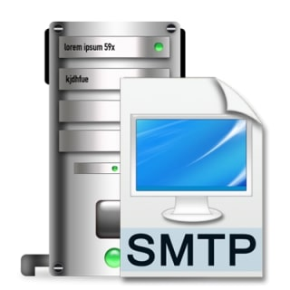

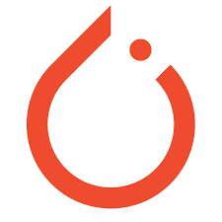
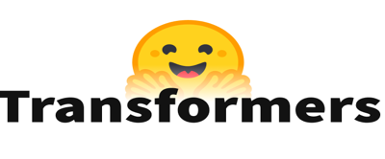

Tech Stack:
Programming languages:
Python
Frameworks/Libraries:
Numpy
Pandas
scikit learn
Smtplib
Joblib
Pytorch
Transformers
Tools/Platforms:
Avaliable GPU on Google colab
Programming Languages
Frameworks/Libraries

Slide 5
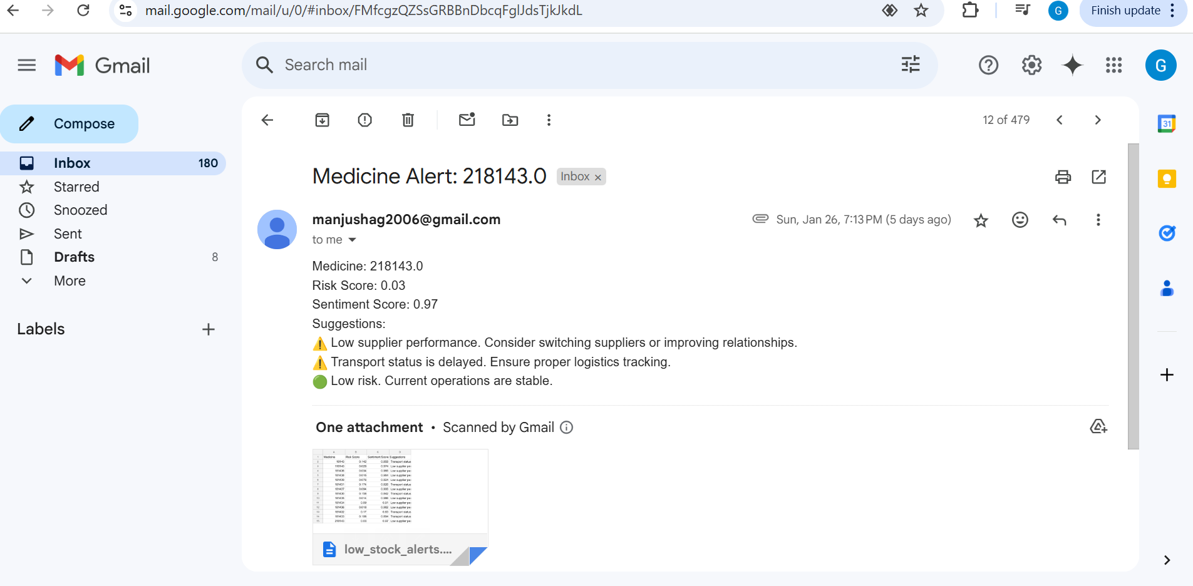

Slide 6
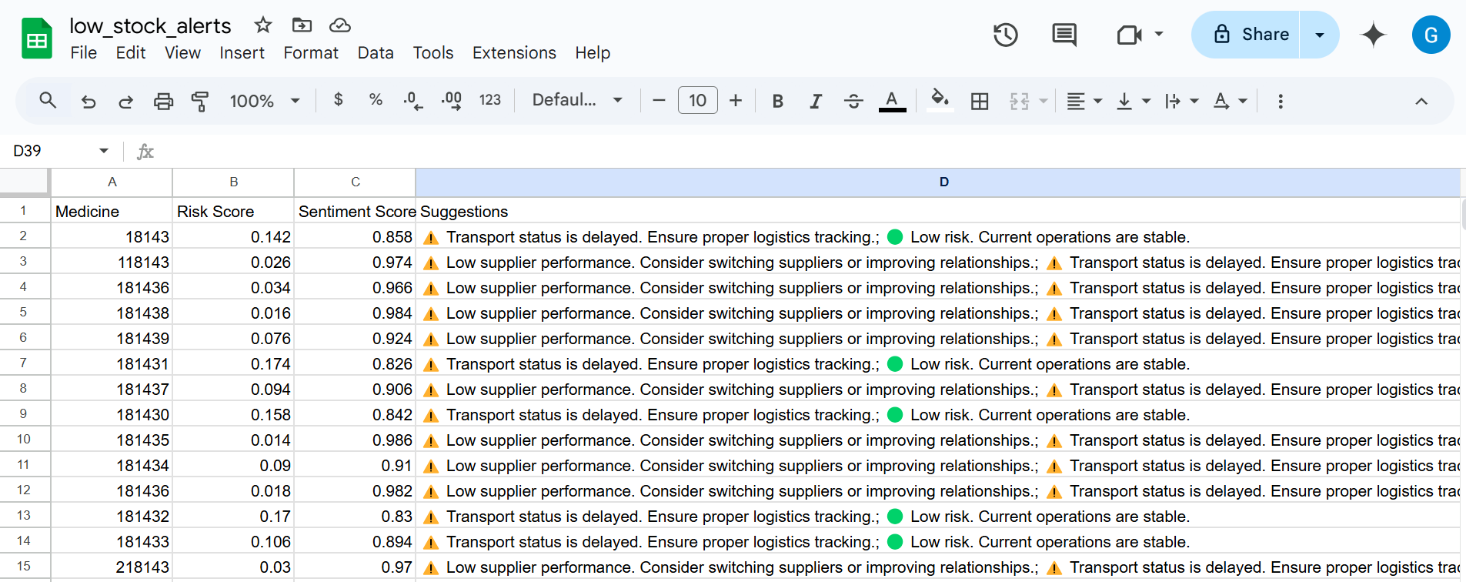
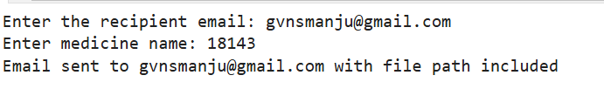
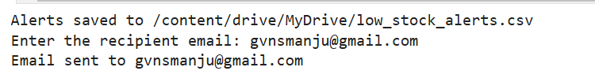

Slide 7


Challenges:
Transportation Delays: Disruptions in logistics due to weather, political issues, or infrastructure limitations.
Shelf Life Constraints: Managing perishable goods with limited shelf lives, requiring efficient inventory control.
Supplier Reliability: Variability in supplier performance affecting timely delivery and quality of medicines.
Regulatory Compliance: Adhering to strict regulations across different regions and countries.
Demand Fluctuations: Predicting and managing varying demand for different medicines, especially during emergencies.

Slide 8

Future Improvements:
Data Integration: Expand data sources to include environmental and geopolitical factors.
Model Refinement: Enhance AI algorithms for better real-time disruption prediction.
Global Collaboration: Foster partnerships for real-time data sharing across regions.
Blockchain Integration: Implement blockchain for improved supply chain transparency and traceability.

Slide 9
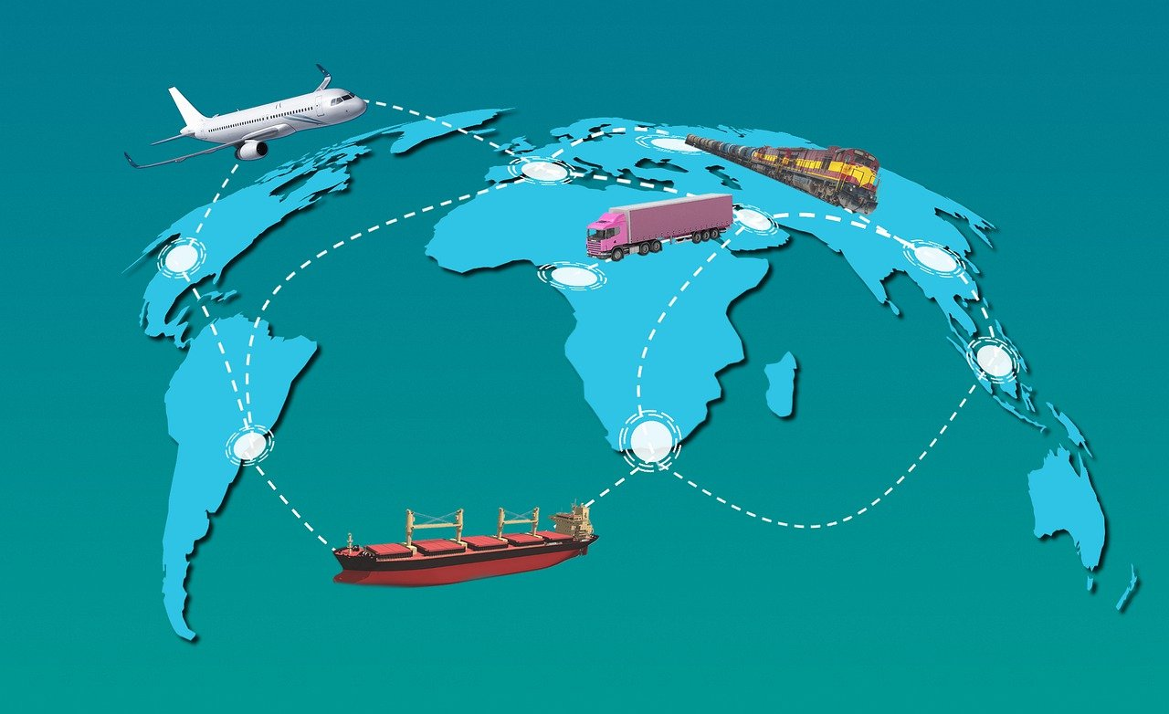
Conclusion:
The medicine supply chain is crucial to public health, and optimizing it can significantly improve healthcare delivery.
AI-driven solutions can address key challenges like demand fluctuations, transportation delays, and regulatory hurdles.
By embracing technological advancements, we can create a more resilient, efficient, and globally accessible supply chain for medicines.

Slide 10

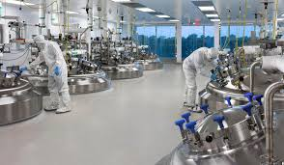
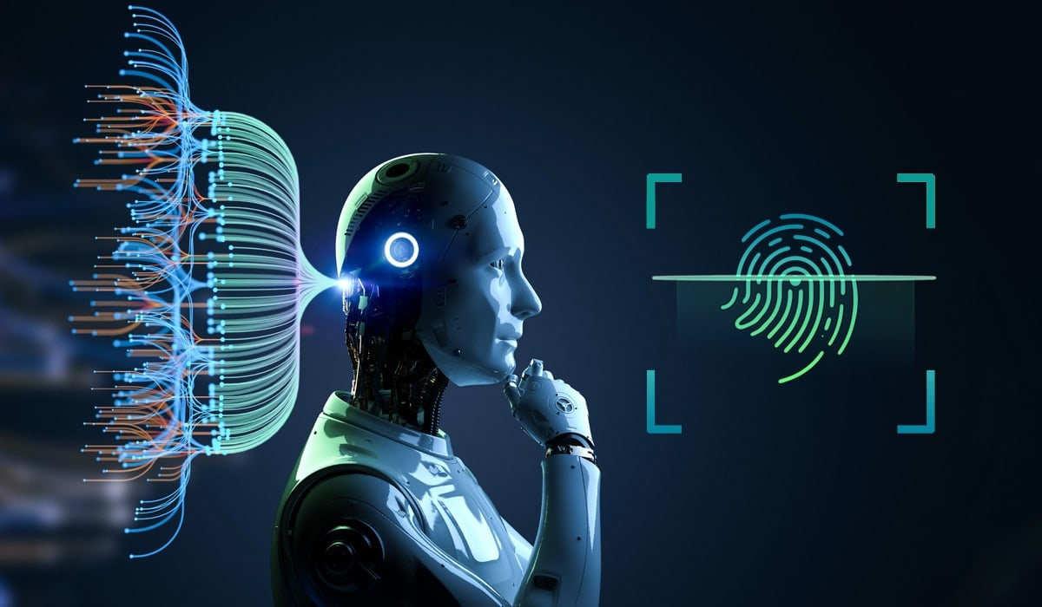


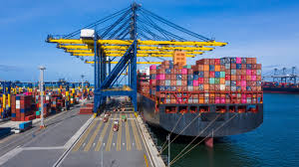

Thank You

