Slide 1



GROUP NO 5
MANJUSHA VALLURI
INFO 5082
1

Slide 2


EXPLORING MENTAL HEALTH USING LLMs:
Comparison between ChatGPT and Gemini
The project is about analysing mental well being with the help of Large Language Models ChatGPT and Gemini and thereby comparing them to find out which model is more efficient.
2

Slide 3
Agenda
Title
Motivation
Background
Abstract(Problem statement)
Literature Survey
Objectives of the Study
Data Set and Data Processing
Research Design(Blueprint/Workflow)
Data Analysis and Model Description 10.Data Visualization and Results 11.Conclusion
12.References
3

Slide 4
Motivation
Mental health has been a major concern in the current generation. Individuals are in real need of monitoring and analyzing their mental health. Since AI technologies are becoming more and more a part of our daily lives, it is important to assess the models’ efficiency in sensitive areas like mental health. This provides an idea of how extent the LLMs can be used in detecting or analyzing mental health of an individual.

Slide 5
Background
The idea of the project is developed from recognizing the importance of supporting and analyzing mental health using AI technologies. The AI technologies have been trending in many areas providing accurate results. Since ChatGPT and Gemini models are being actively used by people, we chose these two models to analyze mental health. It is crucial to assess how well these AI models can provide assistance and guidance in sensitive areas like mental healthcare. By comparing their performance and efficiency, the project aims to increase the implementation of these models for better support to individuals dealing with mental health issues.

Slide 6
Abstract
A significant challenge in mental health care is the timely identification and intervention of mental health issues.The conventional method of screening is clinical, but this procedure is often time-consuming and expensive, and it can yield biased results.Our research utilizes Large Language Models (LLMs) like chat GPT and Gemini to assess response similarity.This work contributes and extends the ongoing efforts to harness the potential of technology in mental health.

Slide 7
Objectives of the Study
A deep study of the main linguistic features concerned with the domain of mental health in text-based communication.
Evaluate ChatGPT and Gemini to accurately identify patterns in the language concerning mental health issues.
Generate embeddings for both models and compare those embeddings with the embeddings of original responses to understand which ones are more similar.
●
Analyzing the performance through benchmarking with dataset and evaluation metric
i.e,cosine similarity score.
Study and treat the ethical considerations and implications of using LLMs (ChatGPT and Gemini) to detect mental health issues.

Slide 8
Literature Survey
Early research aimed at using Natural Language Processing to detect mental disorders (Le Glaz et al., 2021).
The search for markers of mental health conditions then proceeded on several different strands, such as linguistic style, discourse patterns, and topic modeling.
A study assessed ChatGPT during the analysis of mental health with a core understanding of the text (Lamichhane, 2023).
Dominant NLP tools considered good at text generation among LLMs, including ChatGPT and Gemini, are very proficient.

Slide 9
Literature Survey
This project fills the gap by assessing how ChatGPT and Gemini detect mental health by capitalizing on available literature on LLM abilities (Le Glaz et al., 2021).
Particularly it aims to examine how NLP approaches, the use of LLMs can assist in early detection and intervention.
By utilizing insights from existing research, the project aims to contribute to ongoing efforts in utilizing technology for early intervention in mental health (Adhikary et al., 2024)

Slide 10
Data Set and Data Processing
The dataset "mental-health-conversational-data" is collected from Hugging Face.
The Dataset consists conversations between therapists/doctors and patients about mental health.
It consists of three columns such as context, response and knowledge.
Checked for null values and dataset does not contain any null values
The data was loaded using pandas, converted it to a DataFrame, and removed empty strings and none values.
10

Slide 11
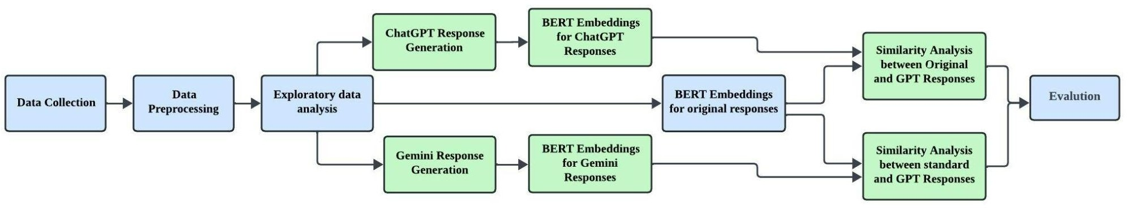
Research Design (Blueprint/workflow)
11

Slide 12
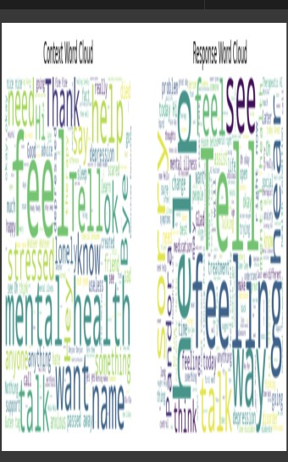
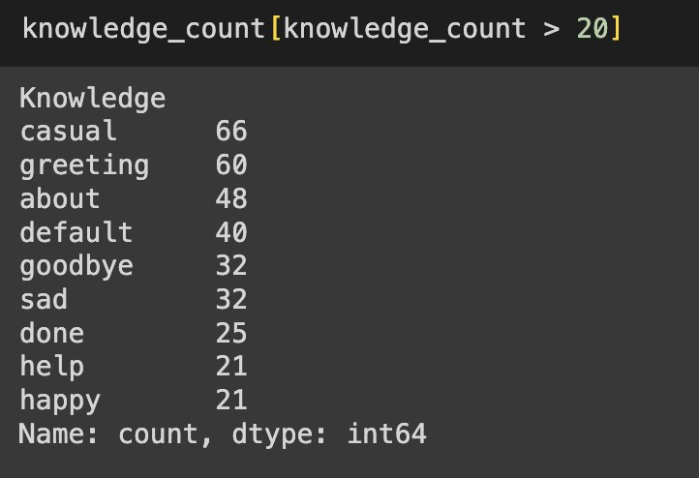
Exploratory Data Analysis
Analyzing most frequent words in both contexts and responses
to understand the conversation topics. Knowledge Column Analysis:
Checking value count of knowledge column
We can observe most of the contexts comes under casual and greeting categories of knowledge.
ChatGPT Response Generation
OpenAI API is utilized to generate the responses for each context using Chat GPT gpt-3.5-turbo model.
12

Slide 13
Gemini Response Generation
Utilizing Gemini-pro model to generate responses for each context.
BERT Embeddings (for standard/chatgpt/gemini responses)
BERT is a pre-trained model for text representation.
BERT is used to encode both original and AI-generated responses into numerical embeddings.
Similarity Analysis
Using cosine similarity to compare the embeddings of original responses with those of ChatGPT and Gemini responses.
Evaluation
The average cosine similarity scores between original responses and ChatGPT is around 93 % and Gemini responses is around 88%.
13

Slide 14
Model description
Pre-Training & Embedding ChatGPT Training:
Pre-trained model: Used OpenAI's pre-trained GPT 3.5 TURBO.
Domain- and context-specific data fine-tuning for mental health conversations.
Embedding: Responses were tokenized and embedded using a BERT- based tokenizer and model.
Tokenizer based on BERT : A tokenizer that uses a pre-trained
vocabulary for breaking down input text into subword units, thereby enabling very effective handling of out-of-vocabulary words and allowing the contextual understanding of the input.

Slide 15
Gemini
Pre-Trained Model: Leveraged Generative AI platform (Genai) for pre- training.
Fine-Tuning: fine-tuned on a diverse range of textual data with specified safety settings to ensure appropriate response generation.
Embedding: Responses converted to embeddings using BERT-based model for further analysis.
Scoring & Evaluation
Cosine Similarity: The cosine similarity scores between the standard and generated responses for the embeddings of ChatGPT and Gemini were computed.
We compared the average cosine similarity scores in the response generation quality rating.

Slide 16
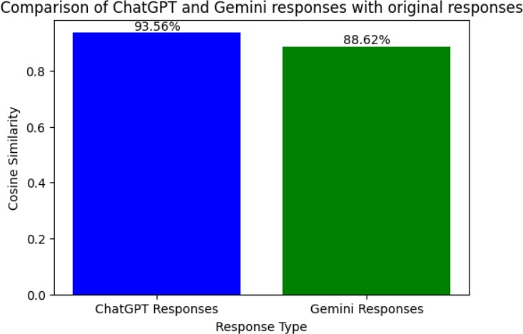
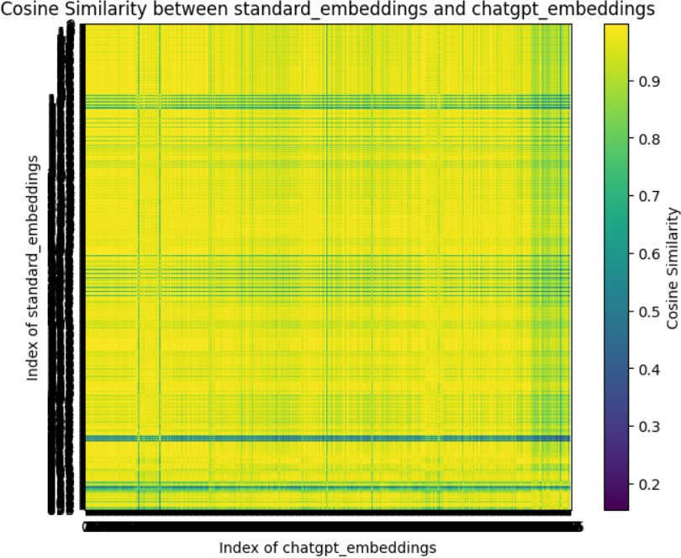
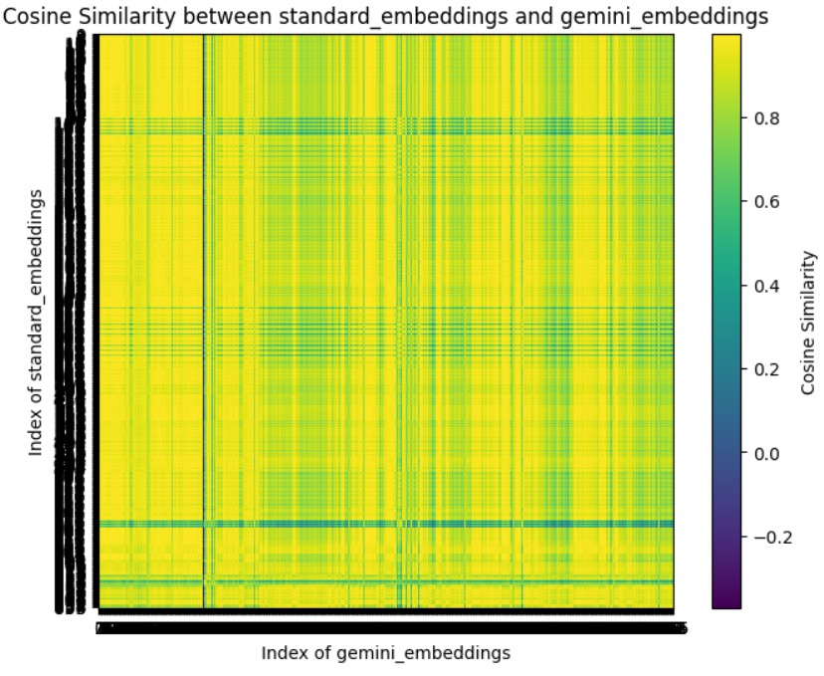
Data Visualizations

Slide 17
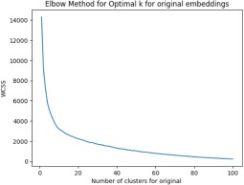
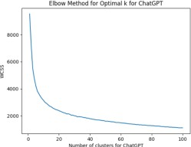
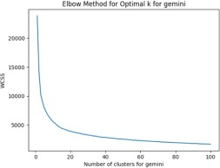
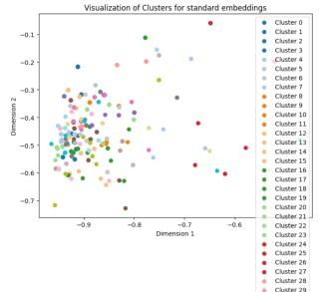
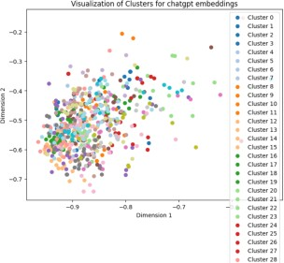
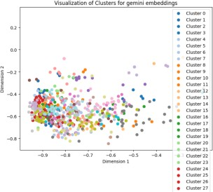
Data Visualizations

Slide 18
Conclusion
After conducting the research, we observed that Chatgpt performed well compared to Gemini.
The performance of Chatgpt was consistent across different contexts making it more
accurate with a similarity score of 93%.
We conducted visual comparisons of ChatGPT and Gemini performance based on their embeddings with standard embeddings.
We also analyzed data using scatter plots,bar chart and clusters were plotted for original, ChatGPT and Gemini embeddings.

Slide 19
References
Le Glaz, A., Haralambous, Y., Kim-Dufor, D. H., Lenca, P., Billot, R., Ryan, T. C., ... & Lemey, C. (2021). Machine learning and natural language processing in mental health: systematic review. Journal of medical Internet research, 23(5), e15708.
Yang, K., Ji, S., Zhang, T., Xie, Q., Kuang, Z., & Ananiadou, S. (2023, December). Towards interpretable mental health analysis with large language models. In The 2023 Conference on Empirical Methods in Natural Language Processing.
Adhikary, P. K., Srivastava, A., Kumar, S., Singh, S. M., Manuja, P., Gopinath, J. K., ... & Chakraborty, T. (2024). Exploring the Efficacy of Large Language Models in Summarizing Mental Health Counseling Sessions: A
Benchmark Study. arXiv preprint arXiv:2402.19052.
Lamichhane, B. (2023). Evaluation of chatgpt for nlp-based mental health applications. arXiv preprint arXiv:2303.15727.

Slide 20



Thank You
20

