Slide 1

BACHELOR OF TECHNOLOGY
IN
Artificial Intelligence and Machine Learning
Section : Aiml-Omega
Project Title : Lexi: The Legal Aid Assistant and Analysis Platform Using
Hybrid Machine Learning Models
Batch Number: Batch- 136
Roll Numbers : 2211CS020562
2211CS020583
2211CS020584
2211CS020596
Project Guide : Prof. K. Divya Bharathi
Department of AIML, School of Engineering
Malla Reddy University

Slide 2
CONTENTS
INTRODUCTION:
  Objective of project
  Scope of the project
ANALYSIS:
  Literature Survey( Min 8 Papers)
  Problem Definition
  Project Planning and Research
  Software requirement specification
    Software requirements
    Hardware requirements
  Model Selection and Architecture
DESIGN:
  Diagrams(Related to Project Details Whatever Applicable See the Guidelines)
  Data Set Descriptions
  Data Preprocessing Techniques
  Methods & Algorithms
References:

Slide 3
INTRODUCTION:
Objective of project:-
Develop an automated legal assistance and analysis system capable of processing and understanding legal documents and complaints with minimal human intervention.
Reduce dependence on manual legal interpretation by professionals and minimize errors caused by complexity, subjectivity, and lack of legal awareness among users.
Combine transformer-based deep learning and machine learning classification techniques to achieve accurate legal domain identification and reliable case severity assessment.
Accurately extract key legal entities, relevant statutes, and important clauses from legal documents and highlight critical information for better interpretation.
Generate simplified legal summaries, professional legal documents, and appropriate lawyer recommendations to support informed legal decision-making and timely action.
Provide fast, reliable, and consistent legal insights that assist individuals and legal professionals in understanding cases, prioritizing actions, and improving access to justice.

Slide 4
  Scope of the project:-
The project focuses on the automated analysis of legal documents and legal complaints as the primary input data.
It covers the complete processing pipeline, starting from legal text extraction and preprocessing to semantic analysis, classification, and response generation.
The system includes feature extraction using a pre-trained transformer-based legal language model and classification using an efficient machine learning classifier.
Legal entity recognition, statute identification, clause extraction, and case severity assessment are included to provide meaningful legal insights beyond basic document understanding.
The project is designed to operate efficiently on moderate hardware systems, making it suitable for real-world deployment in legal assistance environments.
The solution acts as a decision-support tool for individuals and legal professionals, aiding in legal understanding, case prioritization, and informed decision-making.

Slide 5
ANALYSIS:
Project Identification / Problem Definition:-
Legal systems involve complex language and procedures that require accurate interpretation for effective decision-making.
Manual analysis of legal documents by individuals or legal professionals is time-consuming and may lead to misunderstandings due to complexity, subjectivity, and varying levels of legal expertise.
Traditional rule-based systems and generic search platforms rely on keyword matching and lack robust contextual understanding of legal text.
Advanced AI-based legal systems provide improved accuracy but often require large domain-specific datasets and high computational resources, limiting their scalability and accessibility.
There is a need for an automated, accurate, and computationally efficient system to analyze legal documents and simplify legal information.
The project aims to develop a hybrid machine learning-based legal assistance platform that combines deep semantic feature extraction and efficient classification to support informed legal decision-making.

Slide 6
Project Planning and Research
Conducted an initial study on legal assistance systems, legal document analysis, and the challenges involved in understanding complex legal language.
Reviewed existing research papers on traditional rule-based systems, machine learning approaches, transformer-based models, and hybrid AI techniques used in the legal domain.
Analyzed the limitations of existing legal information systems, such as generic responses, lack of contextual understanding, high dependency on legal experts, and limited automation.
Selected a hybrid machine learning approach after comparing the accuracy, efficiency, and scalability of transformer-based models and classical classification techniques.
Identified suitable legal datasets, pre-trained legal language models, and preprocessing methods required for effective legal text analysis and classification.
Planned the project in structured phases, including system design, document processing pipeline development, model integration, testing, and performance evaluation.

Slide 7
Software requirement specification:-
Software requirement:-
Operating System: Windows 10/11 or Ubuntu 20.04.
Programming Language: Python 3.8 or above.
Deep Learning Framework: TensorFlow with Keras for transformer-based legal language models (InLegalBERT / LegalBERT).
Machine Learning Library: Scikit-learn for Multilayer Perceptron (MLP) classification.
Natural Language Processing Tools: NLTK and SpaCy for legal text preprocessing and entity recognition.
AI & Retrieval Frameworks: LangChain and ChromaDB for semantic retrieval and RAG implementation.
Database: SQLite with SQLAlchemy ORM for user and application data management.
Document & Communication Tools: PyPDFLoader, Docx2txtLoader, ReportLab, and SMTP for document processing, PDF generation, and email automation.

Slide 8
2.Hardware requirement
Intel i5 processor or equivalent capable of handling legal text processing, semantic analysis, and model execution tasks.
Minimum of 8 GB RAM to ensure smooth document preprocessing, embedding generation, and classification operations.
Solid State Drive (SSD) with at least 256 GB storage for legal documents, embeddings, models, and generated outputs.
Optional NVIDIA GPU support to accelerate model inference and large-scale document processing, while still allowing efficient CPU-based execution.

Slide 9
Model Selection:-
A hybrid machine learning approach is selected to balance semantic accuracy and computational efficiency in legal document analysis.
InLegalBERT / LegalBERT, a pre-trained transformer-based language model, is chosen for feature extraction due to its strong performance in understanding legal language and domain-specific terminology.
The model effectively captures important linguistic and contextual features such as legal entities, clause semantics, statutory references, and long-range dependencies from legal text.
Multilayer Perceptron (MLP) is selected as the classifier because of its robustness in handling high-dimensional contextual embeddings generated by transformer models.
The combination of deep learning for semantic feature extraction and machine learning for classification improves prediction accuracy while reducing computational and hardware dependency.
This hybrid model is well-suited for legal text analysis tasks and can operate efficiently on moderate hardware systems, making it suitable for real-world legal assistance applications.

Slide 10
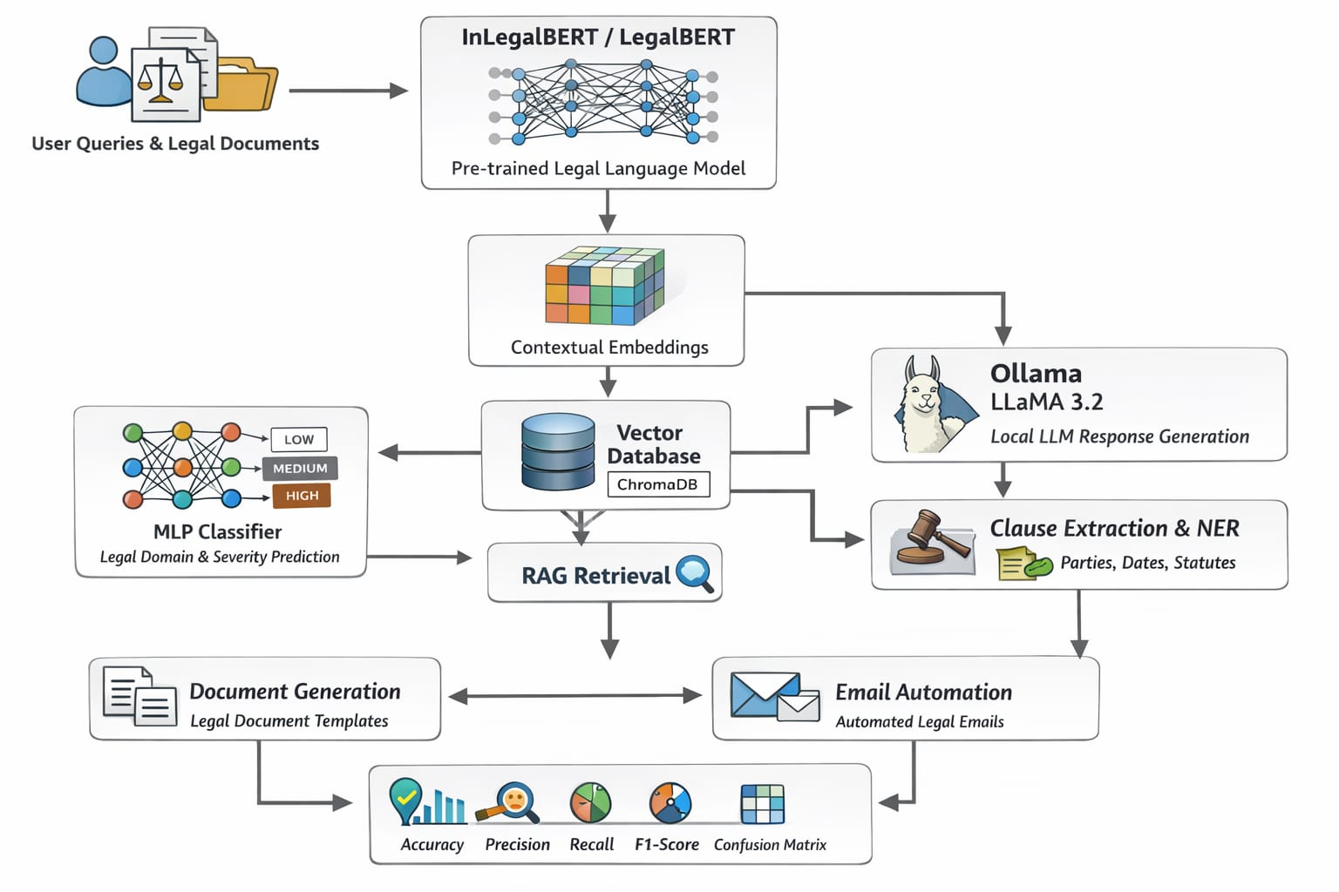
Architecture:-

Slide 11
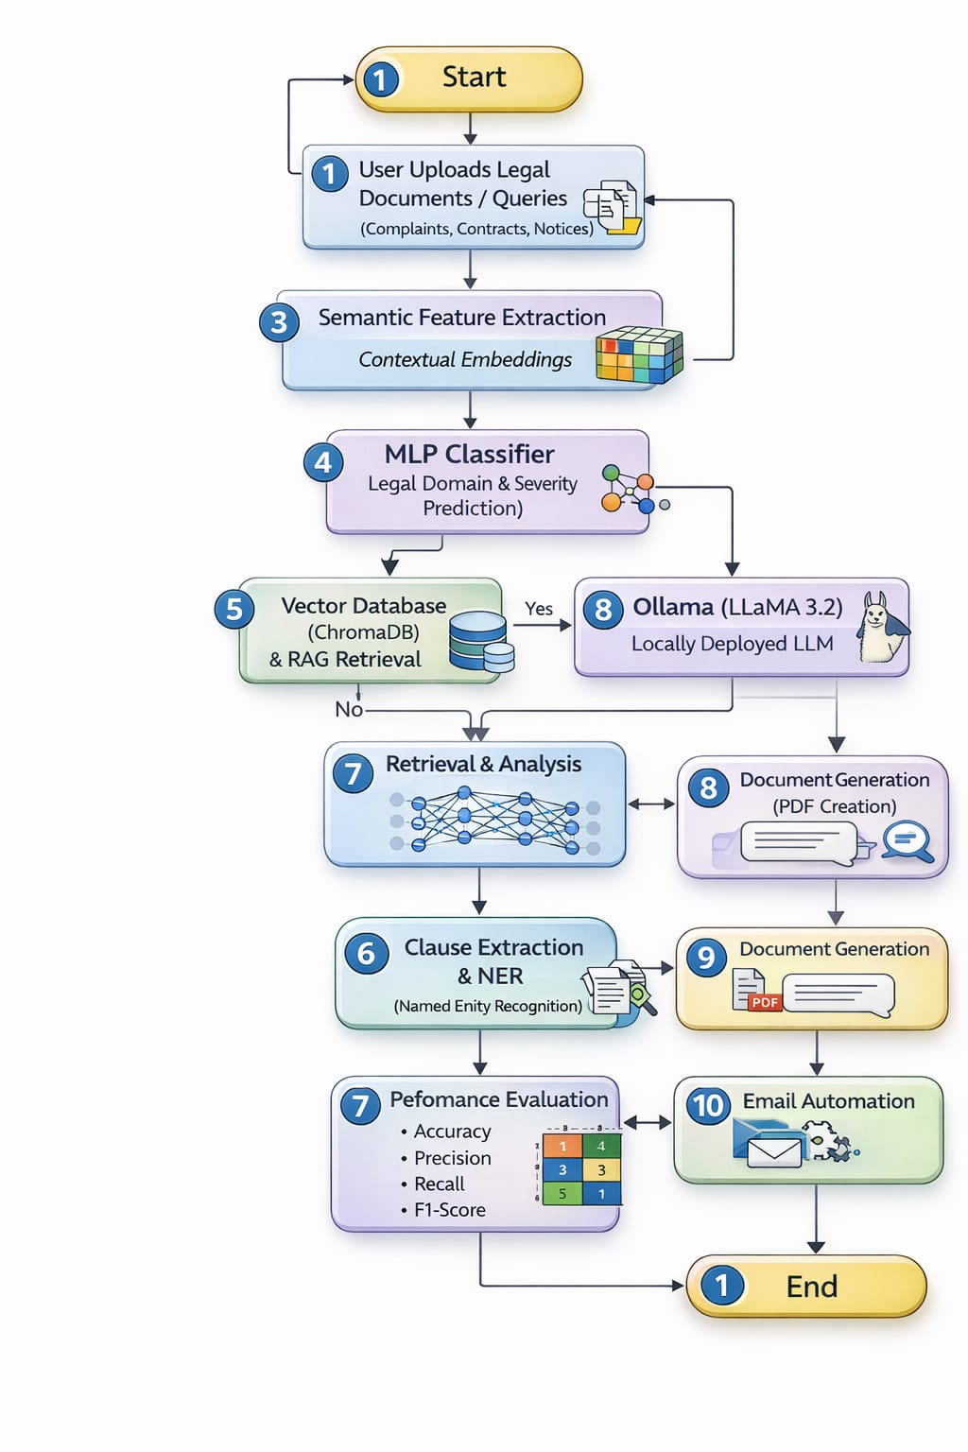
DESIGN:
FlowChart:-

Slide 12
Data Set Descriptions:-
The project does not rely on training a model from scratch using a large custom dataset. Instead, it utilizes pre-trained legal language models such as InLegalBERT which are trained on extensive legal corpora and capture domain-specific legal knowledge.
User-provided legal documents, including complaints, contracts, agreements, and notices, serve as input data for analysis and evaluation.
These documents are used dynamically for semantic understanding, classification, and retrieval-based processing rather than traditional supervised dataset training.
Data Preprocessing Techniques:-
Uploaded legal documents are converted into plain text and cleaned through tokenization and normalization.
Long documents are split into smaller chunks and transformed into contextual embeddings using pre-trained InLegalBERT.
Legal domain and case severity labels are encoded into numerical format for classification.

Slide 13
Methods & Algorithms
Transfer Learning (InLegalBERT / LegalBERT): A pre-trained legal transformer model is used to extract semantic features from legal text without training from scratch.
Semantic Feature Extraction: Contextual embeddings representing legal terminology, clauses, and relationships are generated from input documents.
MLP Classification: A Multilayer Perceptron classifier performs legal domain classification and case severity prediction using extracted embeddings.
Retrieval Augmented Generation (RAG): Relevant legal document chunks are retrieved from a vector database to ground AI-generated responses in source documents.
Ollama (LLaMA 3.2): A locally deployed large language model generates accurate, context-aware legal responses using retrieved information.
Clause Extraction & NER: Key legal clauses and entities such as parties, statutes, and dates are identified using transformer-based analysis.
Document Generation & Email Automation: Legal documents are generated, converted to PDF, and delivered through automated email communication.
Performance Evaluation Metrics: Model performance is evaluated using Accuracy, Precision, Recall, F1-Score, and Confusion Matrix.

Slide 14
THANK YOU

