Slide 1

Welcome to CodeAlpha
Name: Abdirahman Abdikadi Ahmed
Internship: CodeAlpha - cybersecurity Internship.
project: Task 2 - Phishing Awareness Training
Date: 20 jun 2025

Slide 2
Phishing Awareness Training
1. Introduction
2. What is phishing?
3. Common Types of pishing attacks
4. Effective of phishing attacks
5. preventive measures
6. Prevention Tips

Slide 3
Introduction
Phishing is one of the most common and dangerous forms of cyberattacks targeting individuals and organizations. It involves fraudulent attempts by cybercriminals to obtain sensitive information—such as usernames, passwords, credit card details, or confidential data—by pretending to be a trustworthy source, often through email, text messages, or fake websites.

Slide 4
What is Phishing?
Phishing is a cyberattack that tricks you into revealing sensitive information.
Often comes as fake emails, websites, or messages pretending to be real.

Slide 5
Common Types of Phishing
- Email Phishing
- Spear Phishing
- Smishing (SMS Phishing)
- Vishing (Voice Call Phishing)
- Fake Websites

Slide 6
How to Identify Phishing?
Poor grammar or spelling
Urgent or threatening messages
Unknown or strange email addresses
Unexpected attachments or links

Slide 7
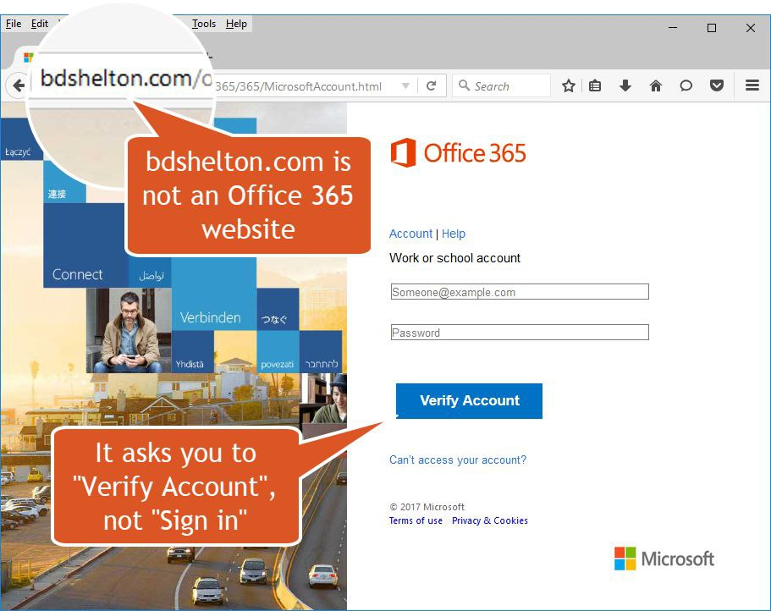
Real Examples

Slide 8
Prevention Tips
Verify sender email addresses
Hover over links before clicking
Don't open suspicious attachments
Use Two-Factor Authentication
Report phishing attempts

Slide 9
Mini Quiz
Q1: Which of the following is a sign of phishing?
a) Professional language
b) Known sender
c) Threatening tone
d) Secure HTTPS
Correct Answer: c

Slide 10
Conclusion
Stay alert and informed.
Cybersecurity is everyone's responsibility.
Be cautious and think before you click.

Slide 11
References
https://www.phishing.org/
https://www.cyberaware.gov/

