Slide 1
Drag-and-Stamp
Qijun Wen,
Weigen Yuan,
Brandon Norberto

Slide 2
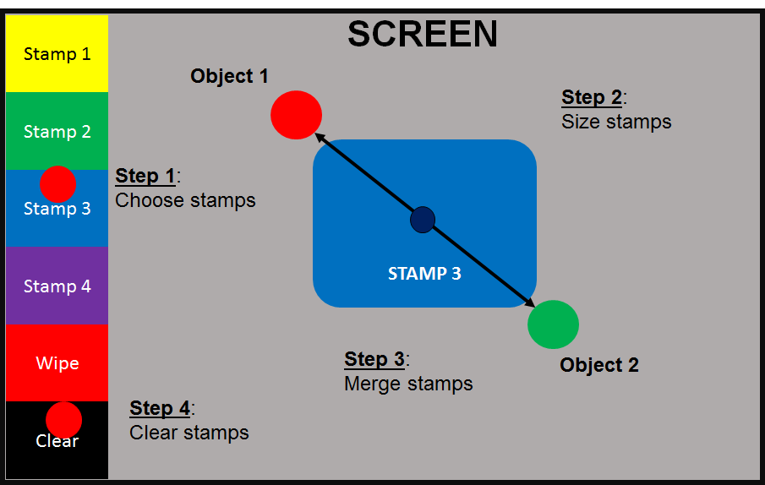
Drag-and-Stamp Overview
Tracks two unique colours as
stamp corners
Stamp sized to fit within the
Corners
User can select stamps using
one colour and a GUI on the left
side

Slide 3
Initial Goals
Multiple stamps are stored in DDR memory to be accessed by a created scaling IP
Two unique colours are to be tracked by a created video-tracking IP, and the centers of each coloured area are used as the tracking points
One selector point is also used to select one of the stamps on a UI on the leftside peripheral
User would make a stamp stick by holding it in place for a given amount of time
User would be able to clear the screen by moving the selector point to a designated area on the UI.

Slide 4
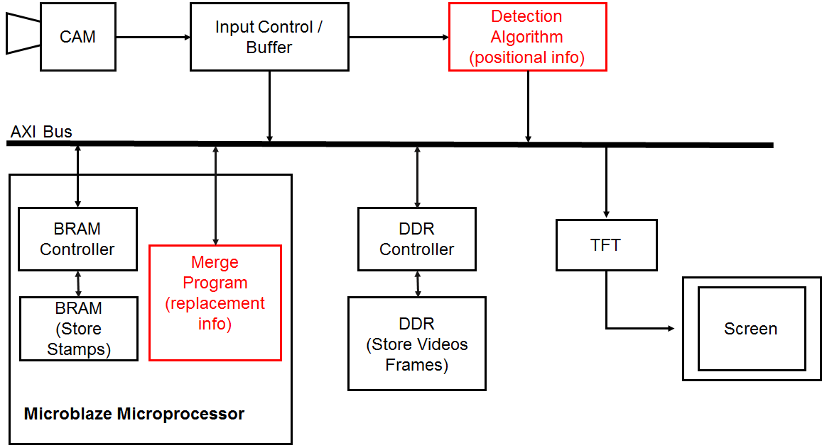
Initial Block Diagram

Slide 5
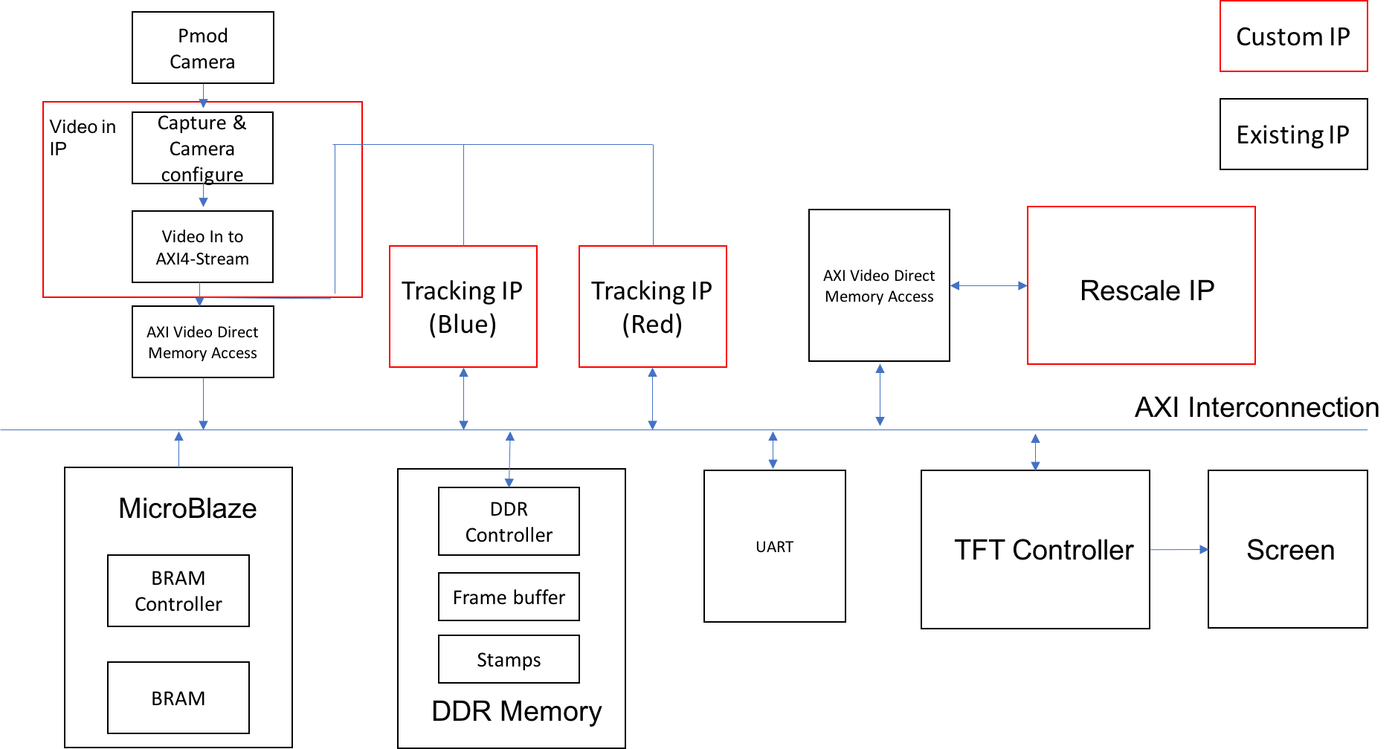
Final Block Diagram

Slide 6
Created IPs
Video In to AXI IP
Tracking IP
Scaling IP
Created Software control
Main control
Memory initialization and formatting algorithm

Slide 7
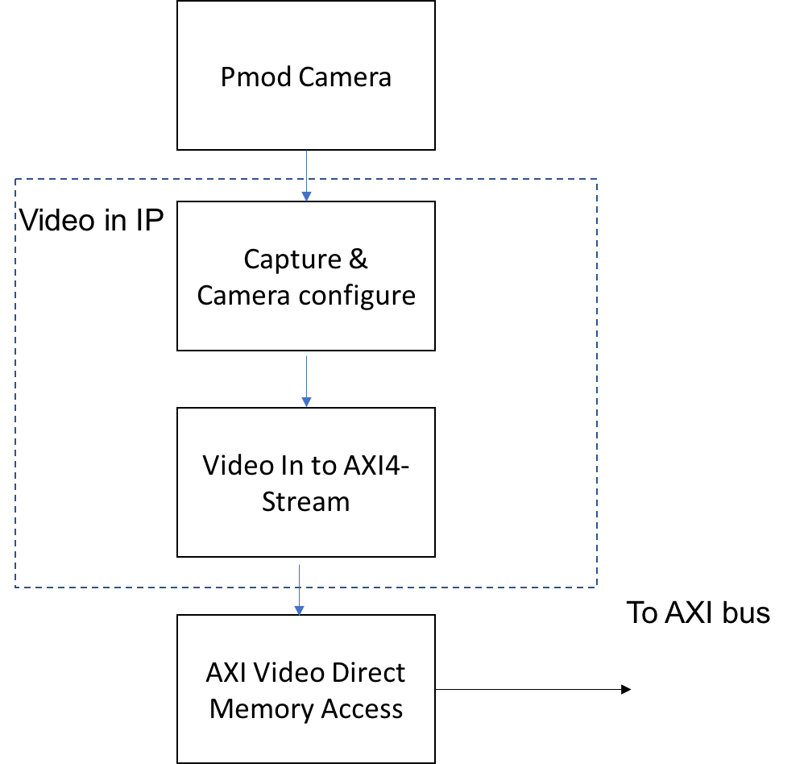
Video In IP
Combine the Configure, capture and the Video in to AXI Stream (Existing IP) to build the final Video in IP
Configure the PMOD Camera to RGB565 and 640 * 480 VGA format
Capture the pixel data from PMOD
Prepare signal for VDMA.

Slide 8
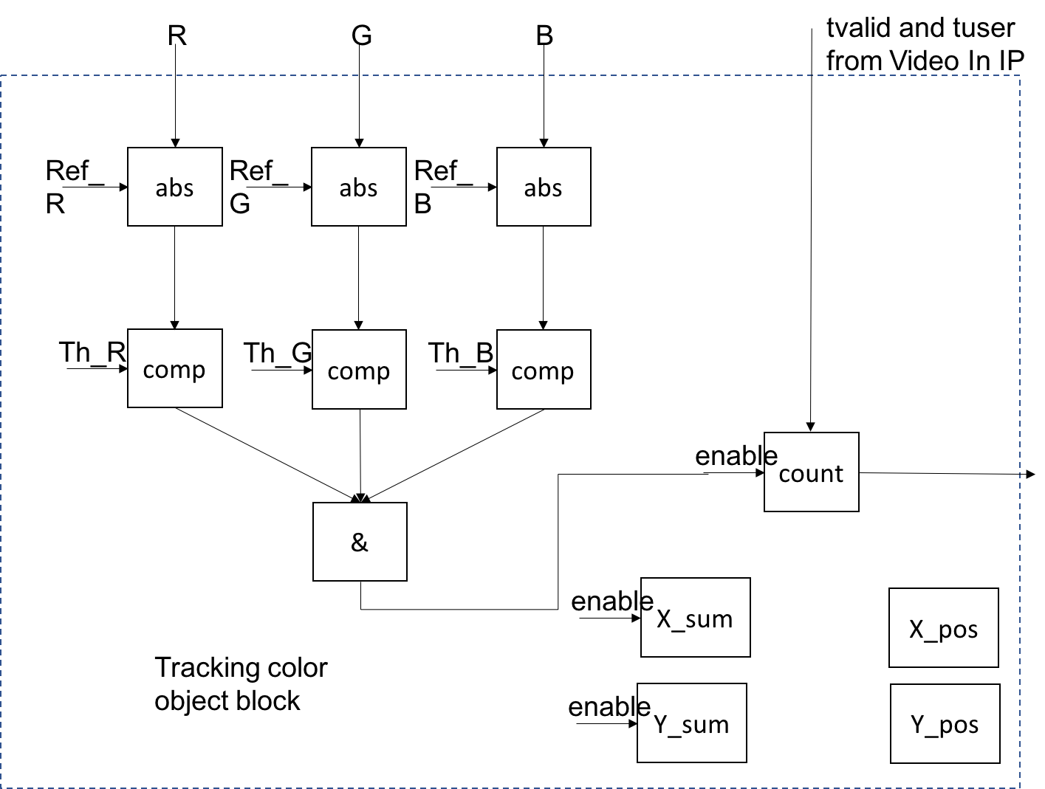
Tracking IP
Average algorithm to tracking the color object.
Build IP as the AXI lite slave, which be control by C driver.
Successfully tracking 2 different color objects at the same time.

Slide 9
Rescale IP
Implement bilinear-interpolation rescaling algorithm
Use fixed point math library found on OpenCores
Stamp inputted from DDR into rescale IP via VDMA (with MM2S_AXIS interface)
Stamp outputted to DDR from rescale IP via VDMA (with S2MM_AXIS interface)
Reading the stamp pixels only once.
  Advantage: time/resource-saving
  Disadvantage: more difficult for hardware design; need to consider skip-row buffering and meet timing constraint
For each two-row buffering from reading, the rescale IP outputs one rescaled row for writing
This IP only supports shrinking now for memory-time-saving purpose, but can adapt easily to any rescaling needs

Slide 10
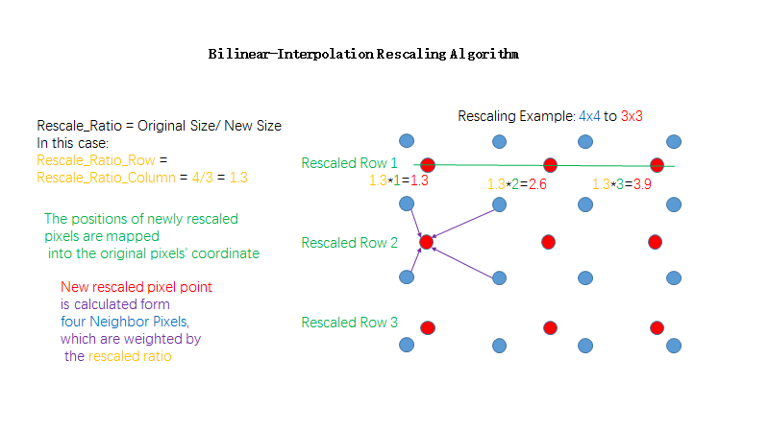

Slide 11
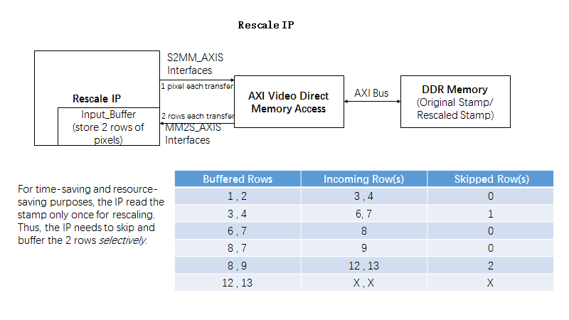

Slide 12
Main Software Control System
Menu driven system that takes in user input.
Users can initialize the DDR with stamps first before running the camera and tracking.
Users can then start the stamp process through the menu after memory initialization

Slide 13
Memory Initialization and Formatting
DDR memory initialized using the AXI UART to transfer stamps to the Nexys Board
Stamp pixels read from the UART are translated from two 8 bit sections, to one 32-bit, padded pixel as follows:
Sec1: 32’bRRRRRGGG; Sec2: 32’bGGGBBBBB -->
Pixel: 32’bRRRRR000GGGGGG000BBBBB000
Stamps stored in base of DDR memory next to each other, display buffer stored in a 65 kB offset from the base.

Slide 14
Achieved Goals
Multiple stamps are stored in the DDR memory in a format that can be passed to a VDMA without any further conversion.
A red and a blue square are tracked as the top left and bottom right corners of the stamp respectively.
The red square is also used as a UI option selector; that is when it is held over a menu option for a given amount of time, the stamp will change to that option.
The two tracked points are used to rescale the stamp and displayed on the background of video input.

Slide 15
Reasoning for Unachieved Goals
Some components of the design had bugs and required several revisions, taking more time than expected to complete.
The team lacked some experience in hardware required to complete some of the components of the design in a timely manner.

Slide 16
What We Learned
Simulation! Simulation!Simulation!
Effective hardware debugging skills with ILA Debug Core
Understand AXI-series interfaces and implement them in hardware
Making the right choice between software and hardware IPs to optimize performance
Using Xilinx, Vivado and general hardware development tools that are better than Altera

Slide 17
Used IPs and Code Blocks
Fixed Point Math Library for Verilog
  OpenCores, can be found here: https://opencores.org/project,verilog_fixed_point_math_library
Portable MD5 hash library in C
  Open source, portable software that works the same way as the openssl library found here: http://openwall.info/wiki/people/solar/software/public-domain-source-code/md5
RealTerm Terminal Emulator
Green screen project UART memory initialization software
  Used the base UART reading code block found here: https://github.com/marmot1234/G9_InteractiveStudio/blob/master/src/proj/hdmi.sdk/video_demo/src/video_demo.c
PMOD Camera Configure and capture
  Piazza Resource 532_pmod_camera_dist

