Slide 1
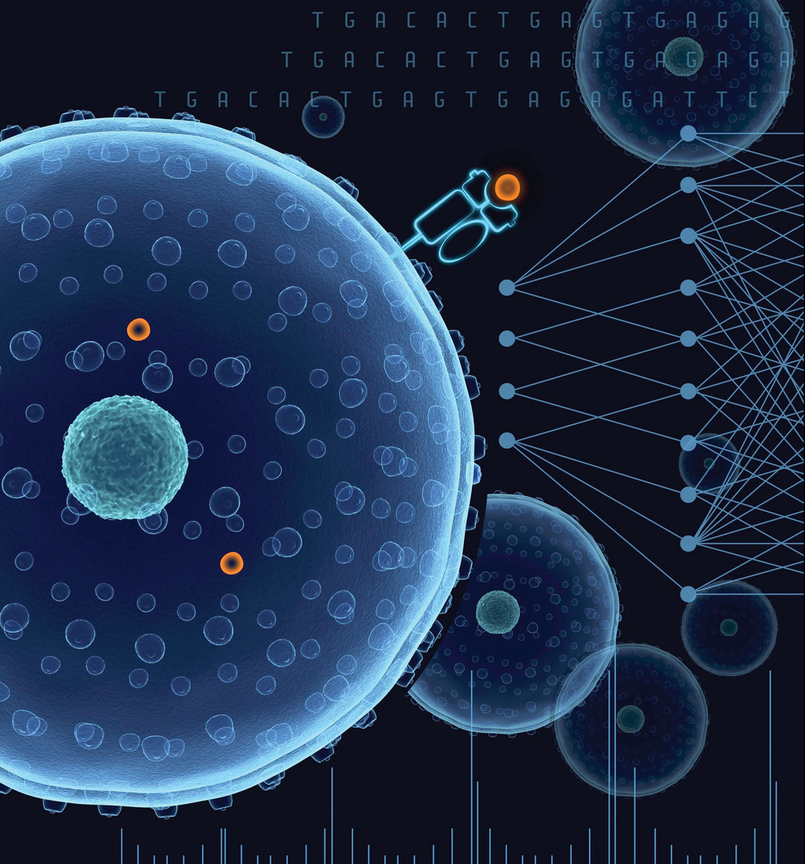
01
VISHWAKARMA STUDENT RESEARCH PROJECT SCHEME (VSRPS) 2020
Drug repurposing
Using AI ( for Covid-19 )
Vaibhav R Mankar

Slide 2

02
Discussion points
Executive summary
Problem
Introduction of the research proposal
Significance of the study
Review of research and development
Objectives
Methodology
Quarterly plan of work
Impact - Expected outcome
Quarterly plan of expenses
VISHWAKARMA STUDENT RESEARCH PROJECT SCHEME (VSRPS) 2020

Slide 3
03
VISHWAKARMA STUDENT RESEARCH PROJECT SCHEME (VSRPS) 2020
Executive summary
The development of a new drug is a tedious, costly, and time-consuming process. Drug repurposing is intended to find alternative uses for a pioneering drug . AI-empowered drug repurposing is a cheaper, faster, and effective approach and can reduce the failures in clinical trials.AI-based Deep learning models can predict drug structures that could potentially treat COVID -19.

Slide 4

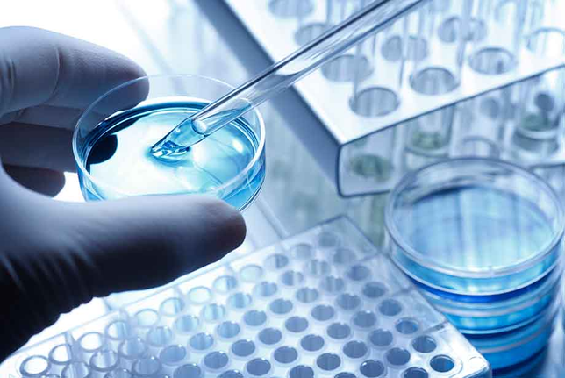
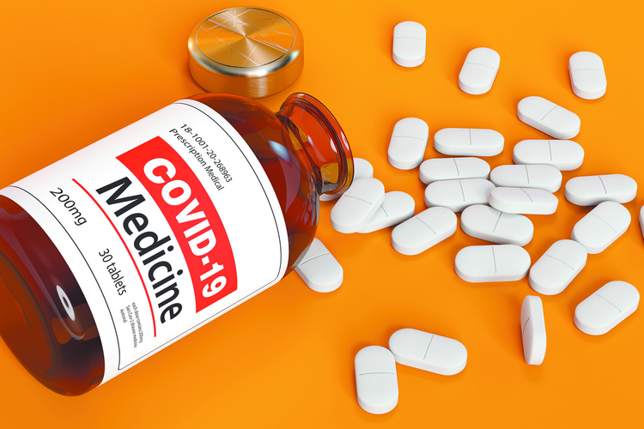
Problem
04
VISHWAKARMA STUDENT RESEARCH PROJECT SCHEME (VSRPS) 2020
Problem 1
Problem 2
Problem 3
The development of a new drug is a tedious, costly, and time-consuming process
Lack of research in the medical data
Drug discovery is entrenched with a high degree of uncertainty that a drug will actually succeed.

Slide 5
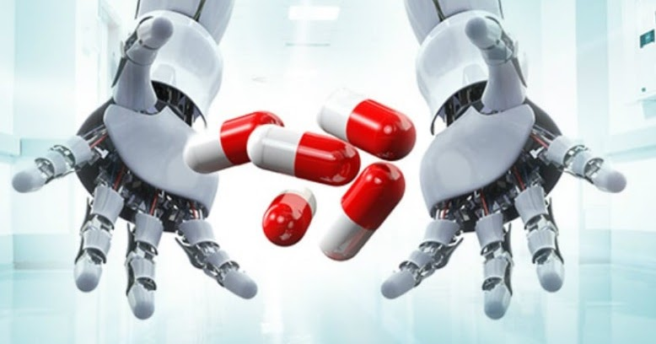
05
VISHWAKARMA STUDENT RESEARCH PROJECT SCHEME (VSRPS) 2020
Introduction of the research proposal
With an increase in technology, the information/data about drugs is increasing. Data is available for the research ( eg Drug bank ), Medical researchers around the globe are using this data for various purposes.
With the help of AI and ML techniques, we can find the correlation between different drugs and medical conditions(Recommendation systems), and using this relation we can suggest few drugs that can help in the treatment of the specific medical condition thereby helping the medical researchers and institutions to get the results more quickly and efficiently.

Slide 6

06
VISHWAKARMA STUDENT RESEARCH PROJECT SCHEME (VSRPS) 2020
Significance of the study
Currently, there are Data science and AI techniques available for the Drug repositioning but given the complexity of the situation and current status of the world, more efficient and reliable techniques are required i.e more study and research in this field is needed.With the advancement in Deep Learning technology, It has opened various ways for the development of AI solutions. The use of deep learning technology in the field of drug repurposing can produce a remarkable performance.

Slide 7
07
VISHWAKARMA STUDENT RESEARCH PROJECT SCHEME (VSRPS) 2020
Review of research and development
Drug repurposing can be done using Neural collaborative filtering and thus we are trying to make a Deep learning model using Neural Collaborative filtering technique.
International
National
Drugs Based on Evolutionary Relationships Between Targets of Approved Drugs and Proteins of Interest, Improving cell-specific drug connectivity mapping with collaborative filtering. Neural Collaborative Filtering is mainly used for recommender systems. It utilizes the flexibility, complexity, and non-linearity of Neural Network to build a recommender system
Repurposing Drugs Based on Evolutionary Relationships Between Targets of Approved Drugs and Proteins of Interest, Implementation of a Pipeline Using Disease-Disease Associations for Computational Drug Repurposing And Neural Collaborative Filtering approach is implemented in DeepReco: Health Recommender System

Slide 8


08
VISHWAKARMA STUDENT RESEARCH PROJECT SCHEME (VSRPS) 2020
Objective
To find out the correlation between drugs and medical conditions( the results of this can be further used for the development of medical research )
To find the Effective way of drug repurposing using data science and AI ( specifically Deep learning )

Slide 9
09
VISHWAKARMA STUDENT RESEARCH PROJECT SCHEME (VSRPS) 2020
Methodology
Research Questions
Can we use Data Science and AI techniques for medical data gathering, processing, and finding the correlation between drugs and medical conditions?
Can we create a novel drug prediction/recommendation technique using AI that can heal in the treatment of the COVID-19?
Type of Data needed
As of now, We will be using secondary data ( i.e during the research we may not need to conduct any survey or any primary data collection process ). The research includes the use of both quantitative and qualitative data

Slide 10

Methods of Data collection and analysis
10
Web Scraping ( medical sites )
Collecting data from the open-source organizations ( Kaggle )
Collecting data from the commercial medical data providers ( Drug bank )
Collecting data from the Governments data portals
COVID-19 data ( Kaggel / WHO / U.S department of health ... )
VISHWAKARMA STUDENT RESEARCH PROJECT SCHEME (VSRPS) 2020
Analysis of the data will be done with the help of software like Power BI and Tableau.

Slide 11
PROPOSED METHOD
11
02
03
01
Data gathering and refining
Finding the correlation between drugs and medical conditions
Drug prediction and repurposing
Collect data.
Refine and preprocess data.
Identify the useful features from the gathered data.
Define the problem in mathematical terms
Develop the mathematical equations/models using data science techniques that can be used to find the correlation between drugs and medical conditions.
perform experiments on the developed model/models.
improve and optimize performance.
Analyze derived correlations and available data.
Define the problem of drug prediction in mathematical terms.
Design/Develop the Machine learning/Deep learning model/models for drug prediction.
Perform experiments on the developed model/models.
Improve and optimize performance.
VISHWAKARMA STUDENT RESEARCH PROJECT SCHEME (VSRPS) 2020

Slide 12
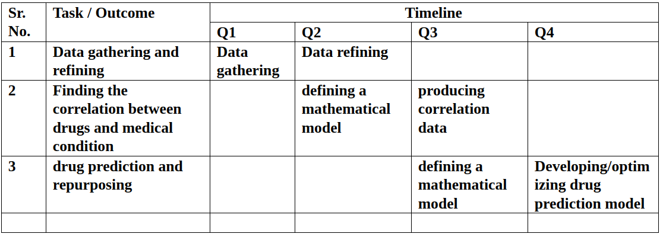
12
VISHWAKARMA STUDENT RESEARCH PROJECT SCHEME (VSRPS) 2020
Quarterly plan of work and targets to be achieved

Slide 13
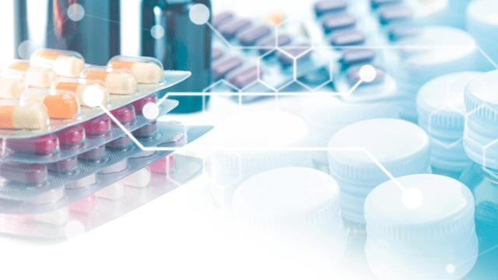
13
VISHWAKARMA STUDENT RESEARCH PROJECT SCHEME (VSRPS) 2020
IMPACT - EXPECTED OUTCOME
We will have the defined correlations between drugs and medical conditions that can be used for other medical research.
We will have a deep learning model ( novel approach ) that can perform better than the available models( approaches ) for the drug prediction and repurposing.
Using this model we can suggest the useful drugs for the treatment of the COVID-19 ( Or the properties of that drug which may help in the development of the drug for the COVID-19 )

Slide 14

14
VISHWAKARMA STUDENT RESEARCH PROJECT SCHEME (VSRPS) 2020
Thank you!
Questions? Clarifications? Let us know!

