Slide 1
MOVIE
RECOMMENDATION
▶
SYSTEM
A content-based recommender with personalized ranking
CINE-MEN
Team Project
My Role • Recommendation • Backend • Integration
Cine-Men • Movie Recommendation System
01
1/12

Slide 2
02
Problem
What does the app solve?
• Too many movies make it difficult to decide what to watch.
• Users may want movies similar to a movie they already like.
• Returning users should get recommendations based on their own activity.
• The system reduces search effort by showing a focused top 5.
THE PROBLEM
TOO MANY
MOVIES
NEED
RELEVANCE
GET TOP 5
Cine-Men • Movie Recommendation System
2/12

Slide 3
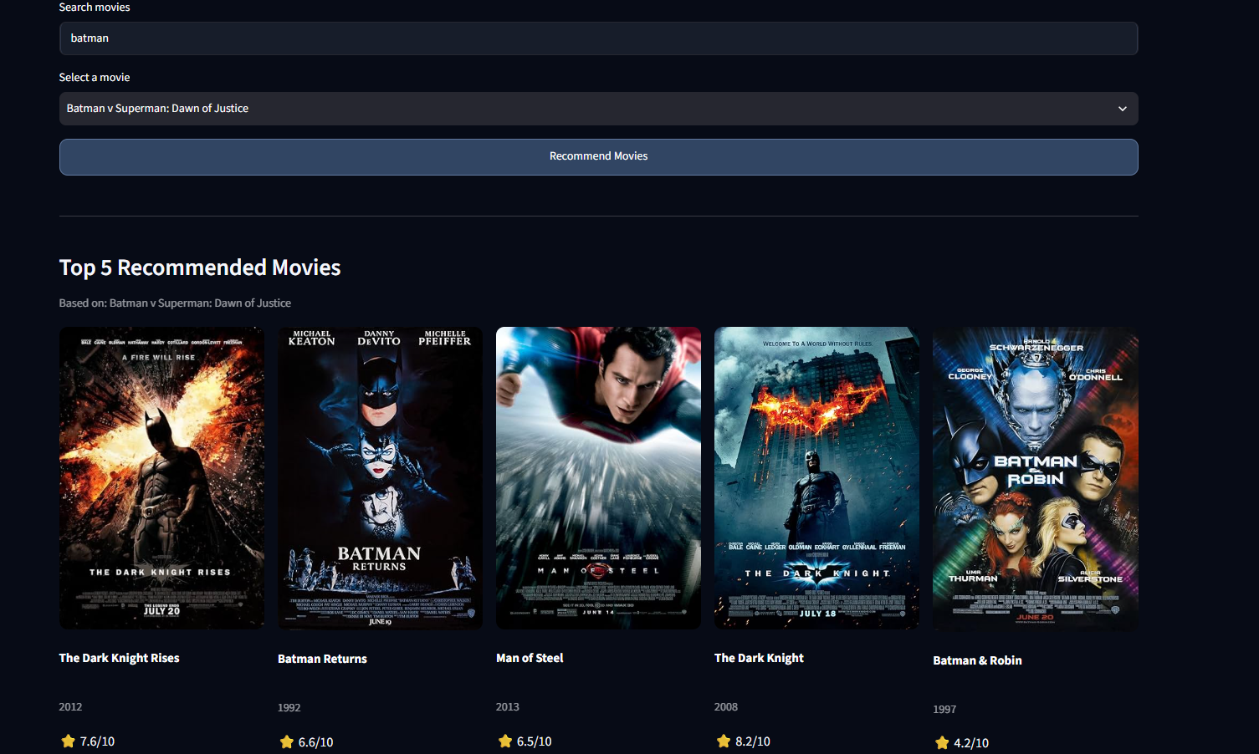
03
Solution
One sentence + actual app screenshot
A content-based movie recommender that uses TF-IDF and cosine similarity, then personalizes the ranking using the selected movie, watch history and favourites.
Cine-Men • Movie Recommendation System
3/12

Slide 4
04
Tech Stack
Tools used in the project
Python
Pandas
Scikit-learn
Streamlit
Core programming
Movie data handling
TF-IDF + similarity
Web application
SQLite
OMDb API
CSS
Git & GitHub
Users + activity
Movie details + posters
Application styling
Version control
Cine-Men • Movie Recommendation System
4/12

Slide 5
05
Architecture
How the components work together
database.py
Users + History
Favourites
omdb.py
Movie details
Posters
user data
app.py
Streamlit UI
Application flow
USER
Selects movie
details
history
recommend
recommender.py
TF-IDF + Cosine
Personalized scoring
TOP 5
Recommendations
shown to user
score
Cine-Men • Movie Recommendation System
5/12

Slide 6
06
LIVE DEMO
Run the application
LIVE
01
Sign in
02
Select
03
Recommend
Existing registered email
Search / choose a movie
Click Recommend Movies
04
Show
05
Update
06
Verify
Display top 5 results
Favourite / mark watched
History / recommendations
Cine-Men • Movie Recommendation System
6/12

Slide 7
07
AI Component
01
02
03
04
05
MOVIE CONTENT
→
TF-IDF
→
COSINE
→
PERSONALIZE
→
TOP 5
Genres + overview
Text → numeric vectors
Measures similarity
Movie + history + favourites
Highest-scoring movies
More similar movie content → higher similarity → stronger recommendation
Cine-Men • Movie Recommendation System
7/12

Slide 8
08
Challenges
1–2 challenges faced
• Personalized scoring: combining the selected movie, watch history and favourites while keeping content similarity meaningful.
• Returning-user persistence: connecting SQLite data with the recommendation flow so previous activity can be reused.
KEY LEARNING
The recommendation engine and database had to work together as one flow.
Cine-Men • Movie Recommendation System
8/12

Slide 9
09
My Role
What I worked on
RECOMMENDATION • BACKEND • INTEGRATION
• Movie data loading and preprocessing
• TF-IDF and cosine-similarity recommendation logic
• Personalized scoring using movie + history + favourites
• SQLite users, history and favourites
• Returning-user flow and OMDb API integration
• Module integration, testing and debugging
• GitHub project integration and version control
Cine-Men • Movie Recommendation System
9/12

Slide 10
10
Future Improvements
Possible next steps
HYBRID RECOMMENDATIONS
BETTER REPRESENTATIONS
Combine content-based + collaborative filtering
Use embeddings for semantic similarity
USER FEEDBACK
EVALUATION
Use ratings / likes to refine results
Add precision, recall and recommender metrics
Cine-Men • Movie Recommendation System
10/12

Slide 11
11
GitHub Link
Project repository
GITHUB REPOSITORY
github.com/mankaran8054/
Movie-recommendation-system-
Application code • recommender • database • API integration • styling
Cine-Men • Movie Recommendation System
11/12

Slide 12
THANK YOU
Movie Recommendation System
CINE-MEN
Cine-Men • Movie Recommendation System
12
12/12

