Slide 1

Prediction of Heart Disease
Mankirat Singh Bhamra MXB220061
Harikrishna Dev HXD220000
Krishnan Venkatesan KXV220007
Medha Priyanga Saravanan MXS220057
Notes:
Add heart picture

Slide 2
Introduction
According to WHO, Cardiovascular diseases are the leading cause of death globally.
It is estimated that 17.9 million people (32%) deaths were caused by CVDs. Of these deaths, 85% were heart attacks and strokes.
Detecting cardiovascular disease early is important to begin management with counseling and medication.
Our objective is to identify high-risk patients for CVD based on their current health-related information obtained from yearly checkups.
The prediction will assist medical professionals and self-assessment tools to evaluate patients' course of medication and health plan choices.
Notes:
Remove smartart

Slide 3

Data introduction
UCI machine learning repository is the original source, and we are using the cleaned-up dataset from Kaggle.
The data consists of a random set of patients from 30 May 1989 to 2 Dec 1996 and it has their medical information.
The data can be accessed from the Kaggle link here.

Slide 4
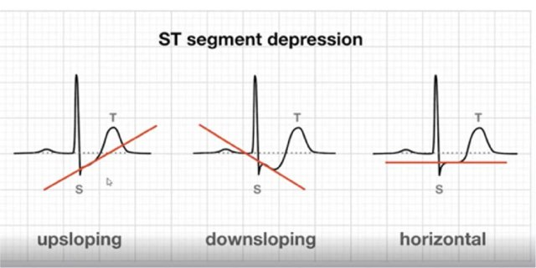
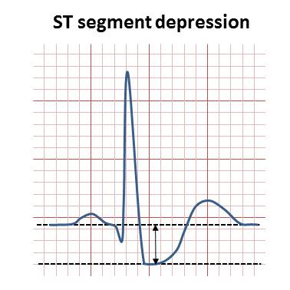
Model variables
Age: age of the patient [years]
Sex: sex of the patient [M: Male, F: Female]
ChestPainType: chest pain type [TA: Typical Angina, ATA: Atypical Angina, NAP: Non-Anginal Pain, ASY: Asymptomatic]
RestingBP: resting blood pressure [mm Hg]
Cholesterol: serum cholesterol [mm/dl]
FastingBS: fasting blood sugar [1: if FastingBS > 120 mg/dl, 0: otherwise]
RestingECG: relaxing electrocardiogram results [Normal: Normal, ST: having ST-T wave abnormality (T wave inversions and/or ST elevation or depression of > 0.05 mV), LVH: showing probable or definite left ventricular hypertrophy by Estes' criteria]
MaxHR: maximum heart rate achieved [Numeric value between 60 and 202]
ExerciseAngina: exercise-induced angina [Y: Yes, N: No]
Oldpeak: oldpeak = ST [Numeric value measured in depression]
ST_Slope: the slope of the peak exercise ST segment [Up: upsloping, Flat: flat, Down: downsloping]
OldPeak

Slide 5
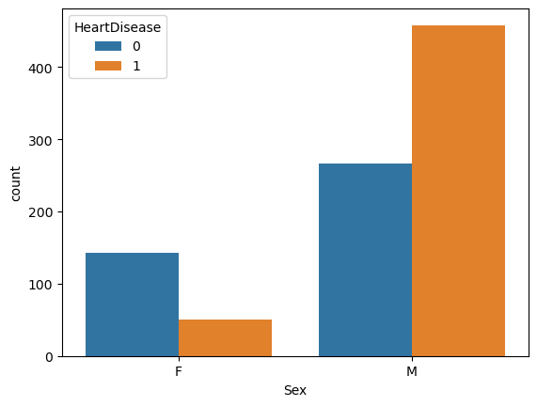
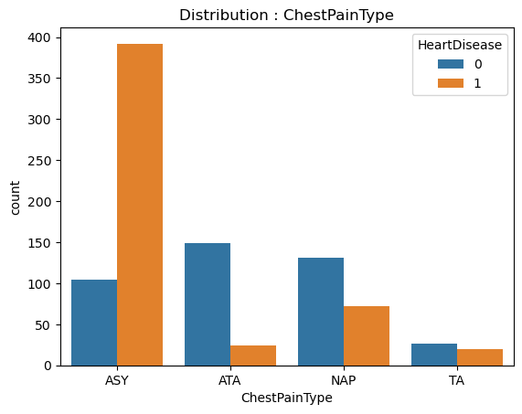
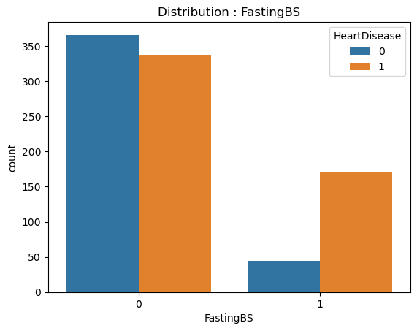
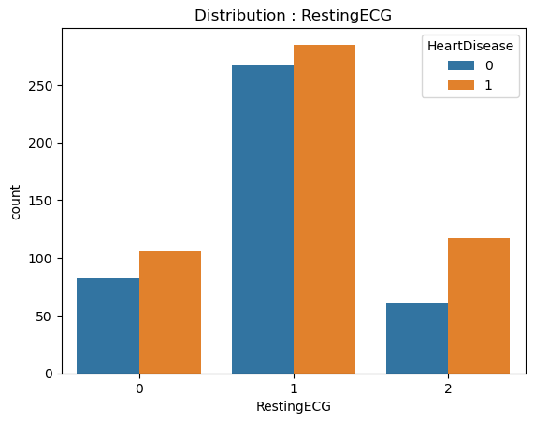
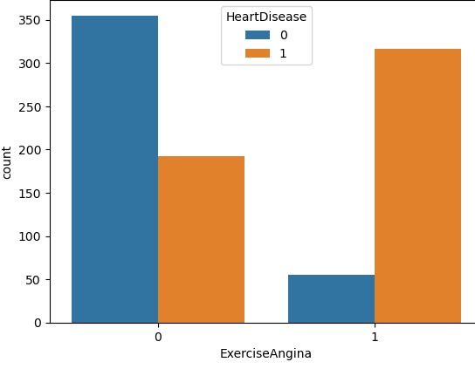
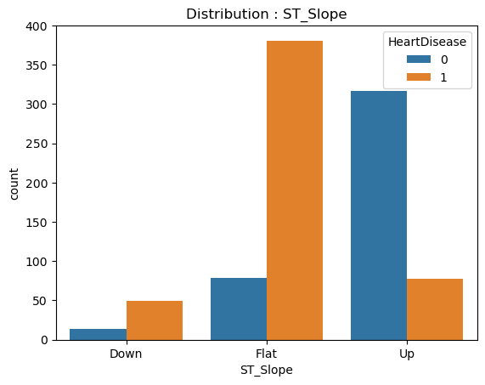
Exploratory Data analysis
Sex: Male patients > Female patients
ChestPainType: ASY > NAP > ATA > TA
FastingBS: ( FBS < 120 mg/dl ) > ( FBS > 120 mg/dl)
RestingECG: Normal > ST > LVH
ExerciseAngina: Angina > No Angina
ST_Slope: Flat > Up > Down
​​Variable​​ | Chi-Squared Score​​
ExerciseAngina​​ | 139.775283​​
ChestPainType​​ | 127.478652​​
ST_Slope​​ | 67.425731​​
FastingBS​​ | 16.015879​​
Sex​​ | 15.600925​​
RestingECG​​ | 0.031521​​

Slide 6
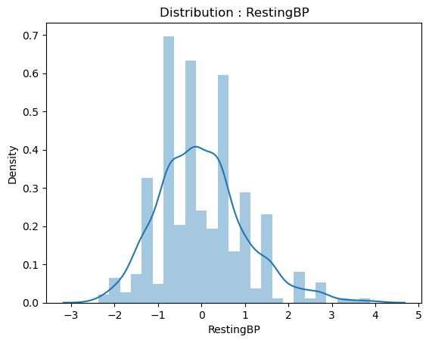
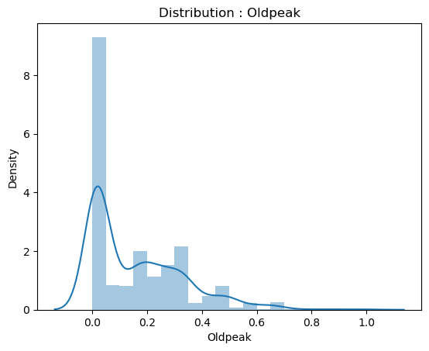
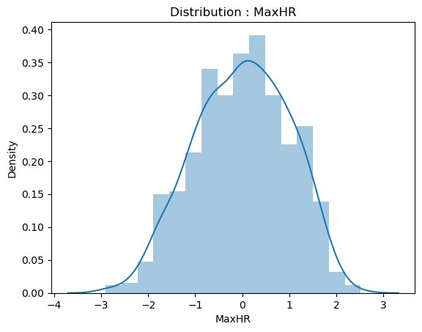
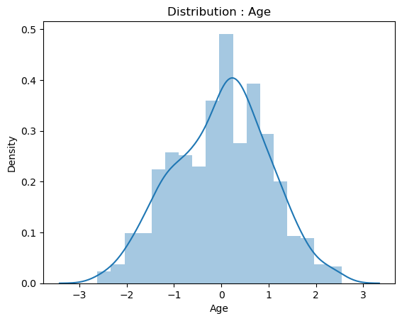
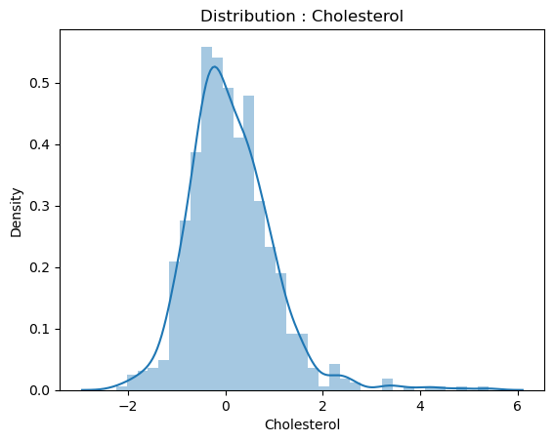
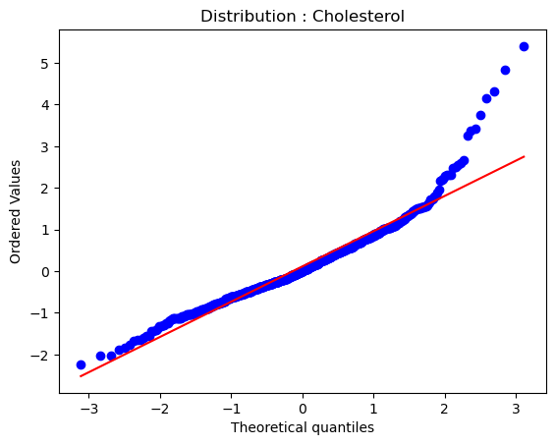
Feature Engineering
Age: 50+
RestingBP: 95 - 170
Cholesterol: 160 - 340
MaxHR: 70 - 180
Oldpeak : 0 - 4
Variables | ANOVA Score
Oldpeak | 242.364279
MaxHR | 123.425078
Age | 72.839116
RestingBP | 23.020309
Cholesterol | 8.113851
Based on the distribution plots, we used these scalers:
Variables | Scaler
Oldpeak | Minmax
Cholesterol | Robust
Other Variables | Standard

Slide 7

Modeling approach
Utilized the h2o ML platform to run multiple models concurrently and hyperparameterize them simultaneously, and integrated AutoML functionality with the Python environment.
Facilitated the selection of the best model and enhanced ease of use.
Identified the XGBoost classifier as the best model.

Slide 8
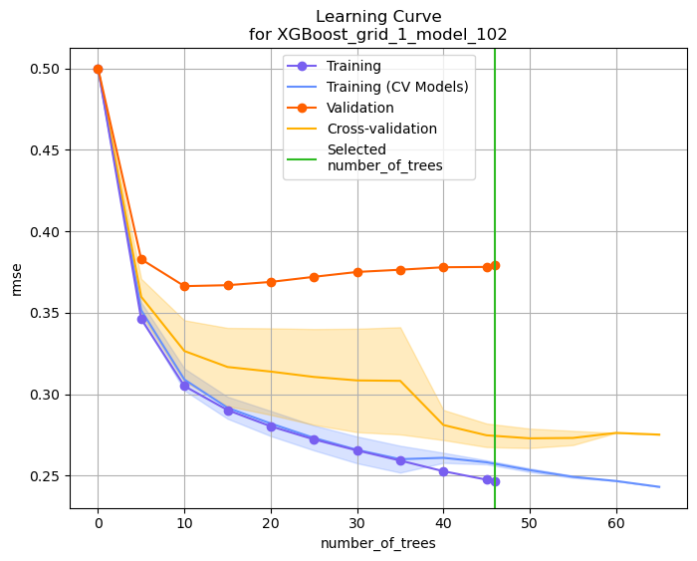
Model used: XGBoost Classifier model
After running multiple binomial classification models (such as Decision Trees, etc.), we were able to conclude that the XGBoost Classifier is the best model.
The Model has 46 trees which were determined by 5-fold cross-validation.

Slide 9
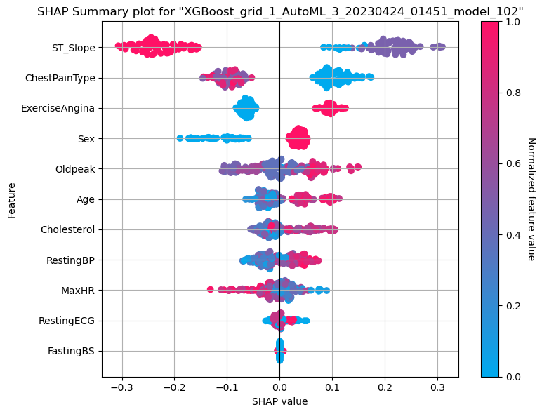
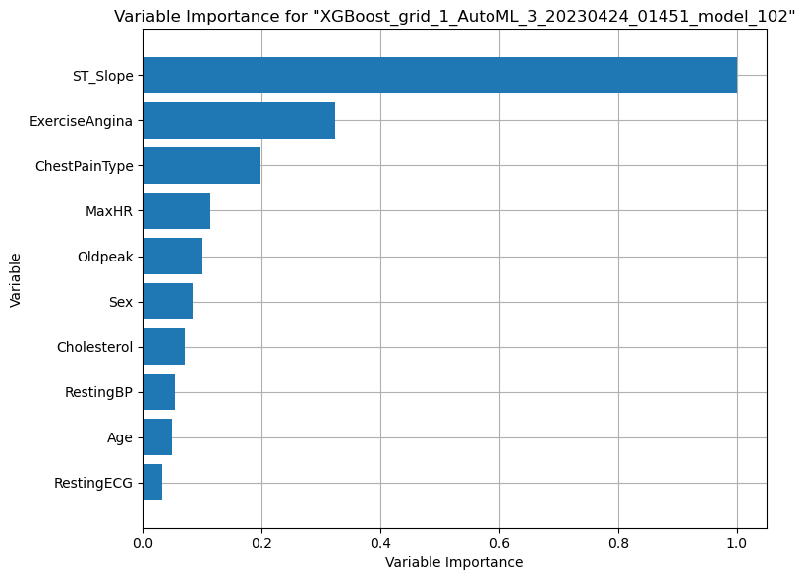
Model Results
ST Slope is the most influential variable based on the variable importance graph.
ST Slope has a wide range of SHAP values, indicating its significance in the model.
MSE: 0.1438 ​
RMSE: 0.379​
MAE: 0.2686​
RMSLE: 0.2642 ​
Mean Residual Deviance: 0.14380​
Accuracy: 89.61%​
Cross-validation Score: 92.20%

Slide 10
Future project implementation scope:
Incorporating time component of features can monitor patient improvement and identify seasonal effects.
Evaluation of treatment effectiveness and lifestyle changes.
Applying AI to analyze large health datasets to identify correlations between health factors.
Developing personalized treatment plans based on individual patient health data and medical history.
Implementing telemedicine platforms that enable doctors to remotely monitor patient progress and communicate with patients in real-time, improving access to care and reducing costs.

