Slide 1

Removing Backdoors from Federated Models via Machine Unlearning
Group - 6 | ISP

Slide 2
Motivation & Problem Statement
•
Federated Learning (FL) trains a shared model across many clients without centralizing data — good for privacy, but the server can't fully verify client behavior.
•
A malicious client can inject a backdoor: the model misclassifies inputs containing a hidden trigger, while behaving normally otherwise — hard to catch via accuracy monitoring.
•
Standard fix = full retraining without the malicious client → expensive, discards all completed training rounds.
•
Core question: can we surgically remove a backdoor from an already-trained FL model without retraining from scratch?

Slide 3

Background: Federated Learning & Backdoor Attacks
•
FL: clients train locally on private data → send model updates (not data) → server aggregates via FedAvg → repeat over many rounds.
•
Data poisoning attack: malicious client mislabels samples containing a fixed trigger (e.g., a pixel patch) toward an attacker-chosen class.
•
Model-replacement attack: malicious client scales its update to dominate aggregation, making the backdoor persist.
•
Distributed backdoor (DBA): trigger split across multiple colluding clients for extra stealth.
•
Key metric: Attack Success Rate (ASR) — % of triggered inputs misclassified to the attacker's target.

Slide 4
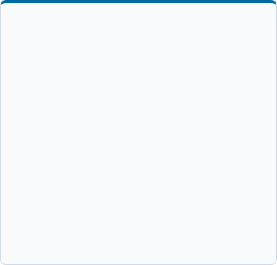
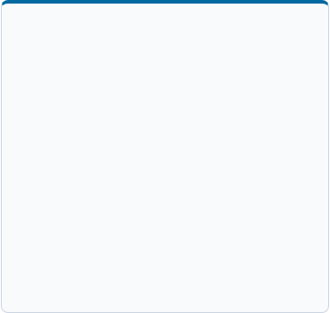
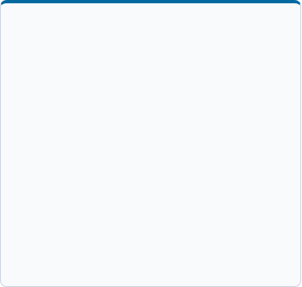



Background: Machine Unlearning
The Goal
Exact vs. Approx
FL Complexity
Make the model behave as if a client's data/updates had never been used, without full retraining.
Exact unlearning (provable, but computationally expensive) vs. Approximate unlearning (cheaper, best-effort).
Client-level unlearning in FL is harder than removing a single data point in centralized ML — the influence is spread across many training rounds.

Slide 5
Related Research Work
Bagdasaryan et al. (2020) — model-replacement backdoor attack on federated learning.
Xie et al. (2020, DBA) — distributed, stealthier backdoor attack across colluding clients.
Liu et al. (2021, FedEraser) — reconstructs unlearned model using calibrated historical updates retained at the server; faster than full retraining.
Wu & Zhu — removes a malicious client's influence via historical-update subtraction plus knowledge distillation, without needing client participation.
BadFU (2026) — shows unlearning itself can be an attack surface: a dormant backdoor can be activated by a fake unlearning request.
Gap: The attack side is mature; using client-level unlearning as a rigorous backdoor incident-response benchmark is newer and less standardized.

Slide 6
RESEARCH OBJECTIVE
Simulate a realistic FL backdoor attack, apply an unlearning method to remove it, and quantify the trade-off between removal effectiveness, clean-task accuracy, and computational cost versus full retraining.

Slide 7
Proposed Pipeline
4. Identify Target
6. Evaluate
2. Inject Attack
Identify/target the malicious client's contribution
Does ASR drop while clean accuracy is preserved?
Inject backdoor via malicious client(s)
1. Train Baseline
3. Confirm Attack
5. Apply Defense
Train clean FL baseline (FedAvg)
Confirm attack success (ASR ↑, clean accuracy stable)
Apply chosen unlearning method

Slide 8

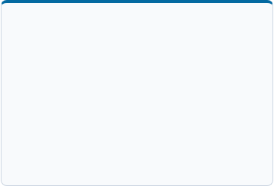
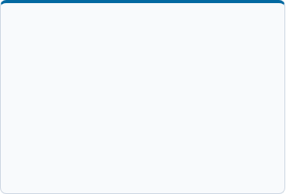
Candidate Attack Designs (for initial discussion)
Option A: Simple Trigger
Option B: Model Replacement
Option C: Distributed (DBA)
Fixed pixel patch + data poisoning (mislabeled samples at 1–2 malicious clients). Easiest MVP, but weaker attack.
Malicious client scales its update to dominate aggregation. More realistic, harder to tune.
Trigger split across colluding clients. Most sophisticated; best as stretch goal.
Recommended path: start with A, upgrade to B once the pipeline is stable, attempt C only if time remains.

Slide 9
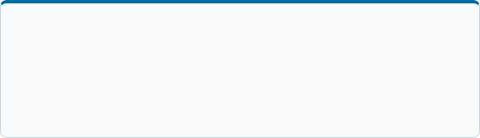
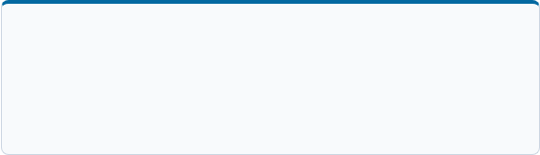
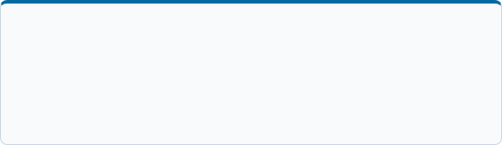

Candidate Unlearning Methods (for discussion)
Option A: Full Retraining
Option B: FedEraser
Mandatory baseline — the gold standard, but computationally expensive.
Server-retained historical updates + calibration training at remaining clients; established published benchmark.
Option C: Historical Subtraction
Option D: Fine-tuning Fallback
Wu & Zhu: server-only, no client re-participation needed, more implementation-heavy.
Gradient-ascent fallback — simplest to implement, weaker theoretical guarantee.
Recommended path: implement A as baseline, choose B or C as the primary method, keep D as fallback.

Slide 10
Experimental Setup & Evaluation Plan
•
Dataset & model: CIFAR-10 or Fashion-MNIST with a small CNN.
•
Comparison: no defense vs. unlearning method vs. naive client removal vs. full retrain.
•
FL config: number of clients, IID/non-IID split, FedAvg, number of rounds.
•
Ablations: poison ratio, number of malicious clients, attack timing.
•
Attack config: trigger design, % malicious clients, poison ratio, attack start round.
•
Success criteria: ASR near random-guess level, clean accuracy within a few points of the undefended model, cost well below full retraining.
•
Metrics: ASR, clean accuracy, wall-clock time, communication cost.

Slide 11
Detailed Timeline (8–10 weeks)
Week | Task | Deliverable / Milestone
Week 1 | Literature review, finalize dataset/model/tools, write proposal | –
Week 2 | Build & validate clean FedAvg baseline | Working clean baseline
Week 3 | Implement Attack Option A | First ASR numbers
Week 4 | Tune attack strength, sweep poison ratio/# malicious clients | Stable attack config
Week 5 | Implement retraining baseline + primary unlearning method | Working unlearning code
Week 6 | Apply unlearning to backdoored model, debug/tune | First successful unlearning run
Week 7 | Full 4-way comparison + ablations + multiple seeds | Results with error bars
Week 8 | Stretch goal (adaptive attacker) + start report/slides | Draft report outline
Week 9 | (If available) polish experiments, sensitivity analysis | Near-final results
Week 10 | Final report, final slides, rehearsal | Submission

