Slide 1

Unix Final Project
Made by Christian & Mankirat

Slide 2

Major Struggles
Git Merge Problems.
Changing the theme.
CSS not loading for pages.
Git script.
Script Service and Timer.

Slide 3

Achievements
Git
Timer
Jekyll

Slide 4
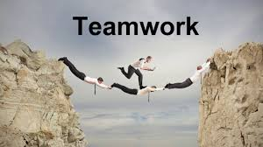
Overall Lesson
Patience
Teamwork
Time Management

