Slide 1
NAME
A freelancing platform helps people ask simple questions and get instant answers

Slide 2



Problems
Can you help me translate a simple paragraph?
I need five days, there are people lining up, I charge $XX per hour…
Problem 1
Long turnover of each transaction
Take days to complete simple tasks
Requesters only want simple answers NOW
Problem 2
Too many experts, too many options
Cause confusion and lose customers

Slide 3
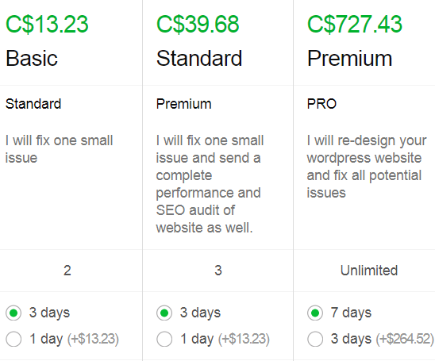




Problems
Problem 3
Pricing system is complicated
Hard to define
Hard to value each work
Work does not worth that price
Problem 4
Rating system is not helpful
All 5 stars for hundreds of freelancers

Slide 4
Solutions - Ian
Instant communication tools, showing online freelancers who can answer questions immediately
Our background and evaluation system will filter and choose registered freelancers who are qualified and capable of answering questions in different fields. They do not have to be experts, but they are knowledgeable and are able to answer simple questions in their fields
Price per question is low, it gives requesters to ask simple questions and test if they are satisfied with the answers of the freelancers, so they can decide if they will continue asking further questions
No 5 star rating rule, only question/project is passed or rejected

Slide 5
Solutions - Ian
Two pictures
We only cover four service areas for now
Translation & language polishing
Business tips, entrepreneurship tips
Fun and lifestyle
Consulting (how to do sth?)

Slide 6






Competitors
Short time, simple task
XXX
High cost
Low cost
Longer time, big project

Slide 7
Market Size - User (Freelancers)
53 M
>50%
There are 53 million freelancers in North America today
Over 50% of the workforce in North America will be freelancers by 2020

Slide 8
Market Size - Customer (Requesters)
6 Questions
2 Billion
12 Billion
On average, people have six questions per day cannot be answered or found easily
Active smartphone users globally in 2017
Total estimated questions of a year

Slide 9
Revenue Model
Freelancers charge from 25 cents per question
We only charge 10% of the revenue paying to the freelancers
Market average is 15% - 25% per transaction

Slide 10
Future Strategy & Vision - Ian
Database of questions
Using Ai to answer questions atomically

