Slide 1
InstAnswer
A freelancing platform that helps you get answers instantly

Slide 2



Problems
Can you help me translate a simple paragraph?
I need five days, there are people lining up, I charge $XX per hour…
Problem 1
Long turnover of each transaction
Take days to complete simple tasks
Requesters only want simple answers NOW
Problem 2
Too many experts, too many options
Cause confusion and lose customers

Slide 3
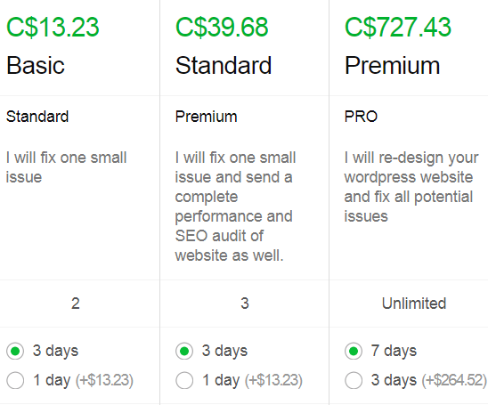




Problems
Problem 3
Pricing system is complicated
Hard to define
Hard to value each work
Work may not worth that price
Problem 4
Rating system is not helpful
All 5 stars for hundreds of freelancers

Slide 4

Solution
Only find you talents online to answer your question right now
Skip your research, we connect you to limited but only qualified talents

Slide 5
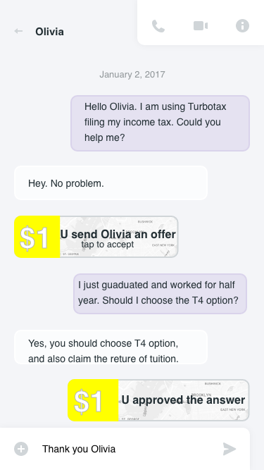
Solution
Instant messenger
Simple 1 dollar price
Approve or Decline

Slide 6
Market Size - User (Freelancers)
53 M
>50%
There are 53 million freelancers in North America today
Over 50% of the workforce in North America will be freelancers by 2020

Slide 7
Market Size - Customer (Requesters)
6 Questions
2 Billion
12 Billion
On average, people have six questions per day cannot be answered or found easily
Active smartphone users globally in 2017
Total estimated questions of a year

Slide 8







Competitors
Short time, simple task
High cost
Low cost
Longer time, big project

Slide 9
Revenue Model
Freelancers charge from $1 per question
We charge 10% of the revenue paying to the freelancers
Market average is 15% - 25% per transaction

Slide 10
Vision and Future Strategy
InstAnswer connects you to someone have your answer
InstAnswer aims to be the Nerve to connect every Neurons in the world
Build the big database, using AI to fuelling personal productivity

Slide 11
InstAnswer
A freelancing platform that helps you get answers instantly

