Slide 1
InstAnswer
A freelancing platform that helps you get answers instantly

Slide 2



Problems
Can you help me translate a simple paragraph?
I need five days, there are people lining up, I charge $XX per hour…
Problem 1
Long turnover of each transaction
Take days to complete simple tasks
Requesters only want simple answers NOW
Problem 2
Too many experts, too many options
Cause confusion and lose customers

Slide 3
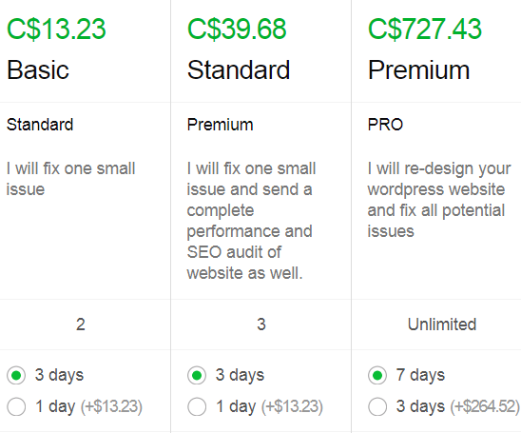




Problems
Problem 3
Pricing system is complicated
Hard to define
Hard to value each work
Work may not worth that price
Problem 4
Rating system is not helpful
All 5 stars for hundreds of freelancers

Slide 4

Solution
Four big topics
Can be answered instantly
Explore your potentials
Monetize your wisdoms

Slide 5

Solution
Only find online talents to answer your question right now
Skip your research, we help connect you with limited but only qualified talents

Slide 6
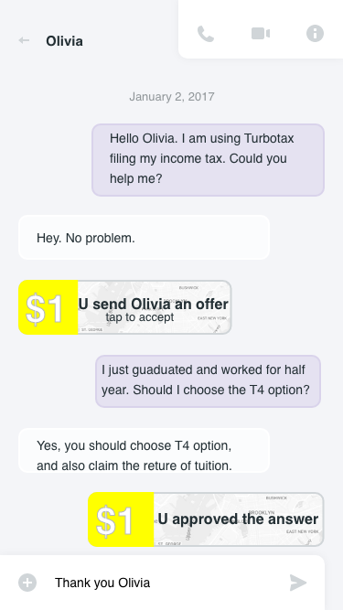
Solution
Instant messenger
Simple 1 dollar price
Approve or Decline

Slide 7
Market Size - User (Freelancers)
53 M
>50%
There are 53 million freelancers in North America today
Over 50% of the workforce in North America will be freelancers by 2020

Slide 8
Market Size - Customer (Requesters)
6 Questions
2 Billion
12 Billion
On average, people have six questions per day cannot be answered or found easily
Active smartphone users globally in 2017
Total estimated questions of a year

Slide 9







Competitive Analysis
Short time, simple task
High cost
Low cost
Longer time, big project

Slide 10
Revenue Model
Freelancers charge $1 per question
We charge 10% of the revenue paying to the freelancers
Market average is 15% - 25% per transaction

Slide 11
Vision and Future Strategy
We help the world not only to share knowledge, but also the wisdom
Our vision of this platform is to build a gateway for different brains to connect together
Build the big database, using AI to fuel personal productivity

Slide 12
InstAnswer
A freelancing platform that helps you get answers instantly

