Slide 1
CROSTutor
Connecting Students & Tutors

Slide 2
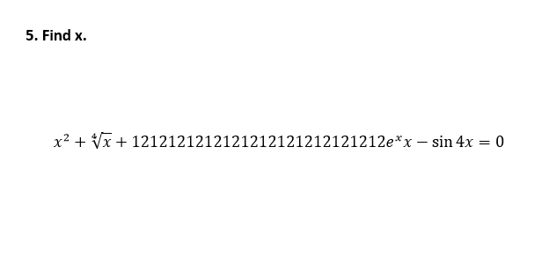

Slide 3


Slide 4


Slide 5
Video Tutoring
https://crosservicetest.firebaseapp.com/

Slide 6
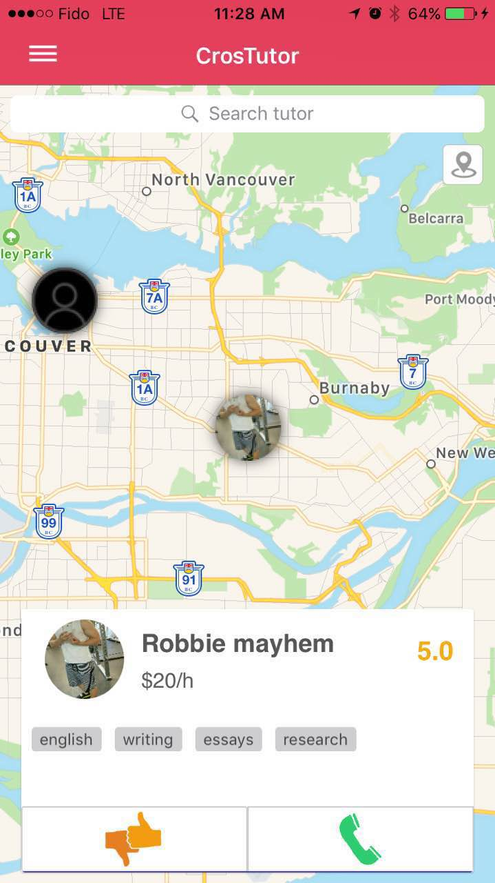
What are we solving?
Information is scrambled
Customizable search
Map/List view
Extensive profiles
Comparison issues - “leap of faith”
Unpredictable turnaround time

Slide 7
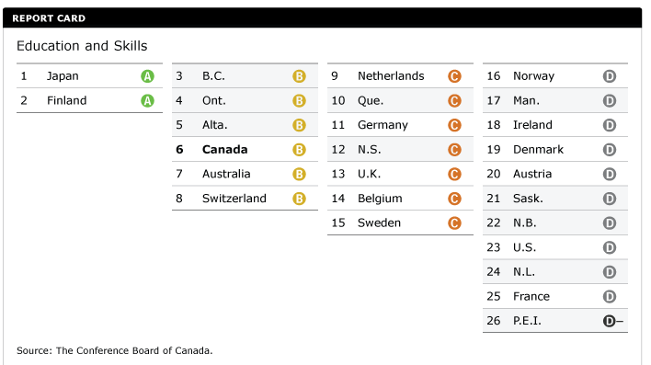
Tutoring Market
In 2015, B.C. hosted over 130,000 international students.
Personal tutor rates steadily increasing, as high as $40-50/hour.
Tutoring companies seeing 9% increase in demand every year.
BC Continues to rank high in education internationally.
Notes:
1）On December 31st 2015, 356,574 international students were present in Canada –an increase of 191% compared with December 31st 2000.The top three source countries* were China (120,339 or 33.7%), India (48,914 or 13.7%) and France (20,218 or 5.7%) and together accounted for 53.1% of the total of the international students.
http://canadaimmigrants.com/canada-international-students-by-country-2015/
http://vancouversun.com/opinion/opinion-the-problem-with-international-students
2）http://globalnews.ca/news/920126/private-tutoring-is-thriving-in-canada-but-is-it-necessary/
3） https://www.tutorhero.me/blog/post/22/The-Average-Tutoring-Cost-in-Canada-2015

Slide 8
Product
Existing Features:
Chat, map view, list view, general search, profile customization, rating/feedback system
In Development:
Video tutoring, payment system
Future Plans:
Online classrooms, expand to other cities

Slide 9

Feasibility
Achievable?
Technology?
Profitability?
Low User-Base (Under 5000)
Small Agencies Ad Fees
Local Business Ad Fees
5%-10% Commission Pull
Goal User-Base (Above 20000)
Large Agencies Ad Fees
National Business Ad Fees
5%-10% Commission Pull

Slide 10
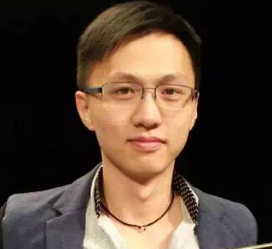
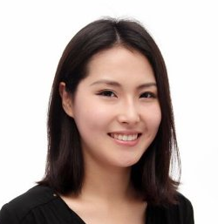


Meet Our Team
daj
Robbie Luo
Co-founder
Marketing
UX
Web
Leona Qin
Co-founder
App Development
UX
UI
Sergior Silva Jr
Android Developer
Felipe Mota
iOS Developer

Slide 11
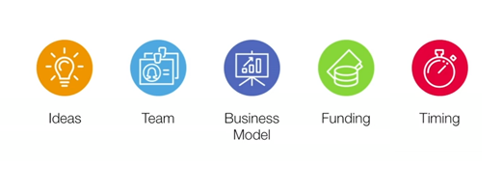
Why Us
The Team
The Timing
The Funding

Slide 12
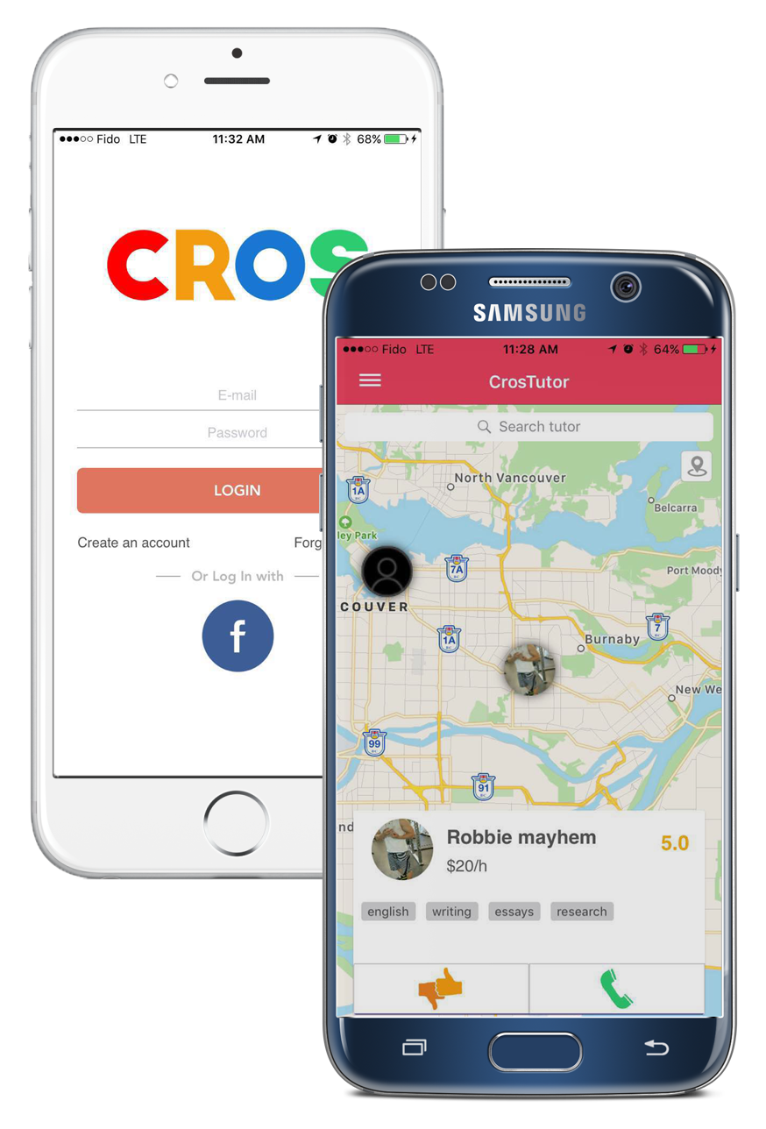
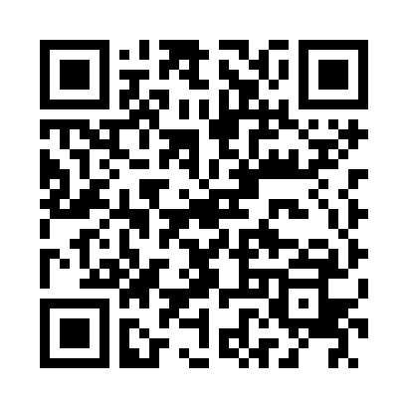

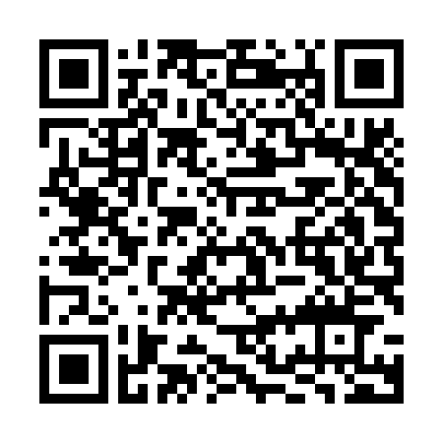

Please Support Us by Downloading CrosTutor App

