Slide 1
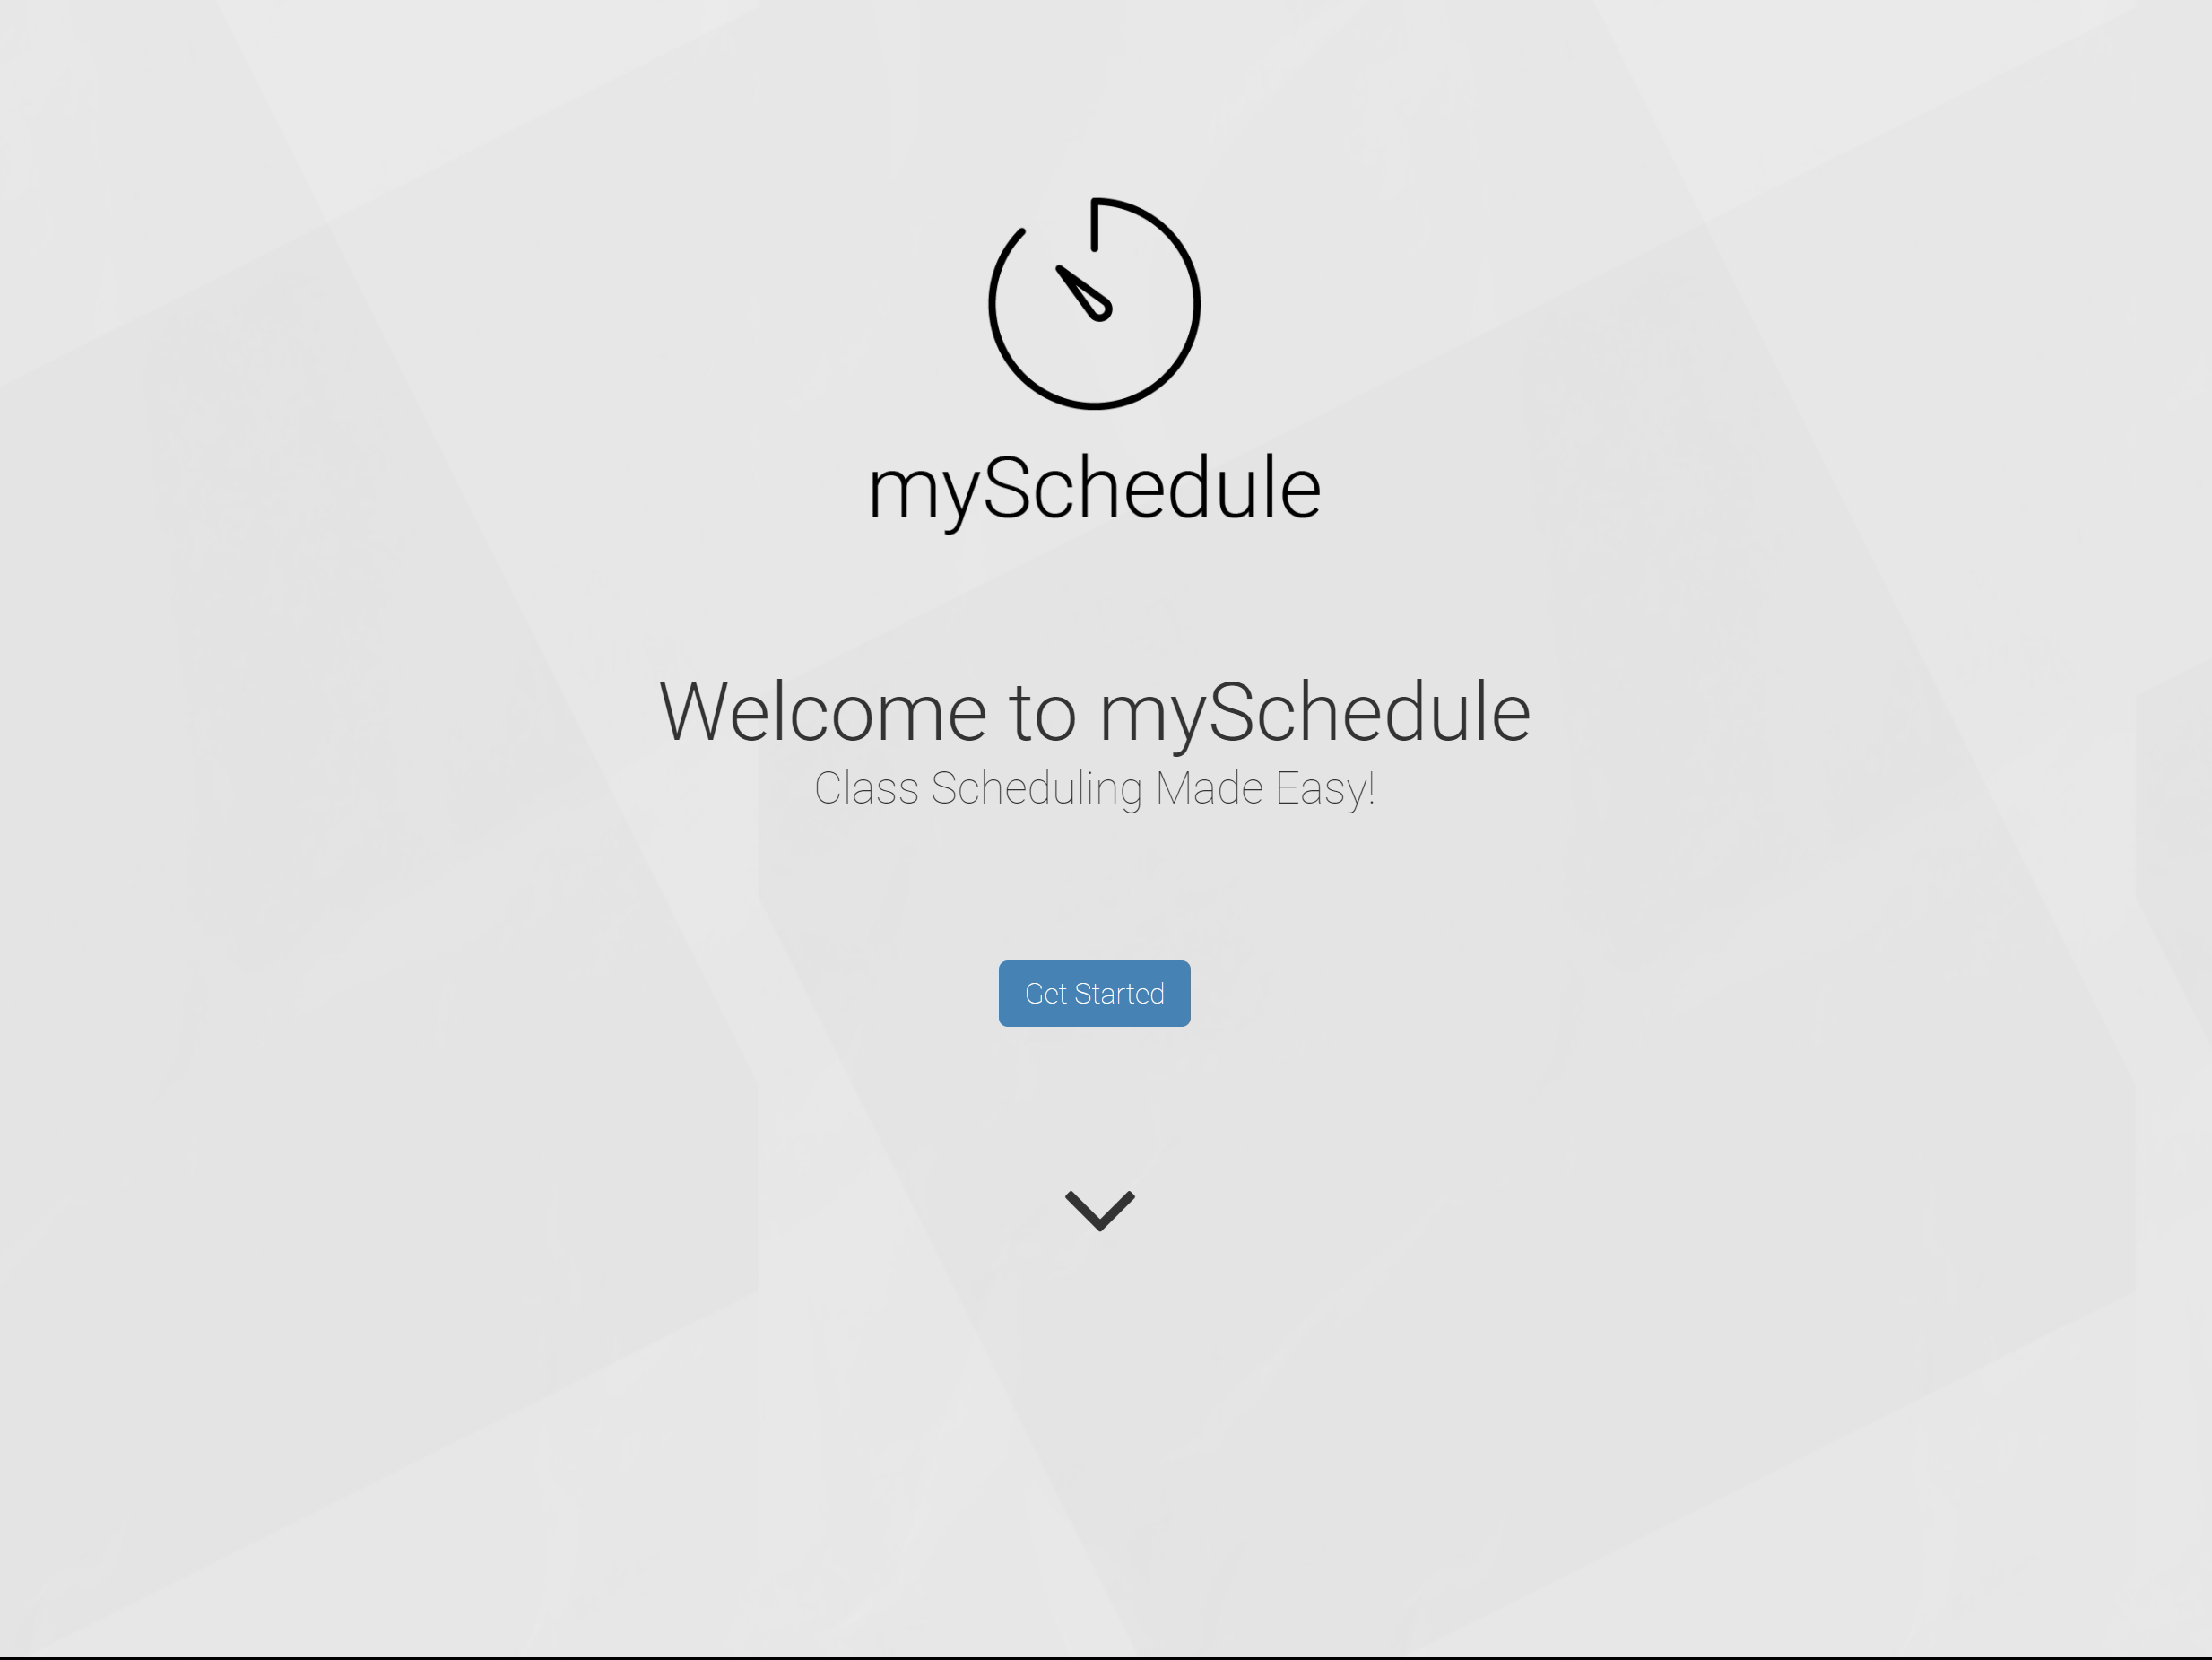
teamB

Slide 2
Why a scheduler?

Slide 3
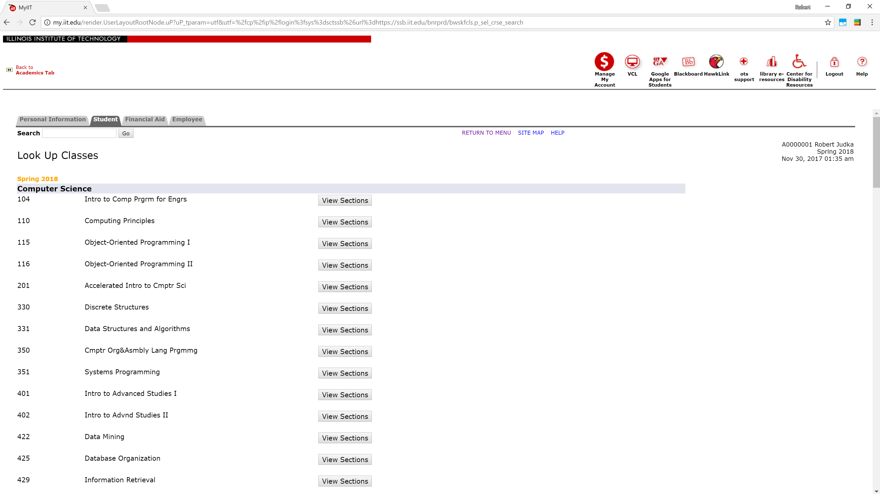

Slide 4
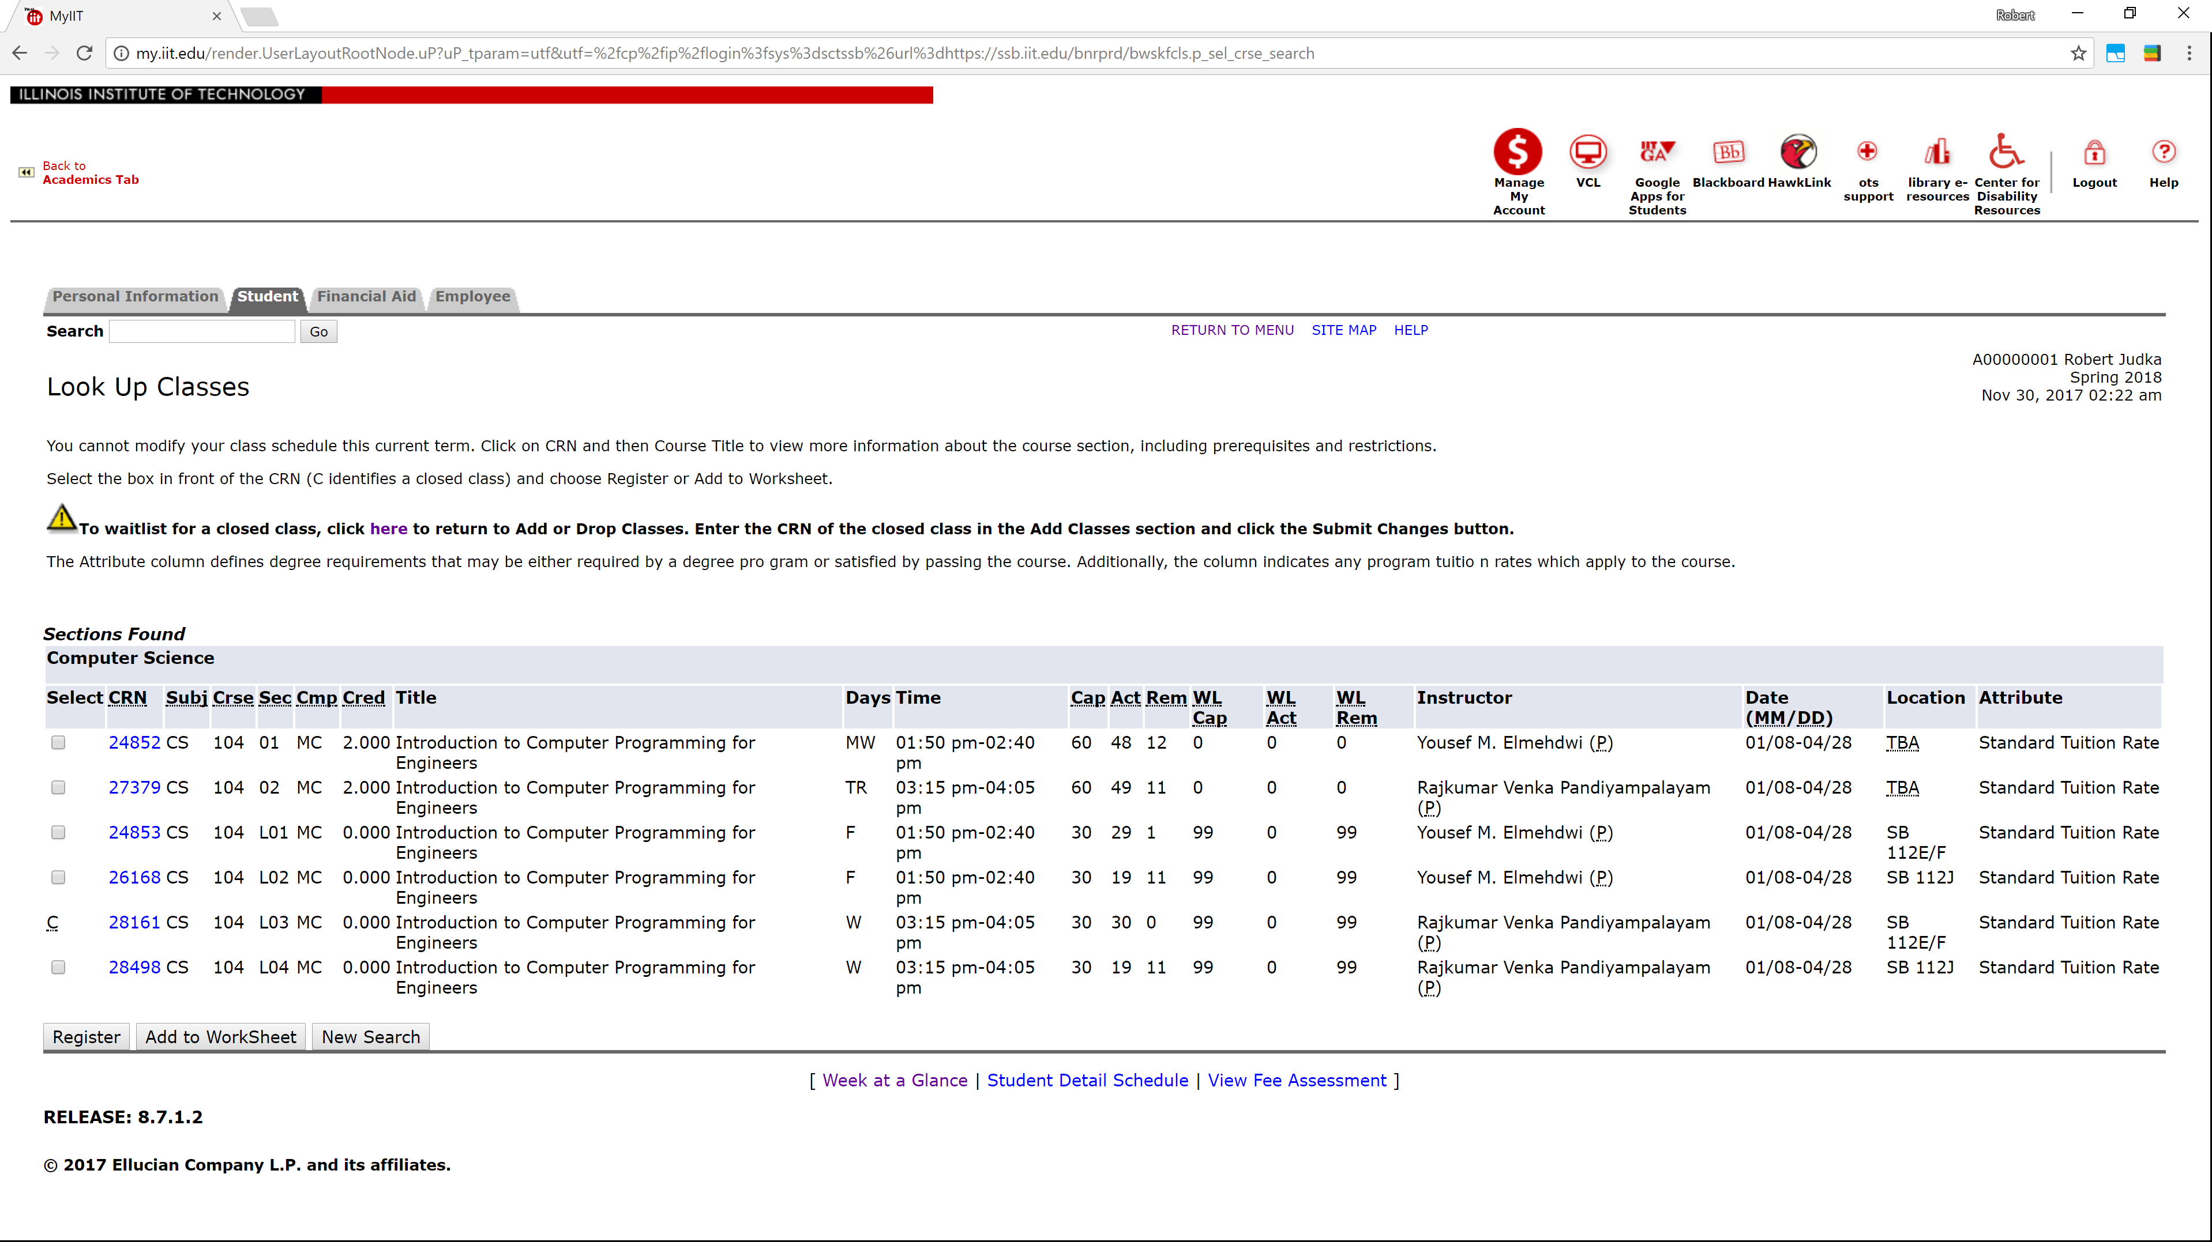

Slide 5
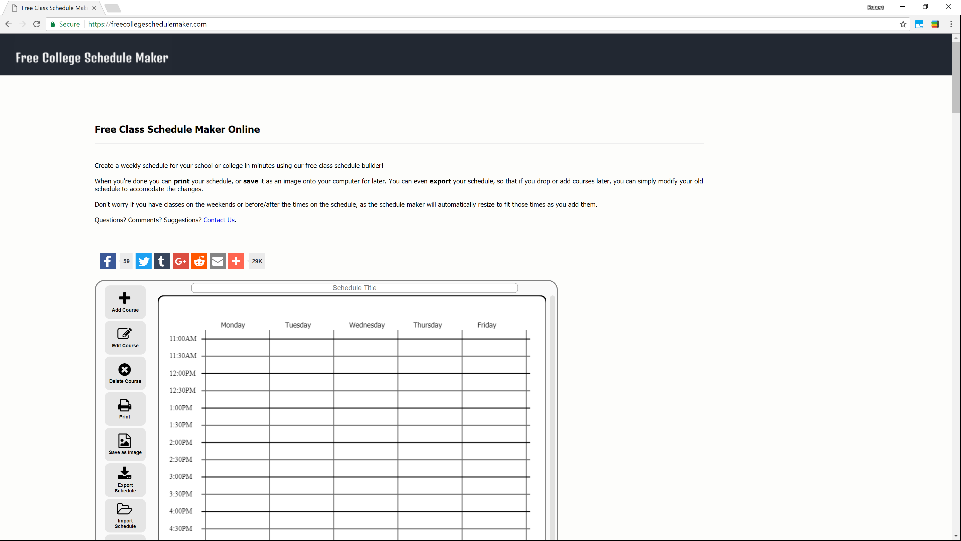

Slide 6
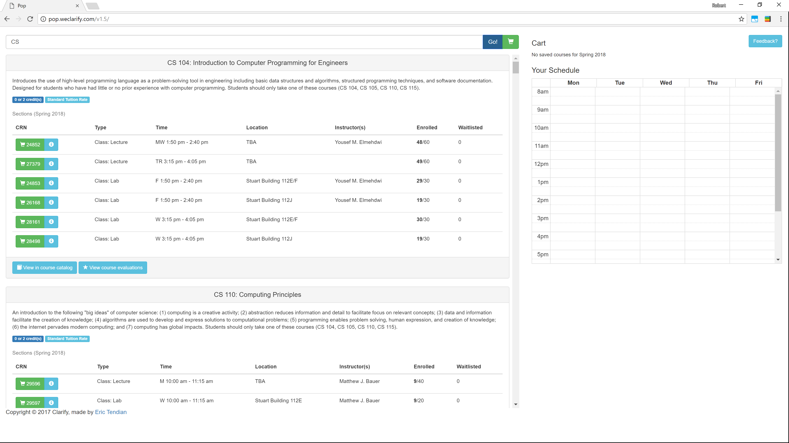

Slide 7
What’s missing?

Slide 8
The 3 A’s
Adaptability
Automation
Appeal

Slide 9
How we achieved it?

Slide 10
Adaptability
YOU choose what your schedule looks like!
Easy classes?
Popular classes?
Morning classes?

Slide 11
Automation
Everything happens on one page!
No more comparing class times
No more checking for time conflicts
No more going on RateMyProfessor.com

Slide 12
Appeal
Quick and simple to use!
No more typing
No more back buttons
No more ugly interfaces

Slide 13
How we built it?

Slide 14


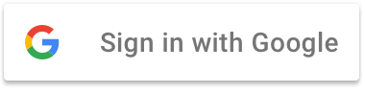

Slide 15
How it works?

Slide 16







Slide 17
Does it works?

