Slide 1
Kmeans
The Data Bootcamp

Slide 2
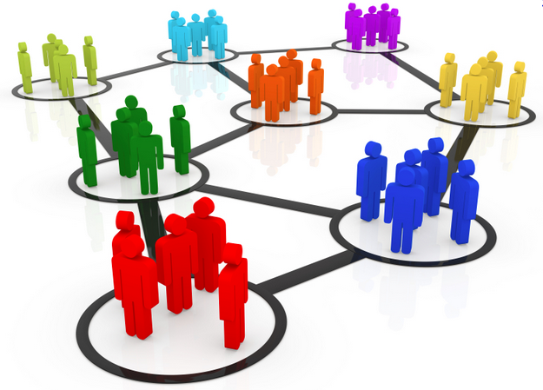
Unsupervised Learning
Unsupervised machine learning algorithms draw inferences directly from the data without any previously labeled outputs (i.e. no y labels).
One common type of unsupervised learning is cluster analysis. That is, the algorithms attempts to group that data into clusters based on relationships and features in the data.

Slide 3
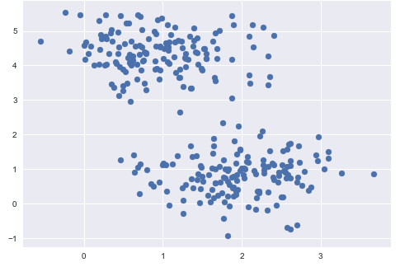
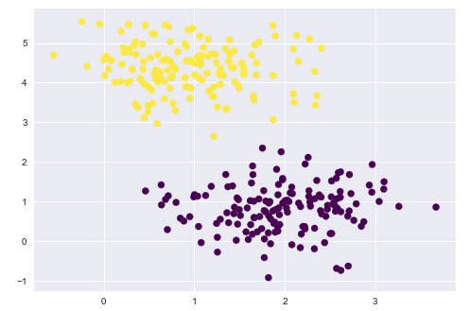
Clustering
While clustering may be intuitive to humans in this case, clustering algorithms have to decide which data points belong together.
Unclustered Data
Clustered Data

Slide 4
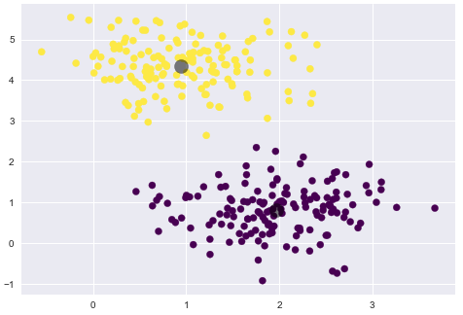
K Means
K means clustering will group the data into `k` groups.
The cluster center is the mean of all the points belonging to that cluster. Therefore each point is closer to it’s own cluster’s center than it is to other cluster centers.
Cluster
Centers

Slide 5
KMeans
K means clustering will group the data into `k` amount of groups.
A small k will create larger clusters.
K = 2

Slide 6
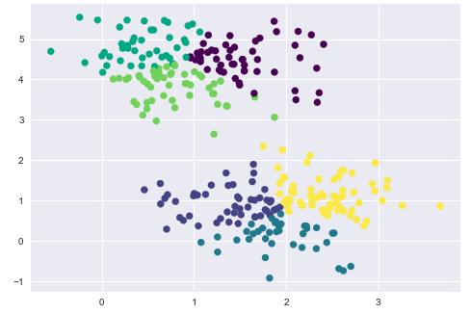
KMeans
A large k will create smaller clusters.
K = 6

Slide 7
Predictions using a trained KMeans model
What group would this new data point belong to?
Hi guys! Where do you want me?

Slide 8
Predictions using a trained KMeans model
Yellow Cluster Center
What group would this new data point belong to?
Hi guys! Where do you want me?
Purple Cluster Center

Slide 9
Predictions using a trained KMeans model
I had better use python to figure out which cluster center is the closest
np.sqrt(sum((x - y) ** 2))
Hmm, I could also figure this out using kmeans.predict(new_data)
Yellow Cluster Center
Purple Cluster Center

Slide 10
Predictions using a trained KMeans model
Purple is closer!

Slide 11
Questions / Discussion
Notes:
It’s important to keep in mind why you joined this class. Let’s talk about your goals.

