Slide 1


META ADVERTISING · NOVEMBER-DECEMBER 2026
Leads to jobs
Results review and action plan for HVAC, plumbing and electrical services in 21 South Miami-Dade ZIP codes.
Prepared for Sunny Bliss Plumbing & Air · October 30, 2026
Notes:
Purpose of the meeting: review what September and October produced in Meta and GoHighLevel, agree on the budget, and confirm the commitments needed to launch on November 4.

Slide 2
META ADVERTISING PLAN
Contents
01
02
03
04
Where we stand
What we learned
The plan
What we need
Meta and GoHighLevel results, September-October
Ads, audience, season and industry evidence
Offer, promotions, lead journey, budget and timeline
Decisions and commitments to launch on November 4
Sunny Bliss Plumbing & Air · Meta advertising plan

Slide 3
01 · WHERE WE STAND
Four findings
49 → 28
Meta reported 49 customer leads; 28 reached GoHighLevel. Instant-form leads stopped arriving after October 1.
11
Homeowners tagged qualified, with 6 estimates booked. Five of the eleven were Spanish speakers.
0
Quotes or sales recorded. Six qualified leads remain at "New Lead (Contact ASAP)".
$74.92
Cost per customer lead. Recruiting ads on the same page attracted 254 job applicants.
Conclusion: Meta has reached interested homeowners. Leads are lost in delivery, attribution and follow-up, and each of these can be corrected before November 4.
Sources: Meta Marketing API (Sept 21 to Oct 29) and GoHighLevel (Sept 24 to Oct 30, 2026)
Notes:
Qualified and unqualified are the tags Sunny Bliss's team applies in GoHighLevel. Cost per lead covers customer campaigns only, Sept 30 to Oct 29. All campaigns were paused on October 30 at the owner's request.

Slide 4
01 · WHERE WE STAND
Lost leads
Instant form
Form connection stopped after October 1
Meta
28
Fix: reconnect to GoHighLevel and confirm with Meta's lead-testing tool before launch.
GHL
9
None received after October 1, and none with a phone number.
Contacts arrived without phone or source
Fix: map every form question to its GoHighLevel field.
Landing page
Meta
21
GHL
19
0 of 28 contacts show which ad produced them
Delivery works; this is where the qualified leads came from.
Fix: pass campaign, ad set and ad names into the fields GoHighLevel already has.
Meta: customer leads, Sept 21 to Oct 29. GoHighLevel: contacts created Sept 24 to Oct 30, 2026
Notes:
Meta counts a lead when the form is submitted; GoHighLevel only receives it if the integration is active. Twenty-one leads reported by Meta have no matching contact in GoHighLevel, almost all from instant forms.

Slide 5
01 · WHERE WE STAND
Stalled follow-up
Landing-page leads in GoHighLevel
ACTION THIS WEEK
Call the 6 qualified leads still at "New Lead (Contact ASAP)". The oldest arrived on October 3.
Contacts received
19
Tagged qualified
11
Every call and visit should move the lead to its next stage, so each dollar can be traced to a booked or sold job.
Estimate booked
6
Quote delivered
0
Since October 15, all 6 new landing-page leads were tagged unqualified; the form questions will be reviewed.
Sold
0
Source: GoHighLevel, Sunny Bliss Lead Pipeline, as of October 30, 2026
Notes:
Five of the eleven qualified leads were Spanish speakers, which supports running every message in English and Spanish. One estimate was booked by a lead tagged unqualified. Recording quotes and sales in the pipeline is what allows the campaign to be judged on revenue.

Slide 6
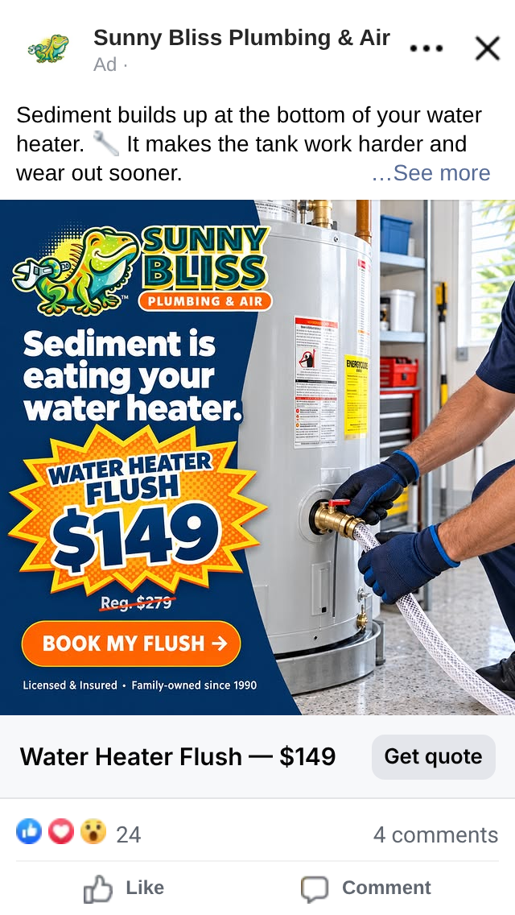
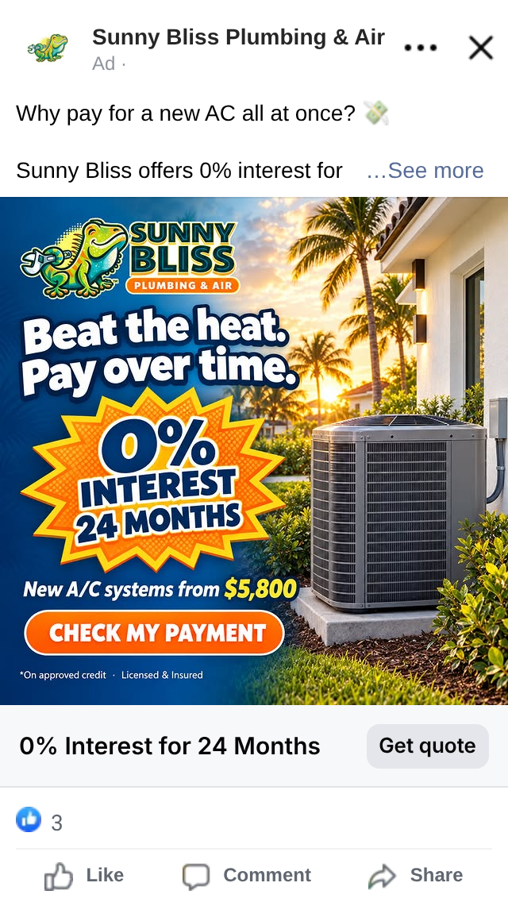
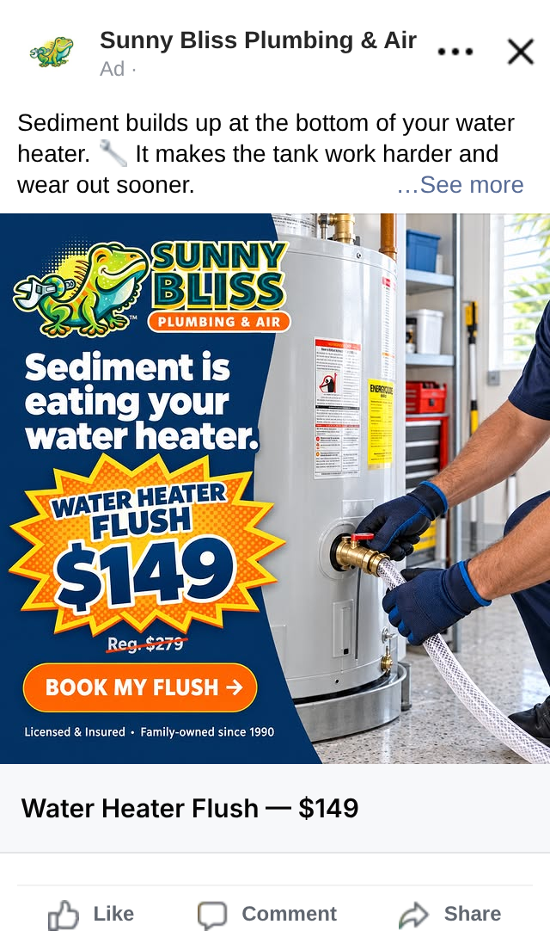
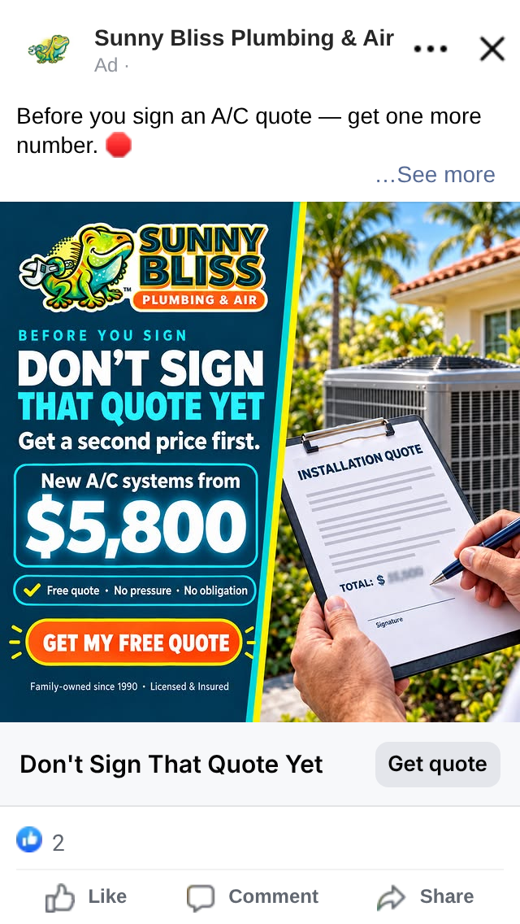
02 · WHAT WE LEARNED
Destination matters
The Water Heater Flush ad produced 14 leads with an instant form and none with the landing page.
Strong
Strong
Weak
Weak
Water Heater Flush $149
0% Interest, 24 Months
Water Heater Flush $149
Don't Sign That Quote Yet
Instant form · 14 leads · $47.40 each
Landing page · 10 leads · $64.25 each
Landing page · $85.62 · 0 leads
Landing page · $137.85 · 0 leads
Meta Marketing API, Sept 30 to Oct 29, 2026. What the strong ads share: one service, a visible price, one call to action
Notes:
The weak ads earned normal click-through rates, so people were interested. They reached a landing page that did not repeat the advertised price or financing and left. The landing pages will be rebuilt to match each ad.

Slide 7
02 · WHAT WE LEARNED
Audience and areas
Cost per lead by age
Best-fit service by area
65+
$55.39
Area | Lead service
Coral Gables | HVAC replacement, panels
Pinecrest, Palmetto Bay, South Miami | Maintenance plans, generators
Key Biscayne | Premium maintenance
Miami Beach | Plumbing, water heaters
Miami Shores area | Electrical upgrades, drains
Cutler Bay | AC repair and financing (Spanish)
Kendall | AC and water heaters (Spanish)
55-64
$66.22
45-54
$133.99
35-44
$183.40
Established homeowners over 55 respond at the lowest cost. Five of the eleven qualified leads were Spanish speakers.
Meta Marketing API, customer campaigns, Sept 30 to Oct 29, 2026; GoHighLevel tags; U.S. Census income data
Notes:
Coral Gables median household income is $130,803 and Key Biscayne's is $181,505 (U.S. Census QuickFacts). The 21 targetable ZIP codes, Kendall included, reach 466,000-548,000 people aged 30 and over on Facebook and Instagram.

Slide 8
02 · WHAT WE LEARNED
Season and electrical
Strong El Niño, December-February
Electrical is not yet visible
The Facebook page is categorized as Plumbing Service, and sunnybliss.com lists plumbing, air conditioning, drains and water filtration. Before electrical ads run:
Plumbing
Wetter than normal, with January the peak: leaks, drain and sewer backups.
Electrical page in English and Spanish, with license number and entry offer
Facebook page services and category updated
Three creatives in the Sunny Bliss brand
HVAC
Humidity control, heat checks before cold fronts, financed replacements.
Electrical
Storm lines in February and March: surge protection and generators.
If not ready on November 4, electrical joins on December 1.
NOAA Climate Prediction Center ENSO discussion (Oct 8, 2026) and U.S. Winter Outlook (Oct 15, 2026)
Notes:
Over 83% probability of a strong to very strong El Niño through January-March 2027. Hurricane season closes November 30. NOAA updates its outlook in mid-November; the message calendar will follow it.

Slide 9
02 · WHAT WE LEARNED
Proven practices
Call within five minutes
One service, one price
Qualify in the form
Qualification odds are about 21 times higher than at 30 minutes.
Priced, single-service offers outperformed generic free estimates.
Ask about home ownership, service needed and urgency.
Return results to Meta
Match page to ad
Lead with proof
Send booked and sold stages from GoHighLevel so Meta learns who buys.
The same offer, price and language from the ad to the page.
4.9 rating, 1,000+ reviews, family-owned since 1990.
Meta builds top of mind and a promotion turns it into leads; Google Search captures emergencies. Proposed for January: a Google Local Services Ads test of $1,000-1,500 per month for emergency plumbing and AC repair.
Oldroyd, InsideSales.com (2007); Harvard Business Review (2011); Meta Conversions API for CRM; contractor-marketing publications (2026)
Notes:
Harvard Business Review found firms that answered within an hour were about seven times more likely to qualify a lead. Meta recommends about 200 leads per month before optimizing on CRM stages. Angi and Thumbtack are not recommended because the same lead is sold to several contractors.

Slide 10
03 · THE PLAN
Bliss Care Plan
One membership for prevention and replacement, for homeowners who are planning ahead.
Included every year
[$__] per month
When it is time to replace
Two AC tune-ups
Water heater flush
Drain and plumbing inspection
Electrical safety check: panel and surge
Priority same-day service, no overtime charges
Member pricing on repairs [__% off]
System-age report at every visit for AC, water heater and panel
[$___] member credit toward a new system
0% financing for 24 months, on approved credit
Same price promise in English and Spanish
Meta: homeowners who have not decided yet. They receive the Bliss Care Plan.
Google: emergencies. They receive same-day service, and the plan after the repair.
Proposed offer for owner approval; bracketed values are set by Sunny Bliss
Notes:
The plan builds on the maintenance plans already listed on sunnybliss.com and the existing promises of same-day service with no overtime charges. It gives Meta a reason to contact undecided homeowners now and turns every maintenance visit into an early replacement conversation.

Slide 11
03 · THE PLAN
Three promotions
INSPECTION
MAINTENANCE
REPLACEMENT
$49 Home Check
Founding Member
Replace and Save
AC, water heater and electrical panel inspected in one visit. The $49 is credited toward any repair or the Bliss Care Plan.
Bliss Care Plan with the first month free and the price locked for 12 months, for the first [100] homeowners.
[$500] off a new AC, water heater or panel, 0% for 24 months, and one year of the Bliss Care Plan included.
A paid visit filters out browsers.
Limited spots create urgency.
Valid through December 31.
Meta: builds top of mind. A promotion is what turns that attention into qualified leads.
Google Search: captures emergencies. People searching for a same-day repair need no promotion.
Proposed promotions for owner approval; bracketed values are set by Sunny Bliss
Notes:
Each promotion maps to one lead-ad angle: inspection, maintenance and replacement. The $49 Home Check builds on the $49 service call already offered on sunnybliss.com. Promotions run in English and Spanish and end December 31.

Slide 12
03 · THE PLAN
Lead journey
Six steps from first impression to a sold job. Each one has an owner and a number to watch.
1 · See
2 · Return
3 · Respond
4 · Contact
5 · Visit
6 · Close
Awareness ads: top-rated team, 4.9 stars, real reviews.
Visits the website or watches the video; sees the Bliss Care Plan again.
Takes a promotion and answers three qualifying questions.
Bilingual call within five minutes, plus a text confirmation.
Home Check or estimate, with a system-age report.
Quote, sale or plan sign-up, then a review request.
Watch: Reach
Watch: Visitors
Watch: Cost per lead
Watch: Minutes to call
Watch: Cost per visit
Watch: Revenue
A good lead: a homeowner in the 21 ZIP codes, with a real need and timing, reachable by phone, called within five minutes, with a visit booked.
Where it broke before: step 3, form leads never reached GoHighLevel, and step 4, qualified leads waited without a call.
Steps 1-3: Meta and the agency · Steps 4-6: Sunny Bliss team in GoHighLevel
Notes:
Each step is a pipeline stage in GoHighLevel, so the weekly report shows how many leads move from one step to the next and where they stop. Meta's job ends at step 3; the value of every lead is decided in steps 4 to 6.

Slide 13
03 · THE PLAN
Campaign structure
FIRST · NOV 2-4 Reconnect forms to GoHighLevel, record the source ad, call the 6 waiting leads, move recruiting to its own page.
AWARENESS · 20%
LEADS · 60%
LEADS · 20%
Top of mind
New homeowners
Website visitors
$10 to $20 per day
$30 to $60 per day
$10 to $20 per day
South Miami's top-rated team, proven by 4.9 stars and real customer reviews.
Maintenance, inspection and replacement ads; instant form against landing page, split evenly.
People who visited sunnybliss.com or watched the brand video in the last 180 days.
Shared: HVAC, plumbing and electrical ads in English and Spanish · residents of 21 ZIP codes, age 30 and over · feeds, Stories and Reels, without Audience Network · every lead measured in GoHighLevel.
Awareness fills the website-visitor audience; if that audience is too small, the difference moves to new homeowners
Notes:
The awareness campaign optimizes for reach and video views and is measured by reach, frequency and growth of the visitor audience, not by leads. The sunnybliss.com pixel already records about 2,600 page views per month, which seeds the visitor audience from day one.

Slide 14
03 · THE PLAN
Incremental budget
Start small, prove results in GoHighLevel, then grow to a $3,000 monthly maximum.
STEP 1 · NOVEMBER
STEP 2 · DECEMBER
STEP 3 · JANUARY · MAXIMUM
$1,500
$2,250
$3,000
$50 per day · about 20 leads
$75 per day · about 30 leads
$100 per day · about 40 leads
Confirm leads reach GoHighLevel, calls happen within five minutes and estimates get booked.
Released when Step 1 books estimates at or below the target cost.
Equal to the August-October average. The budget does not go above this level.
At every step: 20% awareness, 60% new homeowners, 20% website visitors · increases of no more than 20% per week · leads estimated at about $60 each, between the home-services median ($42.95) and this account's history ($74.92).
Benchmark: WordStream/LocaliQ Facebook Ads Benchmarks 2026, home and home improvement
Notes:
Step 1 starts with the November 4 launch. If Step 1 targets are not met, the budget stays at $50 per day and the plan is corrected before any increase. One AC replacement from $5,800 covers nearly four months at the starting budget. Every change is made only with the owner's approval.

Slide 15
03 · THE PLAN
November-December timeline
November · Fix and test
December · Concentrate
Nov 2-4
Fixes, approvals and a test lead
Dec 1
Step 2: $75 per day; electrical joins
Nov 4
Launch at $50 per day
Dec 1-7
Holiday and rainy-season creative
Nov 4-10
Learning period, no edits
Dec 15
Six-week review; January plan
Nov 11, 18
Quality reviews in GoHighLevel
Dec 21-31
Holidays; emergency plumbing focus
Nov 23-29
Thanksgiving week; budget held
Dec 31
Report on booked estimates and sales
Repeats in January and February:
Week 1 · Review
Week 2 · New seasonal message
Week 3 · Hold
Week 4 · Owner report
January: Step 3, up to $3,000, with rainy-season plumbing. February: pre-summer AC and storm readiness
Notes:
Every change in the account is logged the same day with its reason. The 70/30 shift happens only if one destination is at least 30% cheaper per booked estimate with ten or more leads on each side.

Slide 16
04 · WHAT WE NEED
Launch requirements
Item | Owner | When
Approve the incremental budget ($1,500 to $3,000) and the qualified-lead definition | Sunny Bliss | Meeting
Commit to a bilingual first call within five minutes | Sunny Bliss | Meeting
Call the 6 waiting qualified leads; update the pipeline after every contact | Sunny Bliss | This week
Approve the Bliss Care Plan and the three promotions | Sunny Bliss | Nov 3
Share average ticket and close rate per service | Sunny Bliss | Nov 3
Move recruiting ads to a separate page and pixel | Sunny Bliss | Nov 4
Reconnect forms, record the source ad, rebuild landing pages, send a test lead | Agency | Nov 4
Success measure: cost per booked estimate in GoHighLevel. Proposed qualified lead: a homeowner in the 21 ZIP codes, reachable by phone, with a current need. Target cost: [$___].
Sunny Bliss Plumbing & Air · Meta advertising plan
Notes:
If an input arrives after November 3, launch moves by the same number of days. The campaign does not launch until a test lead reaches GoHighLevel with its source ad recorded.

