Slide 1
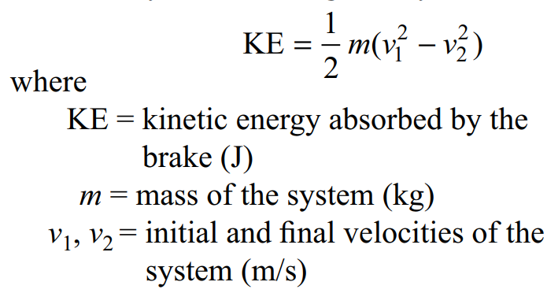
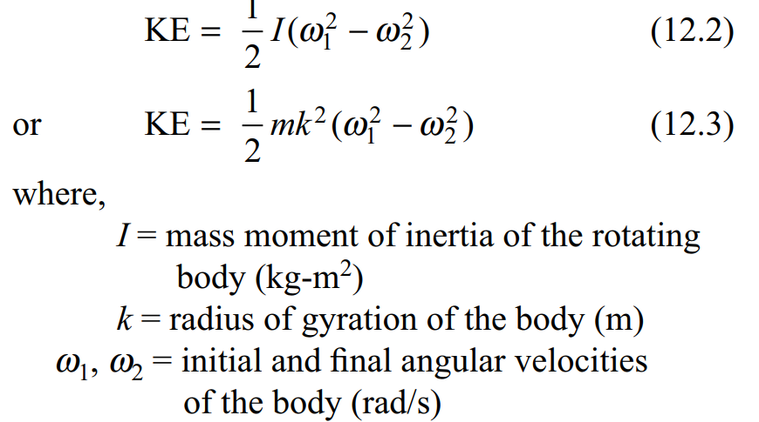

Slide 2
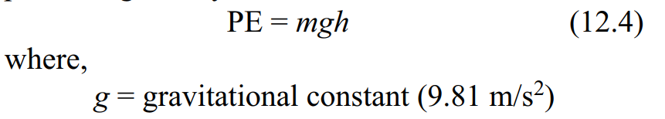
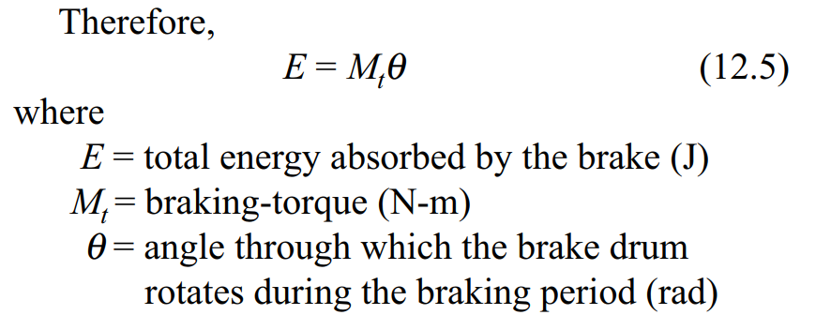

Slide 3
A solid cast iron disk ( density= 7200 kg/ m³), 1m in diameter and 0.2 m thick, is used as a flywheel. It is rotating at 350 rpm. It is brought to rest in 1.5 s by means of a brake. Calculate :
- the energy absorbed by the brake
- The torque capacity of the brake

Slide 4
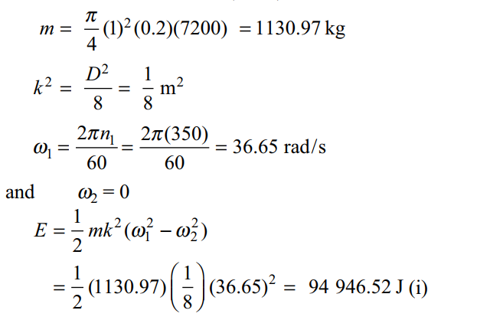
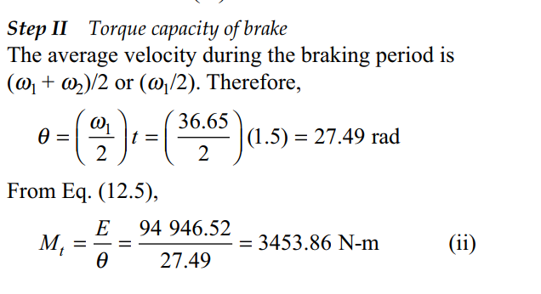
A solid cast iron disk ( density= 7200 kg/ m³), 1m in diameter and 0.2 m thick, is used as a flywheel. It is rotating at 350 rpm. It is brought to rest in 1.5 s by means of a brake. Calculate :
- the energy absorbed by the brake
- The torque capacity of the brake

Slide 5
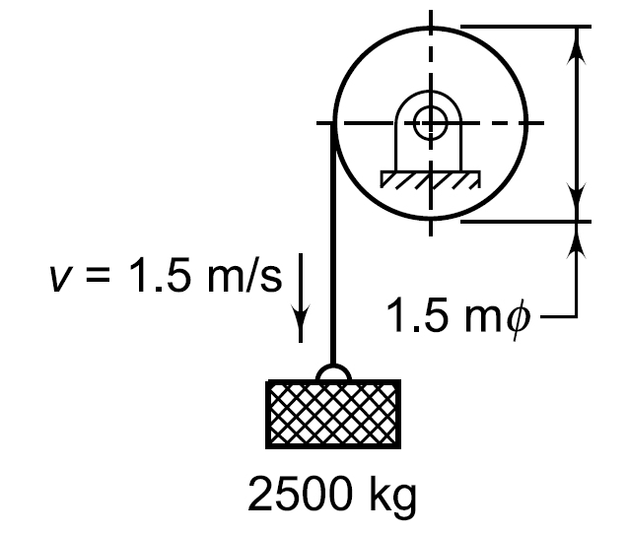
A mass of 2500 kg is lowered at a velocity of 1.5 m/s from the drum. The mass of the drum is 50 kg and its radius of gyration can be taken as 0.7 m. On applying the brake, the mass is brought to rest in a distance of 0.5m. Calculate:
- The energy absorbed by the brake
- The torque capacity of the brake

Slide 6
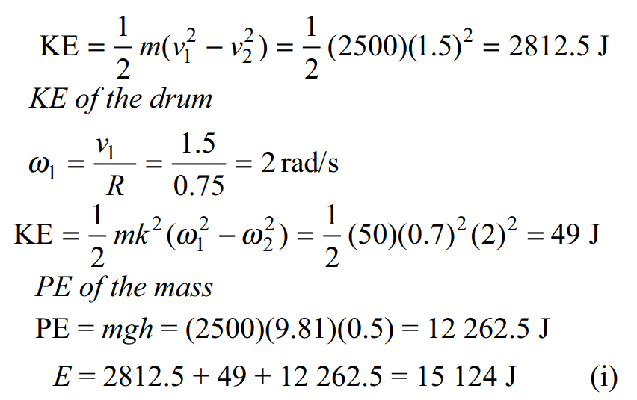
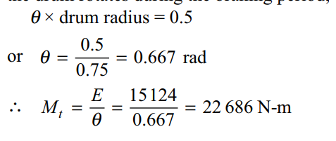

Slide 7
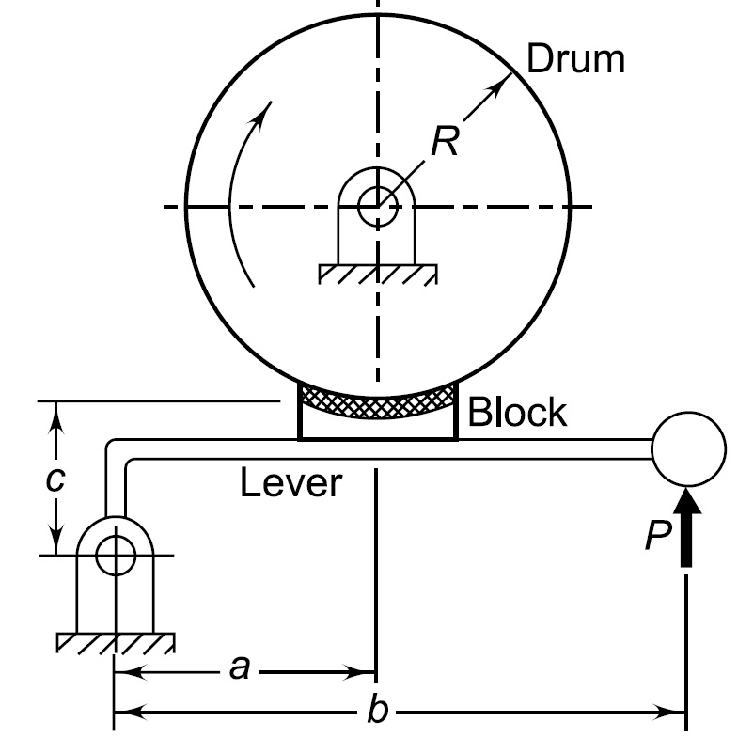

Slide 8
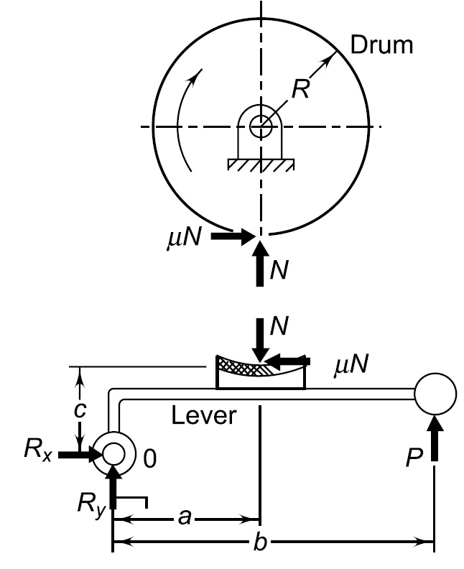

Slide 9
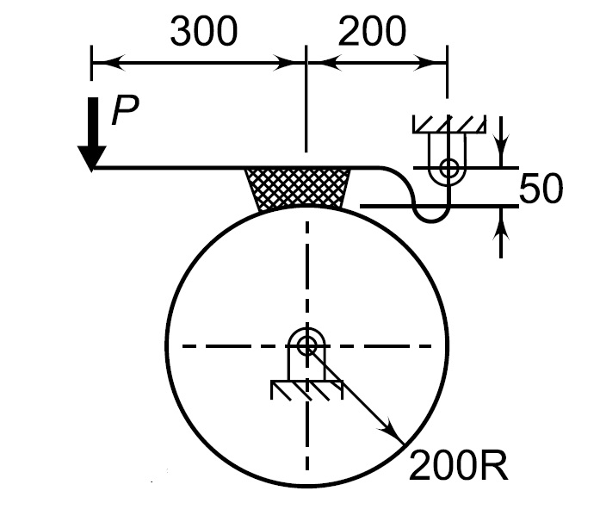
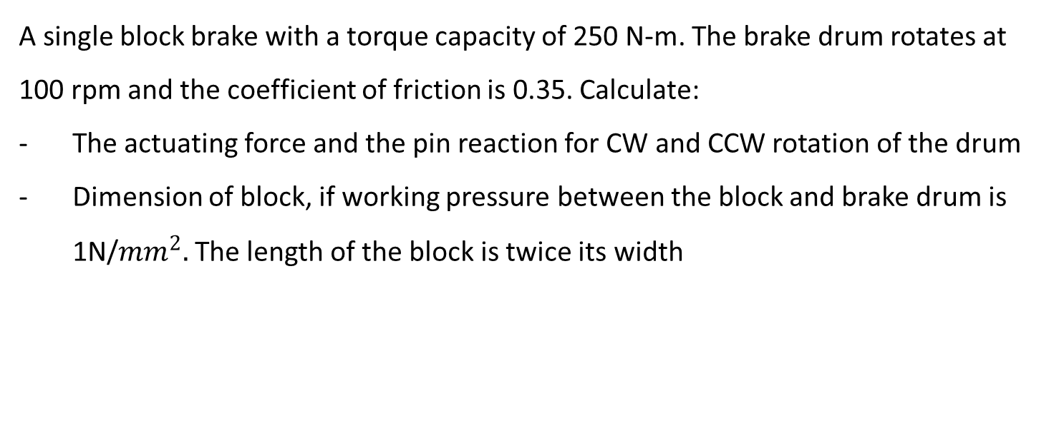
A single block brake with a torque capacity of 250 N-m. The brake drum rotates at 100 rpm and the coefficient of friction is 0.35. Calculate:
The actuating force and the pin reaction for CW and CCW rotation of the drum
Dimension of block, if working pressure between the block and brake drum is 1N/${mm}^{2}.$The length of the block is twice its width

Slide 10
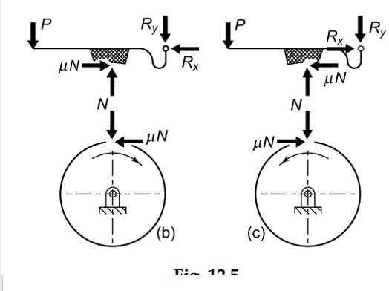
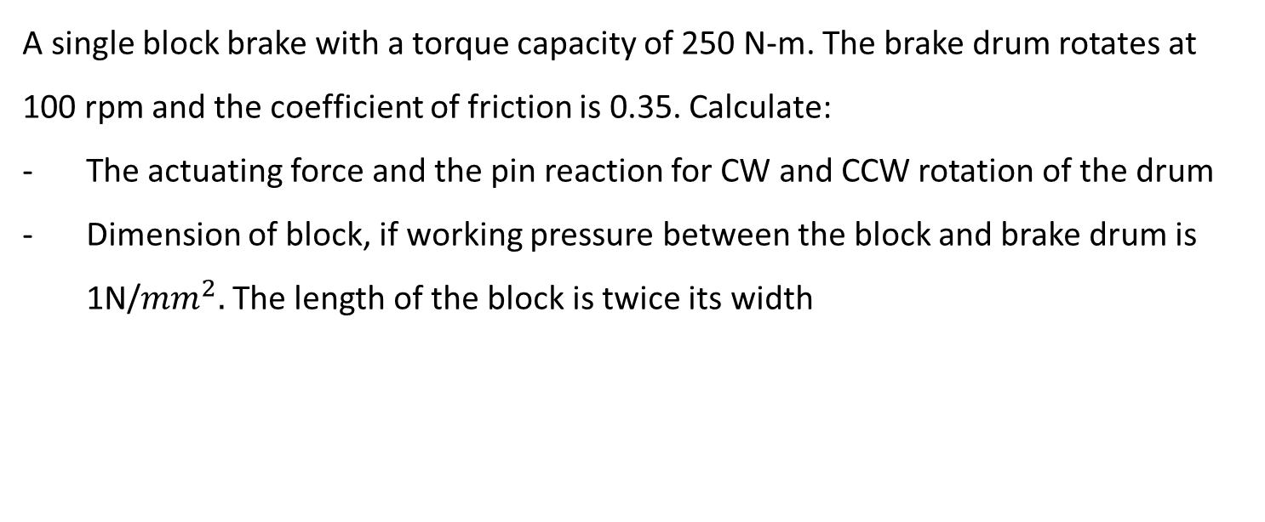
A single block brake with a torque capacity of 250 N-m. The brake drum rotates at 100 rpm and the coefficient of friction is 0.35. Calculate:
The actuating force and the pin reaction for CW and CCW rotation of the drum
Dimension of block, if working pressure between the block and brake drum is 1N/${mm}^{2}.$The length of the block is twice its width

Slide 11
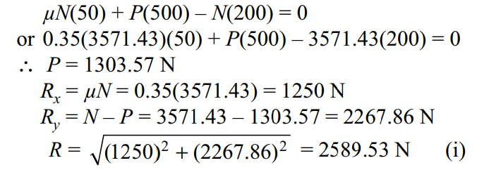
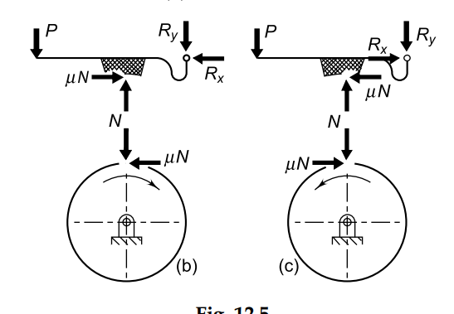
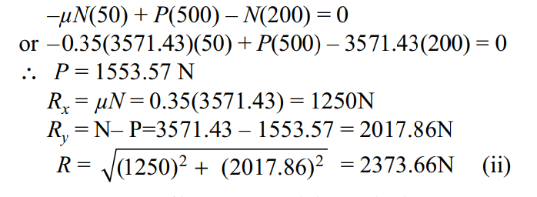
A single block brake with a torque capacity of 250 N-m. The brake drum rotates at 100 rpm and the coefficient of friction is 0.35. Calculate:
The actuating force and the pin reaction for CW and CCW rotation of the drum
Dimension of block, if working pressure between the block and brake drum is 1N/${mm}^{2}.$The length of the block is twice its width

Slide 12
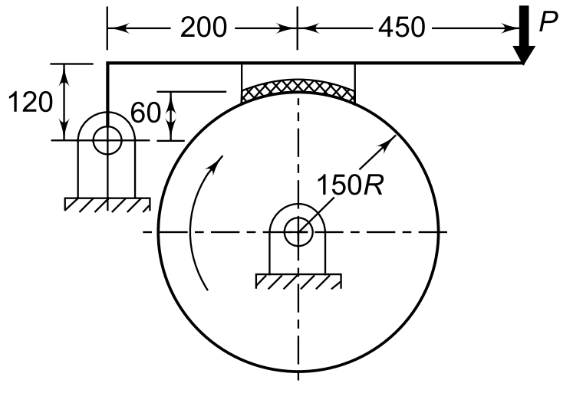
Cho hệ thống phanh như hình vẽ, momen hãm M_{t} = 15 N-m. Má phanh có mặt cắt hình vuông cạnh d, đĩa quay theo chiều kim đồng hồ có bán kính 150 mm. Hệ số ma sát giữa má phanh và đĩa phanh là µ= 0.3. Ứng suất cho phép của vật liệu làm má phanh là 1N/mm². Tính:
Lực tại gối đỡ R (R_{x}. R_{y}), Lực N tiếp xúc giữa má phanh và đĩa
Kích thước d của má phanh

Slide 13

Cho hệ thống phanh như hình vẽ, momen hãm M_{t} = 15 N-m. Má phanh có mặt cắt hình vuông cạnh d, đĩa quay theo chiều kim đồng hồ có bán kính 150 mm. Hệ số ma sát giữa má phanh và đĩa phanh là µ= 0.3. Ứng suất cho phép của vật liệu làm má phanh là 1N/mm². Tính:
Lực tại gối đỡ R (R_{x}. R_{y}), Lực N tiếp xúc giữa má phanh và đĩa
Kích thước d của má phanh

Slide 14
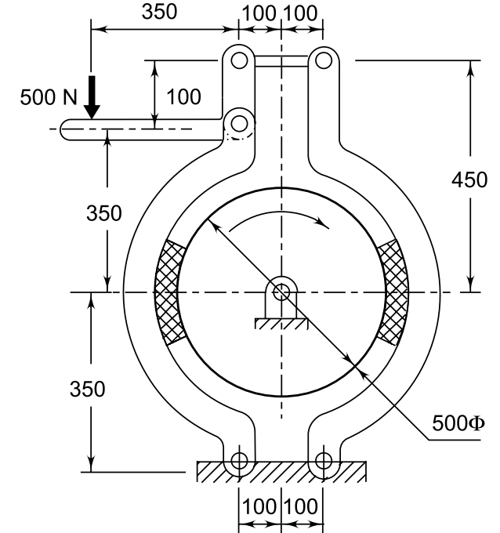

Slide 15
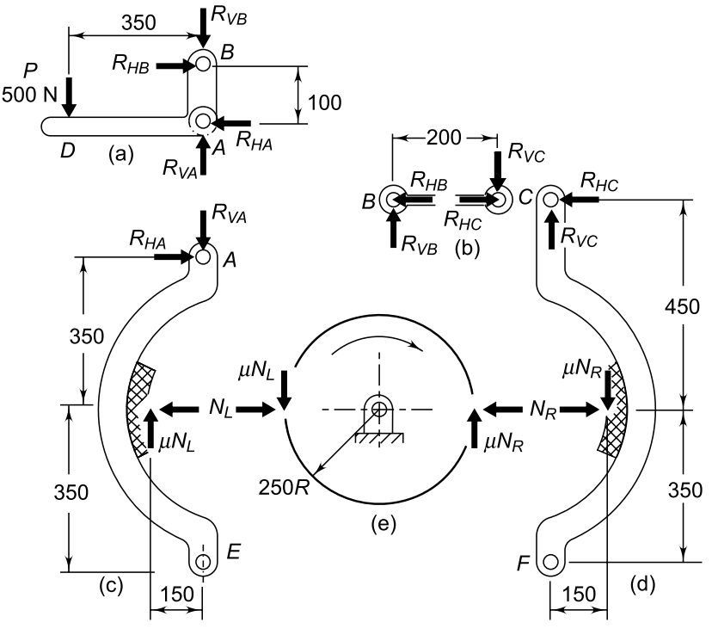
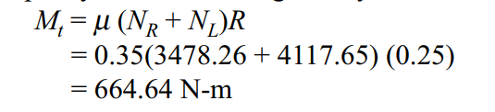

Slide 16
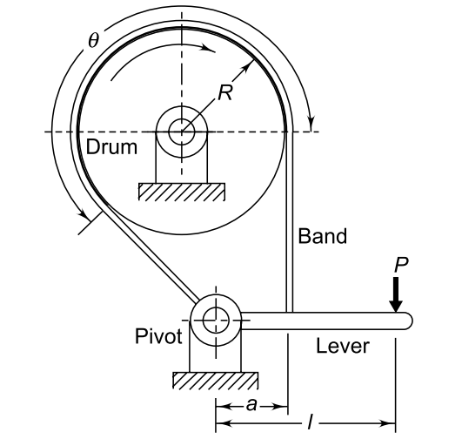

Slide 17
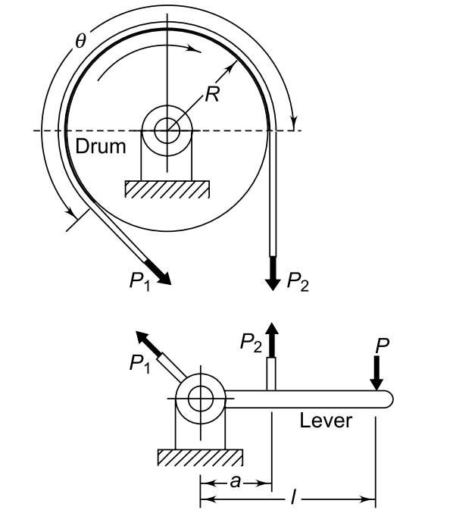

Slide 18
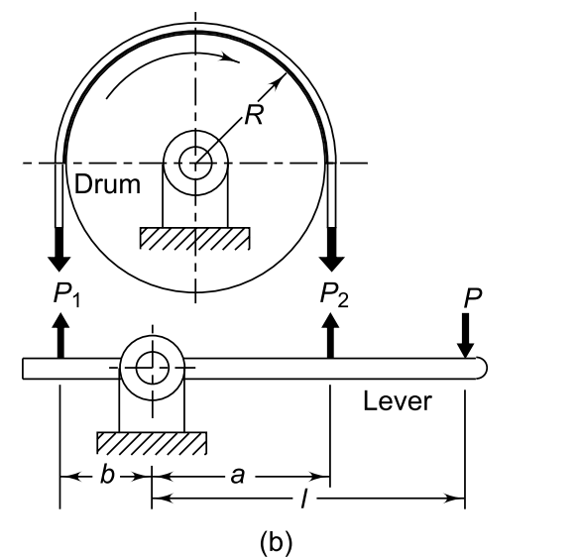
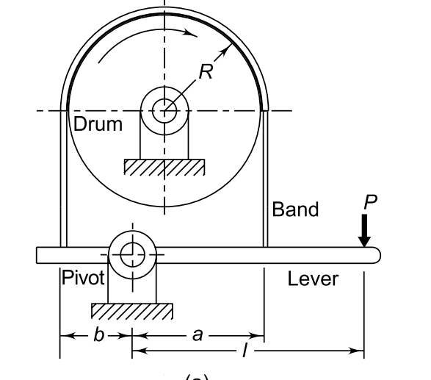

Slide 19
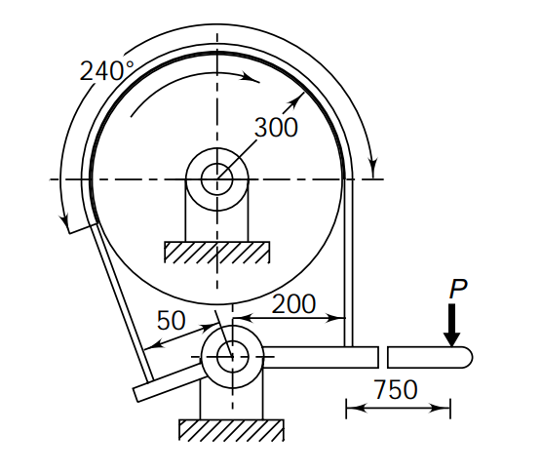
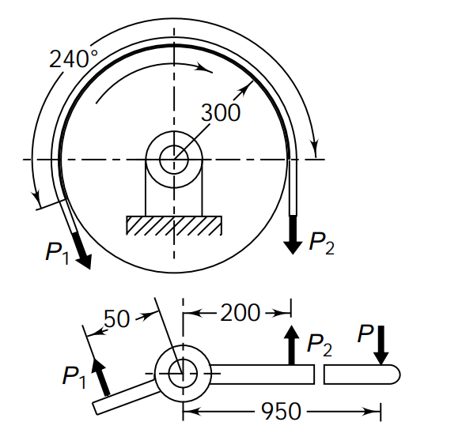
A differential band brake is shown in Fig. The width and the thickness of the steel band are 100 mm and 3 mm respectively and the maximum tensile stress in the band is 50 N/mm². The coefficient of friction between the friction lining and the brake drum is 0.25. Calculate: (i) the tensions in the band; (ii) the actuating force; and (iii) the torque capacity

Slide 20
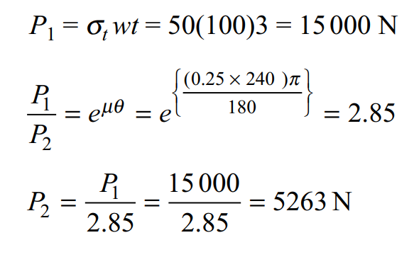
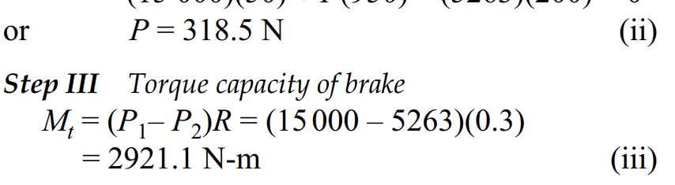

Slide 21
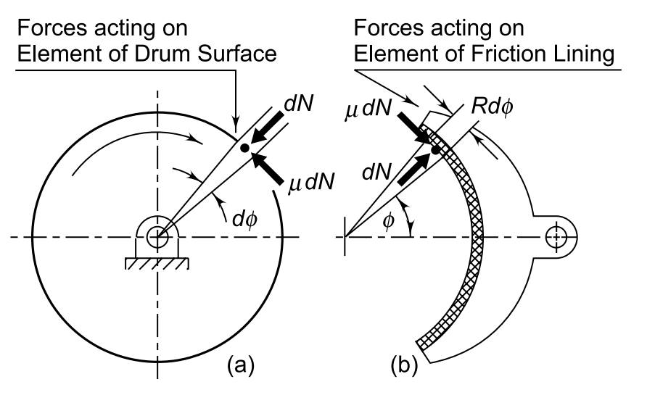

Slide 22
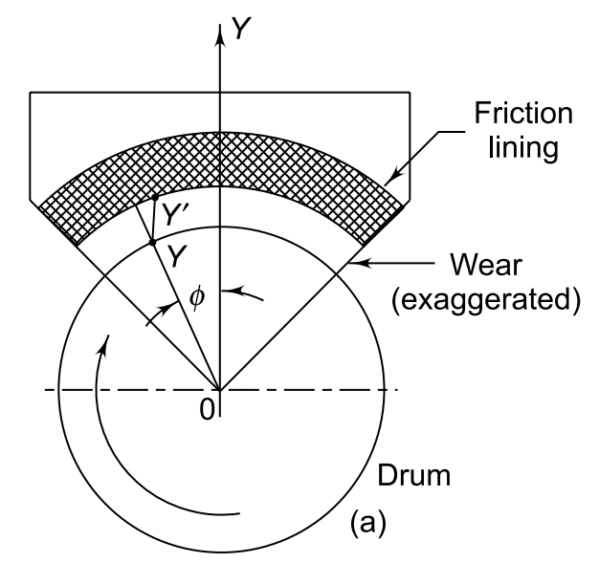

Slide 23
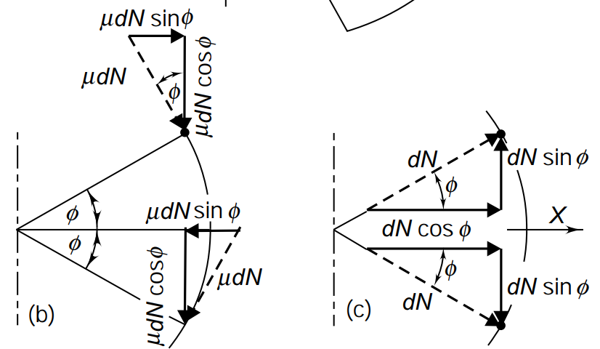

Slide 24
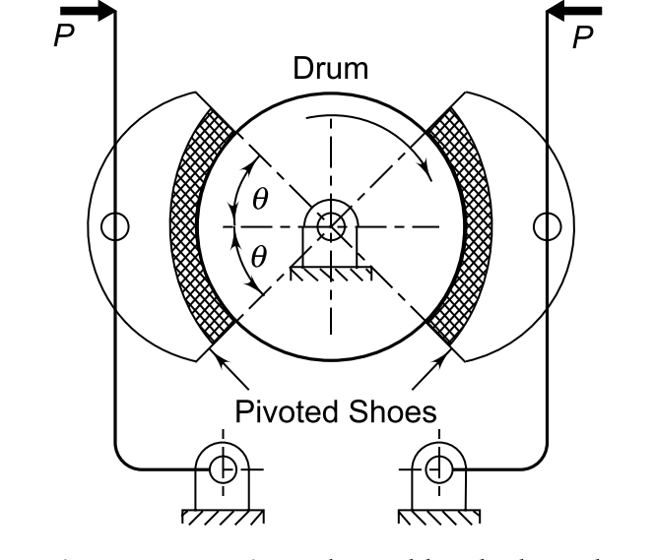
A pivoted double-block brake, similar to that in Figure has two shoes, which subtend an angle (2q) of 100°. The diameter of the brake drum is 500 mm and the width of the friction lining is 100 mm. The coefficient of friction is 0.2 and the maximum intensity of pressure between the lining and the brake drum is 0.5 N/mm2. The pivot of each shoe is located in such a manner that the moment of the frictional force on the shoe is zero. Calculate: (i) the distance of the pivot from the axis of the brake drum; (ii) the torque capacity of each shoe; and (iii) the reactions at the pivot

