Slide 1
Group 1
Manuel Maly, Rudolf Mildner, Petar Petrov

Slide 2
AFFORDANCE
Affordance in General:
A perceived or actual property of a thing (primarily: “How can I use the thing”?)
An action possibility available to the user (e.g. “A door knob can be turned”)
May also depend on user’s context & historic background
Term coined by psychologists J.J. Gibson and Don Norman
Affordance in Ordinary Computing Context:
Every action a user can execute by interacting with an element
Most of the time, it’s about perceived affordances (you can mouse-click on any single pixel, but in many cases it will have no effect -> actual vs. perceived)
Buttons, Hyperlinks, Textfields, Sliders, Virtual Knobs, Levers, Mouse gestures,...

Slide 3
AFFORDANCE
Affordance in Mobile Computing Context:
Similar to ordinary computing context, plus:
Touch-Interface, Touch-Gestures, Accelero/Gyrometer, Compass, Camera (Body gestures),...
Making an element more “affordable” means to make its meaning more obvious (Does this really look like users can tap onto it?)
Meaning has been diluted, Affordance may also mean:
General benefits of a system
General action possibilities of devices without mentioning the UI (“The iPhone can take videos.”)

Slide 4
Articles Describing
Mobile Affordances

Slide 5
Smartphones give you wings: Pedagogical affordances of mobile Web 2.0
Why Mobile Learning?
Enhancement of teaching & learning in tertiary education (college, university,...)
Authentic learning - anywhere, anytime, student-centered; any space -> learning space
Connectivity, mobility, geolocation, social networking, personal podcasting and vodcasting
Bridging digital divide by providing tools that are affordable
Research Project
Studied affordances of mobile Web 2.0 apps for learning
Performed 2007-2009, participants were lectors & students

Slide 6
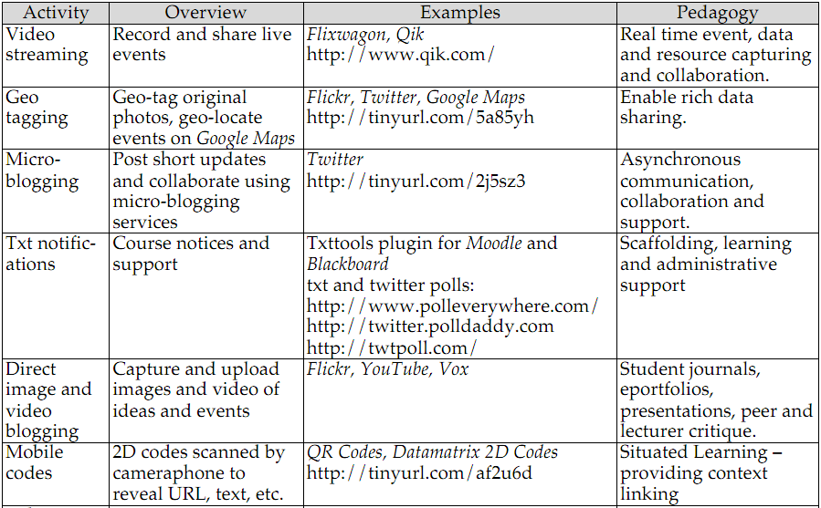
Smartphones give you wings: Pedagogical affordances of mobile Web 2.0
[Excerpt from the Article]

Slide 7
Affordances of mobile technologies for experimental learning
Rapid advancement of mobile technology
Leads to increased research for mobile learning
Experimental learning
Concrete experience
Reflective observation
Abstract conceptualization
Active experimentation

Slide 8
Affordances of mobile technologies for experimental learning
Most important mobile affordances in experimental learning context
Real-time information whenever needed
Always on, always available
Reacting to user and environment
Rotation detection, Location, Accelerometer
Rapid access interface for note taking
Photo, sound, video, notes

Slide 9
Affordances of mobile technologies for experimental learning
Study: design learning flow for experimental learning
Students get equipped with PDAs
Students use PDAs to learn about plants
Photo taking
PDA prompts to experience the plants sensory
Control group without PDAs
Outcome: Students with tool aid performed better

Slide 10
Examples of
Good & Bad Affordances

Slide 11
Example of Mobile Affordances: Netflix ipad App
Rating is not possible
Reordering is not possible – although it is on Netflix’ website

Slide 12
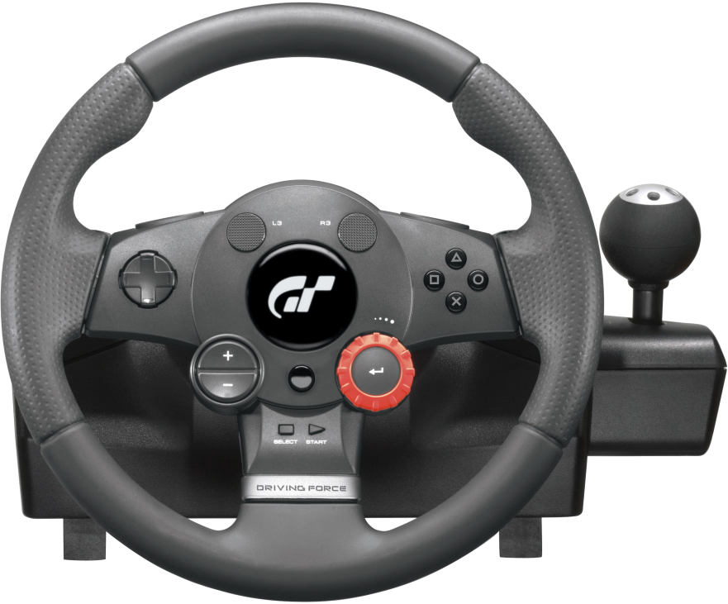
Example of Mobile AffordanceS: Need 4 Speed IPHONE app
What can you do with this?
Turn it
Drive a Car
Play a Car Game
Push the buttons
Smash it
Hang it on the wall

Slide 13
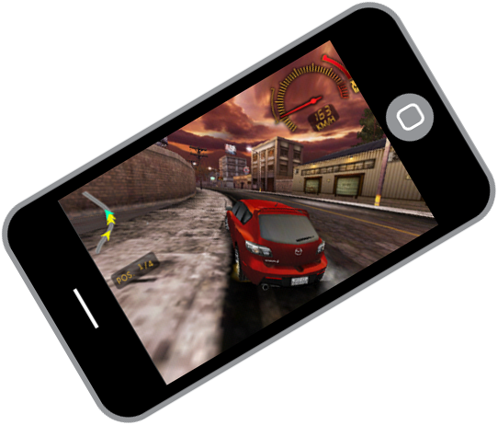
Example of Mobile AffordanceS: Need 4 Speed IPHONE app

Slide 14
References & Further Reading
Papers:
Smart phones give you wings: Pedagogical affordances of mobile Web 2.0, Thomas Cochrane et al., Australasian Journal of Educational Technology http://www.ascilite.org.au/ajet/ajet26/cochrane.pdf
Affordances of mobile technologies for experiential learning: the interplay of technology and pedagogical practices http://www.myrakhattab.com/wp-content/uploads/2011/03/Mobile-Technologies-Article.pdf
Further Reading
http://www.jnd.org/dn.mss/affordances_and_design.html
http://www.interaction-design.org/encyclopedia/affordances.html
http://www.slideshare.net/NeilMilliken/the-affordances-of-mobile-technologies
http://www.slideshare.net/andrewmaier/affordances-in-modern-web-design

