Slide 1
Refinement of Mesh3
convergence

Slide 2
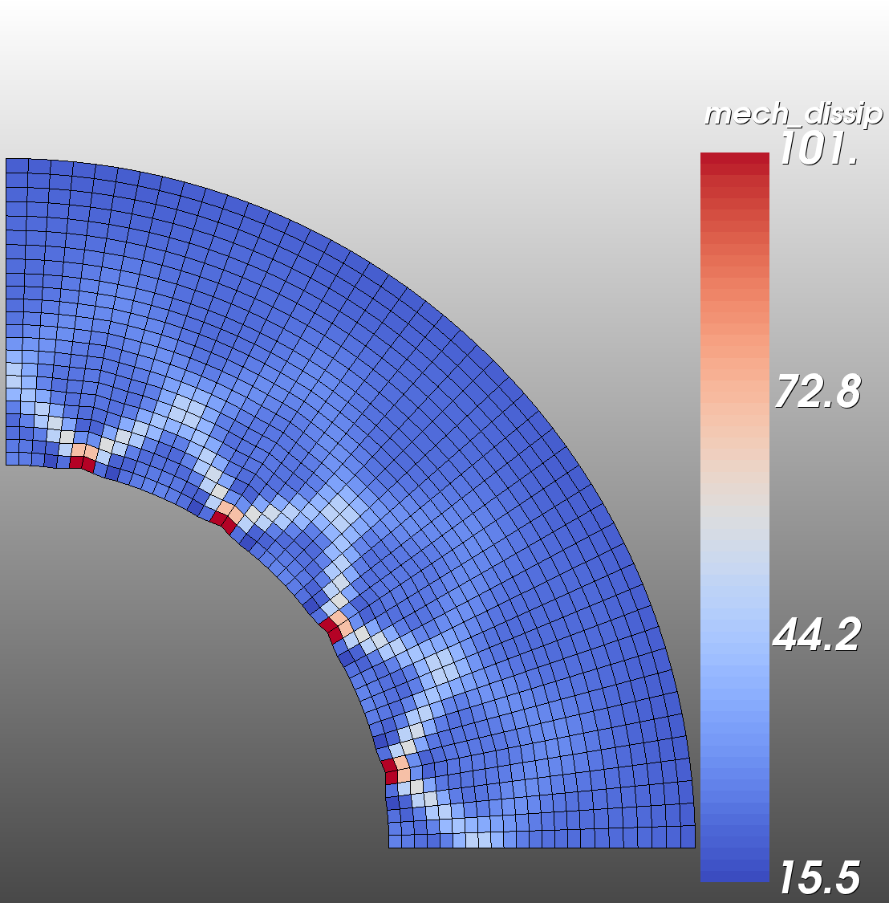
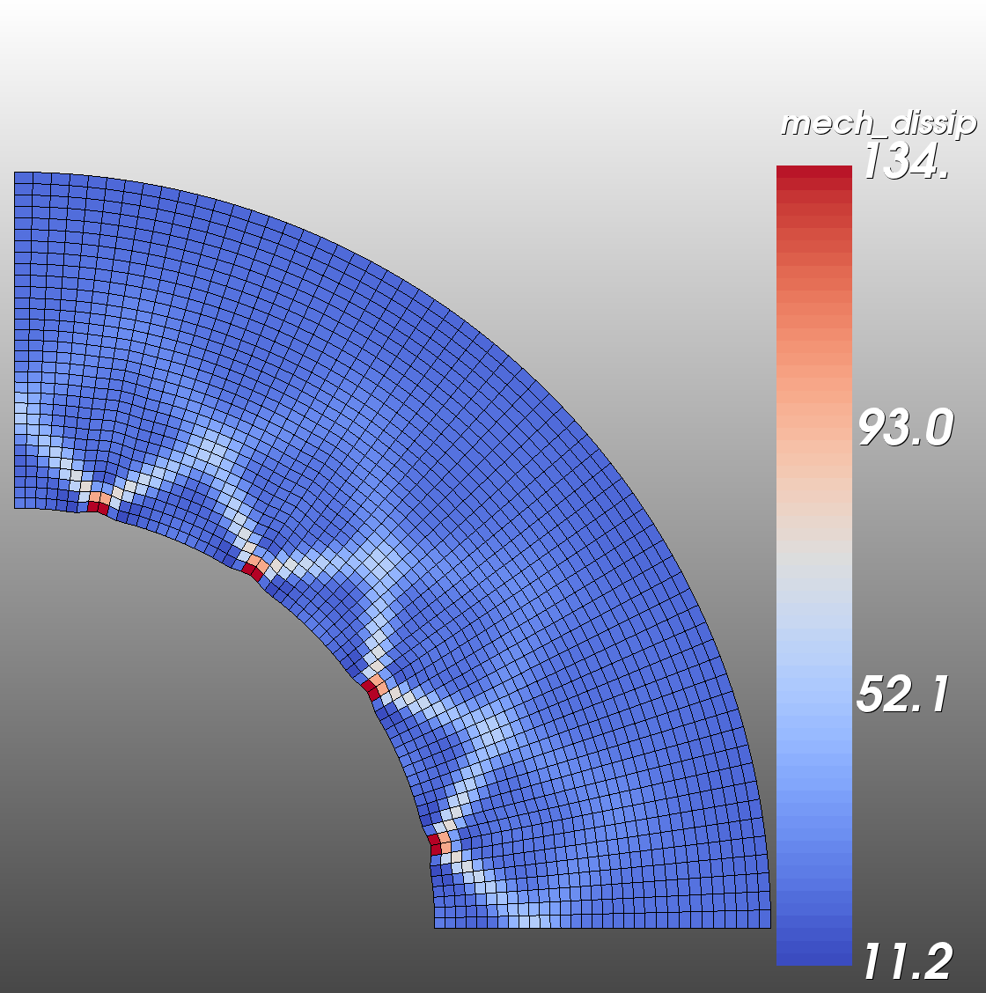
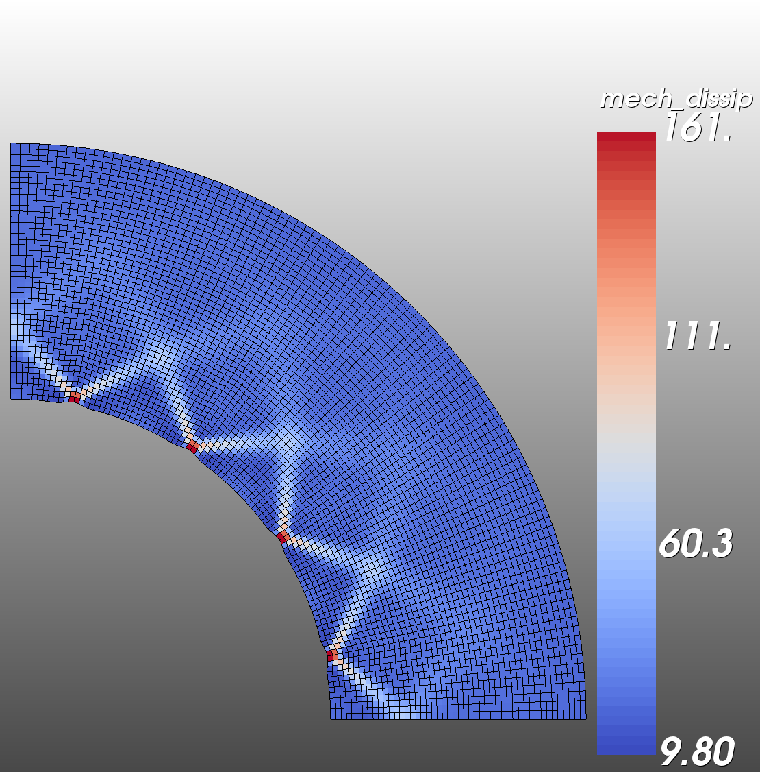
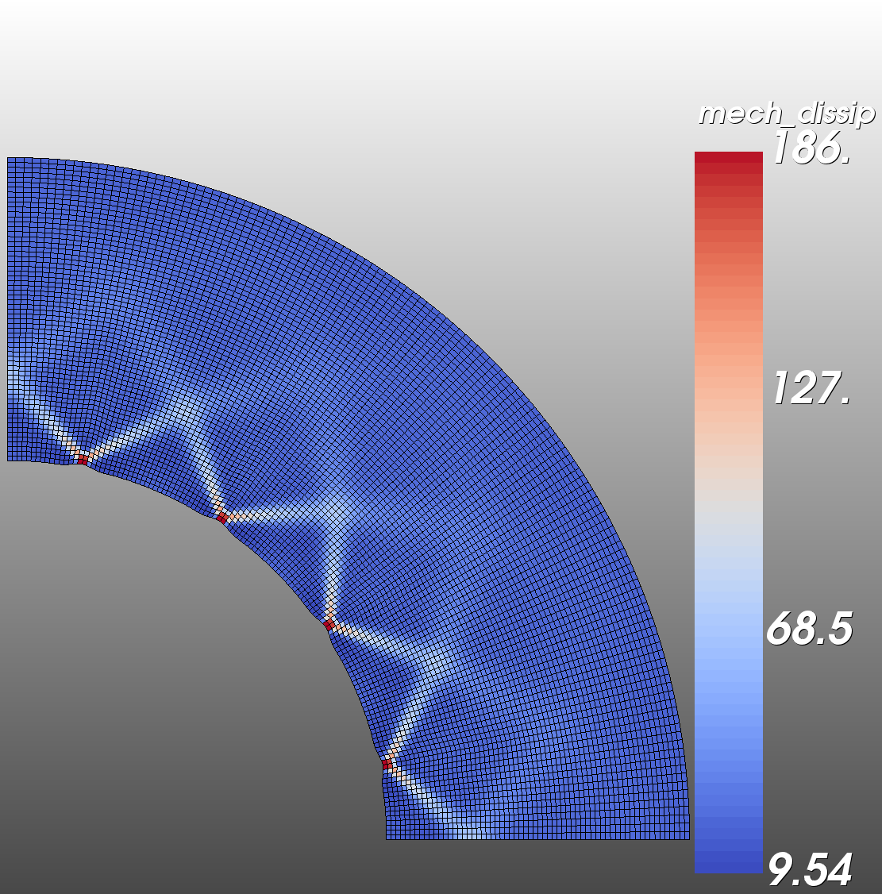

Slide 3

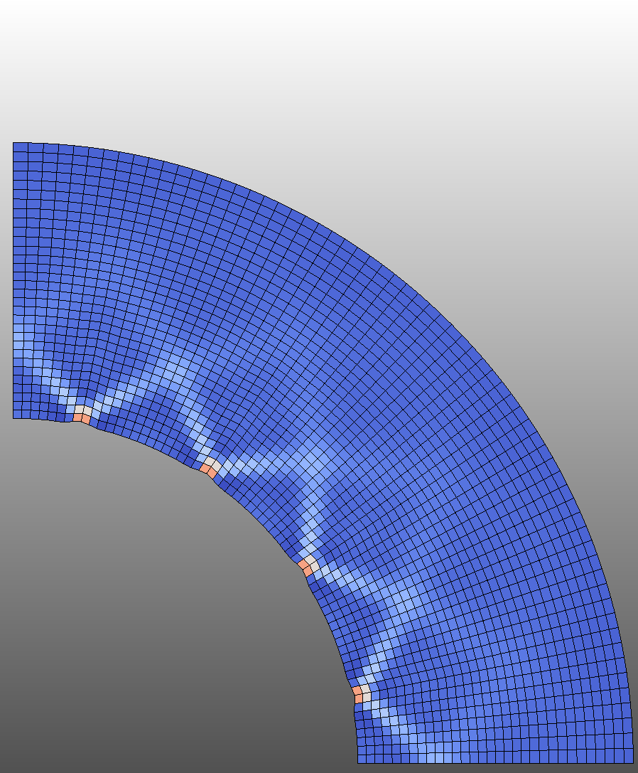



Slide 4
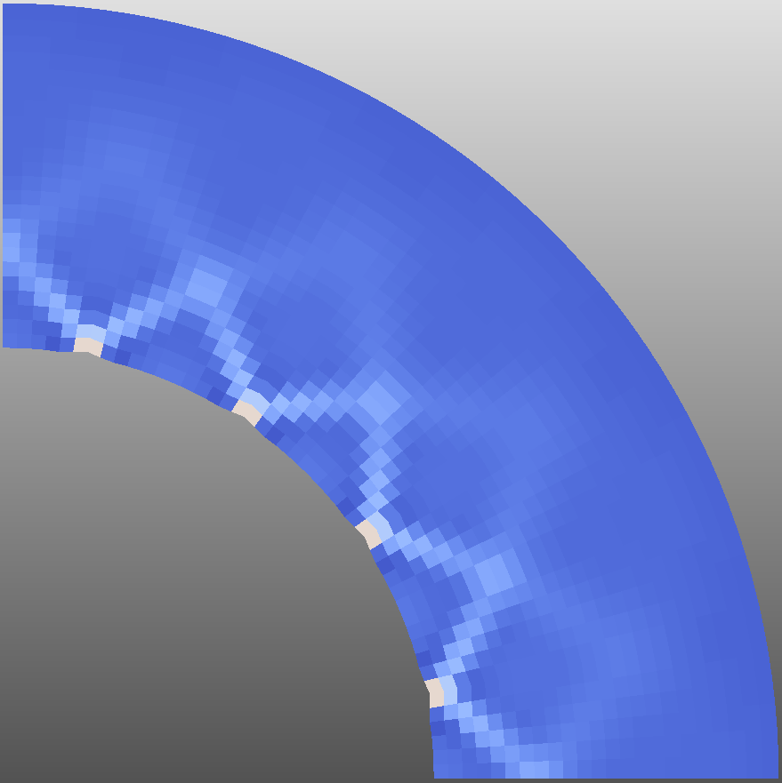
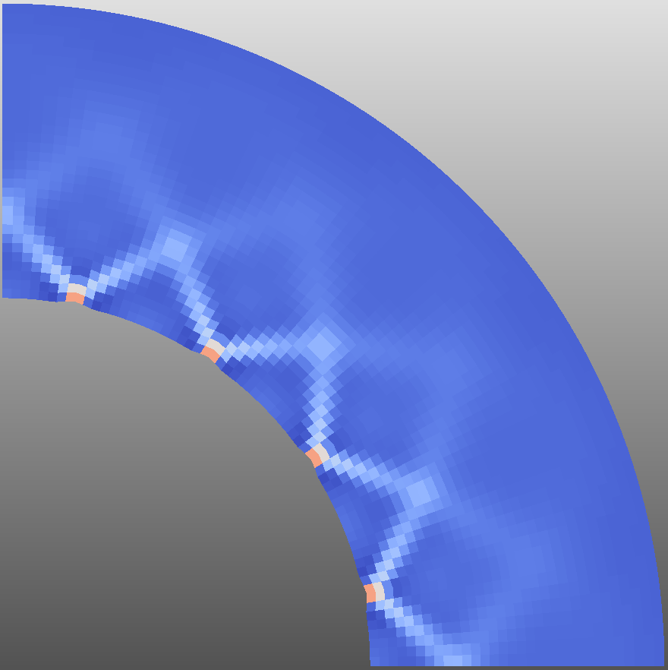

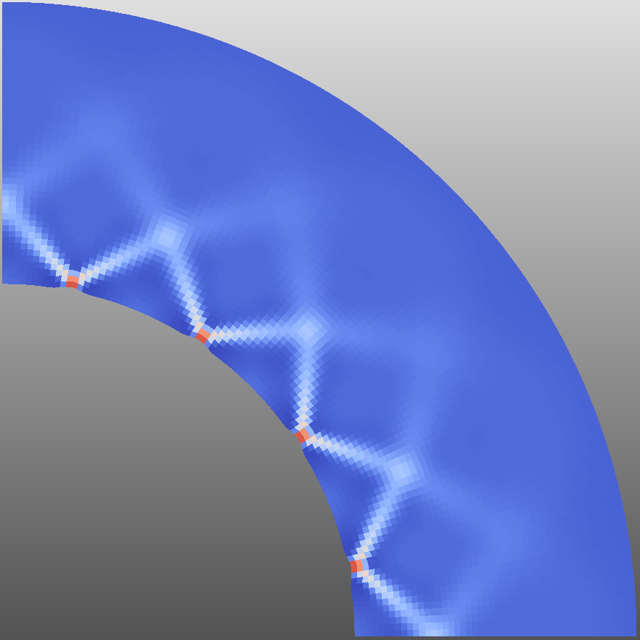
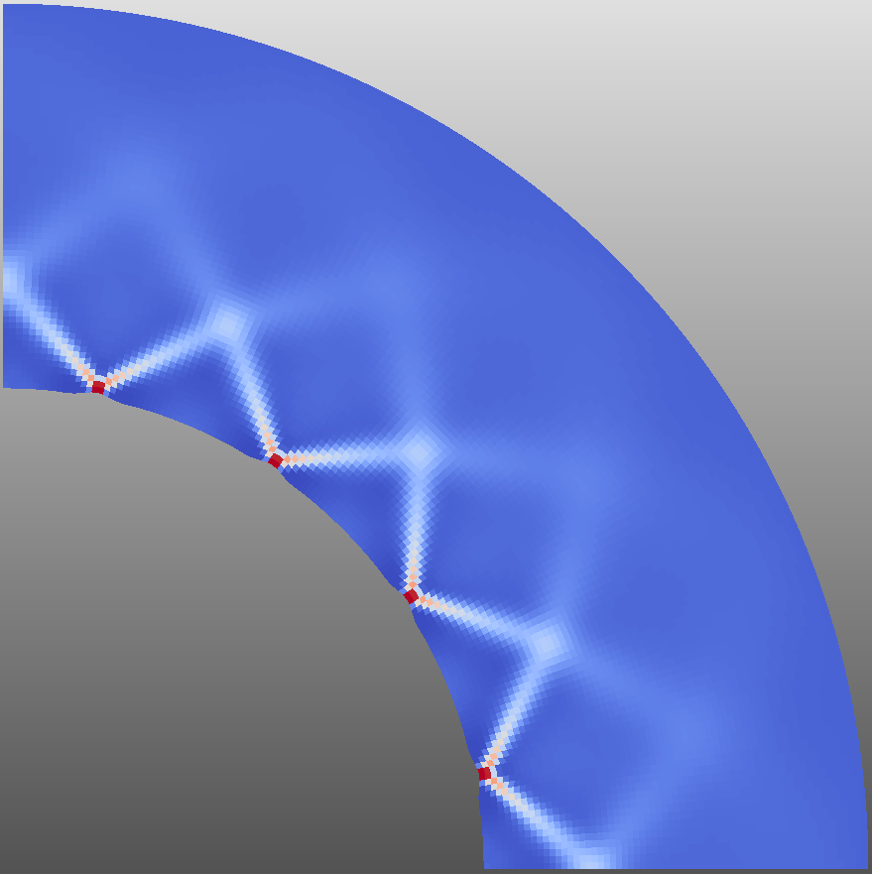
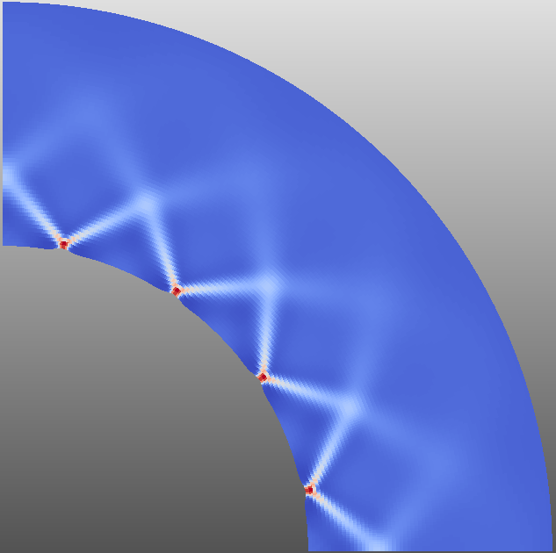
Mechanical Dissipation With Various Mesh Refinements
180
Num. of elements:
1104
1984
4512
8064
16128
123
66.7
a
b
10.0
c
d
e

Slide 5
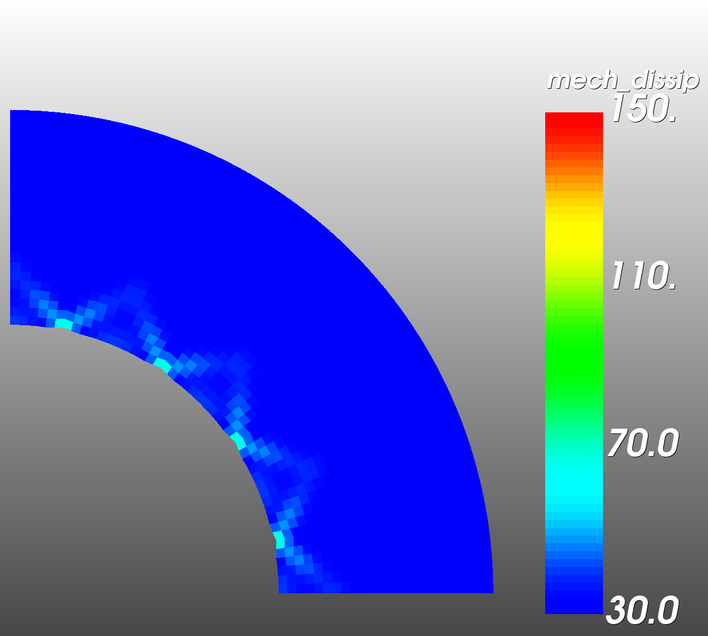
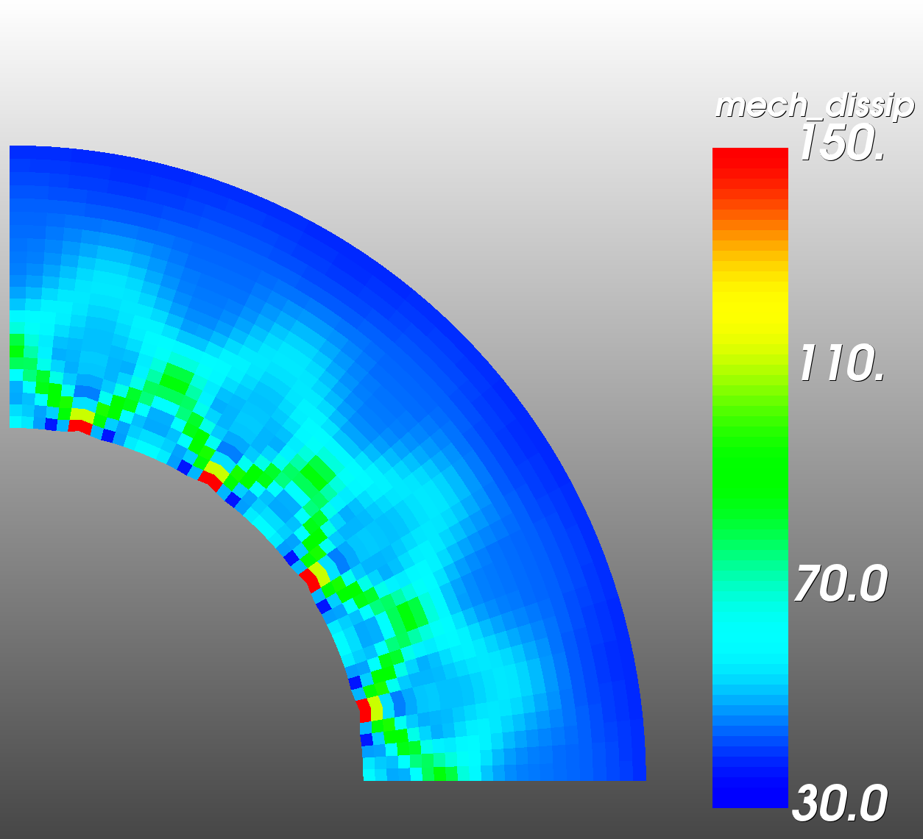
At t/t_{ref}=0.125
a
b
a) Without temperature, at t=0.125
b) With temperature, t=0.125
(thermo-damage coupling)

Slide 6
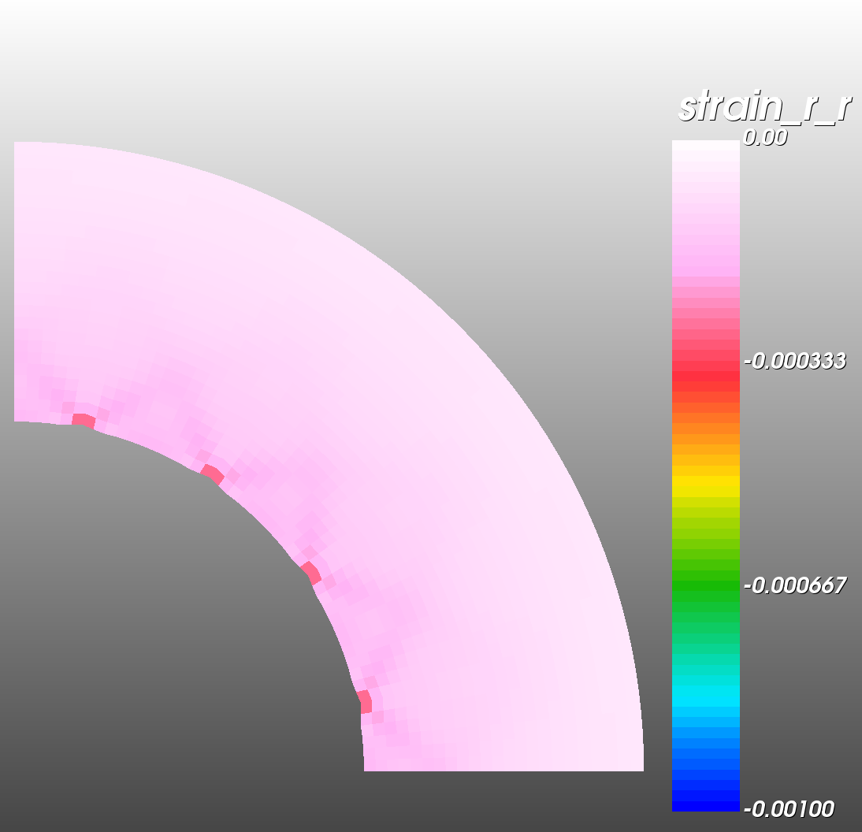
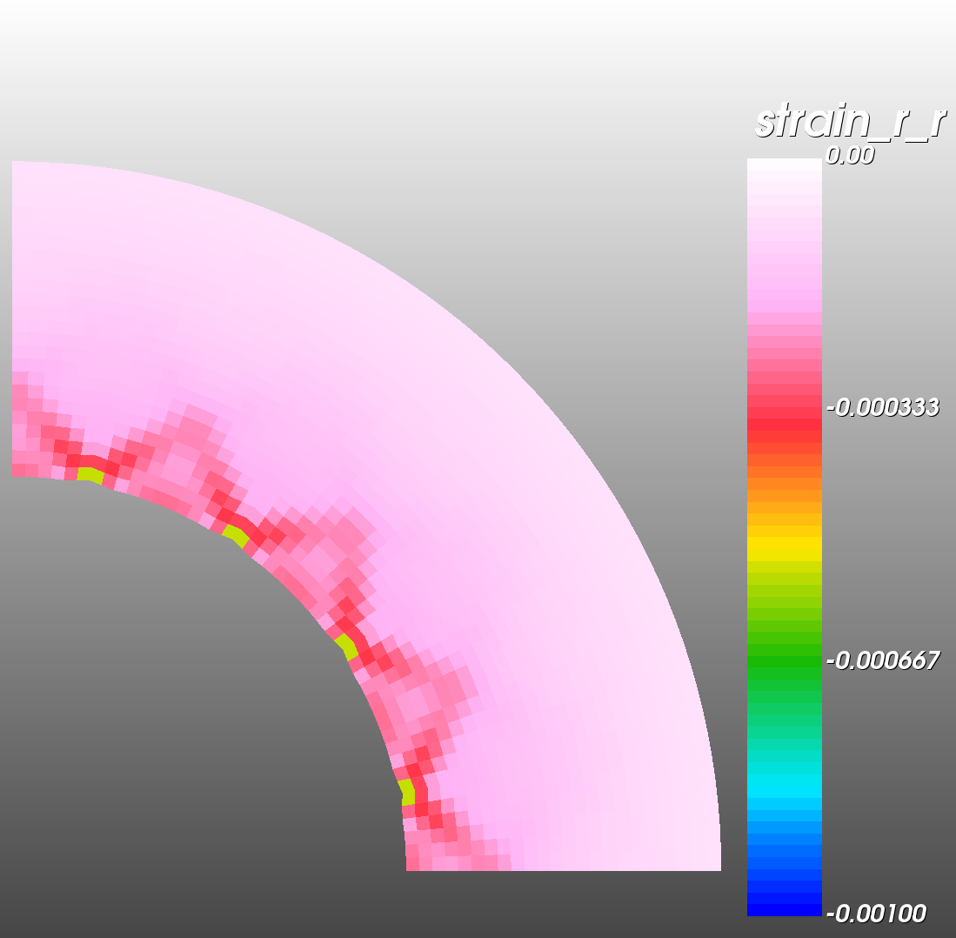
At t/t_{ref}=0.125
a
b
a) Without temperature, at t=0.125
b) With temperature, t=0.125
(thermo-damage coupling)

Slide 7
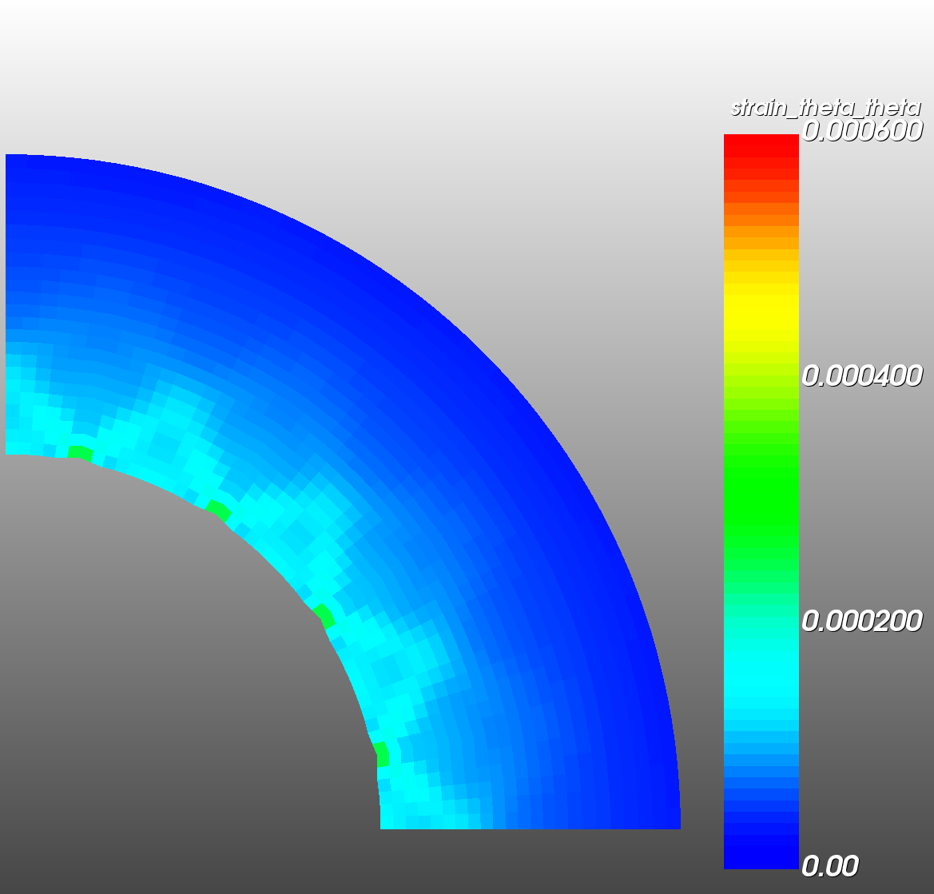
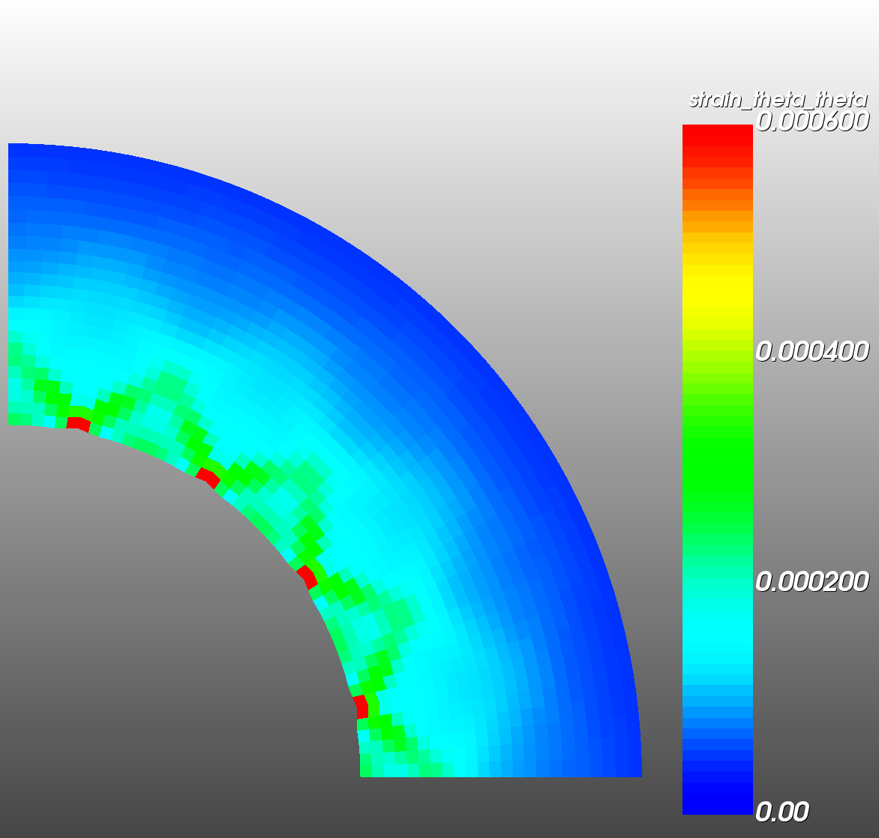
At t/t_{ref}=0.125
a
b
a
b
a) Without temperature, at t=0.125
b) With temperature, t=0.125
(thermo-damage coupling)

Slide 8
Another fig.
If we increase the temperature (e.g. from 0.1 to 1 on the exterior boundary), the slip lines vanish because the material becomes more on the ductile side.

Slide 9
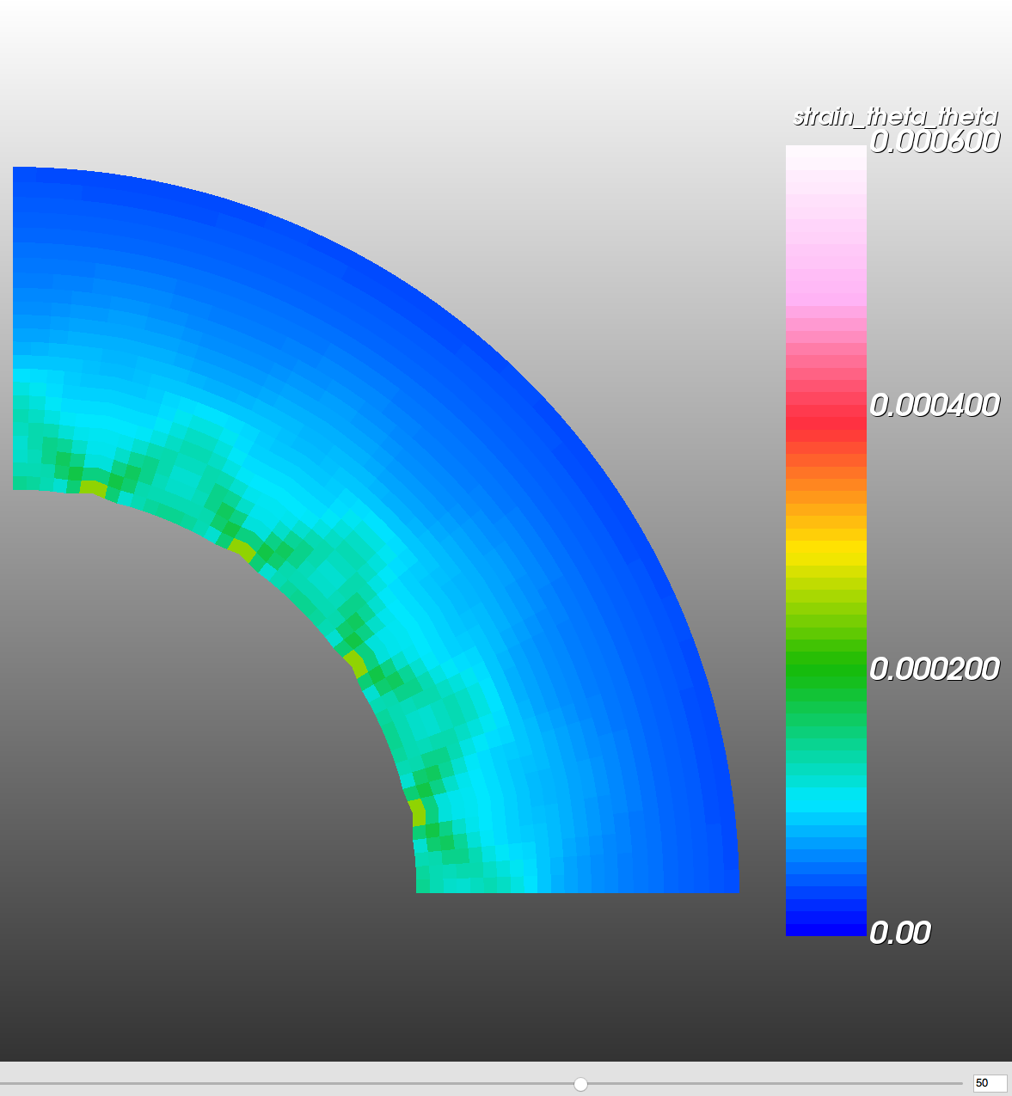
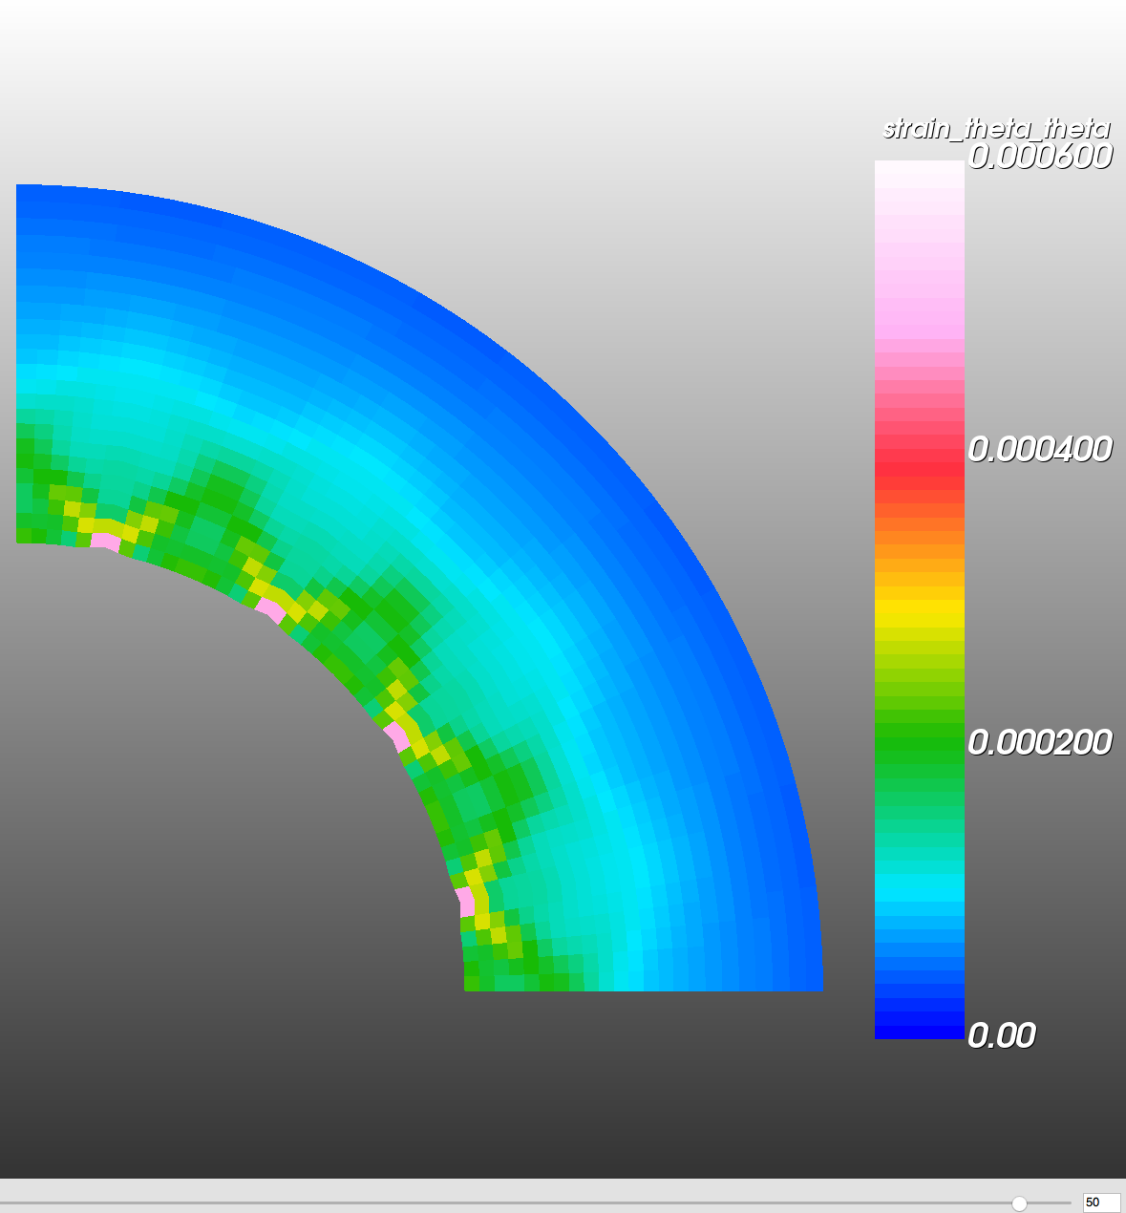
At t/t_{ref}=0.125
Without temperature, at t=0.125
With temperature, t=0.125
(thermo-damage coupling)

