Slide 1
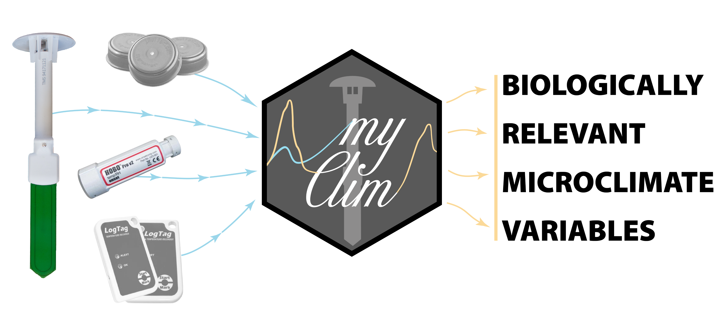
myClim
Microclimate data handling and standardised analyses in R
http://labgis.ibot.cas.cz
https://github.com/ibot-geoecology/myClim
https://github.com/manmatej/2023_SoilTemp_virtual
Matěj Man, Vojtěch Kalčík, Martin Macek, Josef Brůna, Lucia Hederová, Jan Wild, Martin Kopecký

Slide 2
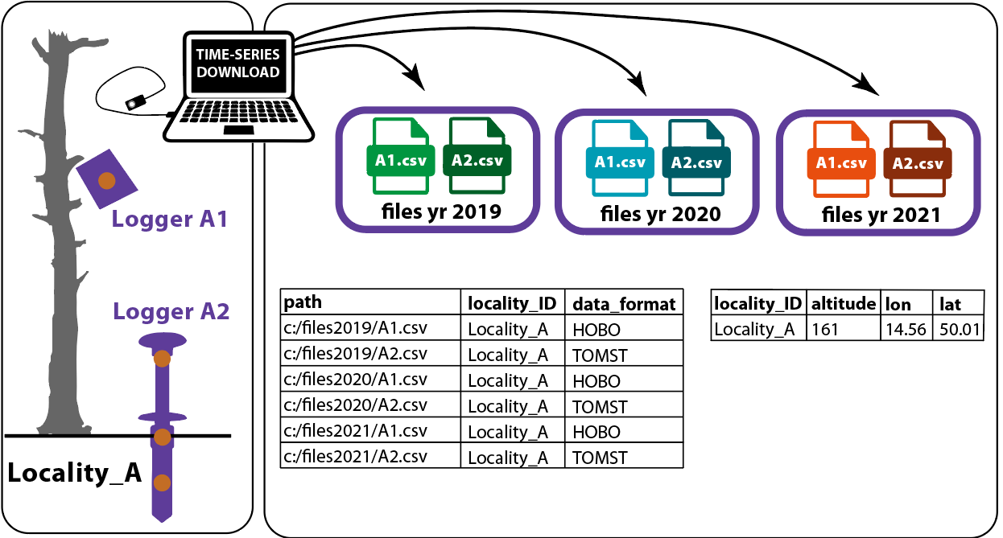

Slide 3
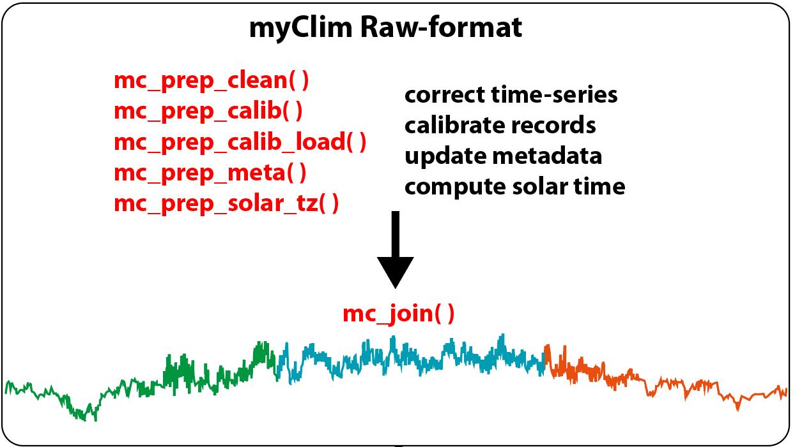

Slide 4
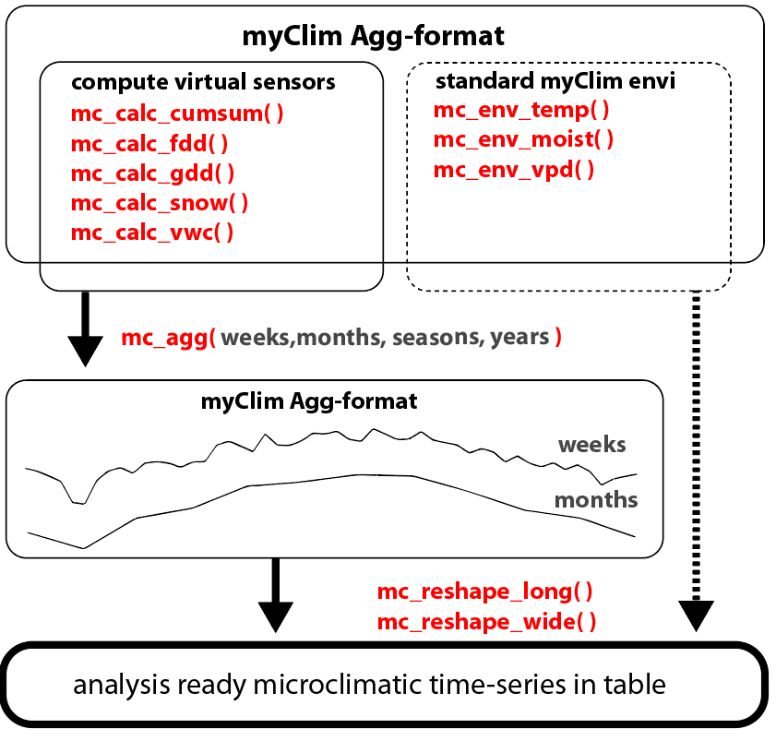

Slide 5
