Slide 1

Walchand College Of Engineering, Sangli. (An Autonomous Institute) Department Of Computer Science and Engineering Under the Guidance of Prof. M. K. Chavan Dr. M. A. Shah HOD Computer Science & Engineering Department WCE, Sangli 2020-21

Slide 2
G-Secure (Securely storing files on google drive using hybrid cryptography)
Members:
Abhay Shirale - 2018BTECS00021
Manmath Bhale - 2018BTECS00049
Moreshwar Sonawale - 2018BTECS00106

Slide 3
ABSTRACT
The world is growing vastly in Digital Terms. In Digital world Data plays crucial role. This includes sensitive data, personally identifiable information (PII), protected health information (PHI), personal information, intellectual property, data, and governmental and industry information systems. The technology is not limited to good people only. Hence the data we store online is at risk by the bad intention people. Hence Securing the data become need of the hour.So we proposed a solution that encrypt the data using Hybrid Cryptography. We build user friendly middleware using Google Drive APIs to upload encrypted files on G-drive. Such data uploaded on Google Drive if stolen or hacked, it will become useless for unauthorized people.

Slide 4
PROBLEM STATEMENT
A lot of people store very important documents such as certificates, bank details, intellectual property, governmental and industry information etc. on google drive and other such service providers. As they are stored on a third party platform, no one knows how secure they are. We have seen many cases where lots of accounts are hacked and their critical data is being leaked on dark webs. So securing those documents is a very important thing.

Slide 5
METHODOLOGY
The primary users of our application are Google Drive users all over the globe.
Every user perform the work of uploading the documents (Images ,videos ,Text Documents ) on the Google Drive using his/her credentials.
This Pieces of information are very confidential and hence should be stored securely. About authorization process of user, google drive APIs will provide appropriate functionality.
User holds all rights like adding, removing, viewing actual documents were uploaded by him/her.
The idea behind storing keys used for cryptographic operations is we will encrypt those keys which enhances the security policy of our application.

Slide 6
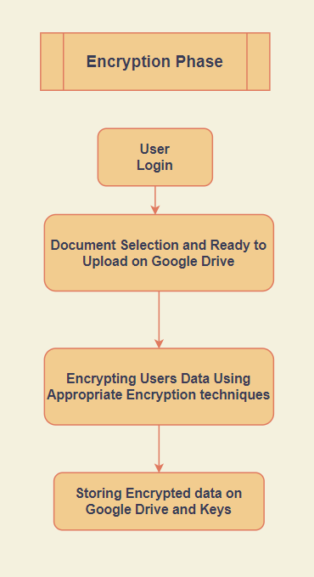
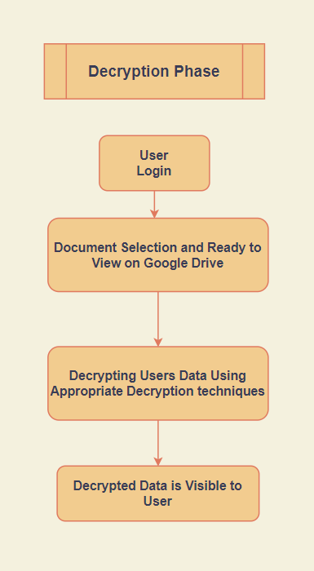
FLOW CHART

Slide 7
OBJECTIVES
To study different cryptography terms and different encryption and decryption algorithm
To study the use of google drive APIs
To design frameworks like Angular and Nodejs
To develop system consist of user friendly middleware with hybrid cryptography feature.
To integrate above mentioned components
To evaluate the reliability of data after uploading

Slide 8


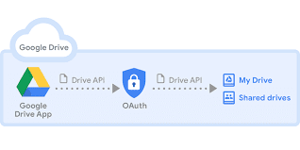
TECHNOLOGY STACK
Angular
Node JS
Cryptography Algorithms
Google drive APIs

Slide 9
CUSTOMER EVALUATION REPORT
The project G-Secure provide a Middleware to customer. It can used by people with no/less technical background also. We as a project provide our customer a service that make them certain about their documents and files that are being uploaded on drive or cloud. We presented and explained the project to our surrounding people that includes students, IT professionals and Government servants. Also we introduced them with a short demo of it and collected the feedback regarding different aspects. We mentioned their feedback as a sum below:

Slide 10
OUTCOMES
Outcome will be a middleware web application which will be used to securely store documents on drive.
Even if accounts are hacked or documents are leaked, there will be no use of it as they will be encrypted means in unreadable format.
Easy to use middleware where person with no technical background can use the middleware to secure their files.
G-Secure is a web application using which we can store our documents after encryption on google drive, so even if it’s hacked or our documents are leaked they will be in encrypted form. So security of our documents will be in our hands.

Slide 11
SUMMARY
As we have discussed in our problem statement data security is a very vital thing. We store a lot of information related to us in many applications without concerning about its security. So we are planning to provide solution to one such concern with google drive.
G-Secure is a web application using which we can store our documents after encryption on google drive, so even if it’s hacked or our documents are leaked they will be in encrypted form. So security of our documents will be in our hands.

Slide 12
REFERENCES
https://nevonprojects.com/secure-file-storage-on-cloud-using-hybrid-cryptography/
https://www.researchgate.net/publication/334418542_A_Review_Paper_on_Cryptography
https://www.businessinsider.in/tech/how-to/is-google-drive-secure-how-google-uses-encryption-to-protect-your-files-and-documents-and-the-risks-that-remain/articleshow/81219345.cms
https://developers.google.com/drive
https://blog.storagecraft.com/5-common-encryption-algorithms/
https://medium.com/@brandonstilson/lets-encrypt-files-with-node-85037bea8c0e

