Slide 1




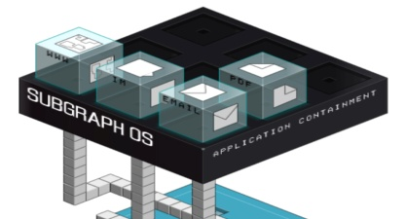

Under the Hood of Container

Slide 2
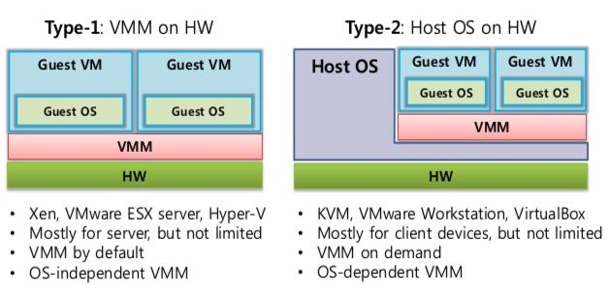
Traditional Virtualization

Slide 3
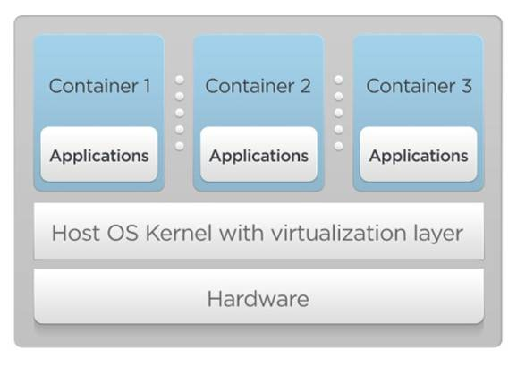
Container Virtualization

Slide 4
High level View: Lightweight VM
I can get a shell on it
through SSH or otherwise
It "feels" like a VM
own process space
own network interface
can run stuff as root
can install packages
can run services
can mess up routing, iptables

Slide 5
Low-level View: chroot( ) on jail
It's not quite like a VM
uses the host kernel
can't boot a different OS
can't have its own modules
doesn't need init as PID 1
doesn't need syslogd, cron...
It's just normal processes on the host machine
contrast with VMs which are opaque

Slide 6

How are they implemented?
Are they in Kernel?
Lets See
$ find ($KERNEL_SOURCE_DIR) -type f | xargs grep '[lxc,lxd,docker]'
Returns 0 results
$ find ($KERNEL_SOURCE_DIR) -type f | xargs grep ‘container’
Returns 1000+ results but all of them are irrelevant, as most of them come from “acpid container” module

Slide 7
Here is the Story
Okay. There is no single technology named “Container” in Linux Kernel
But “Container Technology” can be effectively made up with some of the independent(read orthogonal) technology from linux kernel
cgroup
namespace
capability
selinux
seccomp
apparmor
overlayfs
Let me remind you. Each of them actually was invented for a different purpose

Slide 8

Control Groups

Slide 9
What do we get
By using cgroup, system administrators gain fine-grained control over allocating, prioritizing, denying, managing, and monitoring system resources. Hardware resources can be appropriately divided up among tasks and users, increasing overall efficiency.
Hardware resources can be appropriately divided up among tasks and users, increasing overall efficiency.

Slide 10
What are there in the toolbox?
cpuset - Whole Cores And CPU Mapping
cpuacct - CPU Cycle Accounting
cpu - Less Than Core Granularity
memory - Limits And Accounting
blkio - Limits And Accounting
net_cls - Network Classification
net_prio - Network Priority
checkpoint/restore - Migration

Slide 11
What are Play Rules?
Each subsystem has a hierarchy
separate hierarchies for CPU, memory, block I/O…
Hierarchies are independent
the trees for e.g. memory and CPU can be different
Each process is in a node in each hierarchy
think of each hierarchy as a different dimension or axis
Each hierarchy starts with 1 node (the root)
Initially, all processes start at the root node*
Each node = group of processes
sharing the same resources

Slide 12

Demonstration 1

Slide 13
Dealing with CPU
Keeps track of user/system CPU time
Keeps track of usage per CPU
Allows to set weights
Can't set CPU limits
OK, let's say you give N%
Then the CPU throttles to a lower clock speed now what?
Same if you give a time slot instructions? their exec speed varies wildly

Slide 14
Features in “cpuset cgroup”
Provides Physical CPU assignments & Memory limits
cpuset.cpus
a list of allowed CPUs
cpuset.mems
a list of allowed memory slots
cpuset.cpu_exclusive
CPUs exclusive to this group(no other group can use them)
cpuset.mem_exclusive /cpuset.mem_hardwall
memory slots exclusive to this group(no other group can use them)
cpuset.sched_load_balance
should the kernel balance the tasks between the CPUs in the current cpuset

Slide 15
Features in “cpuacct cgroup”
CPU usage combined for all CPUs (in nanoseconds)
CPU usage per-CPU (in nanoseconds)
Per CPU and user/system(in USER_HZ)

Slide 16
Dealing with Memory: Accounting
Keeps track of pages used by each group
file (read/write/mmap from block devices)
anonymous (stack, heap, anonymous mmap)
active (recently accessed)
inactive (candidate for eviction)
Each page is “charged” to a group
Pages can be shared across multiple groups
e.g. multiple processes reading from the same files
when pages are shared, only one group “pays” for a page

Slide 17
Dealing with Memory: Limiting
Each group can have its own limits.
Limits are optional
Two kinds of limits:
Soft Limits
Soft limits are not enforced. They influence reclaim under memory pressure
Hard Limits
Hard limits will trigger a per-group OOM killer
Limits can be set for different kinds of memory
Physical Memory
Kernel Memory
Total Memory

Slide 18
Features in “ memory cgroup”
Only Memory
memory.usage_in_bytes - show current res_counter usage for memory
memory.limit_in_bytes - set/show limit of memory usage
memory.failcnt - show the number of memory usage hits limits
memory.max_usage_in_bytes - show max memory usage recorded
Memory + Swap
memory.memsw.usage_in_bytes - show current res_counter usage
memory.memsw.limit_in_bytes - set/show limit
memory.memsw.failcnt - show the number of hits limits
memory.memsw.max_usage_in_bytes - show max Memory+Swap usage recorded
memory.soft_limit_in_bytes - set/show soft limit of memory usage
memory.stat - show various statistics
memory.use_hierarchy - set/show hierarchical account enabled
memory.force_empty - trigger forced move charge to parent
memory.pressure_level - set memory pressure notifications
memory.swappiness - set/show swappiness parameter of vmscan
memory.move_charge_at_immigrate - set/show controls of moving charges
memory.oom_control - set/show oom controls.
memory.numa_stat - show the number of memory usage per numa node

Slide 19
Features in “ memory cgroup”
Kernel Memory limits
memory.kmem.limit_in_bytes - set/show hard limit for kernel memory
memory.kmem.usage_in_bytes - show current kernel memory allocation
memory.kmem.failcnt - show the number of kernel memory usage hits limits
memory.kmem.max_usage_in_bytes - show max kernel memory usage recorded
memory.kmem.tcp.limit_in_bytes - set/show hard limit for tcp buf memory
memory.kmem.tcp.usage_in_bytes - show current tcp buf memory allocation
memory.kmem.tcp.failcnt - show the number of tcp buf memory use hits limits
memory.kmem.tcp.max_usage_in_bytes - show max tcp buf memory usage recorded

Slide 20
Dealing with Block I/O
Keeps track of I/Os for each group
Per Block Device
Read Vs. Write
Sync Vs. Async
Set throttle (limits) for each group
Per Block Device
Read Vs. Write
Ops Vs. Bytes
Set relative weights for each group
Note: most writes go through the page cache. So classic writes will appear to be unthrottled at first

Slide 21
Features in “ blkio cgroup”
Hope they are self explanatory
blkio.io_wait_time
blkio.io_merged
blkio.io_queued
blkio.avg_queue_size
blkio.group_wait_time
blkio.throttle.io_serviced
blkio.throttle.io_service_bytes
blkio.weight - allowed range 10 - 1000
blkio.weight_device - weight per device
blkio.leaf_weight[_device] - when competing with child cgroups
blkio.time - disk time allocated in miliseconds
blkio.throttle.read_bps_device
blkio.throttle.write_bps_device
blkio.throttle.read_iops_device

Slide 22
Dealing with Network
Automatically set traffic class or priority, for traffic generated by processes in the group
Only works for egress traffic
net_cls will assign traffic to a class that has to be matched with tc/iptables, otherwise traffic just flows normally
net_prio will assign traffic to a priority priorities are used by queuing disciplines

Slide 23
Features in “ net_* cgroup”
Adding network class to each cgroup so you can later limit it with tc
Documentation/cgroups/net_cls.txt
Prioritizing network traffic on interface
Documentation/cgroups/net_prio.txt

Slide 24
Dealing with Devices
Controls what the group can do on device nodes
Permissions include read/write/mknod
Typical use:
allow /dev/{tty,zero,random,null}
A few interesting nodes:
/dev/net/tun (network interface manipulation)
/dev/fuse (filesystems in user space)
/dev/kvm (VMs in containers, yay inception!)
/dev/dri (GPU)

Slide 25

Namespace

Slide 26
What you can see and can not see?
Provide processes with their own system view
cgroups = limits how much you can use;
namespaces = limits what you can see
You can’t use/affect what you can’t see
Available Namespaces
pid
net
mnt
uts
ipc
user
Each process is in one namespace of each type

Slide 27
pid namespace
Processes within a PID namespace only see processes in the same PID namespace
Each PID namespace has its own numbering starting at 1
If PID 1 goes away, whole namespace is killed.
Those namespaces can be nested. A process ends up having multiple PIDs
One per namespace in which its nested

Slide 28
net namespace
Processes within a given network namespace get their own private network stack, including:
network interfaces (including lo)
routing tables
iptables rules
sockets
You can move a network interface across netns

Slide 29
mnt namespace
Processes can have their own root file system conceptually close to chroot
Processes can also have “private” mounts
Mounts can be totally private, or shared
No easy way to pass along a mount from a namespace to another

Slide 30
uts namespace
gethostname / sethostname
That is enough.

Slide 31
ipc namespace
Does anybody know about IPC?
Does anybody care about IPC?
Allows a process (or group of processes) to have own:
IPC semaphores
IPC message queues
IPC shared memory
... Without risk of conflict with other instances

Slide 32
user namespace
Allows to map UID/GID; e.g.:
UID 0→1999 in container C1 is mapped to UID 10000→11999 on host;
UID 0→1999 in container C2 is mapped to UID 12000→13999 on host;
UID in containers becomes irrelevant
Just use UID 0 in the container
It gets squashed to a non-privileged user outside
Security improvement

Slide 33
Rules of Games
Namespaces are created with the clone() syscall i.e. with extra flags when creating a new process
Namespaces are materialized by pseudo-files
/proc/<pid>/ns
When the last process of a namespace exits, it is destroyed but can be preserved by bind-mounting the pseudo-file It’s possible to “enter” a namespace with setns() exposed by the nsenter wrapper in util-linux

Slide 34
Demonstration 2

Slide 35

Welcome to the World of Containers

Slide 36
Chroot( ) : an useful friend
A chroot on Unix operating systems is an operation that changes the apparent root directory for the current running process and its children. A program that is run in such a modified environment cannot name (and therefore normally cannot access) files outside the designated directory tree. The term "chroot" may refer to the chroot(2) system call or the chroot(8) wrapper program. The modified environment is called a chroot jail.
At startup, programs expect to find scratch space, configuration files, device nodes and shared libraries at certain preset locations. For a chrooted program to successfully start, the chroot directory must be populated with a minimum set of these files. This can make chroot difficult to use as a general sandboxing mechanism.
Only the root user can perform a chroot. This is intended to prevent users from putting a setuid program inside a specially crafted chroot jail (for example, with a fake /etc/passwd and /etc/shadow file) that would fool it into a privilege escalation.

Slide 37
Looking Back in Time
BSD Jail was here. So are you.
https://www.freebsd.org/doc/handbook/jails.html
Jails mainly aim at three goals:
Virtualization: Each jail is a virtual environment running on the host machine with its own files, processes, user and superuser accounts. From within a jailed process, the environment is almost indistinguishable from a real system.
Security: Each jail is sealed from the others, thus providing an additional level of security.
Ease of delegation: The limited scope of a jail allows system administrators to delegate several tasks which require superuser access without handing out complete control over the system.
Unlike chroot jail, which restricts processes to a particular view of the file system, the FreeBSD jail mechanism restricts the activities of a process in a jail can with respect to the rest of the system. In effect, jailed processes are sandboxed. They are bound to specific IP addresses, and a jailed process cannot access divert or routing sockets.

Slide 38
Demonstration 3

Slide 39
Capability
Capability provide fine-grained control over superuser permissions, allowing use of the root user to be avoided.
Software developers are encouraged to replace uses of the powerful setuid attribute in a system binary with a more minimal set of capabilities.
Many packages make use of capabilities, such as CAP_NET_RAW being used for the ping binary provided by iputils. This enables e.g. ping to be run by a normal user (as with the setuid method), while at the same time limiting the security consequences of a potential vulnerability in ping.

Slide 40
Capability: how do you implement it
A process has three sets of bitmaps called the
Inheritable(i)
Permitted(p),
Effective(e)
Each capability is implemented as a bit in each of these bitmaps which is either set or unset.
When a process tries to do a privileged operation, the operating system will check the appropriate bit in the effective set of the process (instead of checking whether the effective uid of the process i 0 as is normally done).
For example, when a process tries to set the clock, the Linux kernel will check that the process has the CAP_SYS_TIME bit (which is currently bit 25) set in its effective set.

Slide 41
How does it play with others?
Files have capabilities. Conceptually they have the same three bitmaps that processes have, but to avoid confusion we call them by other names. The three sets are called the allowed set, the forced set, and the effective set.
Only executable files have capabilities, libraries don't have capabilities (yet).
Users and Groups don't have associated capabilities from the kernel's point of view, but it is entirely reasonable to associate users or groups with capabilities. By letting the "login" program set some capabilities it is possible to make role users such as a backup user that will have the CAP_DAC_READ_SEARCH capability and be able to do backups. This could also be implemented as a PAM module, but nobody has implemented one yet.

Slide 42
Capability Lifecycle
The capability rules are the rules used to set the capabilities of the new process image after an exec. They work like this:
pI' = pI
pP' = fP | (fI & pI)
pE' = pP' & fE [NB. fE is 0 or ~0]
I=Inheritable, P=Permitted, E=Effective // p=process, f=file
'indicates post-exec().
Now to make sense of the equations think of fP as the Forced set of the executable, and fI as the Allowed set of the executable. Notice how the Inheritable set isn't touched at all during exec().
Bits can be transferred from Permitted to either Effective or Inheritable set.
Bits can be removed from all sets.

Slide 43
Three Pillars of Protection
Minimum Privilege
Inherited Privilege
Bounded Privilege

Slide 44
Demonstration 4

Slide 45
seccomp
Seccomp filtering provides a means for a process to specify a filter for incoming system calls. The filter is expressed as a Berkeley Packet Filter (BPF) program, as with socket filters, except that the data operated on is related to the system call being made: system call number and the system call arguments. This allows for expressive filtering of system calls using a filter program language with a long history of being exposed to user land and a straightforward data set.
Additionally, BPF makes it impossible for users of seccomp to fall prey to time-of-check-time-of-use (TOCTOU) attacks that are common in system call interposition frameworks. BPF programs may not dereference pointers which constrains all filters to solely evaluating the system call arguments directly. System call filtering isn't a sandbox. It provides a clearly defined mechanism for minimizing the exposed kernel surface. It is meant to be a tool for sandbox developers to use.

Slide 46
Seccomp: how do we use it?
http://man7.org/linux/man-pages/man2/seccomp.2.html

Slide 47
Demonstration 5

Slide 48
SElinux
Security-Enhanced Linux (SELinux) is a Linux kernel security module that provides a mechanism for supporting access control security policies, including United States Department of Defense–style mandatory access controls (MAC).
SELinux is a set of kernel modifications and user-space tools that have been added to various Linux distributions. Its architecture strives to separate enforcement of security decisions from the security policy itself and streamlines the volume of software charged with security policy enforcement.[2][3] The key concepts underlying SELinux can be traced to several earlier projects by the United States National Security Agency (NSA).

Slide 49
Lemme introduce myself
Adding security context
Labelling of <User:Object:Action>
Exposed via -Z flag of relevant command
Selinux mode
Enforced
Permissive
Disabled

Slide 50
Demonstration 6

Slide 51
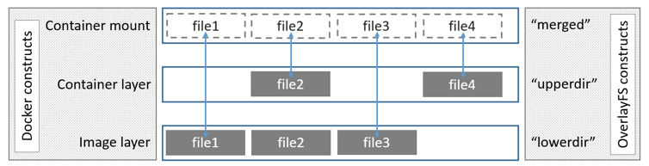
Overlay File System
An overlay file system combines two file systems - an 'upper' file system and a 'lower' file system. When a name exists in both file systems, the object in the 'upper' file system is visible while the object in the 'lower' file system is either hidden or, in the case of directories, merged with the 'upper' object.

Slide 52
Demonstration 7

Slide 53

Let everything put together

Slide 54
Demonstration 8

