Slide 1
failure_type_predictor_AI
IBM AICTE PROJECT
Presented By:
NAME : KORNULE MANMATH MAROTI
COLLEGE NAME : MIT ACDEMY OF ENGINEERING PUNE
DEPARTMENT : CSE(AIML)

Slide 2
OUTLINE :
Problem Statement (Should not include solution)
Proposed System/Solution
System Development Approach (Technology Used)
Algorithm & Deployment
Result (Output Image)
Conclusion
Future Scope
References

Slide 3
Problem Statement
Industrial machines are prone to unexpected failures that lead to increased downtime and operational costs. Traditional maintenance methods often fail to predict these issues in advance. There is a need for an intelligent system that can analyze real-time sensor data and accurately identify early signs of failure. The problem is to develop a predictive maintenance model that can classify the type of failure (such as tool wear, heat dissipation, or power failure) before it occurs. This will enable industries to perform proactive maintenance, reduce machine downtime, and optimize operational efficiency.

Slide 4
Proposed Solution
The proposed system aims to predict potential failures in industrial machinery before they occur, using real-time sensor data and machine learning techniques. This proactive approach will help reduce unplanned downtime, optimize maintenance schedules, and lower operational costs.
The solution consists of the following key components:
Data Collection:
Collect sensor data from industrial machines, including temperature, pressure, vibration, torque, and voltage.
Monitor machine health in real time to capture operational behaviors leading up to failure.
Data Preprocessing:
Clean the data by handling missing values, noise, and anomalies.
Perform feature engineering to extract meaningful indicators that signal machine degradation or risk of failure.
Machine Learning Algorithm:
Train a supervised classification model (e.g., Random Forest, XGBoost, or SVM) to categorize failure types such as tool wear, power failure, and heat issues.
Optimize the model using cross-validation and hyperparameter tuning for better prediction accuracy.

Slide 5
Proposed Solution
Deployment:
Deploy the trained machine learning model directly through IBM Watsonx.ai Studio as an online endpoint .
Use IBM Cloud Lite services to host the model, allowing real-time access for predictions and integration with external systems if needed.
Evaluation:
Evaluate the model using built-in classification metrics provided by Watsonx.ai Studio, such as Accuracy, Precision, Recall, F1-score, and ROC-AUC.
Compare different model pipelines and select the best one based on performance.
Use Watsonx’s visual tools to analyze feature importance and understand model behavior.

Slide 6
System Approach
The "System Approach" section outlines the overall methodology for developing and deploying the predictive maintenance model using IBM Watsonx.ai Studio.
The following are the key components:
System Requirements :
IBM Cloud account (Lite plan) with access to Watsonx.ai Studio and Cloud Object Storage
A dataset of machine sensor readings (CSV format)
Supported web browser (Chrome, Firefox, or Edge)
No local software needed — the entire workflow is done via the cloud
Libraries and Tools Used :
IBM Watsonx.ai Studio – to automate model building using AutoAI
Cloud Object Storage – to upload and manage input datasets
AutoAI – AutoML tool for automatic preprocessing, feature engineering, model training, and optimization
Deployment Space – to deploy the trained model and create a REST API endpoint
Built-in Evaluation Metrics – including Accuracy, Precision, Recall, F1-score, and ROC-AUC

Slide 7
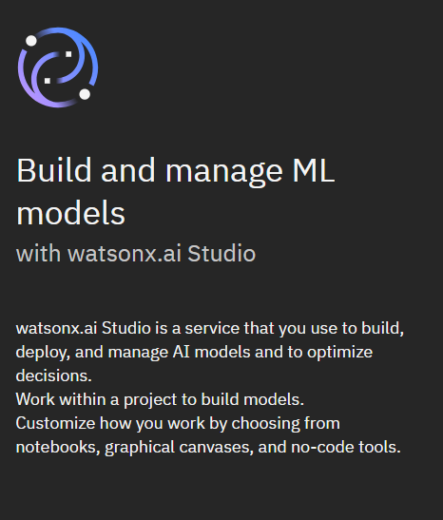
Algorithm & Deployment
Algorithm Selection:
IBM Watsonx.ai Studio's AutoAI feature was utilized to automate model selection and optimization. AutoAI tested various classification algorithms, including:
Random Forest
XGBoost
Logistic Regression
The best-performing model was selected based on accuracy and F1-score. The selected model effectively classifies failure types like Tool Wear, Power Failure, and Heat Dissipation.

Slide 8
Algorithm & Deployment
{
"input_data": [
{
"fields": [
"UDI",
"Product ID",
"Type",
"Air temperature [K]",
"Process temperature [K]",
"Rotational speed [rpm]",
"Torque [Nm]",
"Tool wear [min]",
"Target"
],
"values": [
[
78,
"L45627",
"455.9",
66.4,
67.9,
90.8,
89.8,
34.4,
1
]
]
}
]
}
Data Input:
The input dataset includes real-time sensor readings from industrial machines:
Air Temperature [K]
Process Temperature [K]
Rotational Speed [rpm]
Torque [Nm]
Tool Wear [min]
Product ID and Machine Type The target variable was the type of machine failure, labeled across five categories.

Slide 9
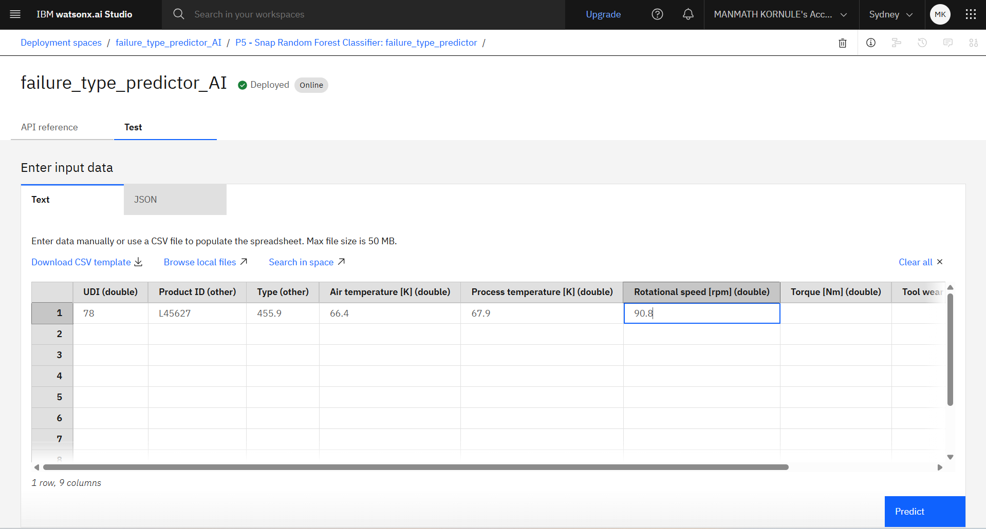
Algorithm & Deployment
Data Input:

Slide 10
Algorithm & Deployment
Training Process:
The model was trained using IBM Watsonx.ai Studio’s AutoAI tool, which automated the complete machine learning workflow. The process involved:
Data preprocessing and intelligent feature engineering
Automatic train-test split and pipeline generation
Model selection and hyperparameter optimization
Cross-validation to ensure robust performance
Watsonx.ai generated multiple model pipelines and evaluated them based on performance metrics like accuracy and F1-score. Among them, the top-performing pipeline (P5), utilizing the Snap Random Forest Classifier, achieved an impressive accuracy of 0.995.

Slide 11
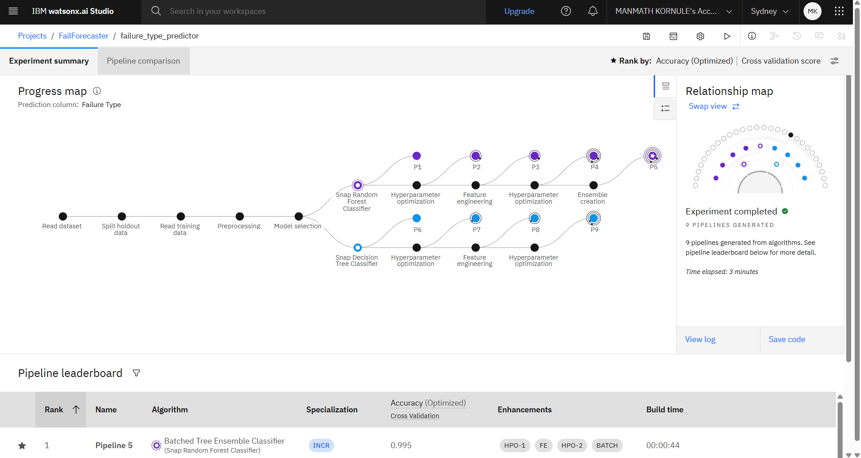
Algorithm & Deployment
Training Process:

Slide 12
Algorithm & Deployment
Prediction Process:
Live Sensor Data: Machines continuously send real-time sensor readings like temperature, speed, torque, and tool wear.
Data Processed: This raw data is cleaned and prepared (just like during training) so the model can understand it.
Model Predicts Failure: The model checks the data and predicts if any failure might happen soon (like tool wear or power failure). It also tells what type of failure is most likely.
Alert Triggered: If the chance of failure is high, the system sends an early warning to the maintenance team.
Machines send sensor data → IBM Watsonx model analyzes it → Predicts possible failures → Sends alerts → Maintenance team takes early action → Prevents breakdowns and saves cost

Slide 13
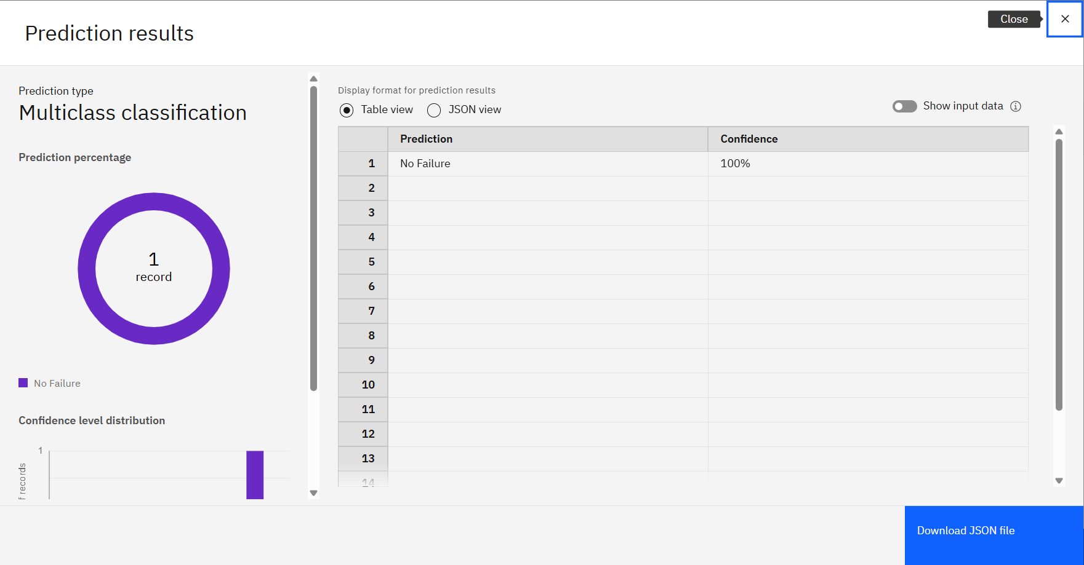
Result

Slide 14
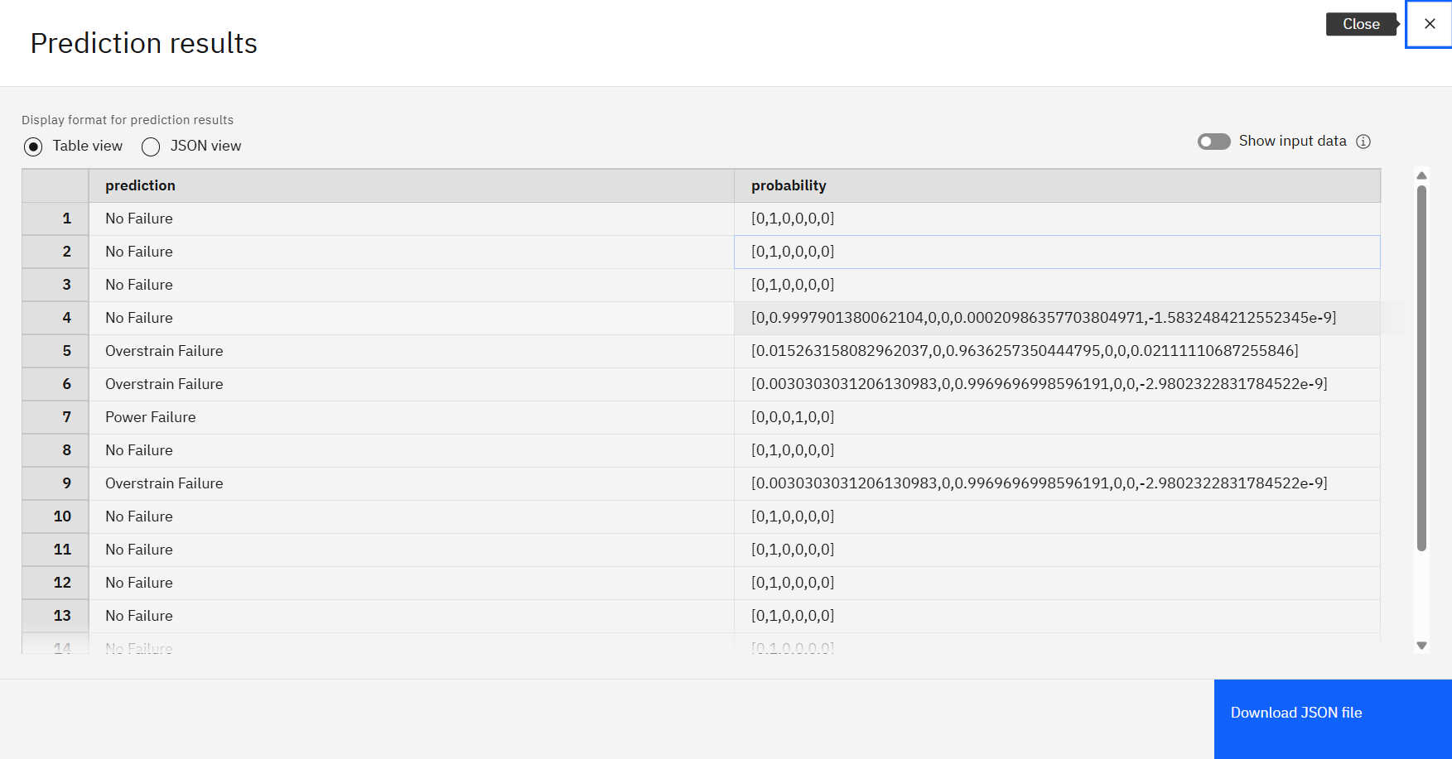
Result

Slide 15
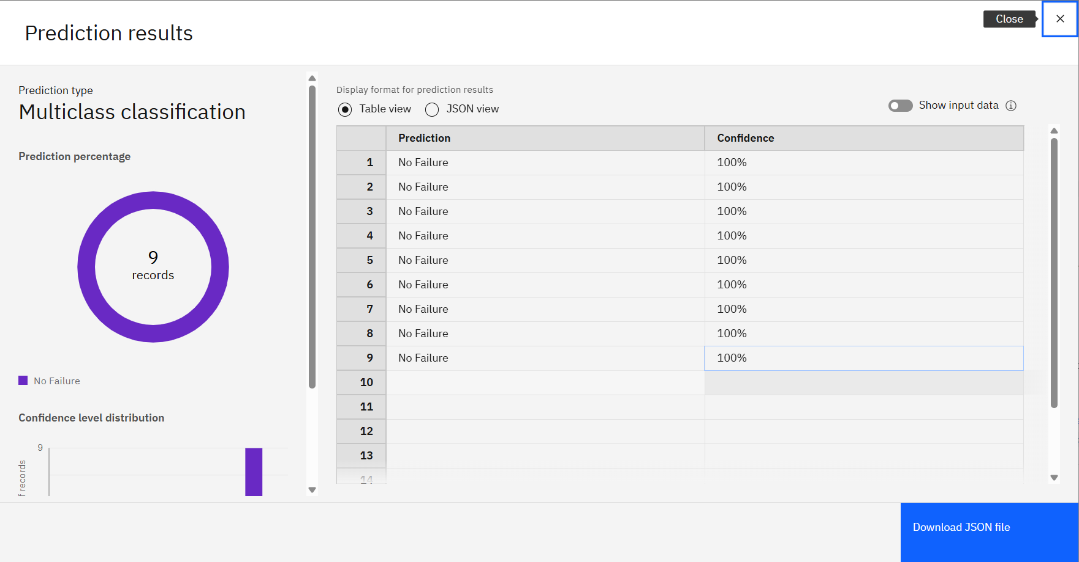
Result

Slide 16
Conclusion
The machine learning model failure_type_predictor_AI, developed using IBM Watsonx.ai, was designed to accurately classify various machine failure types, including power failure, tool wear, heat dissipation, overstrain, and random failures. The model demonstrated high effectiveness, achieving an impressive accuracy
Key Findings:
Random Forest Ensemble Classifier delivered the best performance after extensive hyperparameter tuning and cross-validation.
Real-time sensor features like Air/Process Temperature, Torque, Rotational Speed, and Tool Wear were highly influential in predicting failures.
Challenges Encountered:
The visualization of prediction results was inconsistent at times—especially when switching between pipelines or formats. This made performance interpretation and presentation harder.
Exporting prediction metrics like accuracy, precision, and recall sometimes required schema adjustments or custom post-processing.

Slide 17
Future scope
In the future, the failure_type_predictor_AI model can be improved to make it even more accurate and powerful. We can add more sensor data like vibration levels or oil quality to give the model a deeper understanding of machine conditions. The algorithm itself can also be further optimized using advanced techniques like deep learning or ensemble models. The system could be trained to work in different types of industries, not just the current one. Real-time deployment at the machine edge using edge computing can make predictions faster and more useful. We can also create a mobile-friendly dashboard for maintenance staff. Integrating alerts with IoT devices would help trigger automatic responses. Regular model retraining with fresh data can keep the system smart and up to date. Adding explainability tools can help users understand how the model makes decisions. Overall, the model has a strong future in making industrial systems smarter and more reliable.

Slide 18
References
Dataset Source:– https://www.kaggle.com/datasets/ziya07/power-system faults-dataset
– Source of the predictive maintenance dataset used for model training and testing.
BM watsonx.ai Studio Docs:https://au-syd.dai.cloud.ibm.com/docs/content/wsj/getting-started/welcome-main.html?context=wx&audience=wdp
IBM cloud : https://cloud.ibm.com/
GitHub Repository Link : https://github.com/manmathk31/failure_type_predictor_AI.git

Slide 19
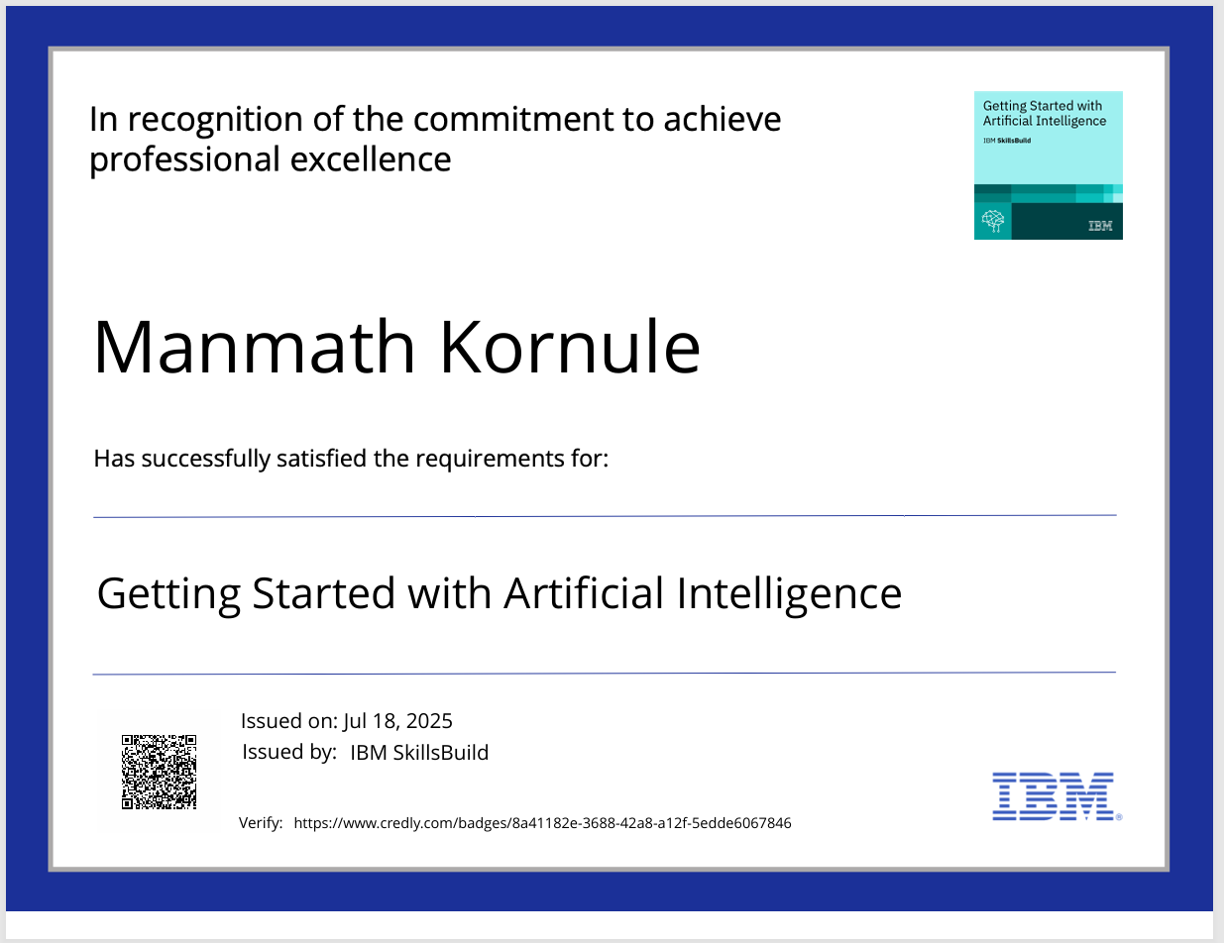
IBM Certifications

Slide 20
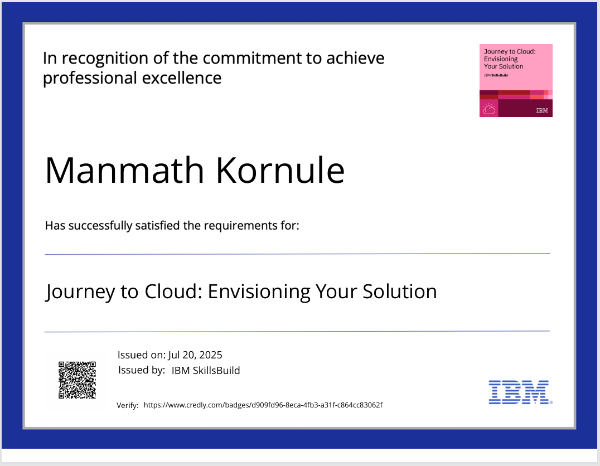
IBM Certifications

Slide 21
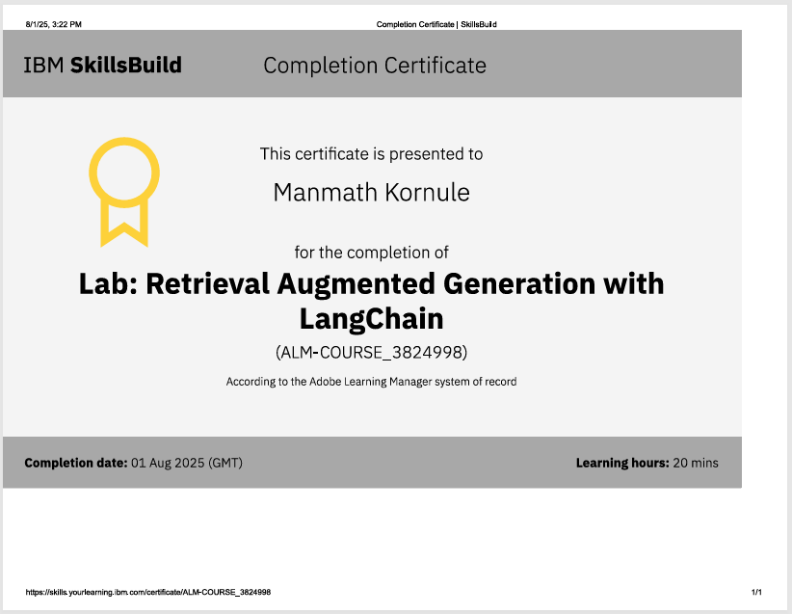
IBM Certifications

Slide 22
THANK YOU

