Slide 1
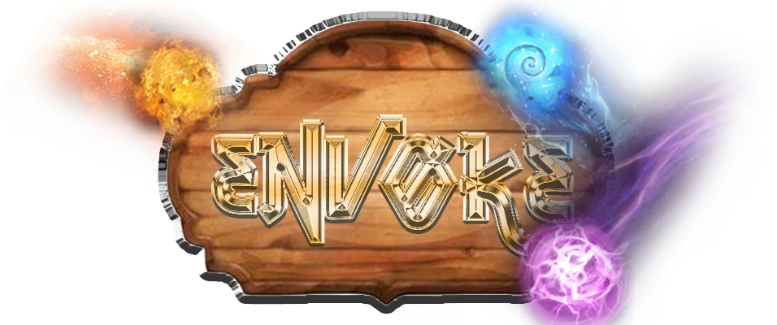
By Generous Koalas
“Top-down dungeon crawler with unique spell combo system”

Slide 2
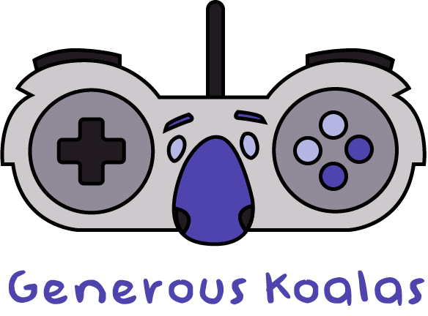
The Team
Yashwant Patel
Upgrades System
Spell System
Matthew Steinhardt
Final Boss
Camera & Movement
Manmeet Singh
Enemy AI
UI & Art Assets
William Bowers
Models & Animation
Dynamic Loot & Gold System
Nicholas Martin
Level Design
Balancing
Aiden Lucas
Sound Design
Traps System

Slide 3
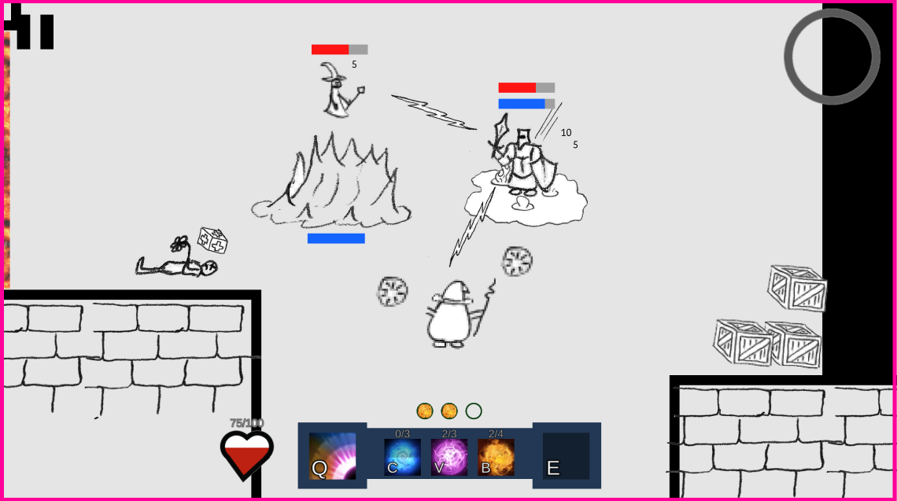
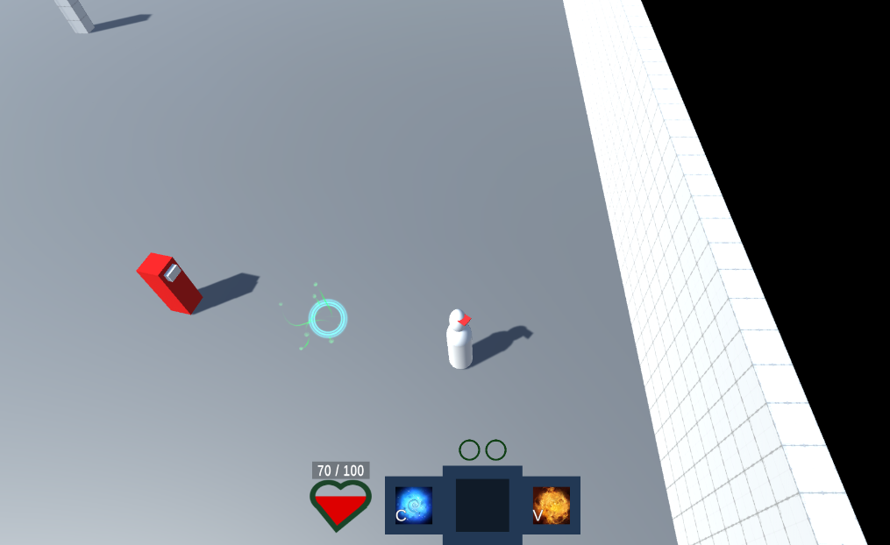
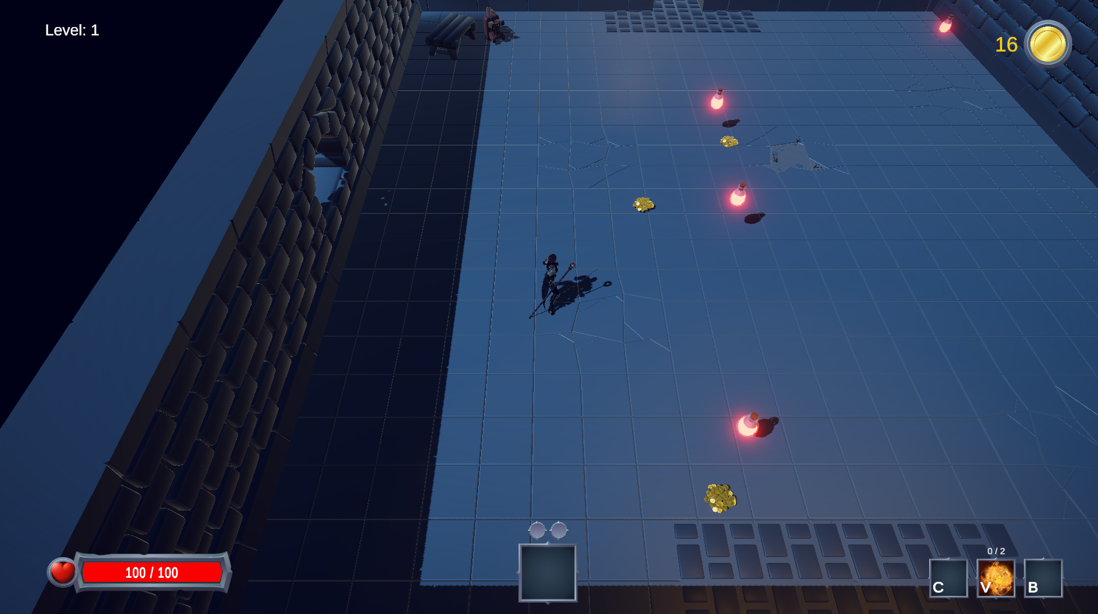
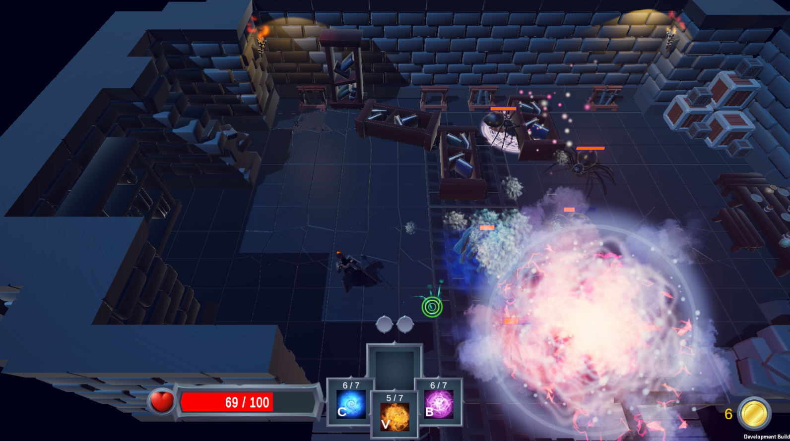
Progress
Prototype
Alpha
First Playable
Final
Notes:
Prototype = PP2 first milestone
First Playable = PP2 final milestone
Alpha = PP3 alpha milestone
Final = Game today

Slide 4
Tips/Tricks
Greenlight Phase
Ensure all team members have the same understanding about what game is being pitched. Often, people think they understand each other until specific details are discussed.
Don’t reinvent the wheel. Utilize existing games as references (especially when pitching to others).
Pre-Production
Paper Models will save you time! Utilize them heavily.
Make sure you cover every system during pre-production. Technical debt can make or break a project!
Use one Trello board as a repository for ideas and potential features, then pull those cards into a different board during prototyping.
Open Production
YouTube is your best friend! Always look up tutorials before wasting all your time trying to do it yourself.
Make hard deadlines and adhere to them.
Start your builds way earlier than you think it will take!
General Tips
Communication is key!
Good communication includes having consistent communication!
Utilize Daily Standups!
Avoid burnout at all cost! (Eat, sleep, take time off)

Slide 5
What Went Right
Decided on the type of game quickly.
Getting on the same page quickly allowed us to spend more time developing our ideas and describing them to the professor.
Our GDD was well thought out.
Helped increase our creativity when thinking about spells, enemies, and systems we wanted to implement.
Most core systems were in a stable state by the time we got to the prototype.
This allowed us to focus on additional features we had to scrap during the Pre-Production.
We had plenty of ideas to pull from Trello.
We didn’t need to think up new ideas halfway through. This allowed us to keep our momentum throughout the entire project.
We completed most of our game before the Beta build.
This allowed us to focus heavily on polishing (lighting, effects, sounds, etc) before Gold release

Slide 6
What Went Wrong
Trying to describe our game pitch was harder than expected.
Understanding the spell system proved difficult to describe for some who had not played the reference games.
We overcame this when the people who didn’t understand continued to ask questions until it was clear.
Draw.io was horrible to use.
We wasted a lot of valuable time trying to work collaboratively with Draw.io.
We overcame this by switching to a much better service called Figma.
Coming to terms with the necessity of scrapping several features during the prototype was difficult.
We spent too much time planning and tweaking possible features. This used up a lot of wasted time and effort.
Once we focused on the bare minimum, we were able to expand on those features more quickly.
Keeping track of checked out Binary files was difficult.
We had many “Oh Shit” moments where someone accidentally mangled someone else’s work.

