Slide 1
A Survey on Face Data Augmentation
By Manmeet Singh
Original Paper by Wang, et al.

Slide 2
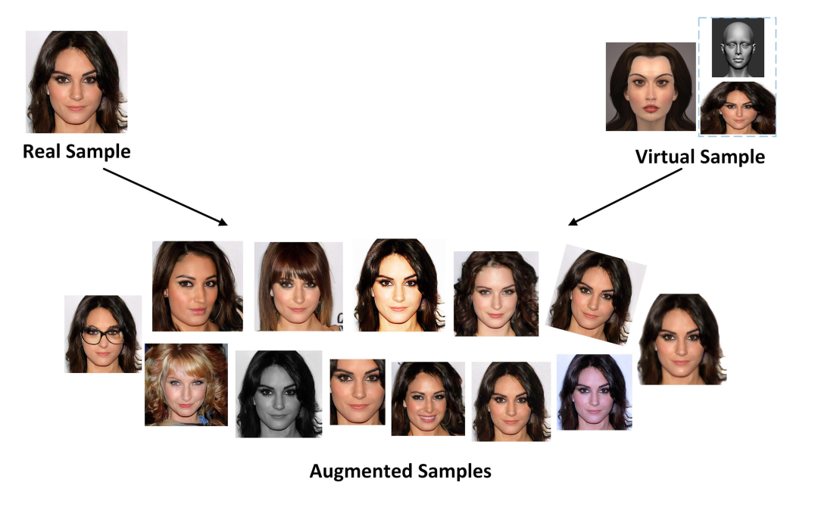
Motivation
Overcome limitation of existing data
Represent un-captured distributions synthetically
Generate faces without self-occlusion
Generate faces with more intra-class variation
Notes:
- Insufficient data
- Unbalanced data

Slide 3
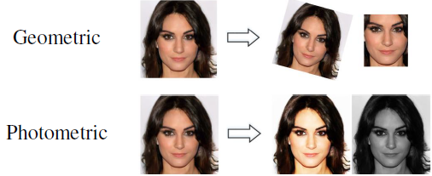
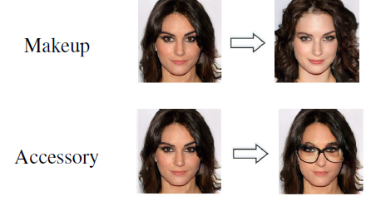
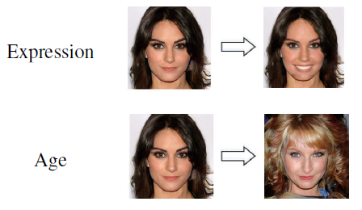
Transformation Types
Generic
Geometric
Photometric
Component
Hairstyle
Makeup
Accessory
Attribute
Pose
Expression
Age

Slide 4
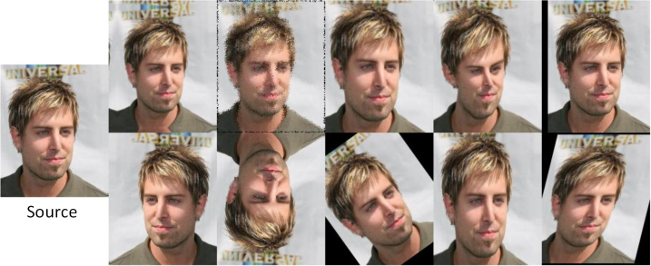
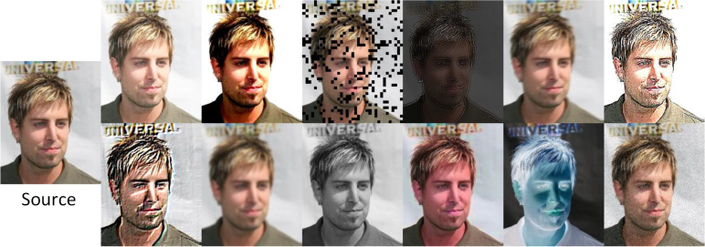
Generic Transformations
Geometric
Flip orientation
Crop and pad
Photometric
Alter RGB channels
Edge enhancement, blurring, etc.

Slide 5
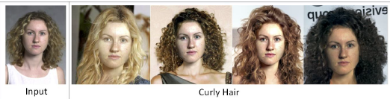
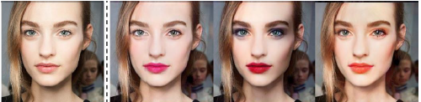
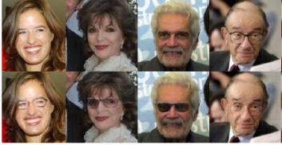
Component Transformations
Hairstyle Transfer
DiscoGAN
StarGAN
Makeup Transfer
Traditional image processing
BeautyGAN
Accessory Transfer
Info-GAN
Notes:
- [18] transformed hair color using DiscoGAN, which was introduced to discover cross-domain relations with unpaired data.
same function was achieved by StarGAN[19], whereas it could perform multi-domain translations usinga single model.

Slide 6
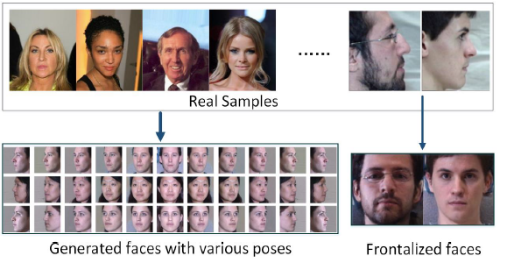
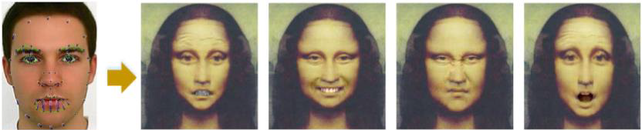
Attribute Transformations
Pose
PCA based 2D shape model
GAN based 3D models
UV-GAN
CAPG-GAN
Others
Expression
4 Primary GAN categories
Age
Input encoded into latent vectors
Reconstructed with different age
Notes:
UV-GAN: to complete the facial UV map and recover the self-occluded regions. virtual instances under arbitrary poses were generated by attaching the completed UV map to the fitted 3D face mesh
CAPG-GAN (Couple-Agent Pose-Guided GAN) to realize flexible face rotation of arbitrary head poses from a single image in 2D space
Other GANs that try to preserve the identity by saving facial features and recasting them onto a rotated canvas
Expression
Based on reference and target images
2) Variable generation of expression codes
3) Continuous action unit coefficients.
4) Preserving identity in images using Geometry-Guided GAN, etc.

Slide 7
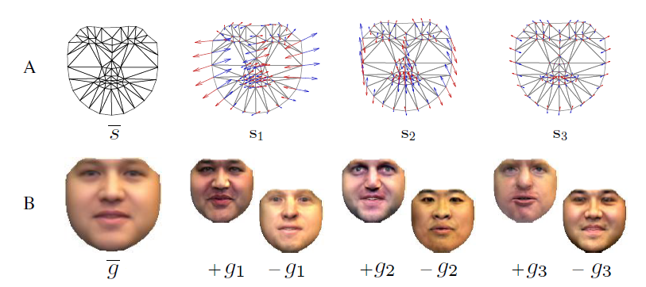
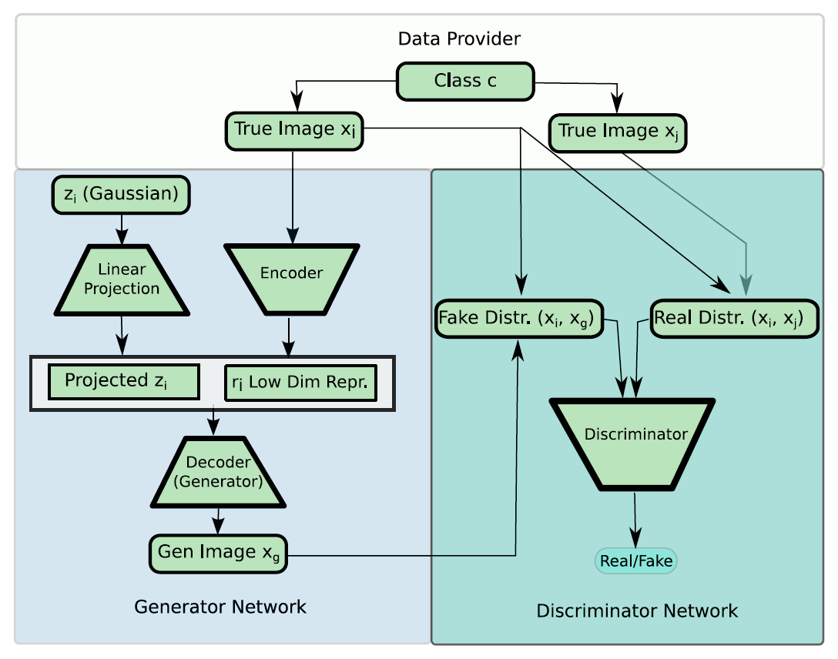
Transformation Methods
Basic Image Processing
Transformations and playing with RGB channels
Model-based Transformation
Fit existing model to input image
Realism Enhancement
Generative-based Transformation
Augmented Reality
Auto Augmentation
Notes:
Augmented Reality (AR) is a technique which supplements the real word with virtual (computer-generated) objects that appear to coexist in the same space

Slide 8
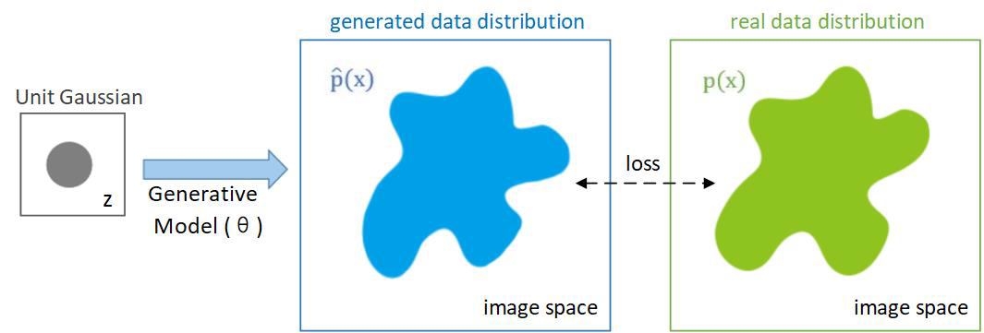
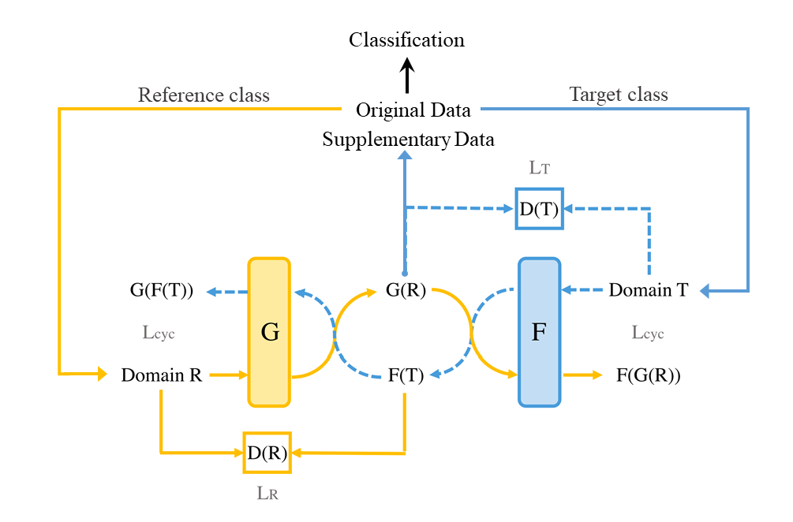
Generative Transformation
Autoregressive Generative Models
Variational Autoencoders
GANs
Flow Based Generative Models
Notes:
The generative model maps a unit Gaussian distribution (grey) to another distribution ^p(x) (blue) through a neural network, which is a function with parameters .
Autoregressive Gen model joint distribution by decomp into product of conditional individual
The idea of VAEs is to learn the latent variables, which are low-dimensional latent representations of the training data and reconstruct input based on those.
GANs are trained to generate auxiliary data for imbalanced datasets after training on complete datasets. CycleGAN is a popular one because it learns mapping between two high dimensional data domains.
Comparison
Flow based generative models learn probability density function of data using normalizing flows.

Slide 9
Evaluation Metrics
Qualitative
Quantitative
Distance Measurement
L1 and L2 norm for color and spatial distance
Accuracy and Error Rate
Require balanced dataset
Inception Score
Relative entropy of two probability distributions
Frechet Inception Distance
Between multivariate Gaussian distributions of real and generated

Slide 10
Challenges and Opportunities
Identity Preservation
Lack realistic variations of make-up, hair color, etc.
Disentangled Representation
Unsupervised Data Augmentation
Improvement of GANs

Slide 11
Thank You

