Slide 1
A Survey on Face Data Augmentation
Original Paper by Want, et al.
Presentation by Manmeet Singh

Slide 2
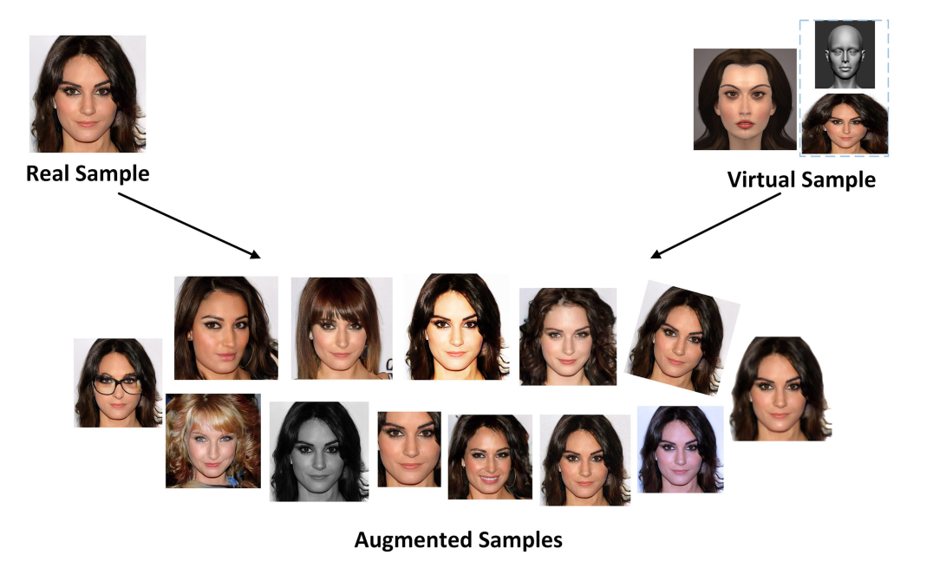
Motivation
Overcome limitation of existing data
Represent un-captured distributions synthetically
Generate faces without self-occlusion
Generate faces with more intra-class variation
Notes:
- Insufficient data
- Unbalanced data

Slide 3
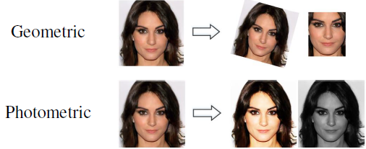
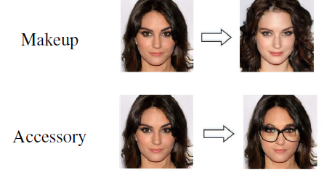
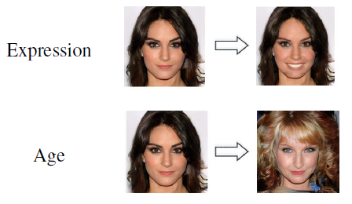
Transformation Types
Generic
Geometric
Photometric
Component
Hairstyle
Makeup
Accessory
Attribute
Post
Expression
Age

Slide 4
Limitations
Lack realistic variations
Make-up, hair color, occlusion, etc.

