Slide 1
A Hands-on Session on Message Passing Interface
Manmeet Singh
Centre for Climate Change Research
Indian Institute of Tropical Meteorology

Slide 2
Cloning the Repository
All the code that would be used in this session is available on github at https://github.com/prince2299/MPI-Tutorials-ESM-School-2016/blob/master/1_HelloWorld/helloWorld.f90
Please clone the repository using the command
Next we will study some basics of parallel computing before moving on to practice session on MPI
git clone https://github.com/prince2299/MPI-Tutorials-ESM-School-2016

Slide 3
Parallel Computing models(Flynn’s Taxonomy)
SIMD – Single Instruction Multiple Data
MIMD – Multiple Instruction Multiple Data
SPMD – Single Program Multiple Data (equivalent of MIMD)
Buffering
Blocking and non blocking communication

Slide 4
Initialization, Rank, Size and finalize
Lets move on to the first program helloworld.f90 on the cloned repository
Following MPI routines are used for starting and ending a parallel program
call MPI_Init(ierr) ! Initializes MPI calls
call MPI_Comm_rank(MPI_COMM_WORLD, rank, ierr) ! obtains the rank of current MPI process
call MPI_Comm_size(MPI_COMM_WORLD, numtasks, ierr) ! obtains the total number of MPI processes */
call MPI_Finalize(ierr) ! Finalizes MPI calls

Slide 5
Helloworld
program helloworld
use mpi
integer :: rank, numtasks, ierr
call MPI_Init(ierr) ! Initializes MPI calls
call MPI_Comm_rank(MPI_COMM_WORLD, rank, ierr) ! obtains the rank of current MPI process
call MPI_Comm_size(MPI_COMM_WORLD, numtasks, ierr) ! obtains the total number of MPI processes */
if (rank == 0 ) then
print *,"hello world. I am MASTER"
else
print *,"hello world from process", rank," of ", numtasks
end if
call MPI_Finalize(ierr) ! Finalizes MPI calls
end program helloworld

Slide 6
Send and Receive
call MPI_Send(message, count, MPI_Datatype, destination, tag, comm, ierr)
MPI Datatypes
MPI_CHAR
MPI_INT
MPI_LONG
MPI_FLOAT
MPI_DOUBLE
call MPI_Receive(message, count, MPI_Datatype, source, tag, comm, status, ierr)

Slide 7
Send and Receive
program greetings
use mpi
integer,parameter :: ROOT = 0
integer :: my_rank, recv_rank, numtasks, p, ierr, status(MPI_STATUS_SIZE)
call MPI_Init(ierr) ! Initializes MPI calls
call MPI_Comm_rank(MPI_COMM_WORLD, my_rank, ierr) ! obtains the rank of current MPI process
call MPI_Comm_size(MPI_COMM_WORLD, numtasks, ierr) ! obtains the total number of MPI processes
if (my_rank .ne. ROOT ) then
call MPI_Send(my_rank, 1, MPI_INT, ROOT, 0, MPI_COMM_WORLD, ierr)
else
do p = 1,numtasks-1
call MPI_Recv(recv_rank, 1, MPI_INT, p, 0, MPI_COMM_WORLD, status, ierr)
print *,"Greetings from Process ", recv_rank
end do
end if
call MPI_Finalize(ierr) ! Finalizes MPI calls
end program greetings

Slide 8
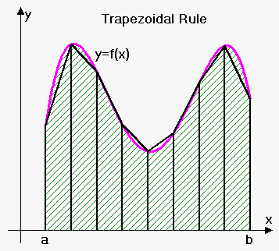
An Example : Numerical Integration using Trapezoidal rule
! Serial Trapezoid Rule Program ! [f(x0)/2 + f(xn)/2 + f(x1) + ... + f(xn-1)]*h
program serial_trapezoid
real :: integral ! definite integral result
real,parameter :: a=0.0 ! left end point
real,parameter :: b=1.0 ! right end point
integer,parameter :: N=100000 ! number of subdivisions
real :: h ! base width of subdivision
real :: x, fx, fa, fb
integer :: i
h = (b-a)/N
call f(a,fa)
call f(b,fb)
integral = (fa+fb)/2.0
x = a
do i=1,N-1
x = x+h
call f(x,fx)
integral = integral + fx
end do
integral = integral*h
print *,"WITH N=", N, " TRAPEZOIDS, INTEGRAL=", integral
end program serial_trapezoid
subroutine f(x,y)
real :: x,y
y = exp(x*x)
end subroutine f

Slide 9
Parallelizing the trapezoidal rule
! MPI Trapezoid Rule Program */ ! [f(x0)/2 + f(xn)/2 + f(x1) + ... + f(xn-1)]*h */
program trapezoid
use mpi
implicit none
real :: integral ! definite integral result
real, parameter :: a=0.0 ! left end point
real, parameter :: b=1.0 ! right end point
real, parameter :: N=100000 ! number of subdivisions
real :: h ! base width of subdivision
real :: x,y,local_y1,local_y2, y1,y2
integer :: i
integer :: my_rank
integer :: numprocs ! we will need some local variables
real :: local_a, local_b
integer :: local_N
real :: lcl_integral
integer :: ierr
integer,parameter :: dest = 0
real :: recv ! a variable to receive results
integer :: status(MPI_STATUS_SIZE)
h = (b-a)/N ! we assume we use the same integration step on all processes ! MPI programming begins
call MPI_Init(ierr)
call MPI_Comm_size(MPI_COMM_WORLD, numprocs, ierr)
call MPI_Comm_rank(MPI_COMM_WORLD, my_rank, ierr)
0
1
2
3
Let’s say we have 4 processors

Slide 10
Parallelizing the trapezoidal rule
! Find out what the local values are on each process
local_N = N/numprocs
local_a = a + my_rank * local_N * h
local_b = local_a + local_N * h ! begins local integration */
x = local_a
call f(local_a,local_y1)
call f(local_b,local_y2)
lcl_integral = (local_y1 +local_y2)/2.0
do i=1,local_N-1
x = x+h
call f(x,y)
lcl_integral = lcl_integral + y
end do
lcl_integral = lcl_integral*h ! send the local results to Process 0
if ( my_rank .ne. dest ) then
call MPI_Send(lcl_integral, 1, MPI_DOUBLE, dest, 0, MPI_COMM_WORLD, ierr)
print *,"local integral in processor number ",my_rank," =",lcl_integral ! Process 0 receives and sums up the results
else
print *,"local integral in processor number ",my_rank," =",lcl_integral
do i=1,numprocs-1
call MPI_Recv(recv, 1, MPI_DOUBLE, i, 0, MPI_COMM_WORLD, status, ierr)
integral = integral + recv
end do
print *, "WITH N=", N, " TRAPEZOIDS, INTEGRAL=", integral
end if ! MPI programming ends
call MPI_Finalize(ierr)
end program trapezoid
0
1
2
3

Slide 11
I/O on Parallel Systems
! MPI Trapezoid Rule Program */ ! [f(x0)/2 + f(xn)/2 + f(x1) + ... + f(xn-1)]*h */
program io
use mpi
implicit none
integer :: a, b, n, my_rank, numprocs, tag, dest, ierr
integer,parameter :: source = 0
integer :: status(MPI_STATUS_SIZE)
call MPI_Init(ierr)
call MPI_Comm_size(MPI_COMM_WORLD, numprocs, ierr)
call MPI_Comm_rank(MPI_COMM_WORLD, my_rank, ierr)
if (my_rank .eq. 0) then
print *, “Enter a ” ; read(*,*) a
print *, “Enter b ” ; read(*,*) b
print *, “Enter n ” ; read(*,*) n
do dest = 1,numprocs – 1
tag = 0
call MPI_Send(a, 1, MPI_FLOAT, dest, tag, MPI_COMM_WORLD, ierr)
tag = 1
call MPI_Send(b, 1, MPI_FLOAT, dest, tag, MPI_COMM_WORLD, ierr)
tag = 2
call MPI_Send(n, 1, MPI_FLOAT, dest, tag, MPI_COMM_WORLD, ierr)
end do
else
tag = 0
call MPI_Recv(a, 1, MPI_FLOAT, source, tag, MPI_COMM_WORLD, status, ierr)

Slide 12
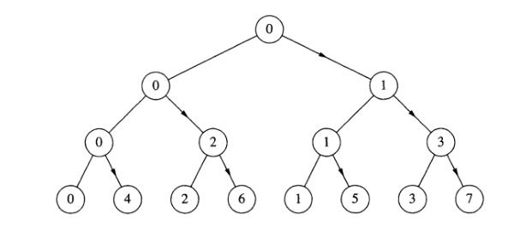
I/O on Parallel Systems
tag = 1
call MPI_Recv(b, 1, MPI_FLOAT, source, tag, MPI_COMM_WORLD, status, ierr)
tag = 2
call MPI_Recv(n, 1, MPI_FLOAT, source, tag, MPI_COMM_WORLD, status, ierr)
end if
end program io
I/O using tree structured communication
- Details involved in writing code for tree structured communication
fairly complicated
- Without knowing the topology of the system, we can’t be sure that hand coded broadcast is the most efficient broadcast possible
- Hence MPI provides a function MPI_Bcast

Slide 13
MPI_Bcast, MPI_Reduce and MPI_Allreduce
call MPI_Bcast(message, count, datatype, root, comm, ierr)
call MPI_Reduce(operand, result, count, datatype, operator, root, comm, ierr)
call MPI_Allreduce(operand, result, count, datatype, operator, comm, ierr)
Operation Name
MPI_MAX
MPI_MIN MPI_SUM
MPI_PROD
MPI_LAND
MPI_BAND
MPI_LOR
MPI_BOR
MPI_LXOR
MPI_BXOR
MPI_MAXLOC
MPI_MINLOC
Tags, Safety, Buffering and Synchronization
When a send cannot complete until the receiver is ready to receive the message, the send is said to use synchronous mode
If the system does not buffering, deadlock may occur

Slide 14
Trapezoidal rule using collective communication
program trapezoid
use mpi
implicit none
integer,parameter :: root = 0
real :: integral ! definite integral result
real, parameter :: a = 0.0 ! left end point
real, parameter :: b = 1.0 ! right end point
integer :: N ! number of subdivisions
real :: h ! base width of subdivision
real :: x,fx
integer :: I, my_rank, numprocs, ierr, status(MPI_STATUS_SIZE)
! we will need some local variables
real :: local_a, local_b, flocal_a, flocal_b, local_N, lcl_integral ! MPI programming begins
call MPI_Init(ierr)
call MPI_Comm_size(MPI_COMM_WORLD, numprocs, ierr)
call MPI_Comm_rank(MPI_COMM_WORLD, my_rank, ierr)
if (my_rank .eq. ROOT) then
print *,"Enter values of "
print *," a = " ;read(*,*) a
print *," b = " ;read(*,*) b
print *," N = ";read(*,*) N
end if
call MPI_Bcast(a, 1, MPI_REAL, ROOT, MPI_COMM_WORLD, ierr)
call MPI_Bcast(b, 1, MPI_REAL, ROOT, MPI_COMM_WORLD, ierr)
call MPI_Bcast(N, 1, MPI_INT, ROOT, MPI_COMM_WORLD, ierr)

Slide 15
Trapezoidal rule using collective communication
h = (b-a)/N ! we assume we use the same integration step on all processes ! Find out what the local values are on each process */
local_N = N / numprocs
local_a = a + my_rank * local_N * h
local_b = local_a + local_N * h ! begins local integration
x = local_a
call f(local_a,flocal_a)
call f(local_b,flocal_b)
lcl_integral = (flocal_a+flocal_b)/2.0
do i=1,local_N-1
x = local_a + i*h
call f(x,fx)
lcl_integral = lcl_integral + fx
end do
lcl_integral = lcl_integral*h ! Reduce and send result to ROOT
call MPI_Reduce(lcl_integral, integral, 1, MPI_REAL, MPI_SUM, ROOT, MPI_COMM_WORLD, ierr) ! To send the updated value of integral to every processor !
call MPI_Allreduce(lcl_integral, integral, 1, MPI_REAL, MPI_SUM, MPI_COMM_WORLD, ierr)
print *,"Process ",my_rank," WITH N=", N, " TRAPEZOIDS, INTEGRAL=", integral
call MPI_Finalize(ierr)
end program trapezoid
subroutine f(x,y)
real :: x,y
y = exp(x*x)
end subroutine f

Slide 16
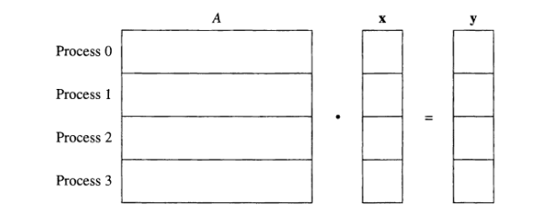
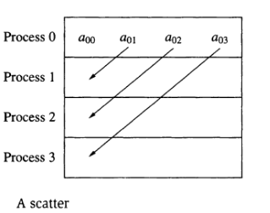
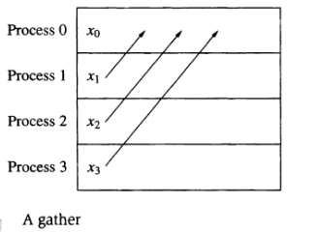
Gather, Scatter, AllGather and AllScatter

Slide 17
Gather, Scatter and AllGather
call MPI_Gather(send_data, send_count, send_type, recv_data, recv_count, recv_type, root, comm, ierr)
call MPI_Scatter(send_data, send_count, send_type, recv_data, recv_count, recv_type, root, comm, ierr)
call MPI_Allgather(send_data, send_count, send_type, recv_data, recv_count, recv_type, comm, ierr)
Thank You

