Slide 1
Git Checkout
Submitted by:- Manmeet(1717),
Rupali(1749),
Balraj(1750),
Mohit(1731)

Slide 2
Git Checkout Command
Checkout command let’s us to switch between the branches created in git branch.
$ git checkout <branch-name>
Checking out that branch,working directory,seeing the updates in the files, what’s new is added in that file.
Through checkout command we can create and switch between new and available branch with the help of :
$ git checkout -b <new-branch-name>

Slide 3
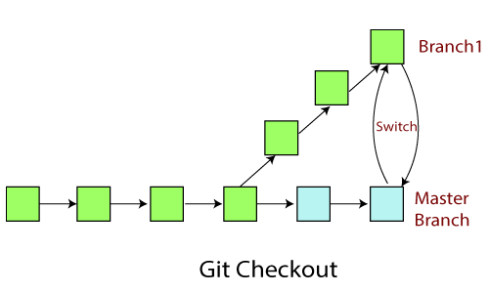
Git Checkout

Slide 4
Git Checkout Command
To view list of branches available in the git branch syntax:
$ git branch
To switch between branches we use following command:
$ git checkout <branch-name>

Slide 5
Checkout Remote
Checkout Remote Branch
Git allows you to check out a remote branch by git checkout command.
It is a way for a programmer to access the work of a colleague or collaborator for review and collaboration.
Each remote repository contains its own set of branches. So, to check out a remote branch, you have first to fetch the contents of the branch.

Slide 6
Thankyou

