Slide 1
On Project Report “ Project Title .” SUBMITTED IN PARTIAL FULFILLMENT OF THE REQUIREMENT FOR THE AWARD OF THE DEGREE OF BACHELOR OF COMPUTER APPLICATION SUBMITTED BY STUDENT NAME (ROLL NUMBER) UNDER THE SUPERVISION OF DR. NITIN KUMAR (ASSITANT PROFESSOR, CSE) DEPARTMENT OF COMPUTER SCIENCE AND ENGINEERING SHOBHIT UNIVERSITY, GANGOH APRIL 2026

Slide 2
⚡ QuickLabour
On-Demand Labour Hiring Platform
India's #1 Labour Hiring App — Connect with verified plumbers,
electricians, painters, carpenters and 50+ more trades.
🌐 quick-labour.onrender.com | College Project | Full-Stack Web Development

Slide 3
📋 Table of Contents
01 Project Overview & Problem Statement
08 Admin Control Center
02 Solution & Key Features
09 Database — MongoDB Atlas
03 Application Walkthrough — Home Page
10 Technology Stack
04 Portal Login System
11 System Architecture
05 User Registration — Client & Worker
12 Challenges & Learnings
06 Worker Dashboard
13 Future Scope & Thank You
07 Client Dashboard

Slide 4
❓ The Problem We Solved
⏳ No Central Platform
🔎 Difficult to Find Workers
Workers & employers had no dedicated digital marketplace in India for on-demand skilled labour hiring.
Employers wasted days searching informally — through word of mouth, middlemen, or unreliable classifieds.
💸 Exploitation & Unfair Wages
📵 Workers Remain Undiscovered
Lack of transparency allowed middlemen to exploit workers with below-market pay and no accountability.
Skilled tradespeople in local areas — electricians, plumbers, carpenters — had no way to show their availability.

Slide 5
💡 Our Solution — QuickLabour
A full-stack web platform connecting clients with verified skilled workers instantly — no middlemen, full transparency.
01
02
03
Browse & Hire Workers
Post Jobs Instantly
Dual Portal System
Search verified workers by trade (Electrician, Plumber, Painter…) with ratings, pricing & availability shown.
Clients post detailed job requests. Workers receive nearby invitations and can accept within minutes.
Separate login portals for Clients and Workers, each with a personalised dashboard and profile.
04
05
06
Admin Control Center
Real-time Earnings Tracker
Aadhaar Verification
Full admin panel for platform moderation — manage users, jobs, reviews, inquiries & revenue metrics.
Workers track completed jobs, monthly earnings (₹) and ratings from their own dashboard.
Workers upload ID proof for verified status, building trust with clients across the platform.

Slide 6
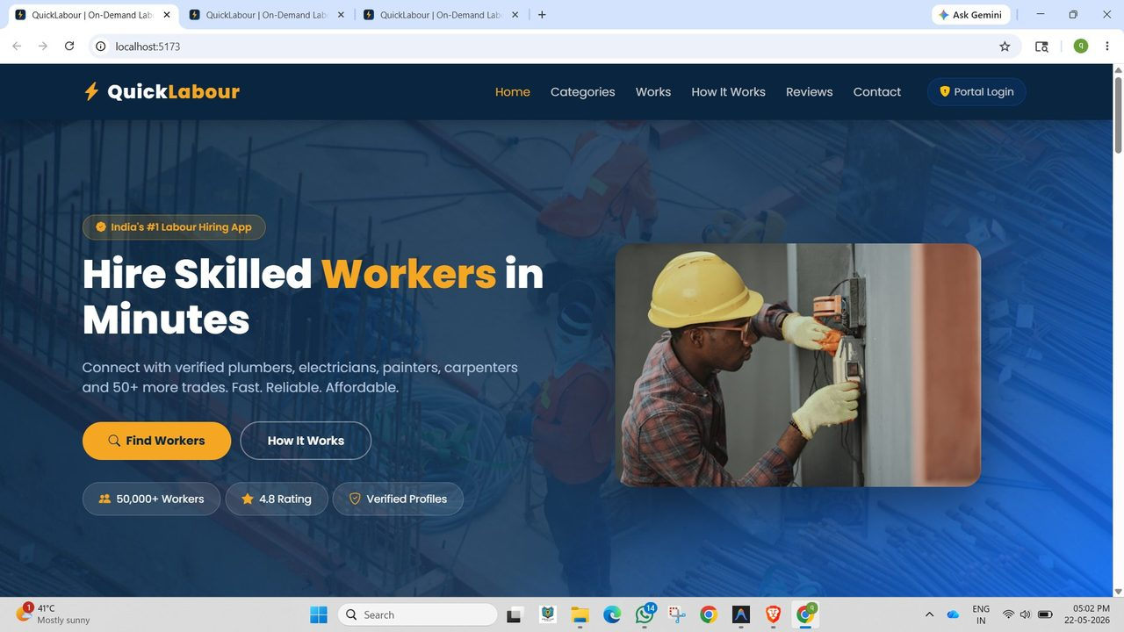
🏠 Home Page — Hero Section
Slide 3 / 23
Key elements: "Hire Skilled Workers in Minutes" hero • 50,000+ Workers badge • 4.8 Rating • Verified Profiles • Find Workers CTA

Slide 7
🏠 Home Page — Feature Highlights
⚡ Brand Logo + Tagline
QuickLabour lightning bolt logo with clear tagline across the dark navy navbar.
🔗 Navigation Menu
Home, Categories, Works, How It Works, Reviews, Contact — and Portal Login button.
👷 Hero Banner
"Hire Skilled Workers in Minutes" with real worker imagery and two CTA buttons.
📊 Trust Indicators
50,000+ Workers, 4.8 Rating, Verified Profiles shown prominently below the hero.
🎨 Dark-Blue Theme
Consistent dark navy background with gold accent colour matching the app identity.

Slide 8
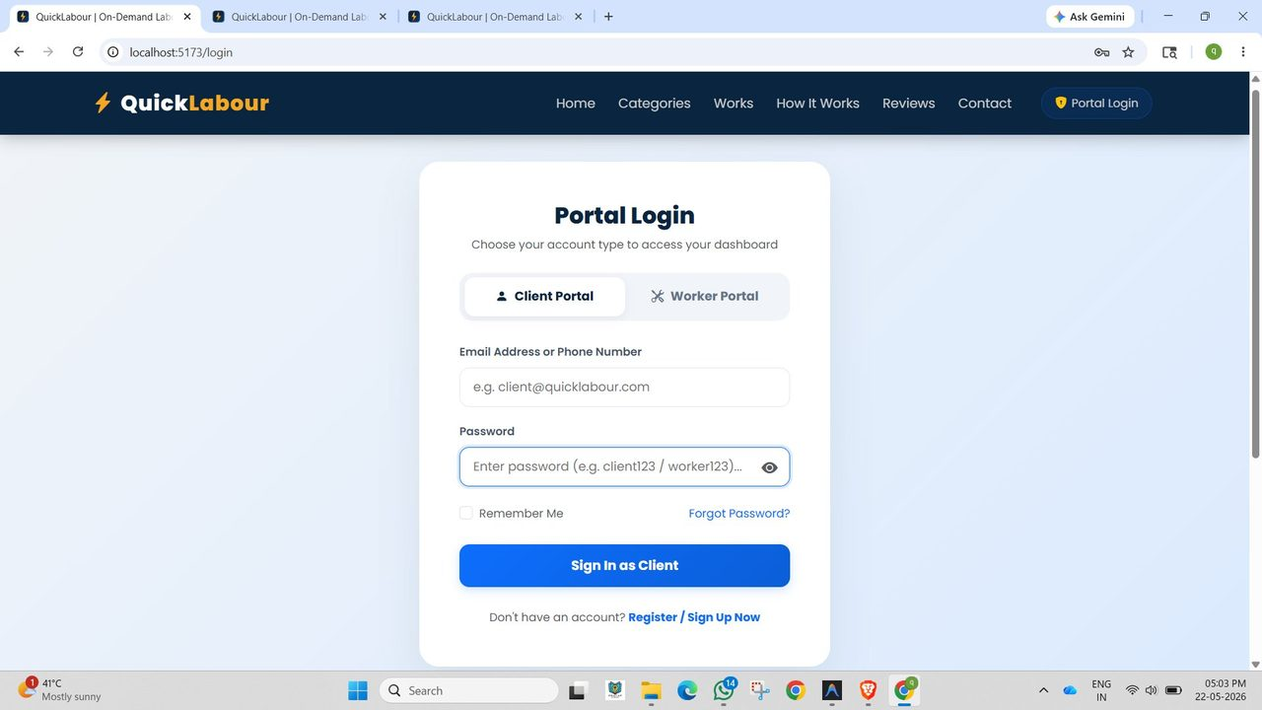
🔐 Portal Login System
Dual Portal Tabs
Users select Client Portal or Worker Portal before entering credentials — separate access paths.
Secure Credentials
Email or phone + password login. Remember Me option for convenience.
Forgot Password
Built-in password recovery flow for both portal types.
Smart Redirect
Login routes user to the correct dashboard (client/worker/admin) based on account type.
Register CTA
New users directed to registration with a single click.

Slide 9
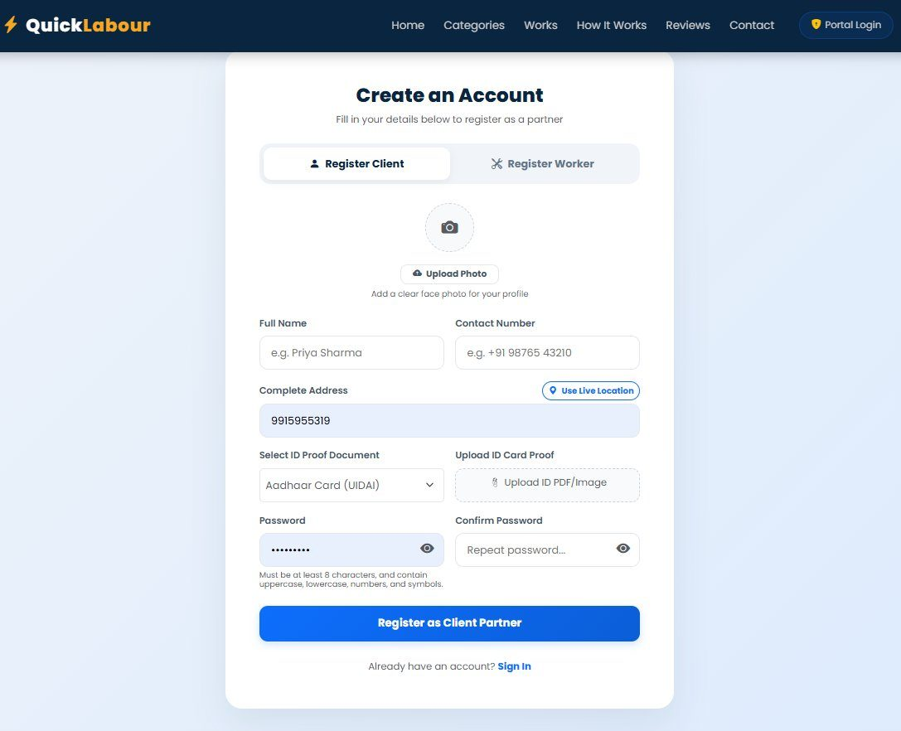
📝 Registration — Client Portal
Form Fields Included:
✅ Profile photo upload (face image)
✅ Full Name & Contact Number
✅ Complete Address + GPS Live Location
✅ Select ID Proof Document type
✅ Upload ID Card (PDF / Image)
✅ Password with strength requirements
✅ Register as Client Partner button

Slide 10
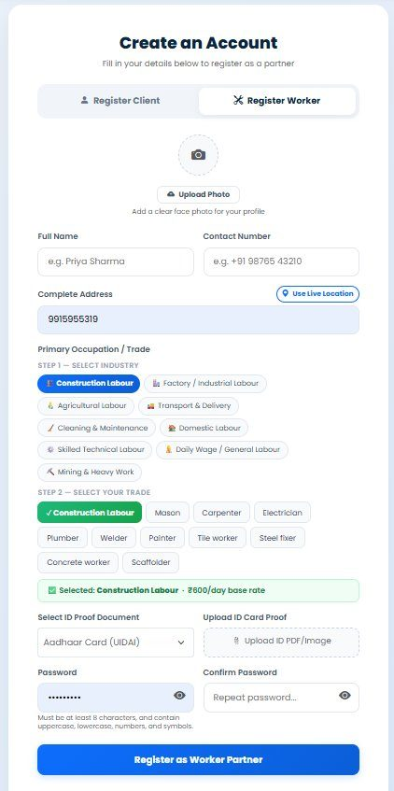
👷 Registration — Worker Portal
2-Step Trade Selection
Step 1: Select Industry (Construction, Factory, Agricultural, Transport…). Step 2: Select specific trade (Mason, Carpenter, Electrician…).
Base Rate Display
Once a trade is selected, the platform shows the base daily rate (e.g. ₹800/day for Construction Labour).
8 Industry Categories
Construction • Factory • Agricultural • Transport • Cleaning • Domestic • Skilled Technical • Mining & Heavy Work
ID Verification
Workers upload Aadhaar Card or other ID proof to earn a verified badge on their profile.
Photo Upload
Workers add a clear profile photo to build trust with potential clients.

Slide 11
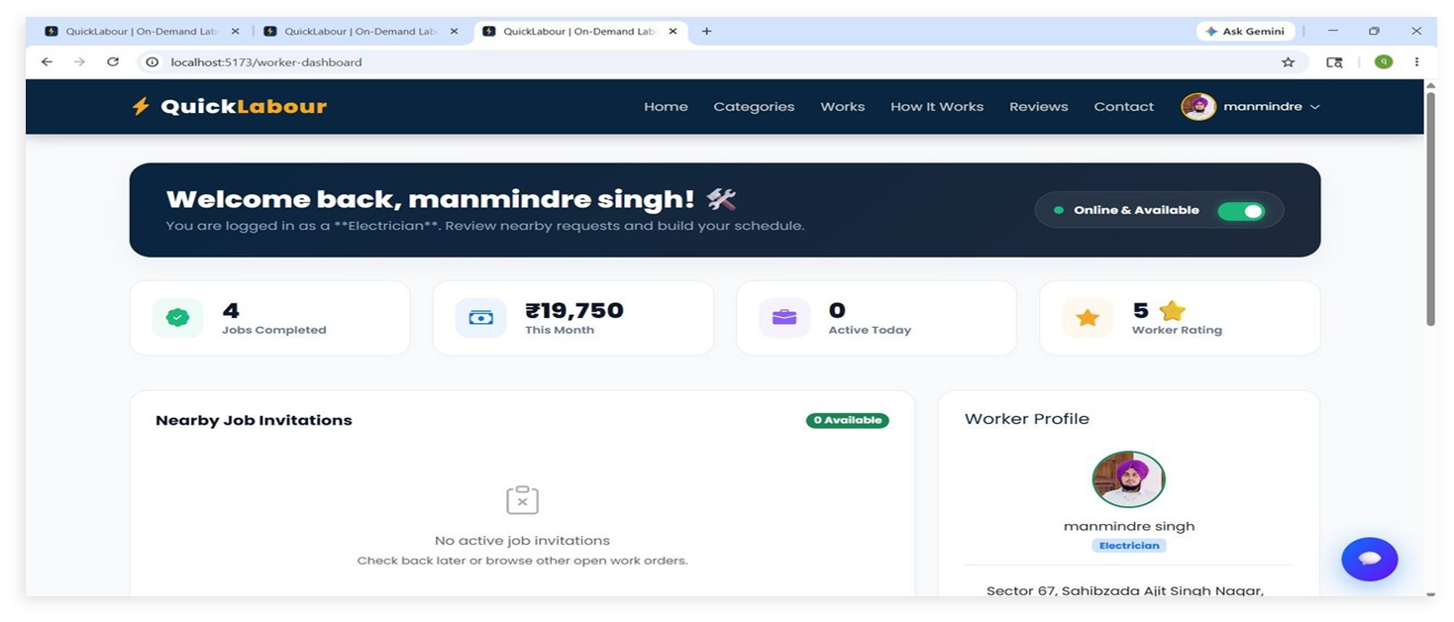
⚙️ Worker Dashboard — Overview
Features: Online/Offline toggle • Jobs Completed counter • Monthly Earnings (₹19,750) • Worker Rating (5★) • Nearby Job Invitations • Worker Profile panel

Slide 12
⚙️ Worker Dashboard — Feature Breakdown
✅ Jobs Completed Tracker
Total count of successfully finished jobs shown prominently on the dashboard.
⭐ Worker Rating Display
Current star rating (1–5) visible to the worker — builds accountability and pride.
📨 Nearby Job Invitations
👤 Worker Profile Panel
Location-based job invitations appear here — worker can review and accept posted jobs.
Right-side panel shows photo, trade, location, and account settings at a glance.

Slide 13
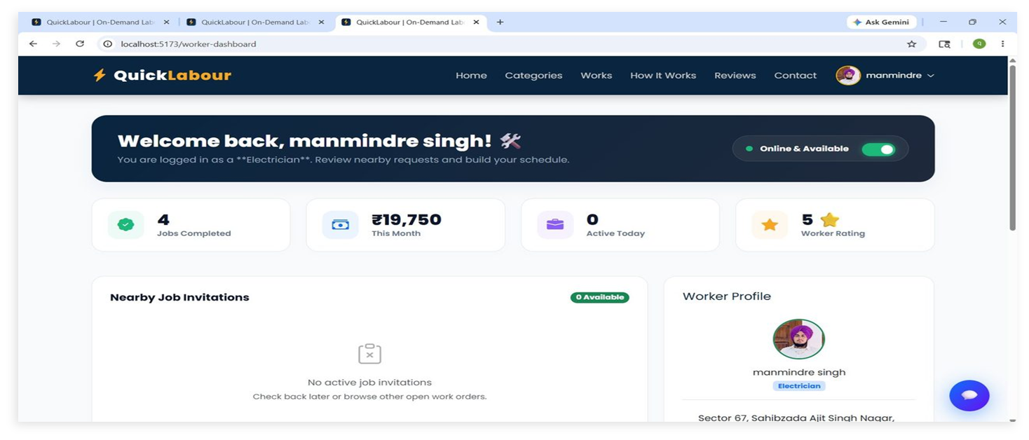
⚙️ Worker Dashboard — All Features
🟢 Online Toggle
✅ Jobs Completed
Instantly switch availability — only online workers appear in client search.
Total completed jobs tracked and displayed.
💰 Monthly Earnings ₹
⭐ Worker Rating
Live monthly income display (e.g. ₹19,750 this month).
Star rating (5★) built from client reviews.
📨 Job Invitations
👤 Profile Panel
4
₹19,750
5 ★
0
Location-based job invites from clients appear here.
Photo, trade, address visible in the right panel.
Jobs Done
This Month
Rating
Active Today

Slide 14
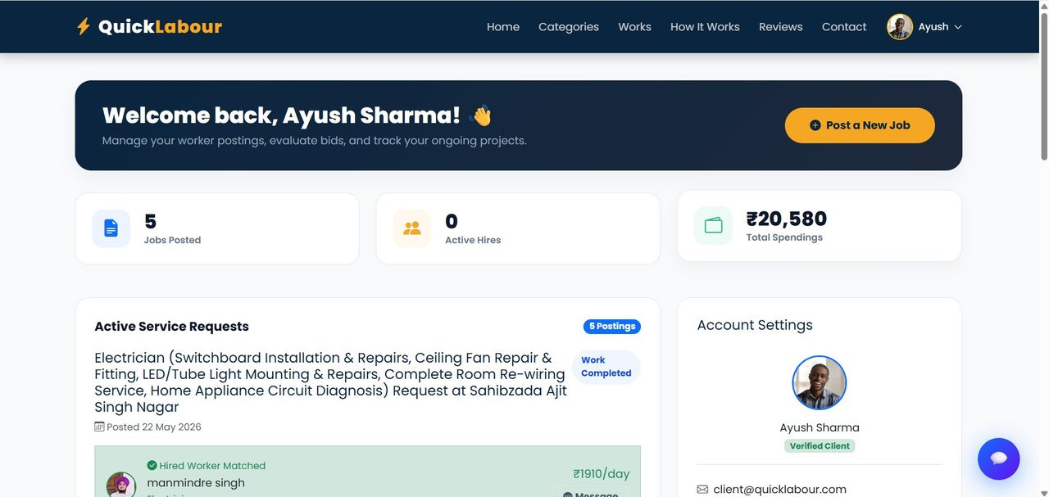
🏢 Client Dashboard — Overview
Dashboard shows: 5 Jobs Posted • 0 Active Hires • ₹20,580 Total Spendings • Active Service Requests with hired worker matched • "Post a New Job" CTA button

Slide 15
🏢 Client Dashboard — Feature Breakdown
📋 Post a New Job
📊 Stats Cards
Prominent orange CTA button allows clients to post a new job request instantly from the dashboard.
Quick view of Jobs Posted, Active Hires, and Total Spendings (₹) all visible at the top.
📝 Active Service Requests
🔗 Worker Matched Indicator
Lists all posted jobs with status badges like "Work Completed" and matched worker details.
Shows which worker was hired for each job, their daily rate (₹1,910/day), and a Message button.
✅ Verified Client Badge
💬 In-App Messaging
Account settings panel on right shows profile photo and a Verified Client green badge.
Clients can message matched workers directly through the platform — no phone number needed.
5
₹20,580
Verified
Jobs Posted
Total Spent
Client Status

Slide 16
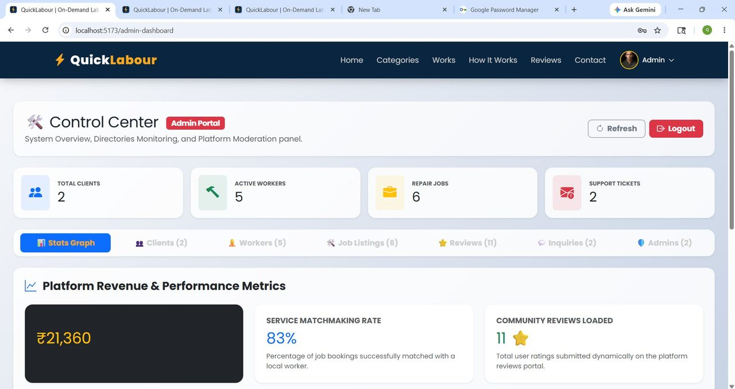
🛡️ Admin Control Center — Dashboard
Admin sees: Total Clients: 2 • Active Workers: 5 • Repair Jobs: 6 • Support Tickets: 2 • Revenue: ₹21,360 • Matchmaking Rate: 83% • Reviews: 11

Slide 17
🛡️ Admin Panel — Tabs & Capabilities
📊 Stats Graph
👥 Clients (2)
Revenue & performance metrics. Platform revenue (₹21,360), Matchmaking Rate 83%, Reviews loaded (11).
Full client directory — view email, phone, address, hired job status. More Details & Delete actions.
👷 Workers (5)
💼 Job Listings (6)
All workers with trade specialty, ratings, completions, availability & verification docs.
All posted jobs — admin can view, moderate and manage job postings across the platform.
⭐ Reviews (11)
💬 Inquiries (2)
Community reviews panel — admin moderates ratings submitted by clients for workers.
Support tickets & contact inquiries from users — admin responds or resolves them.

Slide 18
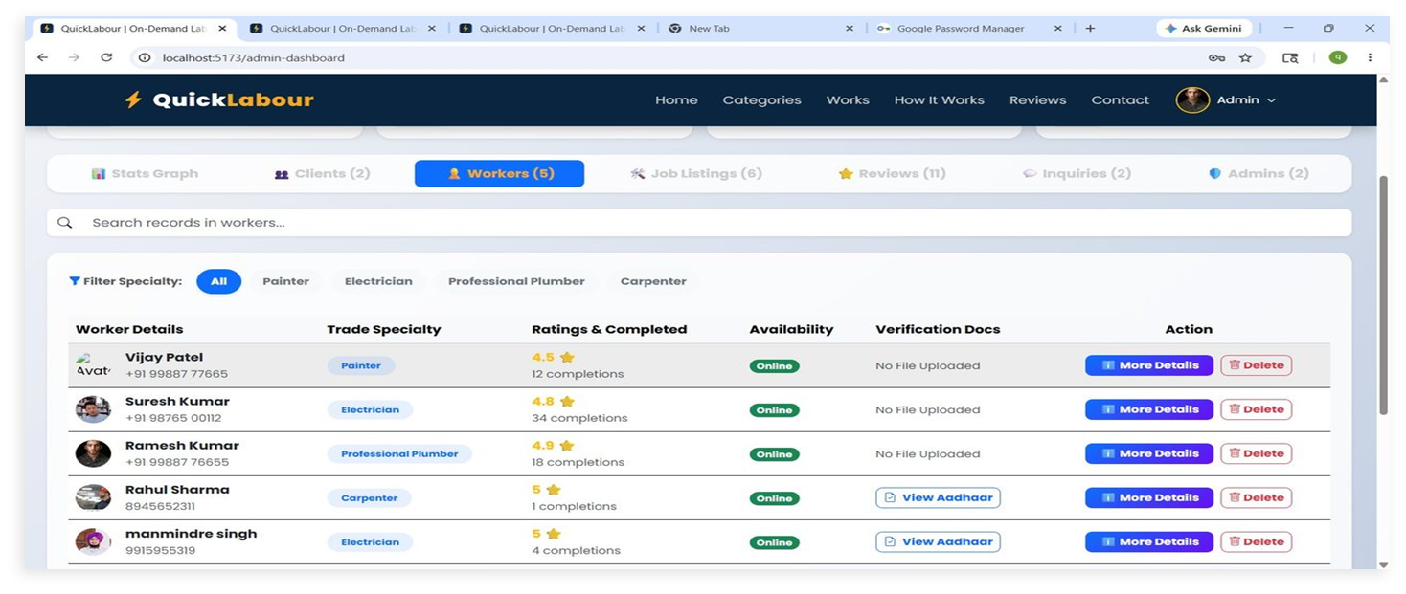
🛡️ Admin — Worker Management
Workers listed: Vijay Patel (Painter 4.5★) • Suresh Kumar (Electrician 4.8★) • Ramesh Kumar (Plumber 4.9★) • Rahul Sharma (Carpenter 5★) • manmindre singh (Electrician 5★) — all showing Online status

Slide 19
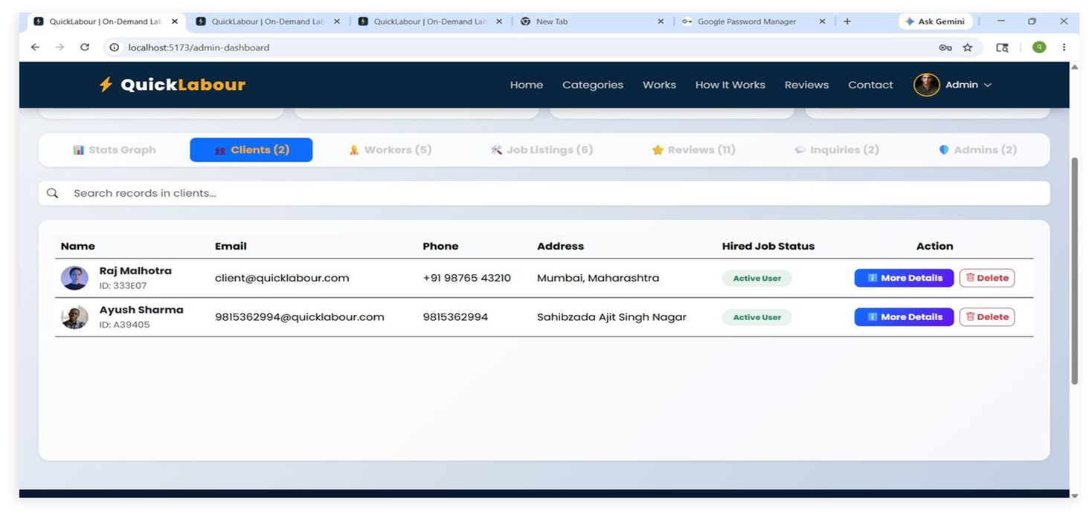
🛡️ Admin — Client Management
Admin can: View client Name, ID, Email, Phone, Address, Status. Filter by specialty. More Details & Delete for each record. Search bar for quick lookup.

Slide 20
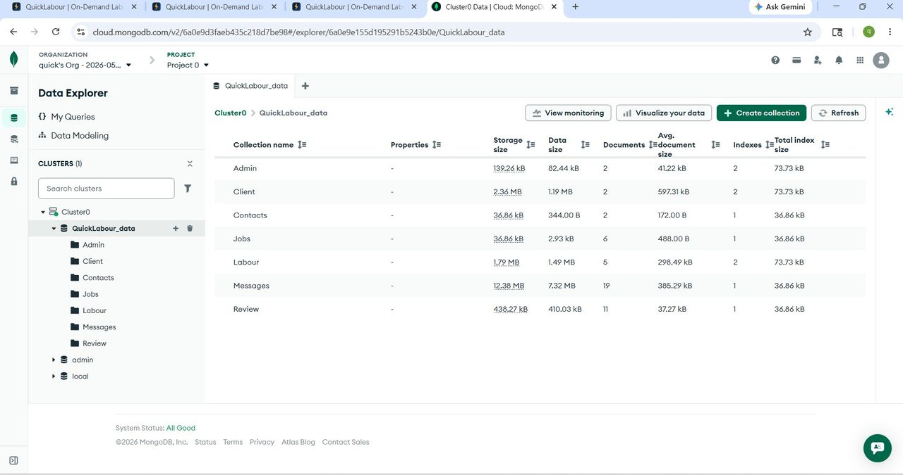
🗄️ Database — MongoDB Atlas
Collections: Admin • Client • Contacts • Jobs (6 docs) • Labour/Workers (5 docs) • Messages (19 docs) • Review (11 docs) | Cluster: Cluster0 on MongoDB Atlas Cloud (free tier)

Slide 21
🗄️ Database Schema — Collections
Admin (2 docs)
Client (2 docs)
_id, name, email, password, role
_id, name, email, phone, address, profilePhoto, idProof, password, jobsPosted, totalSpent
Labour (Worker) (5 docs)
Jobs (6 docs)
_id, name, phone, trade, industry, baseRate, rating, completions, isOnline, idProofUrl
_id, clientId, workerId, jobTitle, location, status, postedDate, dailyRate
Messages (19 docs)
Review (11 docs)
_id, senderId, receiverId, content, timestamp, conversationId
_id, clientId, workerId, rating (1-5), comment, date
Contacts (2 docs)
_id, name, email, message, submittedAt

Slide 22
🔧 Technology Stack
⚛️ Frontend
React.js (Vite) • Tailwind CSS / Bootstrap • React Router DOM • Axios for API calls
🖥️ Backend
Node.js • Express.js • REST API Architecture • JWT Authentication
🗄️ Database
MongoDB Atlas (Cloud) • Mongoose ODM • 7 Collections • Cloud-hosted Cluster0
🔐 Security
bcrypt password hashing • JWT tokens • Session management • ID verification upload
🚀 Deployment
Render.com (Full-Stack) • Free-tier cloud hosting • CI/CD via Git push • Environment variables

Slide 23
🏗️ System Architecture
🌐 Browser / Client
⚛️ React Frontend (Vite)
🚀
Render.com
Hosting
🔐
JWT Auth
& bcrypt
🖥️ Node.js + Express REST API
🗄️ MongoDB Atlas Cloud Database

Slide 24
🎓 Challenges & Learnings
⚡ Challenges Faced
💡 Key Learnings
→ Building a dual-portal auth system (Client + Worker) with role-based routing
✓ Full MERN stack development from scratch to deployment
→ Designing the worker trade selection UI (2-step industry → trade flow)
✓ JWT authentication & role-based access control
→ Real-time availability toggle synced across the platform
✓ MongoDB Atlas cloud database setup and schema design
→ MongoDB schema design for Messages (19 docs) and Reviews
✓ React component architecture and state management
→ Deploying a full-stack MERN app on Render free tier (cold start delays)
✓ REST API design — endpoints, middleware, error handling
→ Matching workers to client jobs based on trade and location
✓ User experience design for diverse (non-tech) users

Slide 25
🚀 Future Scope
Phase 1
Near Term
Phase 2
Growth
Phase 3
Scale
📱 React Native mobile app
🤖 AI-powered worker matching
📊 Analytics for employers
📲 WhatsApp / SMS job alerts
💳 In-app UPI payment gateway
💼 Premium subscription tiers
🌐 Hindi & Punjabi UI support
🪪 DigiLocker ID verification
🤝 NGO & CSR partnerships
⭐ Review reply system
📍 GPS-based live tracking
🏙️ Expansion to 50+ cities

Slide 26
⚡ Thank You!
QuickLabour — Empowering Workers, Enabling Employers
🌐 Live URL quick-labour.onrender.com
🗄️ Database MongoDB Atlas — Cluster0
🚀 Deployed on Render.com (Full-Stack)
📦 Stack MERN (MongoDB, Express, React, Node)
Questions & Feedback Welcome 🙏

