Slide 1
What Makes a Book a Best-Seller?
Group 6:
Thuria, Janie, Manmita and Mingming

Slide 2
Objective Recap
BIG QUESTION TO ANSWER -
What factors can impact whether or not a book becomes a best-seller?
INITIAL FACTORS TO EXPLORE IN DATA -
Genre
Audience Gender
Audience Age
Author
Comparing different best-seller lists
INITIAL SUMMARY OF FINDINGS -
Age and gender information is more scarce, and comparing books across lists is tricky due to differences in formatting

Slide 3
Questions & Data
FINAL FACTORS TO EXPLORE IN DATA -
Genre
Publisher
Length of Book
Book Price
Publish Date
DATA USED -
HISTORICAL DATA - Top 100 books of all time from 1998-2010 (Nielson Books UK)
CURRENT DATA - NY Times Best-Sellers from 2011-2018 (NY Times)
EXTRA FACTORS - Types of books bought most frequently (GoodReads)

Slide 4
HISTORICAL DATA
Cleaning, Exploration, and Analysis

Slide 5
Cleaning and Exploration
AVAILABLE COLUMNS -
Position, ISBN, Title, Author, Imprint, Publisher Group, Volume, Value, RRP, ASP, Binding, Publ Date, Product Class
CONVERT CURRENCY -
Strip column values of “£” sign
Change type from string to float
Convert pounds to dollars
EXTRACT MONTH AND YEAR FROM DATA -
Change date to datetime
Create new year and month column by extracting year and month
DEFINE SEASON -
Establish season by month value
Loop through month column and append new column based on season

Slide 6
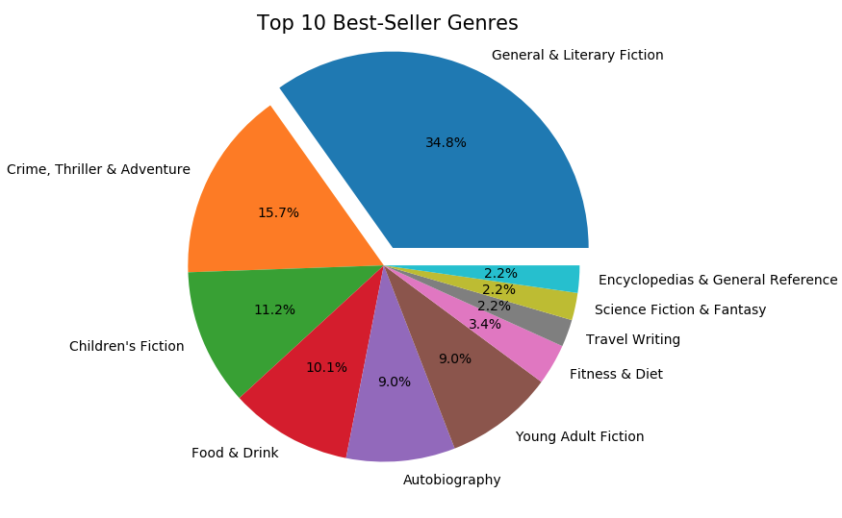
Analysis - Genre
Top Genres:
General Fiction
Crime, Adventure and Thriller
Children’s Fiction

Slide 7
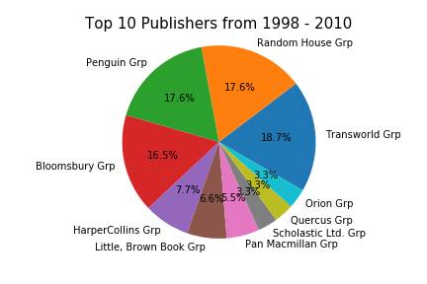
Analysis - Publisher
Top Publishers:
Transworld Group
Random House Group
Penguin Group

Slide 8
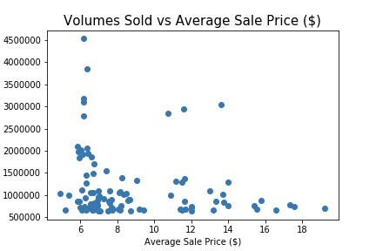
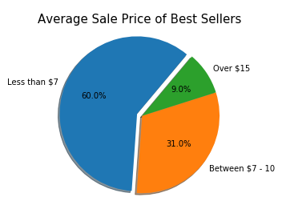
Analysis - Sale Price ($)

Slide 9
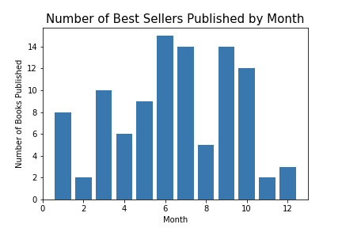
Analysis - Publish by Month

Slide 10
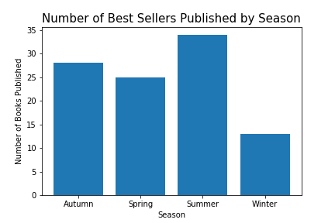
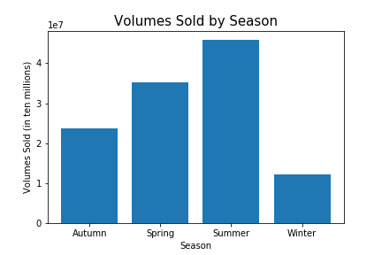
Analysis - Publish by Season

Slide 11
CURRENT DATA
Cleaning, Exploration, and Analysis

Slide 12
Cleaning and Exploration
AVAILABLE COLUMNS -
Publisher, Author, Primary_isbn10, Primary_isbn13, Date, Contributor, Title, Weeks_on_list
EXTRACT MONTH AND YEAR FROM DATA -
Change date to datetime
Create new year and month column by extracting year and month
DEFINE SEASON -
Establish season by month value
Loop through month column and append new column based on season

Slide 13
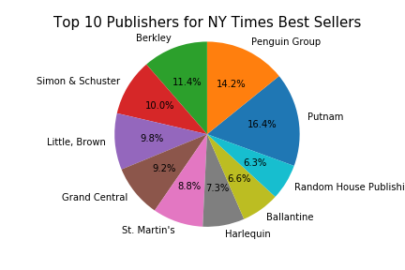
Analysis - Publisher
Top Publishers:
Putnam
Penguin Group
Berkley

Slide 14
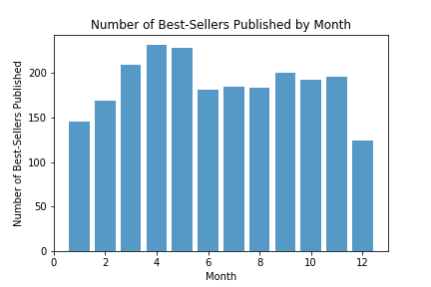
Analysis - Publish by Month

Slide 15
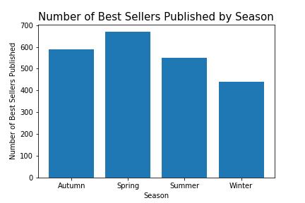
Analysis - Publish by Season

Slide 16
SIMILARITIES?
HISTORIC
CURRENT
Were there similar themes with the data?

Slide 17
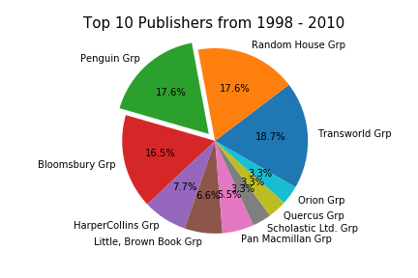
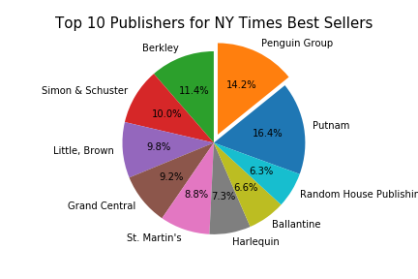
Publisher

Slide 18
Publish Season

Slide 19
ONE STEP FURTHER
Cleaning, Exploration, and Analysis of Extra Book Info

Slide 20
Cleaning and Exploration
AVAILABLE COLUMNS -
BookID, Title, Authors, Average_rating, isbn, isbn13, Language_code, # num_pages, Ratings_count, Text_reviews_count
EXTRA TOPICS TO EXPLORE -
Average rating
Length of Book
Number of Rating

Slide 21
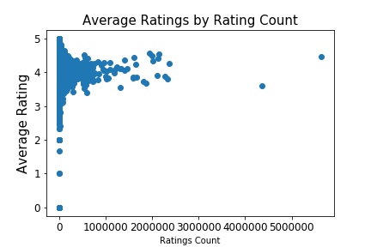
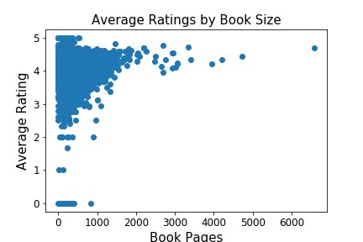
Average Rating - 3.93 out of 5

Slide 22
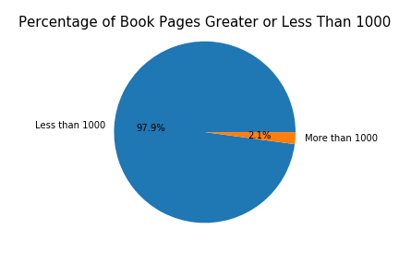
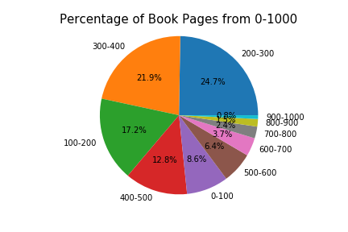
Length of Book

Slide 23
CONCLUSION & REFLECT
What factors will increase your chances of being a best-seller?

Slide 24
Conclusion
FACTORS FOR A BEST SELLER -
Genre - General Fiction (~35%)
Publisher - Penguin/Transworld Group (~54%)
Length of Book - 100-400 pages
Book Price - $10 or less
Publish Season - Spring/Summer

Slide 25
Reflection
WHAT IF WE HAD MORE TIME?
Explore more statistical tests to try against the data
Pull data from APIs
Look into age/gender data

Slide 26
QUESTIONS?
Thank you for listening!

