Slide 1
Major Project Title :-Sentiment Analysis
Project Id: 21B08
Mentor-
Dr Harsh Dev Sir
Members:-
Kushagra Manoj Gupta (1716410129)
Kushagra Sharma (1716410130)
Kushal Omar (1716410131)
Manmohan Krishna (1716410136)

Slide 2
Sentiment Analysis
this project is based sentiment analysis of the text which can be in form of text can be in any of the given format provided by user,which can be in the form of:-
Text file
Pdf file
Text form website
Twitter Comment
As a result we will have a more accurate result in terms of whether the
Thoughts of the user are positive,negative or neural for the given context

Slide 3
Motivation
Though there are already projects like these present but they have a drawback in them , which we will be trying to limit by our approach .
Drawback of existing Sentiment Analysis are:-
They fail to give accuracy with (False-False) statements .
Example - This is not bad approach.(The ordinary machine will yield the result as a negative ,but actually user wants to convey the positive idea)
They fail to give accuracy with (False-True) statements .
Example –Ram is a not good person but an excellent sports man.(Here , we can see that these kind of statement can cause ambiguity for the processing of desired result and the result may vary.

Slide 4
Ideology
We generally use the ‘BAG OF WORDS’ approach for the Sentiment Analysis.Instead we are using ‘Credits Based Algorithm’
There are no credits generally assigned to words but in this approach we will assign the credits to dictionary for the better accuracy in our approach.
The another plus point for this approach is that the grammatical rules can be easily implemented and used to create a mathematical model which will be verifying and maintaining accuracy .

Slide 5
Credit Based Algorithm
In this algorithm we assign a credit to every word in the dictionary so that we can perform mathematical operations on it.
Examples:-
Good=+1, Better=+2, Best=+3
Bad=-1, Worse=-2, Worst=-3
Not=-1
Like=+1,Love=+1.5
Dislike=-1,Hate=-1.5
But={(Less Priority)(but)(More Priority)}
Whereas={(Less Priority)(whereas)(More Priority)}
etc.
These numerical value will be taken as a credit for them.
This will also maintain the accuracy, example:-
Ram is a good boy.>>>(Ram=0,is=0,a=0,good=1,boy=0)>>>0+0+0+1+0>>+1
Ram is not a bad boy.>>>(Ram=0,is=0,not=-1,a=0,bad=-1,boy=0).>>>0+0(-1)*(0+(-1)+0).>>>+1

Slide 6
SDLC
The Software Development Life Cycle plays an important role in the development of the software.
We choose the Iterative Waterfall Technique for this process because it’s the most reliable and best method for starting a development.
Here once the feasible study is done , we have the clear mindset of the project and then follow the steps for the development of the software.

Slide 7
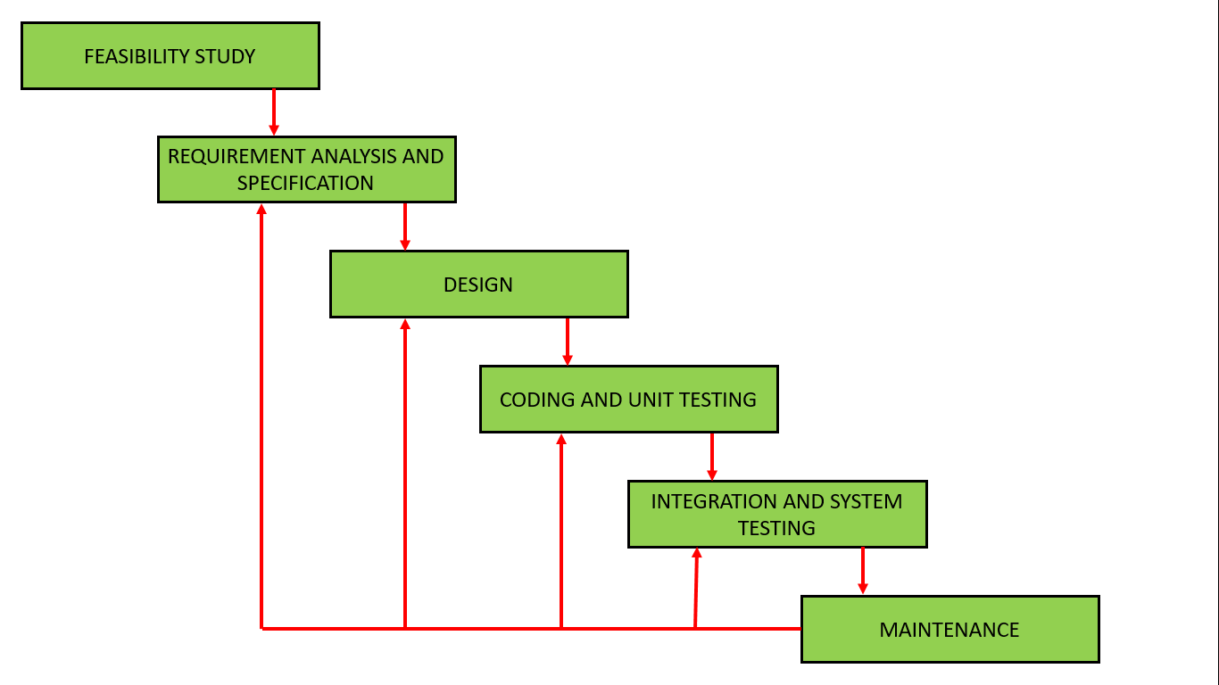
Iterative Waterfall

Slide 8

Feasible Study
The Project is ‘Economically Feasible', as we are using open source ‘tweepy’ ,to interact with the twitter.
The Project is Technical Feasible as the risk is already minimized by keeping in mind about the technology used .Using Python will reduce the risk and easy to debug and eradicate any risk that may arise.
The Project is Operational Feasible, as the proposed idea is giving valid result for the sample statement. Now we need to implement the idea for the further operation.

Slide 9
Technology
FRONT-END :-
Python’s Tkinter - To provide a better GUI to interact with the user.
BACK-END :-
Slate3k -To process PDF
Newspaper3k -To process text from Website
NLTK,TextBlob- To perform the sentiment analysis.
Tweepy – To extract comments from Twitter.

Slide 10
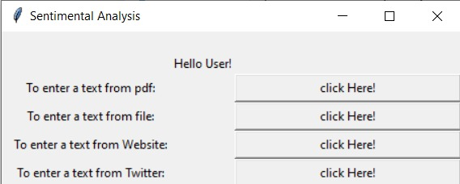
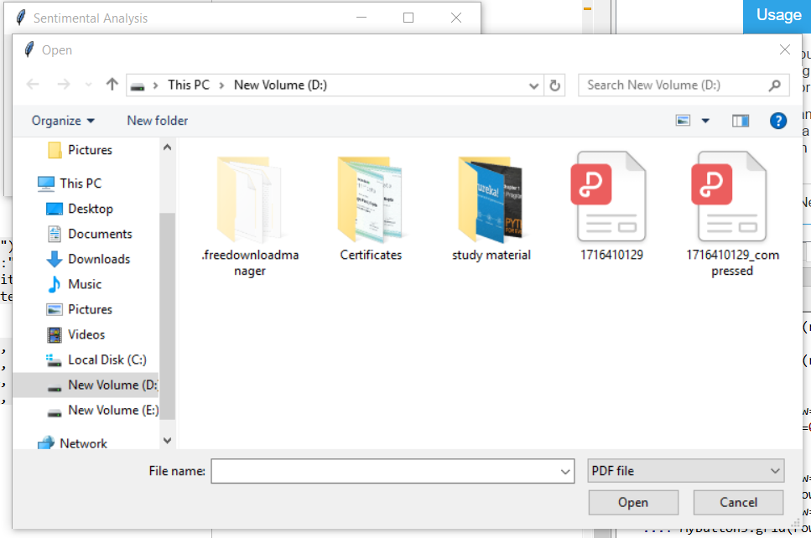
Front – end GUI
This is the main GUI
This is the Inserting the PDF from pc GUI

Slide 11
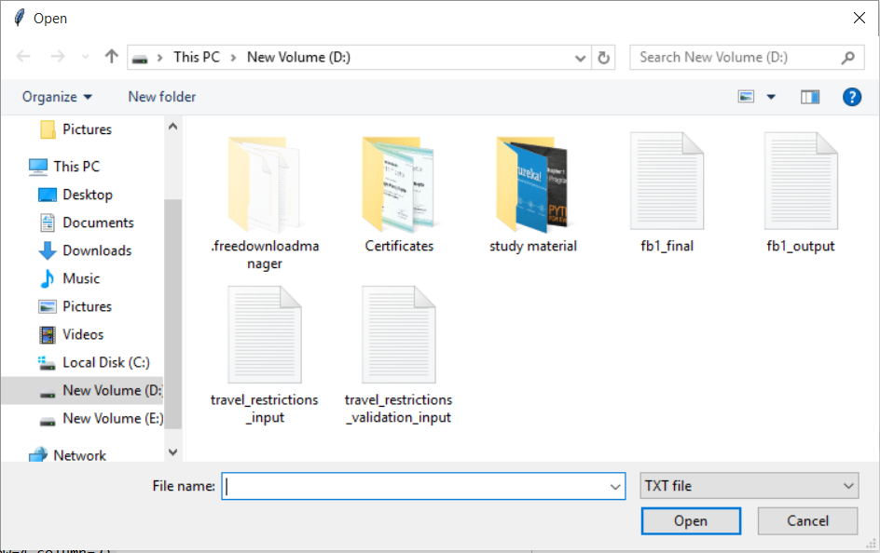
Continued..
This is the main GUI
This is the insert TXT file GUI

Slide 12
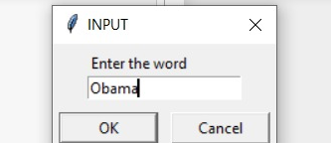
Continued
Extracting Data from Twitter

Slide 13
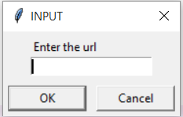
Continued..
This is the main GUI
This is the URL input GUI

Slide 14
Backend Technologies

Slide 15
slate3k
Slate is a Python package that simplifies the process of extracting text from PDF files. It depends on the PDFMiner package.
Slate provides one class, PDF. PDF takes a file-like object and will extract all text from the document, presentating each page as a string of text:

Slide 16
Newspapaper3k
The Newspaper3k package is a Python library used for Web Scraping articles, It is built on top of requests and for parsing lxml.
To scrape from URL’s ,we have used Newspaper3k.

Slide 17
NLTK
The Natural Language Toolkit (NLTK) is a platform used for building Python programs that work with human language data for applying in statistical natural language processing (NLP). It contains text processing libraries for tokenization, parsing, classification, stemming, tagging and semantic reasoning.

Slide 18
STEMMING AND LEMITAIZATION
Stemming and Lemmatization both generate the root form of the inflected words. The difference is that stem might not be an actual word whereas, lemma is an actual language word.
Stemming follows an algorithm with steps to perform on the words which makes it faster. Whereas, in lemmatization, you used WordNet corpus and a corpus for stop words as well to produce lemma which makes it slower than stemming. You also had to define a parts-of-speech to obtain the correct lemma.

Slide 19




TextBlob
TextBlob is a Python library for processing textual data. It provides a simple API for diving into common natural language processing (NLP) tasks such as part-of-speech tagging, noun phrase extraction, sentiment analysis, classification, translation, and more

Slide 20
Screenshots of Backend Code

Slide 21
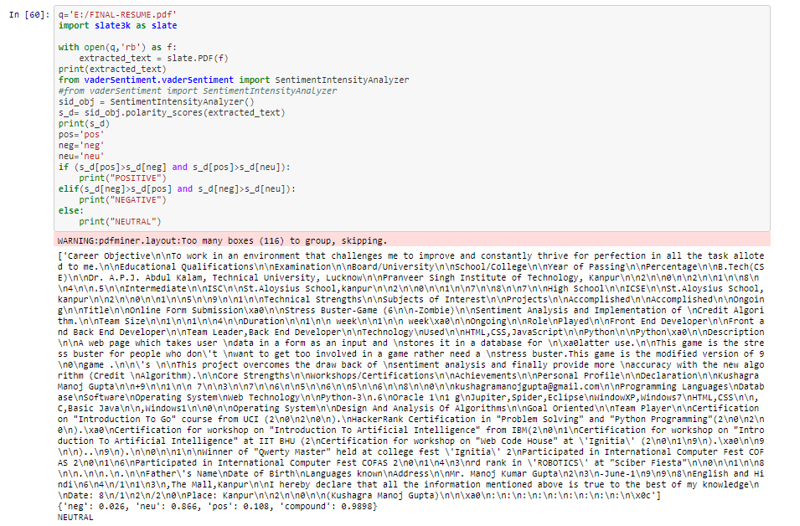
PDF Analysis

Slide 22
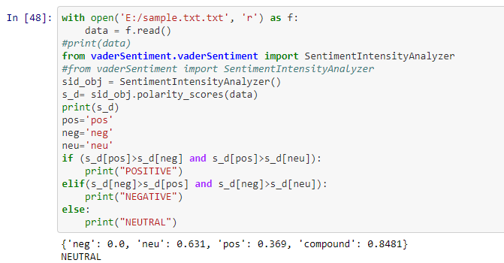
Text File Analysis

Slide 23
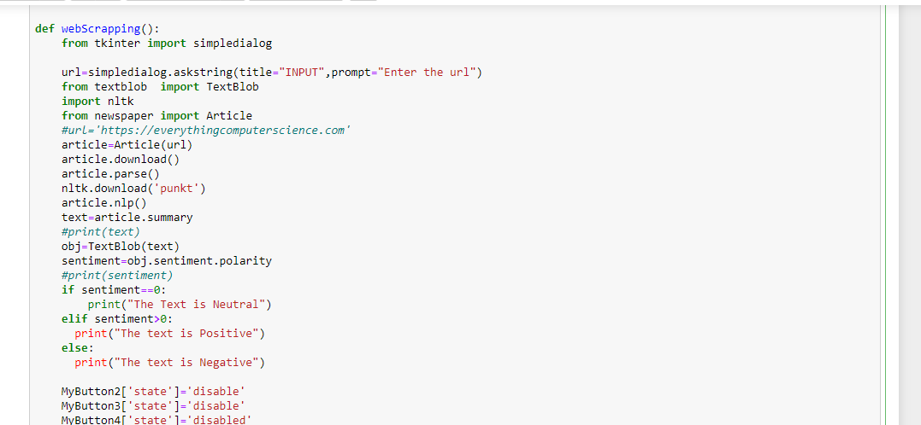
Website Text Analysis

Slide 24
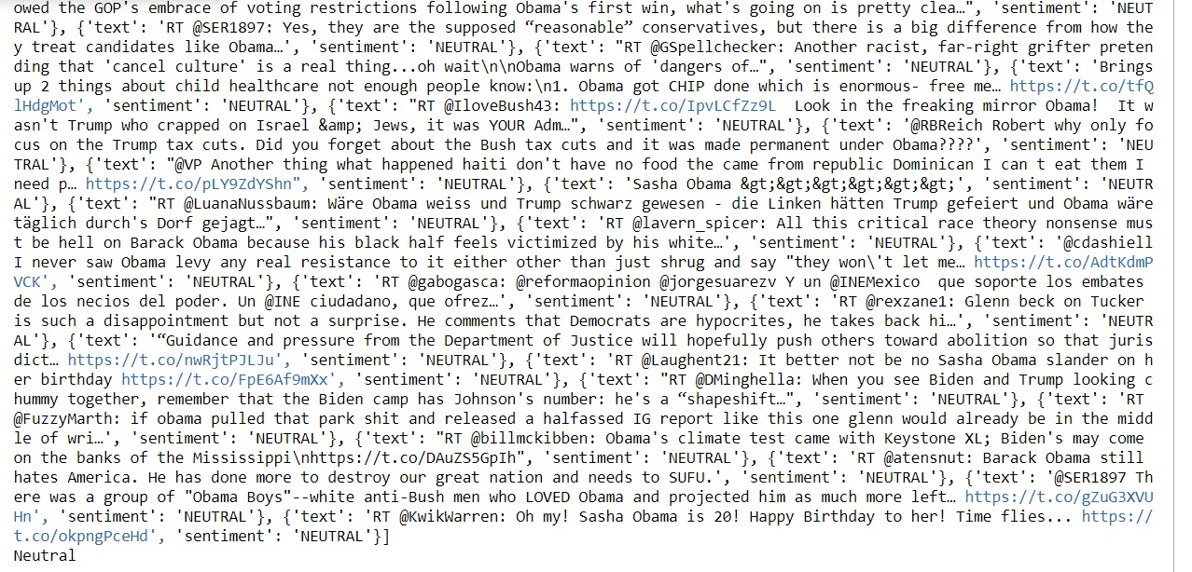
Twitter Comments

Slide 25

Thank you

