Slide 1

Sorting Algorithm of N elements using Modified End to End Bidirectional sort
Team:
Hardik Jain
Maxim Valov
Kapil Dharao
Manmohan Lonawat
Rosellyn Vicente

Slide 2
Introduction
Background
Sorting is the process of placing of elements from a collection using some kind of order
It can be ascending or descending, based on degree of links and more so.
Sorting is done so that it becomes easy to search. For example, phone book, chapters, etc.
Many sorting algorithms in place such as Bubble sort, Insertion sort, Shell sort and so on..

Slide 3
Motivation and Problem Statement
Sorting a given set of numbers
For this problem, we have several ways to sort in ascending order as below:-
Insertion Sort
Bubble Sort
Selection Sort
But which one is the best out of them, it can be found out using time and space complexity.
Based on the logic of these algorithm’s, we can build up a new one with better results.

Slide 4
Proposed Method
Quick Sort
Divide and Conquer Algorithm
In-place sorting, no extra space required
Worst case is O(n²)
Best case is O(n log n)
Average case is O(n log n)

Slide 5
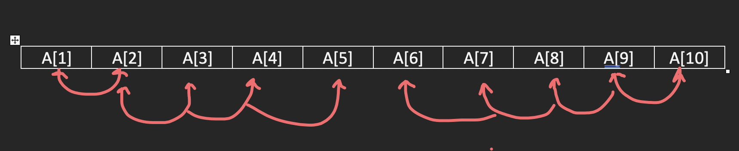
Proposed Method cont.
EEBS (End-to-End Bi-directional Sort)
Divide and Conquer Algorithm
In-place sorting, no extra space required
Number of swaps to sort list is reduced

Slide 6
Related work - method
Combining bidirectional sort with two auxiliary approaches helps to decrease number of sorting cycles as compared to the traditional unidirectional architectures.
A low-complex preprocessing method working on traditional methods by dividing the primary arrays into sub-arrays, using a mean-based approach, which can be used in parallel for multi-core structures.
To find the smallest element, compare with other elements and move it to the top of the array. Repeat for the rest of the elements, thereby sorting much faster than other comparing-based algorithms.
A mean-based sorting algorithm is used by making the quasi- sorted subarray. It sorts data and checks regularly for other sorted data.

Slide 7
Related Work - Novelty
To reduce the sorting cycles and for tasks to be done simultaneously in low and high parts of the architecture, a hardware-based bidirectional sorting algorithm is used and is done by combining it with Boundary Finding and Queue storing.
A new and unique method for low-complex preprocessing that enables data sorting algorithms to be more efficient for large and medium data sets in serial and parallel realization as compared to the previously used algorithm.
New algorithm was proposed, which is faster in run time at different array sizes when compared to other ones. It has also shown nearly equal performance when compared to the insertion sort algorithm.
New algorithm was proposed, which achieves the same quasi sorted algorithm that helps an array get a sorted subarray with the same and approximate the same length independently.

Slide 8
Related Work – Result/ finding/ analysis
Using k-1 bits for hot decoding as compared to others which uses circuit paths. This approach was better in terms of execution time for a large dataset. The number of sorting cycles in the worst case is reduced as compared to other architectures.
Parallel mean-based independent sub-array works better than Serial as it reduces the number of experiences, swaps, and comparison.
Comparisons and swapping in the selection, insertion, bubble sort with the proposed sorting is done. In range 2000-6000 new sort is faster, in range below 2000 it is the best case, while for average case it has little changes and for worst case it degrades its performance but still better in a small range.
Similar to quicksort. For the best case O(N) comparison. For the average case Theta(NlogN). For the worst case, the time complexity is O(NlogN).

Slide 9
Related Work - Comparisons
Requires an external hardware like field-programmable gate arrays(FPGA) or very largescale integrated(VLSI) circuits. Improves the performance of the conventional unidirectional architecture by reducing sorting cycles using bidirectional sorting.
The results are not highly effective and accurate on small datasets as compared to the large and medium datasets. Establishing low-complex preprocessing, improves the performance of the existing algorithms, and makes the implementation easy and faster.
The only limitation of this sort algorithm is the time complexity when compared in average and worst cases it has O(n2) same as other algorithms.
Consumption of space is greater when compared to other conventional algorithms. This algorithm minimizes the comparison, swapping, and assignment operations.

Slide 10
Our Approach
Attempt to make an improvement over currently used sorting algorithms to see if higher efficiency can be achieved and attempt to improve upon concepts given from various other sorting algorithms
Apply a bi-directional approach in attempt to reduce the number of swaps required to sort a given unsorted array of data
Use of current key ideas/approaches from already existing well known sorting algorithms, primarily the idea of a pivot from quick sort and the idea of splitting an array into two from merge sort
The new algorithm splits an array by a chosen pivot, checks and swaps bi-directionally along a given array, then merges split arrays back together, effectively sorting the unsorted array

Slide 11
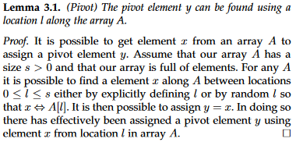
Our Approach (Pivot lemma & proof)

Slide 12
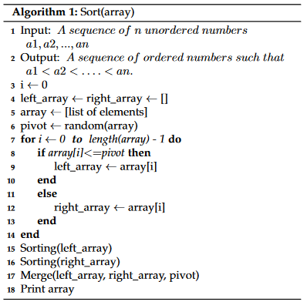
Our Approach (Pivot & splitting)
The sort portion of the algorithm chooses a random element from the array to serve as the pivot for splitting an array into two separate arrays where one array get assigned values that are less than or equal to the pivot elements value and another array get assigned values that are greater than the pivot elements value
These split arrays will be sorted then merged back together to form a fully sorted array

Slide 13
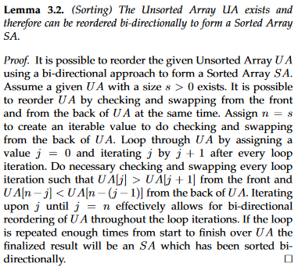
Our approach (sorting lemma & proof)

Slide 14
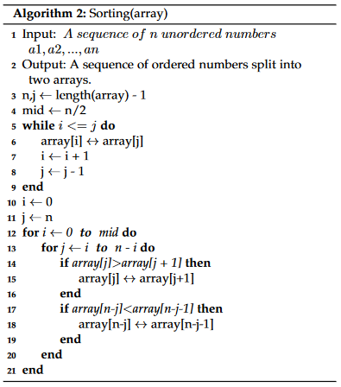
Our Approach (Sorting)
The sorting portion of the algorithm takes a given array and sorts towards both ends of the given array starting from both ends of the given array bi-directionally
An element from the front of the array is compared to the element right after itself whilst an element in the back of the array is compared to the element right before itself
Necessary checks and swaps are made along the array iteratively during these comparisons, checking and swapping bi-directionally from front to back and back to front of the array within the same iteration
Repeating this cycle for half of the size of the array will result in a fully sorted array

Slide 15
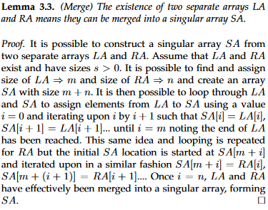
Our approach (Merge lemma & proof)

Slide 16
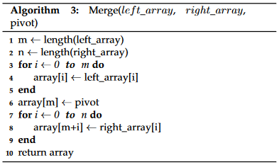
Our Approach (merging)
Since the primary array in the beginning is split up into sub-arrays to be sorted, they must be put back together after sorting
Merging takes place between the sorted arrays where the first sorted arrays elements are put into the primary array up to the first arrays length with our pivot put at the end of the placement, then the second arrays sorted elements are put into the primary array starting after the pivot up to the end of the second arrays length
In doing so both sorted arrays have effectively been merged into a singular sorted array, completing our sorting

Slide 17
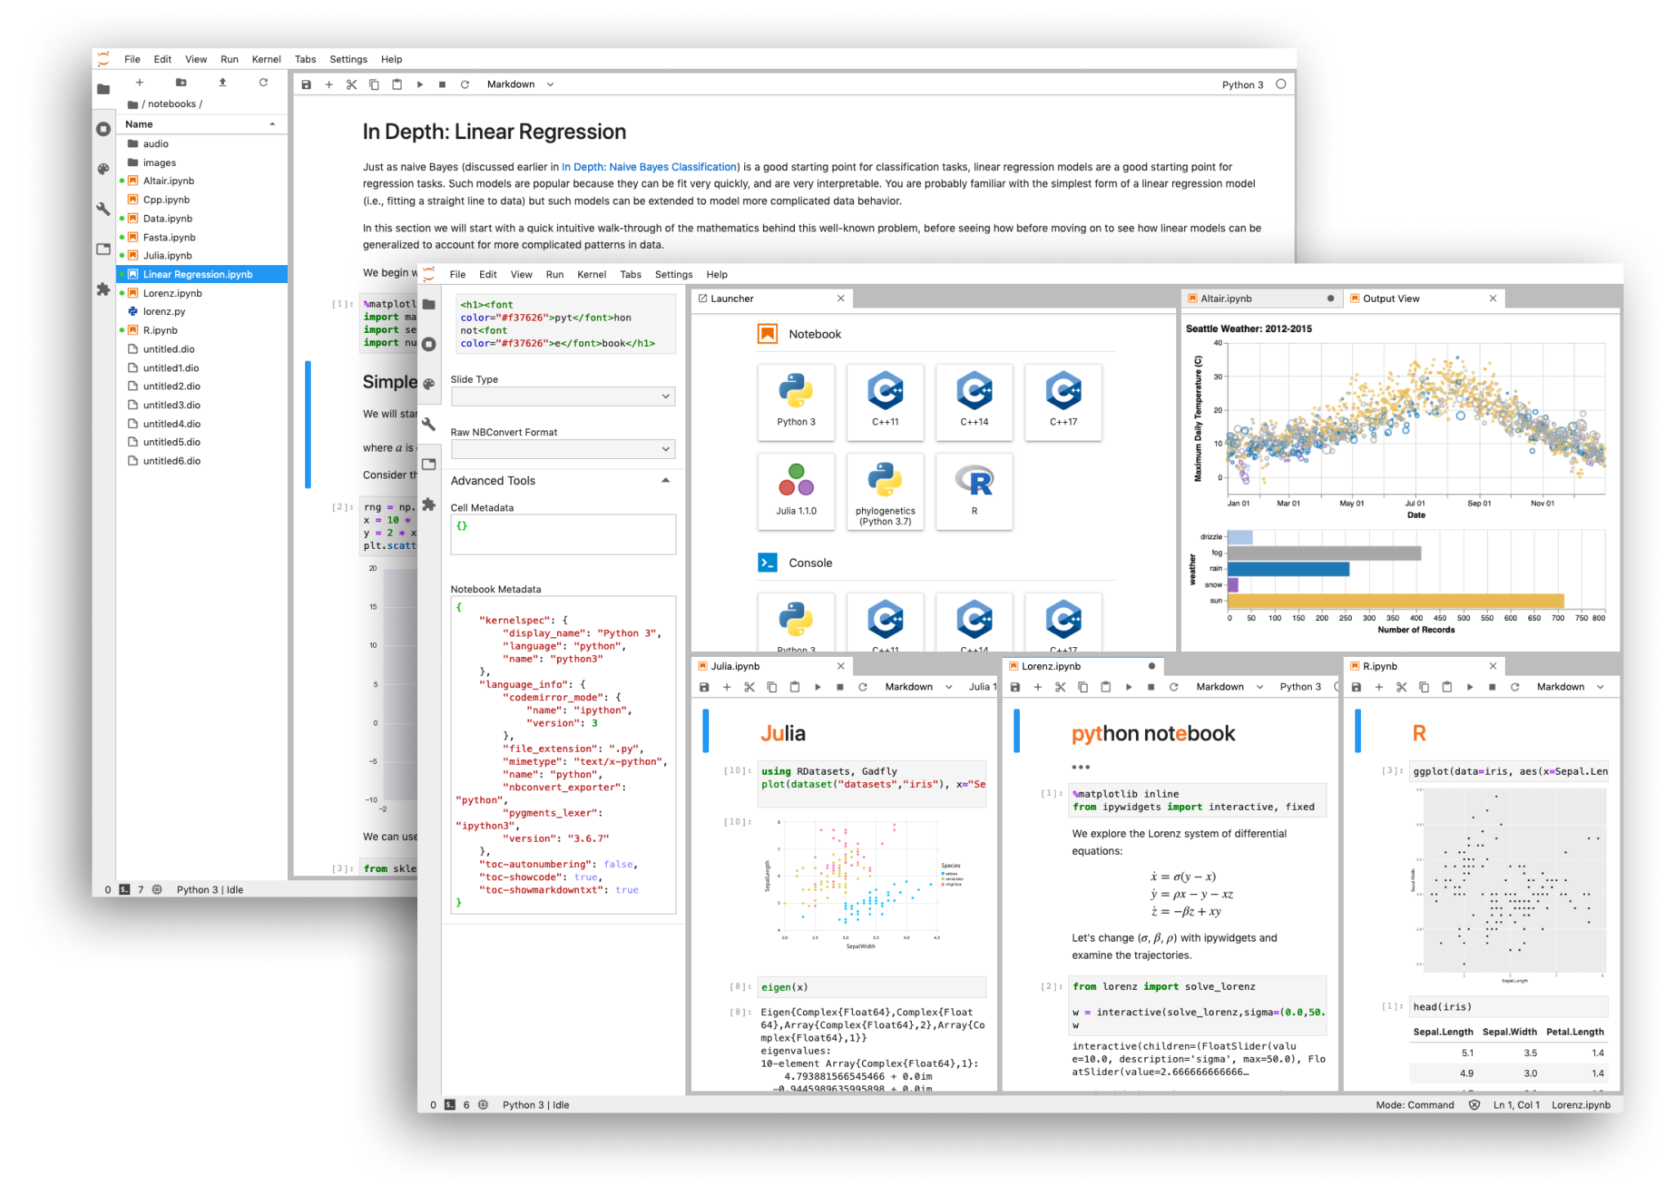

Experiment : Setup
We used Python as our Programming language for the project.
This experiment have being performed on an online web tool know as jupyter.
Jupyter is an open source interactive web tool and is also known as computational notebook.
Jupyter is mainly used for research purposes as its easy to integrate software codes, get computation output in a single document.

Slide 18
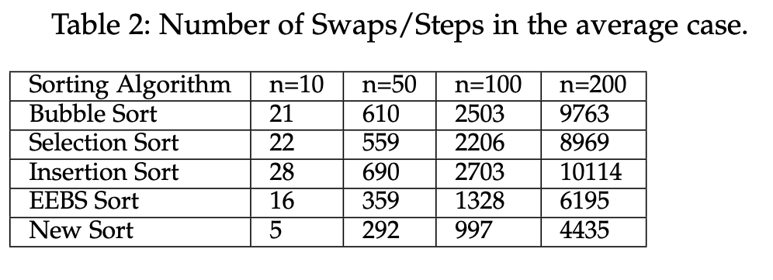
Experiment : Data Sets
In the proposed paper, results are being calculated using different datasets to get the precise and accurate analysis.
In the paper, 2 cases have been taken of 200 elements each of different elements each time.
Multiple algorithms have been used on single and calculated the result of each algorithm.
The result showed that the our new algorithm took less iterations and swaps as compared to other algorithms.

Slide 19
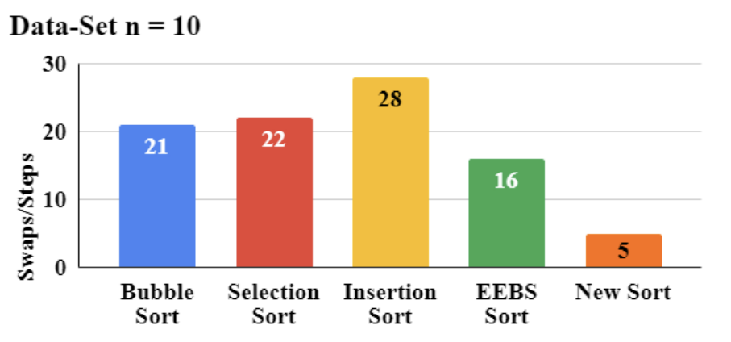
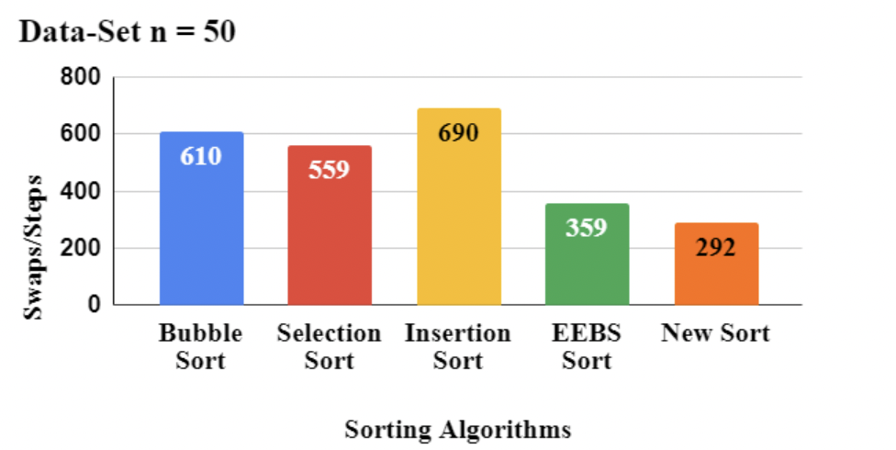
Results and Discussion : Numerical analysis and comparision
In this section, other sorting algorithms are compared with the New Algorithm using different number of elements.
Case 1 : If N = 10
Maximum swaps : Insertion sort : 28
Minimum swaps : New algorithm : 5
Case 2 : If N = 50
Maximum swaps : Insertion sort : 690
Minimum swaps : New algorithm : 292

Slide 20
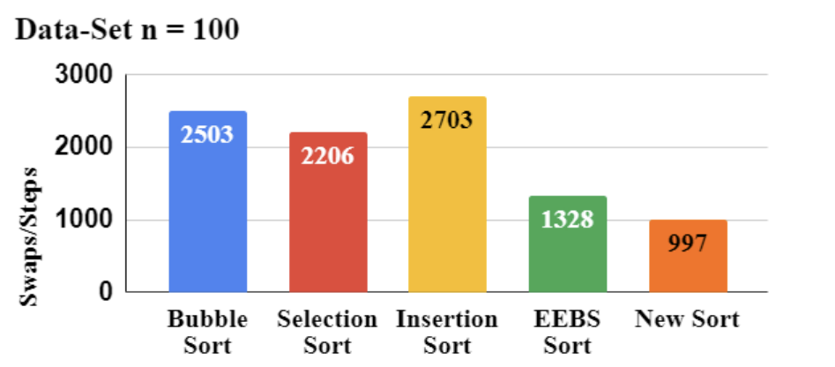
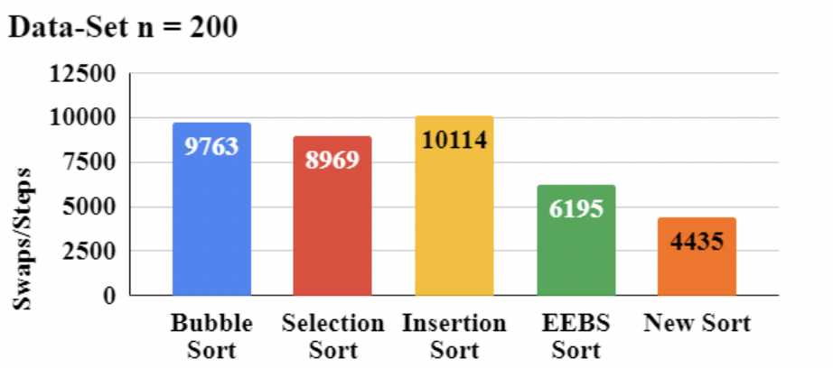
Results and Discussion : Numerical analysis and comparision
In this section, other sorting algorithms are compared with the New Algorithm using different number of elements.
Case 1 : If N = 100
Maximum swaps : Insertion sort : 2703
Minimum swaps : New algorithm : 997
Case 2 : If N = 200
Maximum swaps : Insertion sort : 10114
Minimum swaps : New algorithm : 4435

Slide 21
Complexity Analysis and Average Case Analysis
Time Complexity of this new algorithm : O(n²)
TC of insertion sort is O(n²)
Similar TC for other sorting algorithm
In the average case analysis
Result derived from n elements
Depending on how sorted the code is
The result may vary

Slide 23
conclusion
There are three main algorithms involved in the BiDi sorting algorithm which are sort, sorting, and merge
The sort function takes a random element from the list, creates the pivot, splits the list in half based off the pivot, and the sub-arrays are then sent to the sorting function
The sorting function takes two elements, one from the front and one from the rear, compares them, and swap if necessary, resulting in the larger numbers in the back and the smaller numbers in the front. Once half of the array is reached, sorting now takes two elements from the front and rear to compare, sort, and swap
The merge function first copies all the elements from the left array to our final array and append the pivot. Then it appends the right array to our final array, resulting a fully sorted array

Slide 24
conclusion
All algorithms are possible with the help of three main lemmas pivot, sorting, and merge that allows the algorithm to function as directed
Lemma 3.1 states the pivot element y can be found using a location l along the array A which proves that an arbitrary element in the list can be found and used as a pivot
Lemma 3.2 states the Unsorted Array UA exists and therefore can be redordered bi-directionally to form a Sorted Array SA which proves that any unsorted array can be sorted using bi-direction
Lemma 3.3 states the existence of two separate arrays LA and RA means they can be merged into a singular array SA which proves that two arrays may merge into a singular array

Slide 25
conclusion
When executed, it has proved to work faster and take a smaller number of swaps/steps compared to other sorting algorithms
For example: In a data set of n = 200, insertion sort required 10114 swaps/steps to sort the set and the BiDi sorting algorithm required 6195 swaps/steps, resulting in approximately a 44% swaps/steps difference compared to insertion sort
Similar results were seen in the other 3 cases where n = 10, 50, and 100, respectively
From the results and analysis, BiDi sort algorithm has also been proven to be more efficient than Bubble Sort, Selection Sort, Insertion Sort, and its predecessor, EEBS (End-to-End Bi-directional Sort)
With a time complexity of O(n²), although it does not differ with existing sorting algorithms, BiDi sorting algorithm has fewer swaps and comparisons between entries in datasets
For future work, optimization may be implemented to reduce the time complexity from O(n²)

Slide 26
acknowledgement
The work was performed as a research project for a course at the California State University, Fresno. The authors would like to give a special appreciation to Matin Pirouz for her constant support and guidance during the tenure of this research. She helped us to understand the former research and make this successful.

