Slide 1
A novel split-merge-evolve k clustering algorithm

Slide 2
content
Clustering
K-means clustering
Bisecting k-means clustering
Agglomerative hierarchical clustering
Split-merge-evolve clustering
Algorithm
Advantages
Evaluation
Conclusions and future work

Slide 3
clustering
Many existing algorithms
Efficiency depends on fit between algorithm and data set
We propose a new flexible clustering algorithm
Simple, flexible and efficient
Similar to existing k-means and agglomerative hierarchical clustering
Flexible implementation (centroid-based, linkage-based, etc.)
User-defined quality measure for the expected clustering result
Flexibility to trade off between computation time and accuracy
Ability to optimize the result when new data is added dynamically to the clusters (in our use case)

Slide 4
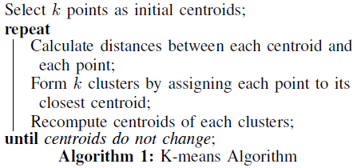
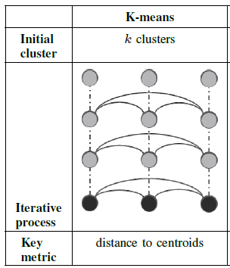
K-means Existing clustering algorithms
Randomly chooses k initial centroids
Assigns data vectors to clusters and re-calculates centroids until centroids do not change any more
Key metric is the distance between centroids and data vectors
Manhattan distance, Euclidian distance, etc.

Slide 5
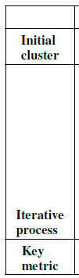
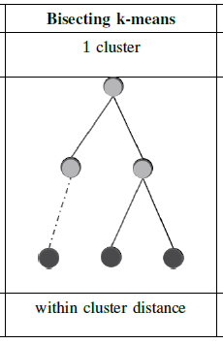
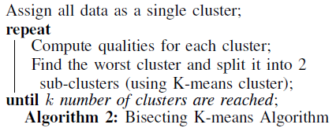
Bisecting k-means Existing clustering algorithms
Starts with 1 cluster
Iteratively picks the worst cluster to split until k clusters are formed
Key measure is the quality of a cluster
E.g., within cluster median distance

Slide 6
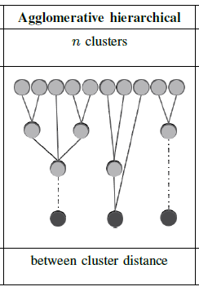
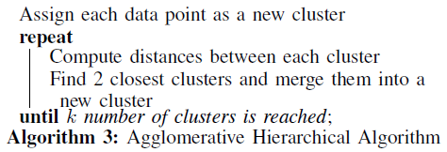
Agglomerative hierarchical clustering Existing clustering algorithms
Starts with singleton clusters
Keeps merging pairs of closest clusters in a tree structure until k clusters are formed
Key metric is the distance between clusters
E.g., Ward’s or link-based method

Slide 7
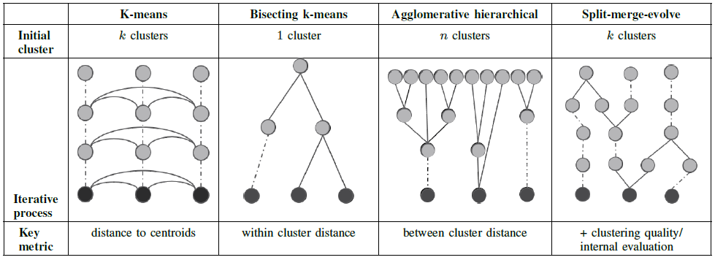
Comparison
Split-merge-evolve
Randomly initialises k clusters
Keeps splitting bad clusters and merging closest clusters until the clustering result evolves towards the user-defined quality measure
Key metrics for each step in iteration:
+quality of cluster/user-defined quality measure

Slide 8






Split-merge-evolve
Split
measure the quality of clusters to decide which to split into 2 (or more)
Key measure: quality of cluster,
e.g.
or
Merge
find 2(or more) clusters with closest distance between them and merge them
Key measure: distance between clusters,
e.g.
or
Evolve
evolve the final result towards the user defined measure
Key measure: quality measure (may require additional analysis of problem)
e.g.,
or
To avoid getting stuck into a situation where split and merge work on the same clusters, we can randomly select one of the top largest clusters for splitting

Slide 9
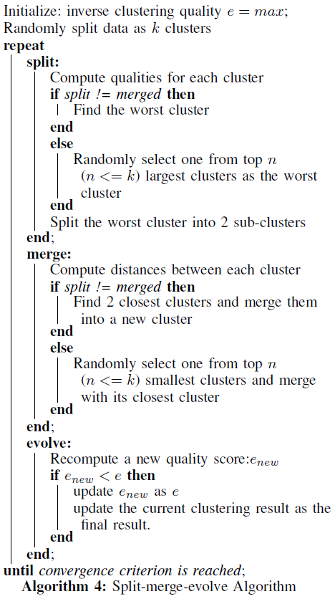
Split-merge-evolve
To avoid getting stuck into a situation where split and merge work on the same clusters, we can randomly select one of the top largest clusters for splitting

Slide 10
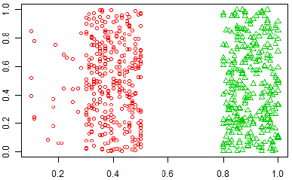
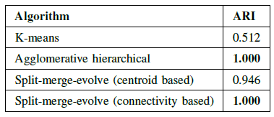
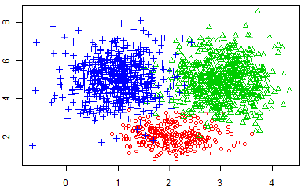
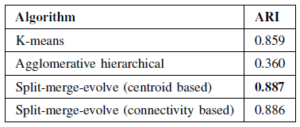
evaluation
Data set 1- Artificial
Clear boundaries between classes
Data set 2 - Artificial
No clear boundaries between classes
Results : avg ARI over 20 runs

Slide 11
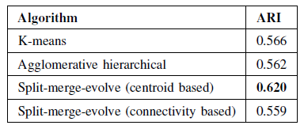
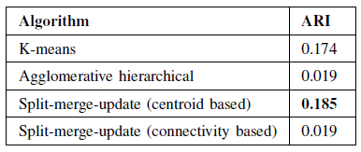
evaluation
Data set 3 - Real life
3 classes of Iris flowers, 4 attributes
Data set 4 - Real life
From US forensic science service, 6 classes of glasses, 9 attributes
Results : avg ARI over 20 runs

Slide 12
split-merge-evolve in action
Runs over different data sets (video)

