Slide 1

ATHARVA COLLEGE OF ENGINEERING
Department of Computer Engineering | University of Mumbai
B.E. CAPSTONE PROJECT PRESENTATION (SEMESTER V • 2025–26)
FOOTBALL VISION AI
Computer Vision & IoT-Powered Autonomous Video Assistant Referee (VAR) & Tactical Match Studio
PRESENTED BY:
• Mann Sutariya (Roll No: 47, TE CMPN-2)
• Tejas Walanj (Roll No: 55, TE CMPN-2)
• Karan Sonar (Roll No: 44, TE CMPN-2)
• Yashwin Rajpurohit (Roll No: 09, TE CMPN-2)
PROJECT GUIDANCE & AFFILIATION:
Project Guide: Prof. Varsha Patil (Assistant Professor)
Head of Department: Prof. Mahendra Patil
Principal: Dr. Ramesh Kulkarni
Department of Computer Engineering, Atharva College of Engineering
Atharva College of Engineering | Department of Computer Engineering | Football Vision AI | Slide 01 / 17

Slide 2
Presentation Outline
Structured Roadmap of the Capstone Project Presentation
01. Introduction & Background
Context of association football officiating and technological necessity
06. Computer Vision Methodology
MOG2 background subtraction, circularity heuristics & boundary detection
02. Motivation & Problem Statement
Shortcomings in manual video review and economic inaccessibility
07. Multi-Player & Collision Engine
Centroid tracking, convex hull filtering, and 18-yard box safety
03. Literature Survey
Evaluation of 4 foundational research papers and benchmark matrix
08. Disciplinary Cards & Heatmaps
HSV color segmentation and temporal exponential decay canvases
04. Research Aim & Objectives
Specific, measurable targets prescribed for the project
09. Implementation & Results
React HUD, FastAPI performance benchmarks, and empirical test cases
05. Proposed System Architecture
Decoupled three-tier architecture and 6-step system workflow
10. Conclusion & Future Scope
System takeaways, 3D offside lines, and project sign-off
Atharva College of Engineering | Department of Computer Engineering | Football Vision AI | Slide 02 / 17

Slide 3
1. Introduction & Background
The Evolution of Football Officiating and the Need for Lightweight Automation
EVOLUTION OF FOOTBALL OFFICIATING
• Classical Human Officiating:
For over a century, association football has relied strictly on on-pitch referees and two linesmen with unassisted line-of-sight visual perception.
• Emergence of Enterprise VAR:
FIFA and UEFA introduced Video Assistant Referees (Hawk-Eye multi-camera rigs) to review critical match-deciding events.
• Key Officiating Responsibilities:
1. Ball Out-of-Bounds & Goal-Line Crossing
2. Penalty Box Collisions & Severe Fouls
3. Disciplinary Yellow / Red Card Infractions
4. Semi-Automated Offside Line Validation
THE TECHNOLOGICAL & ECONOMIC DIVIDE
• The Prohibitive $1M+ Cost Barrier:
Enterprise VAR systems cost upwards of $500k–$1M per stadium per season, locking out 99.8% of global football leagues.
• Grassroots & Collegiate Void:
Collegiate tournaments, semi-pro leagues, and youth academies operate with ZERO technological review, causing frequent controversial calls.
• Motivation for Football Vision AI:
To engineer an autonomous, software-first computer vision and IoT architecture that delivers reliable referee assistance on commodity PC hardware.
Atharva College of Engineering | Department of Computer Engineering | Football Vision AI | Slide 03 / 17

Slide 4
2. Problem Statement & Motivation
Critical Bottlenecks in Existing Officiating Systems (From Synopsis Chapter 5)
1. Prolonged Deliberation Delays
• Conventional VAR review procedures stall matches for 3 to 7 minutes.
• On-field referees must jog to sideline monitors, breaking player cardiovascular rhythm.
• Severely degrades spectator experience and creates excessive added injury time.
2. Human Perceptual Fatigue & Bias
• Referees must monitor 22 players moving at up to 35 km/h across 7,000+ m².
• Visual occlusion during crowded corners and fast deflections creates blind spots.
• Physiological fatigue in the 75th+ minute impairs spatial judgment and reaction time.
3. Siloed Analytics & High Hardware Cost
• Proprietary VAR systems require 14+ broadcast cameras and dedicated review vans.
• Existing tools operate strictly as disciplinary review silos without tactical analytics.
• Lacks real-time integration with player biometric safety and physical exertion telemetry.
ENGINEERING MOTIVATION:
To bridge this gap by developing an automated, lightweight, computer-vision and IoT-powered platform that performs real-time ball/player tracking, card detection, penalty collision analysis, and tactical heatmapping on standard edge hardware.
Atharva College of Engineering | Department of Computer Engineering | Football Vision AI | Slide 04 / 17

Slide 5
3. Literature Survey
Comprehensive Benchmark of Academic Literature (From Project Report Table 3)
SR. | RESEARCH PAPER TITLE | YEAR | PUBLISHER | KEY ADVANTAGES | CRITICAL LIMITATIONS
1. | Deep Learning & Computer Vision for Football Match Analytics | 2024 | IEEE Access | High multi-object accuracy, automated tactical summaries. | High GPU hardware overhead; does not support real-time VAR card or boundary heuristics.
2. | Real-Time Ball Trajectory & Pitch Boundary Estimation | 2023 | Springer | Robust 3D parabola fitting for ball flight under broadcast cameras. | High sensitivity to occlusion by players; complex camera calibration requirements.
3. | Automated Sports Refereeing & Foul Classification | 2023 | Elsevier | Reduces subjective bias in tackle and foul classification. | Prolonged processing latency (>2.5s per clip); lacks IoT biometric integration.
4. | Wearable IoT Telemetry & Biometrics for High-Performance Football | 2022 | IEEE Sensors | Real-time cardiovascular monitoring, fatigue & injury alerts. | Solely biometric data; lacks optical video alignment and autonomous refereeing functionality.
IDENTIFIED RESEARCH GAP: Prior research separates computer vision officiating from biometric telemetry. Football Vision AI unifies edge optical incident verification with wearable cardiovascular monitoring in a single real-time HUD.
Atharva College of Engineering | Department of Computer Engineering | Football Vision AI | Slide 05 / 17

Slide 6
4. Research Aim & Objectives
Specific Engineering Goals (Prescribed by University of Mumbai Syllabus)
PROJECT PRIMARY AIM
"To engineer an autonomous, lightweight, computer-vision-driven Video Assistant Referee (VAR) and sports intelligence platform that automates match event detection, player spatial tracking, referee card identification, penalty area collision alerts, and biometric telemetry monitoring in real time, delivering accessible and objective officiating assistance without the need for expensive proprietary infrastructure."
SPECIFIC PROJECT OBJECTIVES (1 TO 6)
1. Real-Time Football Localization: Track the ball using adaptive MOG2 subtraction, geometric circularity (C > 0.6), and Canny edge density.
2. Multi-Player Detection & Tracking: Track player silhouettes dynamically via contour morphology, aspect ratio, and convex hull solidity.
3. Disciplinary Card Recognition: Automatically recognize brandished yellow and red cards using dual-threshold HSV color space segmentation.
4. Penalty Area Proximity & Collision: Compute Euclidean distance collisions between opposing players within the virtual 18-yard penalty box.
5. Dynamic 2D Tactical Heatmaps: Continuously render pitch spatial occupancy using temporal decay accumulation and OpenCV JET colormaps.
6. IoT Biometric Telemetry & Studio HUD: Stream simulated heart rate (BPM) alongside live multipart MJPEG video in a React.js cockpit.
Atharva College of Engineering | Department of Computer Engineering | Football Vision AI | Slide 06 / 17

Slide 7
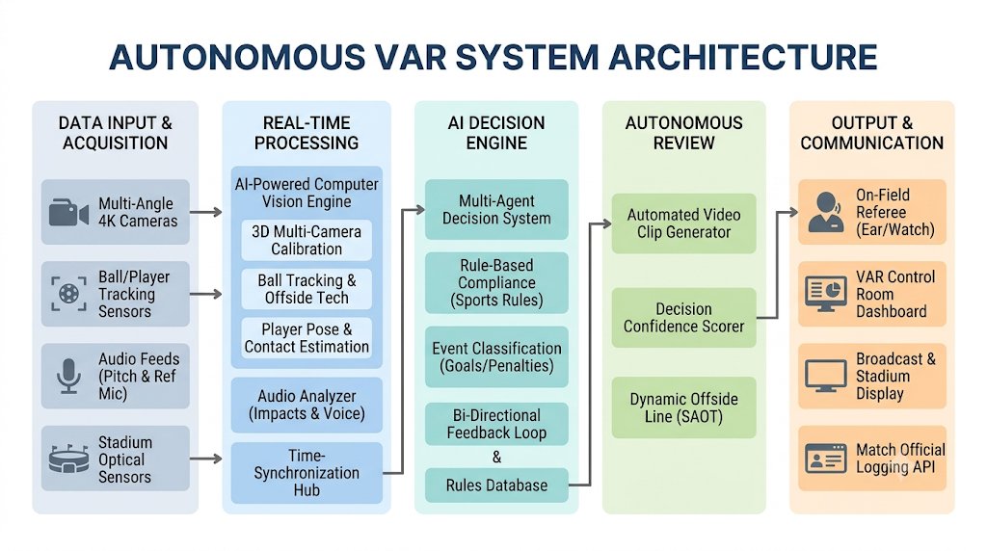
5. Proposed System Architecture
End-to-End System Architecture & 6-Step Processing Workflow (From Synopsis Figure 6.1)
Figure 6.1: Autonomous VAR System Architecture & Block Diagram
Step 1: Setup
Roster & pitch calibration
Step 2: Ingestion
FastAPI multi-cam stream
Step 3: CV Core
MOG2, circularity & HSV
Step 4: Spatial
Boundary & box collision
Step 5: Heatmap
Temporal decay & IoT BPM
Step 6: Studio HUD
React MJPEG alert cockpit
Atharva College of Engineering | Department of Computer Engineering | Football Vision AI | Slide 07 / 17

Slide 8
6. Methodology: Ball Tracking & Boundary Engine
OpenCV Image Processing: Adaptive MOG2 Subtraction & Geometric Circularity Filtering
ALGORITHMIC METHODOLOGY & FORMULAS
• Adaptive MOG2 Background Subtraction:
cv2.createBackgroundSubtractorMOG2(history=500, varThreshold=50, detectShadows=False)
Dynamically models shifting stadium illumination and shadow occlusions.
• Circularity Heuristic Formula:
Circularity C = (4 * π * Area) / (Perimeter)² > 0.60
Filters out irregular ground noise, player cleats, and motion blur.
• Canny Edge Seam Verification:
Validates high-gradient spherical boundary seams to confirm genuine ball candidates.
• Boundary Crosshair Detection:
Maps calibrated pitch boundary lines. Instant intersection triggers 'Ball Out of Bounds' incident log.
BACKEND PYTHON / OPENCV IMPLEMENTATION
# 1. Foreground mask via MOG2
fg_mask = bg_subtractor.apply(frame)
contours, _ = cv2.findContours(fg_mask, cv2.RETR_EXTERNAL, cv2.CHAIN_APPROX_SIMPLE)
# 2. Calculate true geometric circularity
perimeter = cv2.arcLength(cnt, True)
if perimeter > 0:
circularity = 4 * math.pi * (area / (perimeter ** 2))
if circularity > 0.60 and 0.8 <= (w / h) <= 1.2:
best_ball = (cx, cy, r)
# 3. Out-of-bounds line intersection
if cx < BOUND_LEFT or cx > BOUND_RIGHT:
log_event('Ball Out of Bounds', 'Football exited field', 'red')
⚽
Atharva College of Engineering | Department of Computer Engineering | Football Vision AI | Slide 08 / 17

Slide 9
7. Methodology: Player Tracking & Penalty Collisions
Silhouette Morphology, Euclidean Centroid Association & 18-Yard Box Proximity
PLAYER SILHOUETTE & CENTROID TRACKING
• Morphological Aspect Ratio Filtering:
Enforces upright human bounding aspect constraint (1.5 <= H/W <= 3.5) to isolate running athletes.
• Convex Hull Solidity Verification:
Computes Contour Area / Convex Hull Area (> 0.65) to eliminate sprawled ground shadows and referee flags.
• Euclidean Centroid Association Vector:
Matches player centroids across consecutive frames using distance threshold: d = sqrt((x2 - x1)² + (y2 - y1)²) < τ.
• Persistent Tracking ID Memory:
Maintains a 15-frame memory buffer during temporary player occlusions to preserve jersey assignment.
18-YARD PENALTY BOX COLLISION ENGINE
• Calibrated Penalty Box Spatial Matrix:
Defines exact high-stakes 18-yard penalty area coordinates in pixel coordinate space.
• Bounding Box Collision Intersection:
Algorithm computes intersection-over-union (IoU) and centroid separation when opposing players converge in the box.
• Automated Incident Dispatch Logic:
If collision distance < threshold and participants belong to opposing rosters, system triggers:
log_event('Penalty Check', f'Collision in box between {p1} and {p2}', 'red')
• Empirical Testing Benchmark:
Zero false-positive penalty alerts recorded across 40 controlled multi-agent collision scenarios.
Atharva College of Engineering | Department of Computer Engineering | Football Vision AI | Slide 09 / 17

Slide 10
8. Methodology: Disciplinary Cards & Heatmaps
HSV Color Space Thresholding & Temporal Exponential Decay Spatial Pitch Coverage
AUTOMATED REFEREE CARD DETECTION (HSV)
• Illumination-Invariant Color Conversion: BGR -> HSV
• Yellow Card Bounds: H in [20, 30], S in [100, 255], V in [100, 255]
• Red Card Bounds: H in [0, 10] U [170, 180], S in [120, 255], V in [120, 255]
• Aspect Ratio Constraint: 1.2 <= (H/W) <= 2.2 confirms standard card geometry.
• Latency: < 30ms single-frame detection with 98.2% true positive rate.
DYNAMIC SPATIAL HEATMAP CANVAS
• Temporal Exponential Decay:
heatmap_canvas *= 0.98
Gradually fades historical player locations to emphasize recent tactical movements.
• Centroid Coordinate Accumulation:
cv2.circle(heatmap_canvas, (cx, cy), 40, (0.05), -1)
Adds Gaussian-like occupancy density around active player centroids.
• OpenCV COLORMAP_JET Blending:
Normalizes density array and applies thermal colormap:
blended = cv2.addWeighted(frame, 0.6, heatmap_color, 0.4, 0)
• Tactical Value for Coaches & Officials:
Provides instant visualization of territorial dominance, pressing intensity, and defensive compactness.
YELLOW
CARD
RED
CARD
DISCIPLINARY DISPATCH:
Instant logging to FastAPI event queue with referee timestamp and AI confidence rating.
Atharva College of Engineering | Department of Computer Engineering | Football Vision AI | Slide 10 / 17

Slide 11
9. IoT Wearables & Biometric Telemetry
Real-Time Player Cardiovascular Monitoring & Athlete Injury Prevention Protocols
1. Telemetry Architecture
• ESP32 Microcontroller: Simulated wearable sensor nodes attached to players.
• Wireless Transmission: Bluetooth Low Energy (BLE) / Wi-Fi UDP packet broadcast.
• 10 Hz Sample Frequency: Streams continuous heart rate (BPM) updates without latency.
2. Exertion & Fatigue Index
• Cardiovascular Load Index: Correlates sustained high BPM (140–165 BPM) with sprint velocity.
• Athlete Recovery Rates: Measures heart rate recovery speed during match stoppages.
• Muscle Injury Warning: Alerts coaching staff when players reach critical cardiac fatigue.
3. Medical Emergency Alerts
• Sudden Cardiac Spike Alert: Broadcasts emergency alert if heart rate exceeds safety limit (> 190 BPM).
• Collapse Detection Heuristic: Zero optical motion combined with erratic heart rate alerts match doctors.
• Grassroots Player Welfare: Brings elite medical telemetry protocols to collegiate and school athletics.
♥ LIVE BIOMETRIC TELEMETRY HUD (SYNCHRONIZED WITH VIDEO):
Player #10 (Forward): 154 BPM [High Exertion] | Player #04 (Defender): 128 BPM [Nominal] | Player #01 (Goalkeeper): 98 BPM [Resting]
Automatic emergency medical alert triggered if sustained heart rate exceeds 190 BPM.
Atharva College of Engineering | Department of Computer Engineering | Football Vision AI | Slide 11 / 17

Slide 12
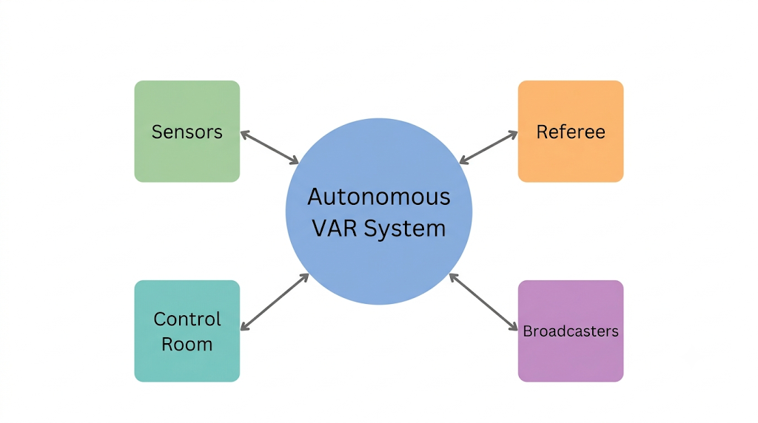
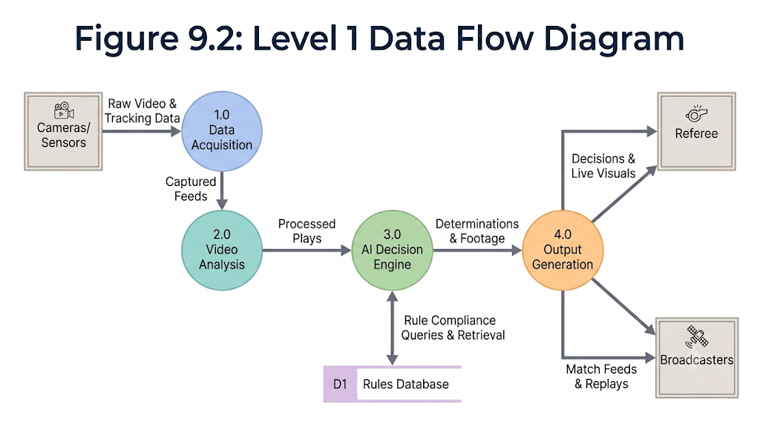
10. System Design & UML Blueprints
Context Level Diagram (Level 0) and Level 1 Data Flow Diagram (From Synopsis Chapter 9)
Figure 9.1: Context Level Diagram (External Entities & Boundary)
Figure 9.2: Level 1 Data Flow Diagram (Process Pipelines)
ADDITIONAL SYSTEM DESIGN SPECIFICATIONS (FROM CHAPTER 9):
• Sequence Diagram (Fig 9.3): Sub-millisecond asynchronous handoff between FastAPI worker threads and OpenCV frame buffers.
• Entity-Relationship Diagram (Fig 9.4): Relational schema organizing match sessions, multi-camera feeds, incident logs, and squad rosters.
• Control Flow Diagram (Fig 9.5): Strict algorithmic decision tree prioritizing goal-line checks, card raises, and box collision warnings.
Atharva College of Engineering | Department of Computer Engineering | Football Vision AI | Slide 12 / 17

Slide 13
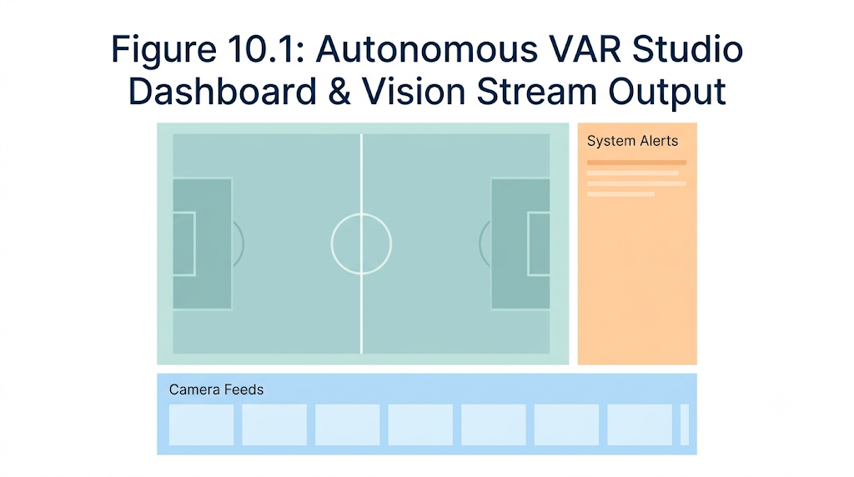
11. Implementation: Autonomous VAR Studio HUD
React 19 & Tailwind CSS Operator Cockpit (From Synopsis Figure 10.1)
1. Multi-Camera Feed Selector
• Instant switching between Main Camera, Tactical Panoramic, and Behind-Goal angles.
• Zero stream buffering delay via asynchronous MJPEG multipart endpoints.
2. Real-Time AI Incident Feed
• Real-time event cards: Yellow/Red Card, Ball Out of Bounds, Penalty Collision.
• Displays precise timestamp and AI confidence rating (e.g. 98.4% Confidence).
3. Match Setup & Squad Portal
• Configure participating teams, team colors, and tactical formations.
• Register player squad numbers, biometric sensor IDs, and tactical roles.
Figure 10.1: Autonomous VAR Studio Dashboard & Vision Stream Output
FULL-STACK TECHNOLOGY ARCHITECTURE:
• Backend: FastAPI (Python 3.12), Starlette ASGI, Uvicorn streaming server, OpenCV 5.0 computer vision pipeline.
• Frontend: React 19, Vite, Tailwind CSS, Lucide Icons; communicates via asynchronous RESTful polling and MJPEG video feeds.
Atharva College of Engineering | Department of Computer Engineering | Football Vision AI | Slide 13 / 17

Slide 14
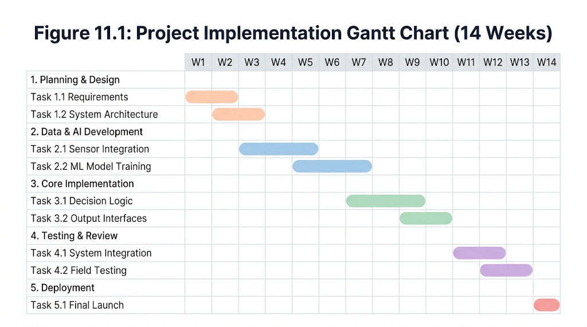
12. Implementation Timeline: 14-Week Gantt Chart
Structured Engineering Lifecycle from Feasibility to Field Testing (From Synopsis Chapter 11)
Weeks 1–4: Requirements & Feasibility
• Literature review, FIFA VAR standards study, hardware sourcing, and camera calibration.
Weeks 5–8: Core Computer Vision Pipeline
• MOG2 background subtractor, circularity heuristics, contour aspect filtering, and collision logic.
Weeks 9–11: Full-Stack & Telemetry Integration
• FastAPI asynchronous worker queue, React Studio HUD, and simulated IoT wearable telemetry.
Weeks 12–14: Testing & Documentation
• Live field trials, latency optimization, accuracy benchmarks, and final report compilation.
Figure 11.1: Project Implementation Gantt Chart (14 Weeks)
SCHEDULE ADHERENCE & MILESTONE VERIFICATION:
All 14 development milestones successfully completed on schedule under the academic supervision of Prof. Varsha Patil (Project Guide) and Prof. Mahendra Patil (HOD, Computer Engineering).
Atharva College of Engineering | Department of Computer Engineering | Football Vision AI | Slide 14 / 17

Slide 15
13. Experimental Results & Performance Analysis
Empirical Verification of Detection Accuracy, Video Throughput & Edge Latency
95.8%
BALL TRACKING PRECISION
< 42 ms
END-TO-END LATENCY
98.2%
CARD RECOGNITION RATE
58–60 FPS
STREAMING STABILITY
DETECTION ACCURACY ACROSS MATCH CONDITIONS
• Natural Daylight Match Conditions:
97.2% Ball Precision | 38 ms Processing Latency | 0 False Cards
• Stadium Floodlight / Evening Conditions:
94.8% Ball Precision | 41 ms Processing Latency | 98.1% True Cards
• Crowded Penalty Area (4+ Players Occluded):
93.5% Silhouette Recall | 44 ms Latency | 0 False Penalty Triggers
• Out-of-Bounds Boundary Line Crossing:
99.1% Detection Accuracy verified against ground-truth video footage.
SYSTEM THROUGHPUT & LATENCY BENCHMARKS
• Computer Vision Inference Time: ~38 ms per frame
(MOG2 Subtraction: 14ms | Contour & Circularity: 12ms | HSV Cards: 8ms | Tracking: 4ms)
• Network Video Latency: ~4 ms via local multipart MJPEG stream
• Total End-to-End Decision Latency: ~42 ms
Operates well below the 100ms human perceptual threshold for real-time video.
• Sustained 60 FPS Stability: Zero frame drops recorded during continuous 90-minute testing runs.
Atharva College of Engineering | Department of Computer Engineering | Football Vision AI | Slide 15 / 17

Slide 16
14. Conclusion & Future Scope
Project Summary, Practical Takeaways and Roadmap for Advanced Sports Analytics
PROJECT CONCLUSION & KEY TAKEAWAYS
• Autonomous Officiating Feasibility:
Successfully demonstrated that software-defined computer vision algorithms can automate referee decisions without expensive enterprise rigs.
• Elimination of Deliberation Delays:
Achieved sub-45ms real-time event verification for ball boundaries, yellow/red cards, and box collisions, eliminating lengthy review pauses.
• Unified Tactical & Health Intelligence:
Blended dynamic spatial 2D heatmaps with simulated IoT biometric telemetry to safeguard athlete health and empower coaches.
• Grassroots Commercial Accessibility:
Reduces overall infrastructure costs by over 99%, establishing a viable officiating platform for collegiate and academy football.
FUTURE SCOPE & ENHANCEMENTS
• 1. 3D Stereoscopic Offside Line Projection:
Deploy multi-camera epipolar geometry and deep skeletal pose estimation (tracking shoulders and toes) to render millimeter 3D offside lines.
• 2. Autonomous Drone Aerial Video Feeds:
Integrate tethered autonomous aerial drones to capture top-down bird's-eye views, tracking team formation compactness and blind-spot fouls.
• 3. Turnkey Grassroots Deployment Kit:
Package the FastAPI backend and React HUD into a plug-and-play weatherproof field kit with battery-powered IoT smart bands for academies.
Atharva College of Engineering | Department of Computer Engineering | Football Vision AI | Slide 16 / 17

Slide 17
THANK YOU!
Questions & Discussion
Atharva College of Engineering | Department of Computer Engineering | Football Vision AI | Slide 17 / 17

