Slide 1
Kubernetes ConfigMap
info@zekeLabs.com | www.zekeLabs.com | +91 8095465880

Slide 2
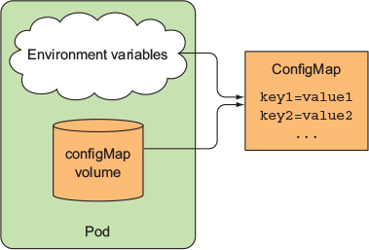
ConfigMap
info@zekeLabs.com | www.zekeLabs.com | +91 8095465880

Slide 3
Creating ConfigMap
$ kubectl create configmap fortune-config --from-literal=sleep-interval=25
$ kubectl create configmap my-config --from-file=config-file.conf
info@zekeLabs.com | www.zekeLabs.com | +91 8095465880

Slide 4
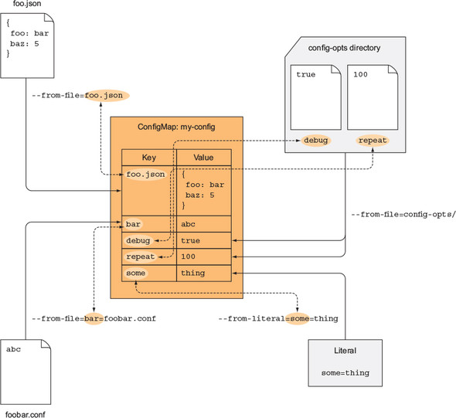
info@zekeLabs.com | www.zekeLabs.com | +91 8095465880

Slide 5
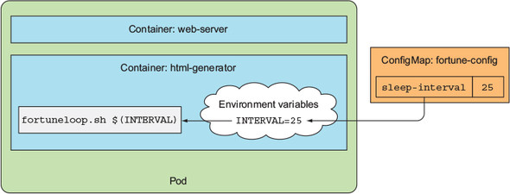
info@zekeLabs.com | www.zekeLabs.com | +91 8095465880

Slide 6
Resource Requests
info@zekeLabs.com | www.zekeLabs.com | +91 8095465880

Slide 7
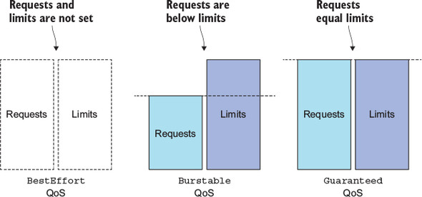
QoS
info@zekeLabs.com | www.zekeLabs.com | +91 8095465880

Slide 8
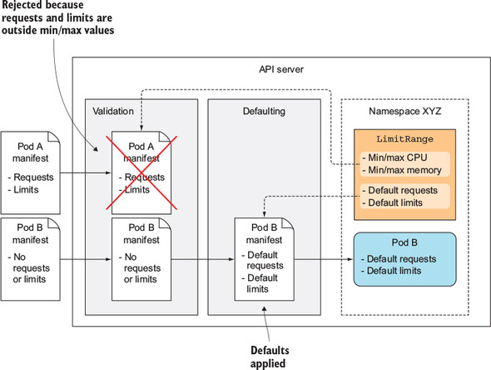
Namespace controlled Resource
info@zekeLabs.com | www.zekeLabs.com | +91 8095465880

Slide 9
RBAC
info@zekeLabs.com | www.zekeLabs.com | +91 8095465880

Slide 10
Users in Kubernetes
Kubernetes clusters have two categories of users:
normal users - managed by an outside, independent service
service accounts - managed by Kubernetes,
You can enable multiple authentication methods at once.
You should usually use at least two methods:
service account tokens for service accounts
at least one other method for user authentication.
info@zekeLabs.com | www.zekeLabs.com | +91 8095465880

Slide 11
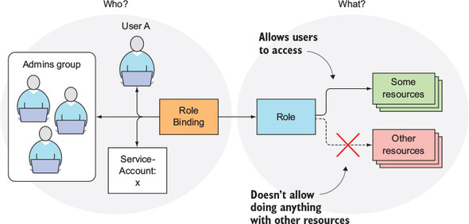
Role role bindings RBAC
info@zekeLabs.com | www.zekeLabs.com | +91 8095465880

Slide 12
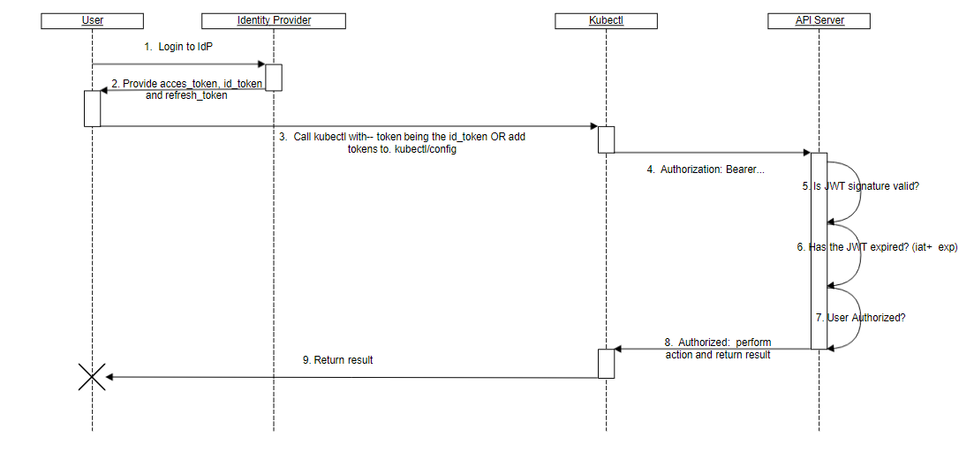
User Authentication in Kubernetes (With OpenID Connect tokens)
info@zekeLabs.com | www.zekeLabs.com | +91 8095465880

Slide 13
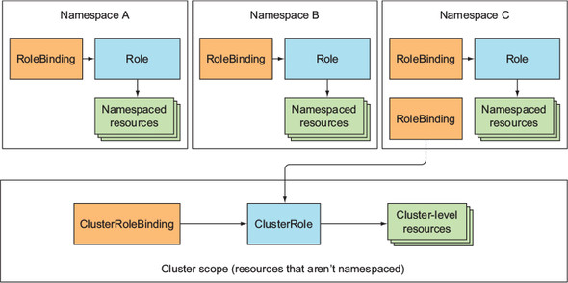
Cluster Role & Cluster role bindings
info@zekeLabs.com | www.zekeLabs.com | +91 8095465880

Slide 14
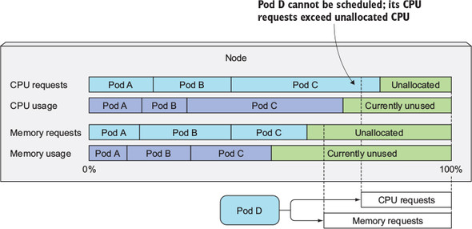
Node allocation based on cpu and memory
info@zekeLabs.com | www.zekeLabs.com | +91 8095465880

Slide 15
QoS based on cpu and memory req and limits
CPU requests vs. limits | Memory requests vs. limits | Container QoS class
None set | None set | BestEffort
None set | Requests < Limits | Burstable
None set | Requests = Limits | Burstable
Requests < Limits | None set | Burstable
Requests < Limits | Requests < Limits | Burstable
Requests < Limits | Requests = Limits | Burstable
Requests = Limits | Requests = Limits | Guaranteed
info@zekeLabs.com | www.zekeLabs.com | +91 8095465880

Slide 16
HA
info@zekeLabs.com | www.zekeLabs.com | +91 8095465880

Slide 17
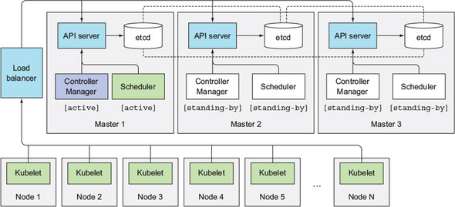
HA on Master
info@zekeLabs.com | www.zekeLabs.com | +91 8095465880

Slide 18
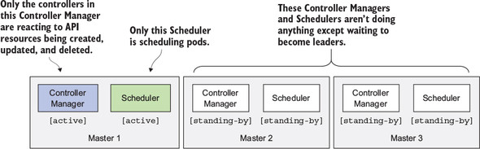
General points
info@zekeLabs.com | www.zekeLabs.com | +91 8095465880

Slide 19
API server is (almost completely) stateless (all the data is stored in etcd, but the API server does cache it).
Usually, one API server is collocated with every etcd instance.
Each individual component will only be active when it’s the elected leader.
Only the leader performs actual work, whereas all other instances are standing by and waiting for the current leader to fail.
General points
info@zekeLabs.com | www.zekeLabs.com | +91 8095465880

Slide 20
THANK YOU
Let us know how can we help your organization to Upskill the employees to stay updated in the ever-evolving IT Industry.
Get in touch:
www.zekeLabs.com | +91-8095465880 | info@zekeLabs.com
Visit : www.zekeLabs.com for more details

