Slide 1
Kubernetes
info@zekeLabs.com | www.zekeLabs.com | +91 8095465880

Slide 2
The Control Plane is what controls and makes the whole cluster function. To refresh your memory, the components that make up the Control Plane are
The etcd distributed persistent storage
The API server
The Scheduler
The Controller Manager
Components of the Control Plane
info@zekeLabs.com | www.zekeLabs.com | +91 8095465880

Slide 3
The Kubelet
The Kubernetes Service Proxy (kube-proxy)
The Container Runtime (Docker, rkt, or others)
Components running on the worker nodes
info@zekeLabs.com | www.zekeLabs.com | +91 8095465880

Slide 4
Add-on components
The Kubernetes DNS server
The Dashboard
An Ingress controller
Heapster
Container Network Interface network plugin
info@zekeLabs.com | www.zekeLabs.com | +91 8095465880

Slide 5
Kubernetes system components communicate only with the API server.
They don’t talk to each other directly.
The API server is the only component that communicates with etcd.
None of the other components communicate with etcd directly, but instead modify the cluster state by talking to the API server.
General points
info@zekeLabs.com | www.zekeLabs.com | +91 8095465880

Slide 6
Although the components on the worker nodes all need to run on the same node, the components of the Control Plane can easily be split across multiple servers.
There can be more than one instance of each Control Plane component running to ensure high availability.
While multiple instances of etcd and API server can be active at the same time and do perform their jobs in parallel, only a single instance of the Scheduler and the Controller Manager may be active at a given time—with the others in standby mode.
General points
info@zekeLabs.com | www.zekeLabs.com | +91 8095465880

Slide 7
The Control Plane components, as well as kube-proxy, can either be deployed on the system directly or they can run as pods
The Kubelet is the only component that always runs as a regular system component, and it’s the Kubelet that then runs all the other components as pods. To run the Control Plane components as pods, the Kubelet is also deployed on the master.
etcd is the only place Kubernetes stores cluster state and metadata.
General points
info@zekeLabs.com | www.zekeLabs.com | +91 8095465880

Slide 8
Kubelet
info@zekeLabs.com | www.zekeLabs.com | +91 8095465880

Slide 9
Kubelet : General points
Kubelet is the component responsible for everything running on a worker node.
It registers the node it’s running on by creating a Node resource in the API server.
It continuously monitors the API server for Pods that have been scheduled to the node.
It starts the pod’s containers by telling the configured container runtime to run a container.
It constantly monitors running containers and reports their status, events, and resource consumption to the API server.
Kubelet runs the container liveness probes, restarting containers when the probes fail.
Lastly, it terminates containers when their Pod is deleted from the API server and notifies the server that the pod has terminated.
info@zekeLabs.com | www.zekeLabs.com | +91 8095465880

Slide 10
API Server
info@zekeLabs.com | www.zekeLabs.com | +91 8095465880

Slide 11
Provides a consistent way of storing objects in etcd.
Performs validation of those objects, so clients can’t store improperly configured objects (which they could if they were writing to the store directly).
Along with validation, it also handles optimistic locking, so changes to an object are never overridden by other clients in the event of concurrent updates.
General points
info@zekeLabs.com | www.zekeLabs.com | +91 8095465880

Slide 12
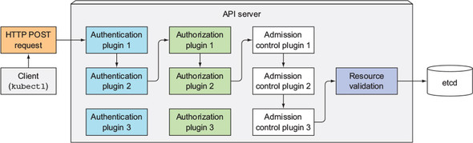
What API server does
info@zekeLabs.com | www.zekeLabs.com | +91 8095465880

Slide 13
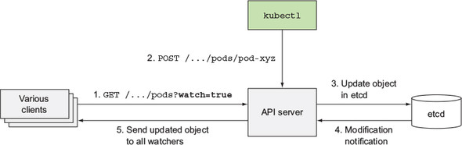
What API server does
info@zekeLabs.com | www.zekeLabs.com | +91 8095465880

Slide 14
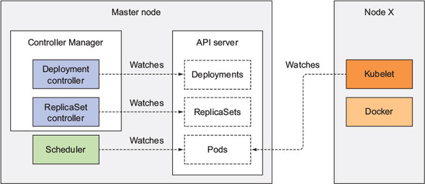
HOW KUBE COMPONENTS WATCH
info@zekeLabs.com | www.zekeLabs.com | +91 8095465880

Slide 15
Scheduler
info@zekeLabs.com | www.zekeLabs.com | +91 8095465880

Slide 16
Waits for newly created pods through the API server’s watch mechanism and assign a node to each new pod that doesn’t already have the node set.
All the Scheduler does is update the pod definition through the API server. The API server then notifies the Kubelet (again, through the watch mechanism described previously) that the pod has been scheduled.
General points
info@zekeLabs.com | www.zekeLabs.com | +91 8095465880

Slide 17
The selection of a node can be broken down into two parts
Filtering the list of all nodes to obtain a list of acceptable nodes the pod can be scheduled to.
Prioritizing the acceptable nodes and choosing the best one.
General points
info@zekeLabs.com | www.zekeLabs.com | +91 8095465880

Slide 18
Can the node fulfill the pod’s requests for hardware resources?
Is the node running out of resources (is it reporting a memory or a disk pressure condition)?
If the pod requests to be scheduled to a specific node (by name), is this the node?
Does the node have a label that matches the node selector in the pod specification
If the pod requests to be bound to a specific host port, is that port already taken on this node or not?
If the pod requests a certain type of volume, can this volume be mounted for this pod on this node, or is another pod on the node already using the same volume?
Does the pod specify node and/or pod affinity or anti-affinity rules?
Scheduling criteria
info@zekeLabs.com | www.zekeLabs.com | +91 8095465880

Slide 19
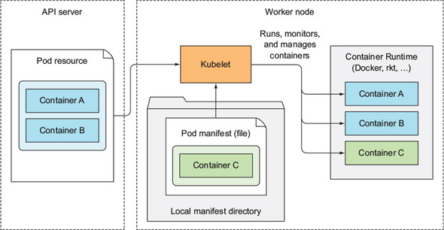
What KUBELET does?
info@zekeLabs.com | www.zekeLabs.com | +91 8095465880

Slide 20
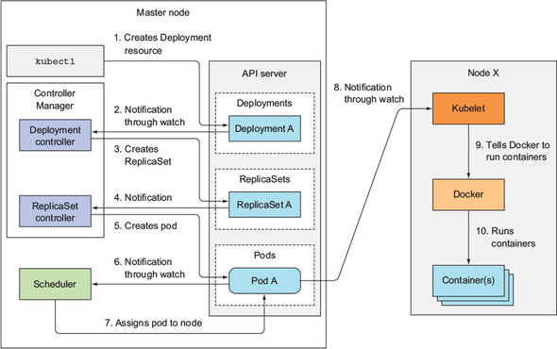
Creation of Deployment
info@zekeLabs.com | www.zekeLabs.com | +91 8095465880

Slide 21
Kube-proxy
info@zekeLabs.com | www.zekeLabs.com | +91 8095465880

Slide 22
Purpose is to make sure clients can connect to the services you define through the Kubernetes API.
The kube-proxy makes sure connections to the service IP and port end up at one of the pods backing that service.
When a service is backed by more than one pod, the proxy performs load balancing across those pods.
Kube-proxy: General points
info@zekeLabs.com | www.zekeLabs.com | +91 8095465880

Slide 23
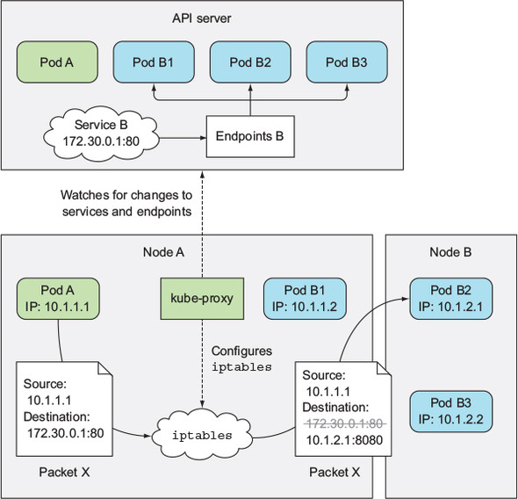
Kube proxy
info@zekeLabs.com | www.zekeLabs.com | +91 8095465880

Slide 24
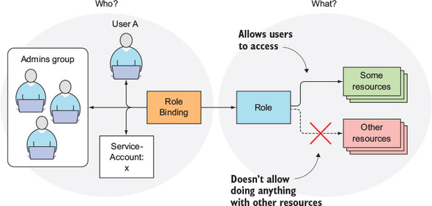
Role role bindings RBAC
info@zekeLabs.com | www.zekeLabs.com | +91 8095465880

Slide 25
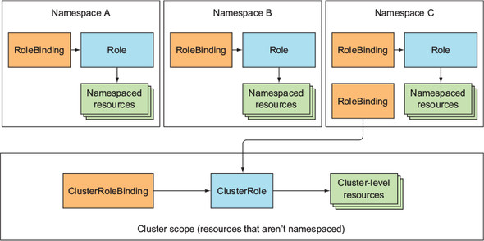
Cluster Role & Cluster role bindings
info@zekeLabs.com | www.zekeLabs.com | +91 8095465880

Slide 26
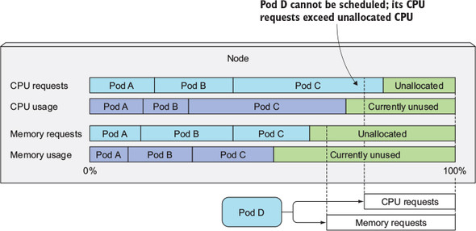
Node allocation based on cpu and memory
info@zekeLabs.com | www.zekeLabs.com | +91 8095465880

Slide 27
HA
info@zekeLabs.com | www.zekeLabs.com | +91 8095465880

Slide 28
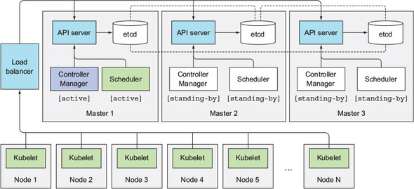
HA on Master
info@zekeLabs.com | www.zekeLabs.com | +91 8095465880

Slide 29
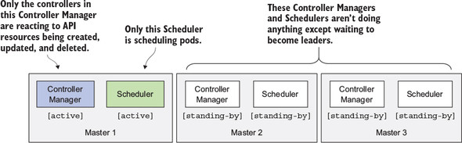
General points
info@zekeLabs.com | www.zekeLabs.com | +91 8095465880

Slide 30
API server is (almost completely) stateless (all the data is stored in etcd, but the API server does cache it).
Usually, one API server is collocated with every etcd instance.
Each individual component will only be active when it’s the elected leader.
Only the leader performs actual work, whereas all other instances are standing by and waiting for the current leader to fail.
General points
info@zekeLabs.com | www.zekeLabs.com | +91 8095465880

Slide 31
THANK YOU
Let us know how can we help your organization to Upskill the employees to stay updated in the ever-evolving IT Industry.
Get in touch:
www.zekeLabs.com | +91-8095465880 | info@zekeLabs.com
Visit : www.zekeLabs.com for more details

