Slide 1
zekeLabs
Learning made Simpler ! www.zekeLabs.com

Slide 2
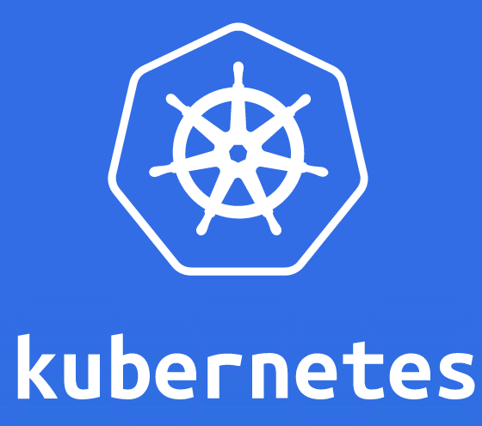

Slide 3
Kubernetes : Security
info@zekeLabs.com | www.zekeLabs.com | +91 8095465880

Slide 4
Configuring the security context
Specify the user (the user’s ID) under which the process in the container will run.
Prevent the container from running as root Run the container in privileged mode, giving it full access to the node’s kernel.
Configure fine-grained privileges, by adding or dropping capabilities
Run container with all possible permissions by running it in privileged mode.
Set SELinux (Security Enhanced Linux) options to strongly lock down a container.
Prevent the process from writing to the container’s filesystem.

Slide 5
Configuring the security context
Run as a guest user only (pod-as-user-guest.yaml)
runAsUser : 405
kubectl exec pod-as-user-guest id

Slide 6
Configuring the security context
Preventing containers from running as root: pod-run-as-non-root.yaml
runAsNonRoot: true
kubectl get po pod-run-as-non-root
## Pod would Never come in ready mode

Slide 7
Configuring the security context
A pod with a privileged container: pod-privileged.yaml
privileged: true
kubectl exec -it pod-privileged ls /dev
## shall show all the system devices

Slide 8
Configuring the security context
A container with a read-only filesystem: pod-with-readonly-filesystem.yaml
readOnlyRootFilesystem: true
kubectl exec -it pod-with-readonly-filesystem touch /new-file
## shall fail

Slide 9
Configuring the security context
Dropping a capability from a container: pod-drop-chown-capability.yaml
capabilities:
drop:
- CHOWN
kubectl exec pod-drop-chown-capability chown guest /tmp
## shall fail

Slide 10
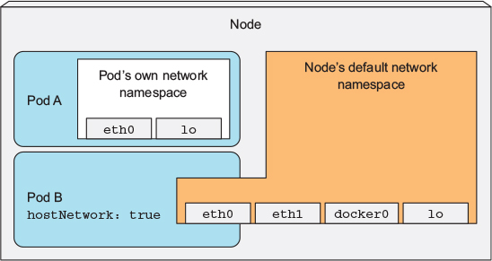
Pod(B) using host’s network namespace
info@zekeLabs.com | www.zekeLabs.com | +91 8095465880

Slide 11
Pod B (pod-with-host-network.yaml)
apiVersion: v1
kind: Pod
metadata:
name: pod-with-host-network
spec:
hostNetwork: true
containers:
- name: main
image: alpine
command: ["/bin/sleep", "999999"]
Notes:
When the Kubernetes Control Plane components are deployed as pods you’ll find that those pods use the hostNetwork option, effectively making them behave as if they weren’t running inside a pod.
e.G
kubectl get pods kube-proxy-6kgp5 -n kube-system
## search for hostnetwork
## you can also use hostport

Slide 12
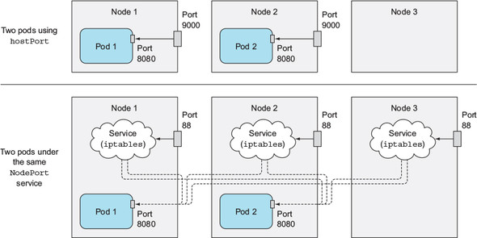
Pod using hostport & comparison with nodeport
info@zekeLabs.com | www.zekeLabs.com | +91 8095465880

Slide 13
kubia-hostport.yaml
apiVersion: v1
kind: Pod
metadata:
name: kubia-hostport
spec:
containers:
- image: luksa/kubia
name: kubia
ports:
- containerPort: 8080
hostPort: 9000
protocol: TCP

Slide 14
Pod can use the node’s PID and IPC namespaces
Similar to the hostNetwork option are the hostPID and hostIPC pod spec properties
Checkout the file:
pod-with-host-pid-and-ipc.yaml
Apply the yaml file and check the processes
kubectl exec pod-with-host-pid-and-ipc ps aux

Slide 15
Pod Security policy
info@zekeLabs.com | www.zekeLabs.com | +91 8095465880

Slide 16
PodSecurityPolicy resource can define
PodSecurityPolicy is a cluster-level resource, which defines what security-related features users can or can’t use in their pods.
The job of upholding the policies configured in PodSecurityPolicy resources is performed by the PodSecurityPolicy admission control plugin running in the API server.
When someone posts a pod resource to the API server, the PodSecurityPolicy admission control plugin validates the pod definition against the configured PodSecurity- Policies.
If the pod conforms to the cluster’s policies, it’s accepted and stored into etcd; otherwise it’s rejected immediately.

Slide 17
PodSecurityPolicy resource can define
○ Whether a pod can use the host’s IPC, PID, or Network namespaces
○ Which host ports a pod can bind to
○ What user IDs a container can run as
○ Whether a pod with privileged containers can be created
○ Which kernel capabilities are allowed, which are added and which are dropped
○ Whether a container can use a writable root filesystem or not
○ Which filesystem groups the container can run as
○ Which volume types a pod can use

Slide 18
THANK YOU
Let us know how can we help your organization to Upskill the employees to stay updated in the ever-evolving IT Industry.
Get in touch:
www.zekeLabs.com | +91-8095465880 | info@zekeLabs.com
Visit : www.zekeLabs.com for more details

