Slide 1

AI-Powered Carpool Request and Offer Extraction from WhatsApp Chats
MLOPS PROJECT 2024

Slide 2
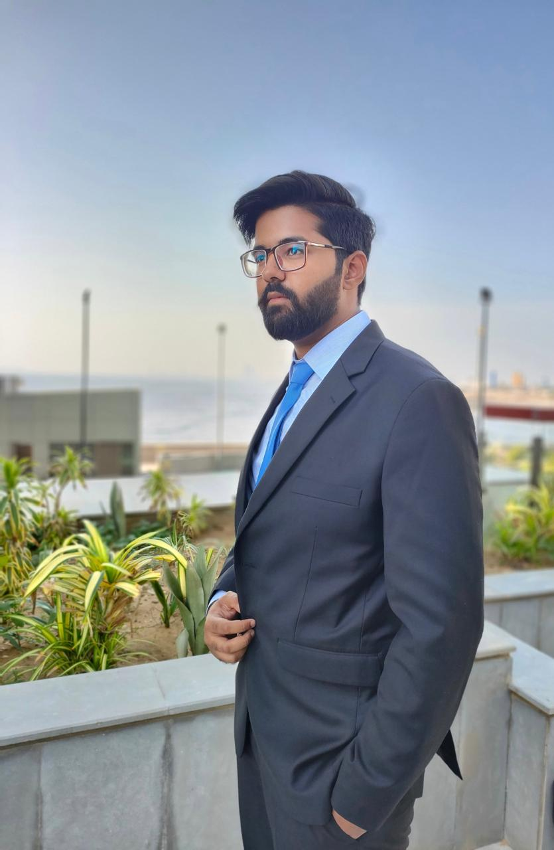
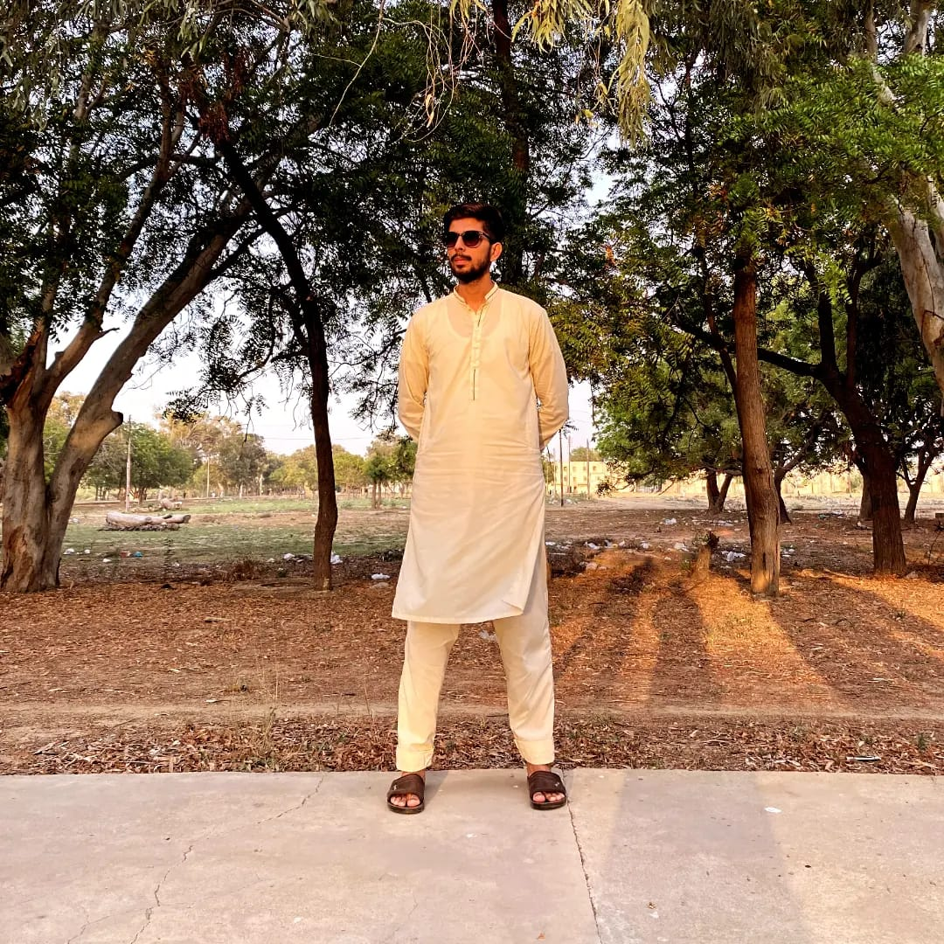
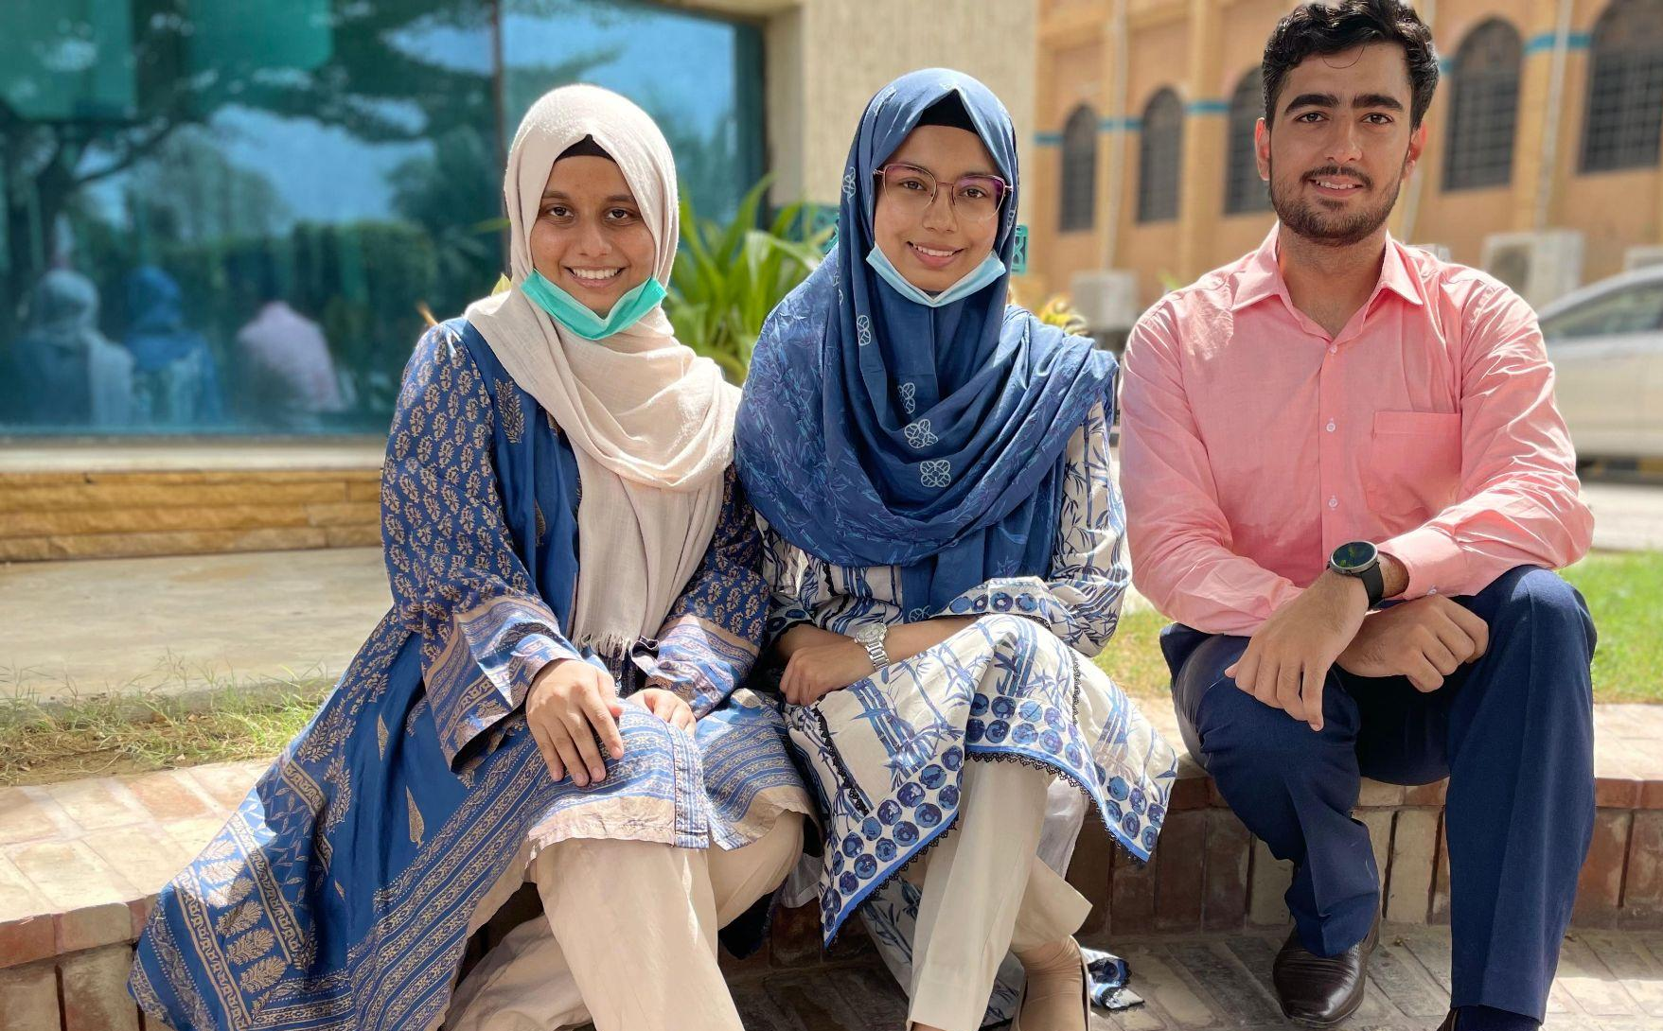
Team
Anas
Maqbool
Mannahil Alishba Arham

Slide 3
Problem Statement
Many individuals use WhatsApp groups to share ride offers and requests for carpooling. As the owner of a carpooling app, you want to leverage AI to automatically extract relevant ride requests and offers from these WhatsApp group chats. The AI system will then convert these extracted messages into actionable requests and offers within your carpooling app.

Slide 4
Solution
DATA PREPARATION
Data Collection
Source: WhatsApp FAST-NU carpool group chat
Exported Data: Text file containing chat messages
Data Transformation
Conversion: Converted text file to CSV format
Preprocessing:
Removed irrelevant rows
Anonymized authors by removing their names

Slide 5
3. Feature Engineering
Output Column Creation:
Manually created type, source & destination columns
Extracted relevant information from raw messages:
Type: Carpool request or offer
Source: Origin location
Destination: Final destination
4. Prompt Creation & Data Formatting for LLAMA-2
Added a new column for prompts associated with each raw message.
Human: Extract information from the following ride message: {input}
Assistant: {response}
Converted the dataset into the format compatible with LLAMA-2.

Slide 6
LLAMA-2 MODEL TRAINING WORKFLOW
LLAMA-2 Model Setup
Base Model Selection:
Used the LLAMA-2 7b-chat language model.
Leveraged its pre-trained weights for language understanding.
Quantization with QLoRa:
Applied quantization to reduce model size and improve efficiency.
Model Training and Saving
Tokenizer Loading:
Loaded the tokenizer associated with the base model.
Training Process:
Trained the fine-tuned LLAMA-2 model on the prepared dataset.
Adapted the model to the prompt engineering task.
Model Persistence:
Saved the trained model for future use.

Slide 7
MODEL DEPLOYMENT ON HUGGING FACE
Reload Base Model
Load the Llama-2-7b-chat language model.
Load Model for Fine-Tuning
Load the fine-tuned using weights from the base model.
Merge and Unload Weights
Merge the weights of the fine-tuned model with the weights of the base model.
Unload the base model to save memory.
Reload Tokenizer
Load the tokenizer for the Llama-2-7b-chat model.
Model Push
Logged into hugging face using CLI.
Pushed the fine-tuned model to hugging face hub.

Slide 8
LLAMA-2 Model Testing Workflow
Text Generation Pipeline
Model Selection:
Load the fine tuned LLAMA-2-7b chat language model from hugging face.
Input Prompt:
Created a prompt for extracting information from a ride message.
Provided an example ride message with details (seats available, departure time, and route).
Model Execution
Pipeline Initialization:
Set up the text generation pipeline.
Model Inference:
Generated text based on the input prompt and ride message.
Extracted relevant information from the generated response i.e., type, source & destination.

Slide 9
Real-Time Carpool Information Extraction Workflow
Model Output Analysis
Generated Text:
Extracted relevant details: type (request/offer), source, and destination.
Geolocation Data Retrieval
Geolocator.geocode():
Used the geolocator service to obtain coordinates (longitude and latitude).
Converted source and destination names to geographical coordinates.
Carvan API Format
Data Transformation:
Structured all extracted details (type, source, destination, and coordinates).
Formatted the data according to the Carvan API specifications.

Slide 10
4. Real-Time Integration
Carvan Carpool App Display:
Designed for real-time use.
Displays relevant carpool information extracted from WhatsApp group messages.

Slide 11
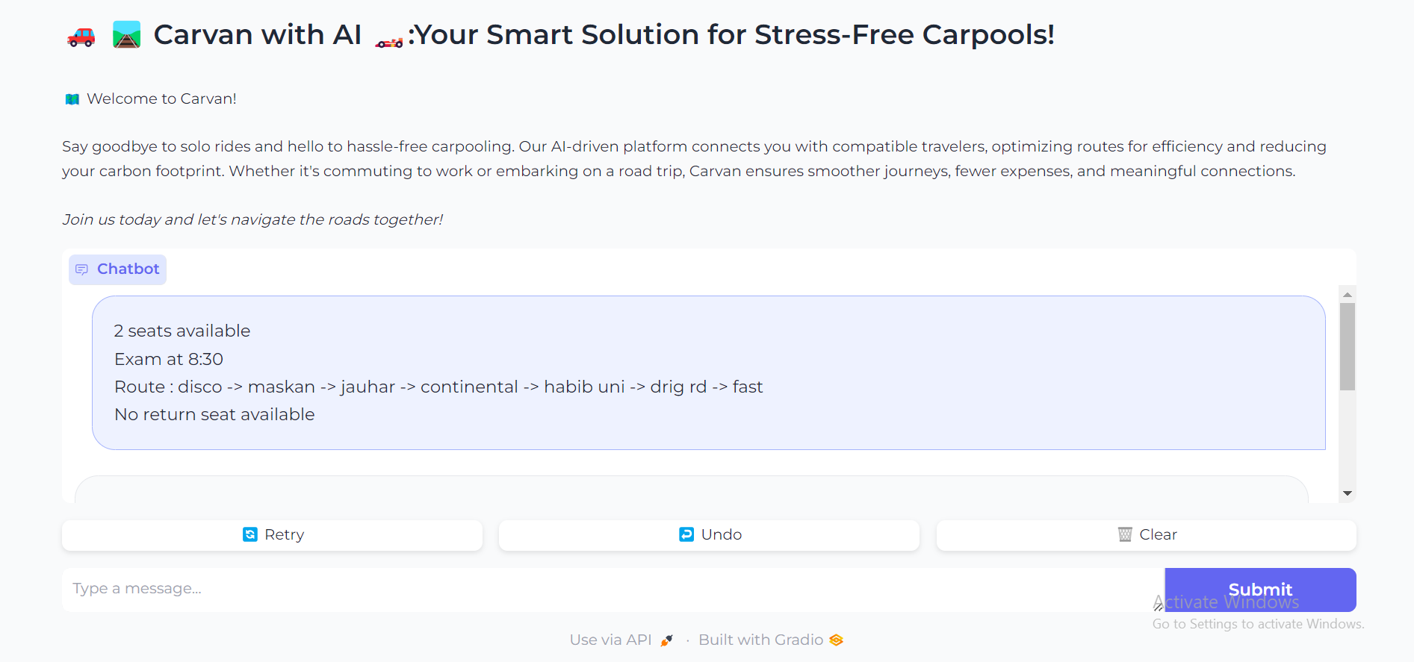
USER INTERFACE

Slide 12
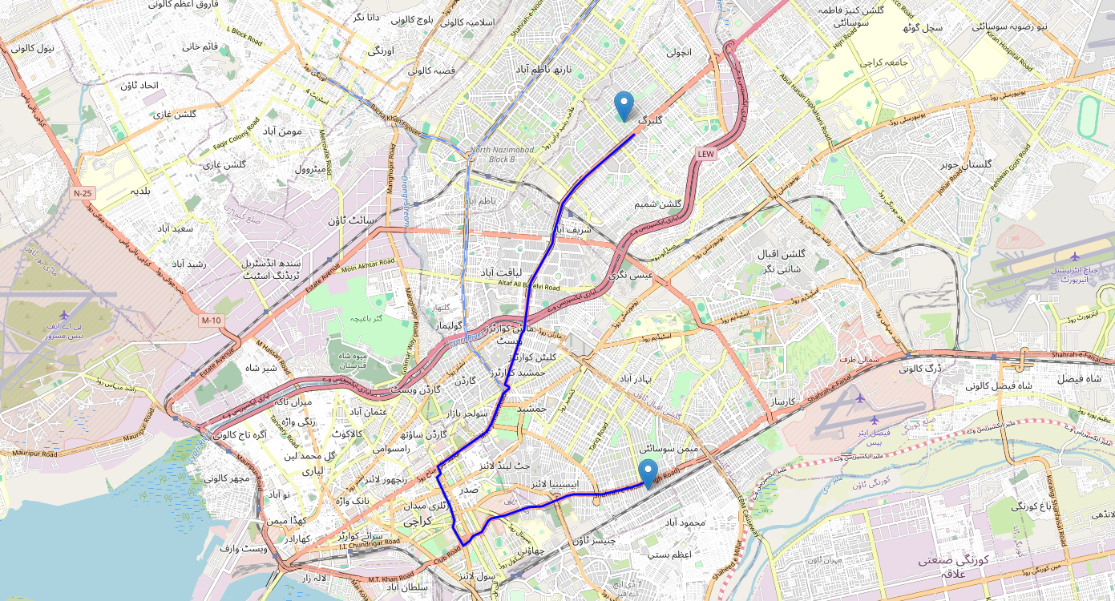
MAP
Route: Ayesha Manzil to Fast

Slide 13
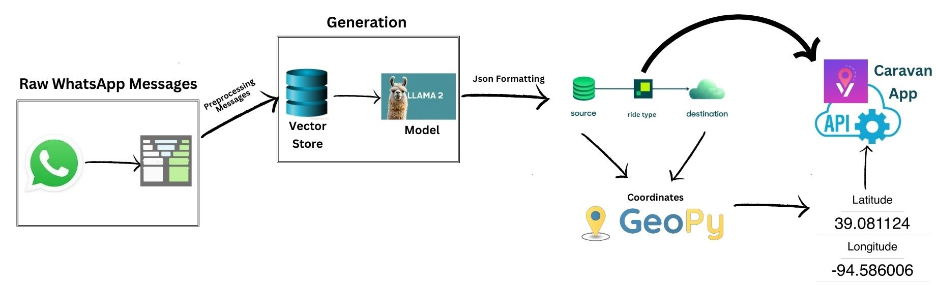
WorkFlow

Slide 14
THANKS FOR LISTENING
Q/A

