Slide 1

Domain: Matlab
Technology: Communications
Multihop D2D Communication to Minimize and Balance SAR in 5G

Slide 2
Index
Abstract
Introduction
Literature review
Existing Method
Drawbacks
Proposed method
Advantages
Applications
Hardware and Software Requirements
References

Slide 3
Abstract
5G is the 5th generation mobile network. It is a new global wireless standard after 1G, 2G, 3G, and 4G networks. 5G enables a new kind of network that is designed to connect virtually everyone and everything together including machines, objects, and devices. But this system causes high specific absorption rate (SAR). Hence, we introduces a novel technique.
In this paper, we propose an elegant method of band selection with appropriate data rate for multi-hop packet routing, to minimize and also to balance the transmission power and hence the associated EMF effect on us in terms of the Specific Absorption Rate (SAR). Theoretical analysis has been presented for linear networks that results an upper bound on the number of hops permitted for a given spectrum band. Simulation results on random networks show that the proposed technique achieves a better improvement in terms of SAR, compared to the conventional direct communication via base station.

Slide 4
Introduction:
With the rapid increase in the usage of wireless technologies, exposure to associated radiation and the electromagnetic field (EMF) is becoming a major concern for any living being and our ecosystem.
During recent years, it has been observed that the volume of wireless traffic is getting doubled in every four years, with an affinity towards higher frequency, resulting huge energy generated from numerous sources and being transmitted through space.
There is considerable confusion and misunderstanding about the meaning of the maximum reported Specific Absorption Rate (SAR) values for cell phones (and other wireless devices). SAR is a measure of the rate of RF (radiofrequency) energy absorption by the body from the source being measured – in this case, a cell phone.

Slide 5
SAR provides a straightforward means for measuring the RF exposure characteristics of cell phones to ensure that they are within the safety guidelines set by the FCC.
What SAR Shows:
The FCC requires that cell phone manufacturers conduct their SAR testing to include the most severe, worst-case (and highest power) operating conditions for all the frequency bands used in the USA for that cell phone.
The SAR values recorded on the FCC’s authorization and in the cell phone manual to demonstrate compliance with Commission rules.

Slide 6
What SAR Does Not Show ?
The SAR value used for FCC approval does not account for the multitude of measurements taken during the testing. Moreover, cell phones constantly vary their power to operate at the minimum power necessary for communications; operation at maximum power occurs infrequently.
In this work, we have investigated the multi-hop routing strategy for future wireless technologies and have proposed a novel technique for multi-hop packet routing with appropriate band assignment to reduce the EMF pollution in terms of SAR (Specific Absorption Rate) by balancing it across the network.
Analysis has been done for SAR balance on a linear network with uniform traffic generated at each node that represents a worst case scenario of load imbalance, and may be extended easily for random networks.
Simulation results on random network shows the proposed technique will be highly effective for future wireless technologies to reduce the harmful effects of associated EMFs on our ecosystem.

Slide 7
Literature review:
S. NO | Journal Type with year | Authors | Title | Outcomes
1 | Proceedings of the 20th International Conference on Distributed Computing and Networking, 2019 | A. Das and S. Kundu | To protect ecological system from electromagnetic radiation of mobile communication | A testbed is designed utilizing sensors to measure the EMF strength over a given region, and a heat map is generated in order to rise issue alerts
2 | IEEE Access, 2018 | J. Gui and J. Deng | Multi-hop relay-aided underlay D2D communications for improving cellular coverage quality | This paper focuses on the underlay D2D relay function to improve cellular coverage quality
3 | IEEE Communications Letters, 2019. | A. Das, N. Das, A. D. Barman, and S. Dhar | Energy incentive for packet relay using cognitive radio in IoT network | An energy incentive model for sharing wide band cognitive spectrum

Slide 8
Existing method:
To improve the network performance, multi-hop D2D communication has recently attracted many researchers [5] to forward packets via users’ devices serving as relay nodes which results improved energy efficiency and outage probability.
Various incentive schemes and policies have proposed in the context of ad hoc networks [6], [7].
In [8], authors proposed a novel energy incentive based technique of preferential band selection using cognitive radio for ad hoc IoT networks, and Multihop D2D networks as well, to motivate nodes to serve as relay nodes to support multi-hop communication preserving its energy resource, and to achieve significantly better QoS and coverage.

Slide 9
Disadvantages in Existing method:
High SAR values.
Low energy efficiency and outage probability.

Slide 10


Proposed method:
SAR value is dependent on the distance of separation of the body and the radiation source expressed as:
Since, the effects of EMFs on living beings depend on the transmission power and the frequency of operation as well, it is important to investigate the relation between the two. From information theoretic point of view, Shannon-Hartley theorem says that the error-free information transmission rate k in bits/sec is upper bounded as given by:

Slide 11



By using this formula the SNR value will be obtained. Where B is the channel bandwidth in Hz, and SNR is the signal to noise power ratio at the receiver. So, minimum SNR required to receive data at a rate of k bits/sec, is given by
If Prmin be the minimum power to be received at the receiver and N0 be the constant noise level at the receiver, then we get,
By these above equations, we are going to consider the power value from which we are going to derive the SAR value which is given by:

Slide 12
Advantages of Proposed method:
Provides less SAR value.
Maintains better energy efficiency.

Slide 13
Software& hardware Requirements
Software: Matlab 2018a or above
Hardware:
Operating Systems:
• Windows 10
• Windows 7 Service Pack 1
• Windows Server 2019
• Windows Server 2016
RAM:
Minimum: 4 GB
Recommended: 8 GB

Slide 14
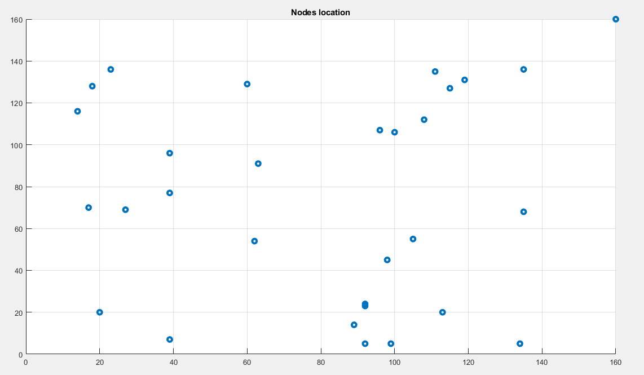
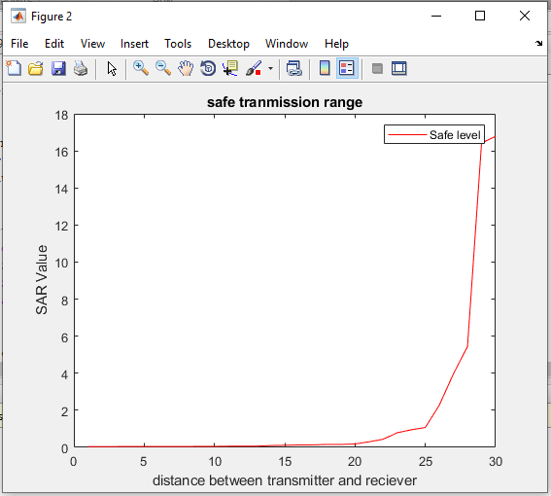
Results
Figure: 2
Figure: 1

Slide 15
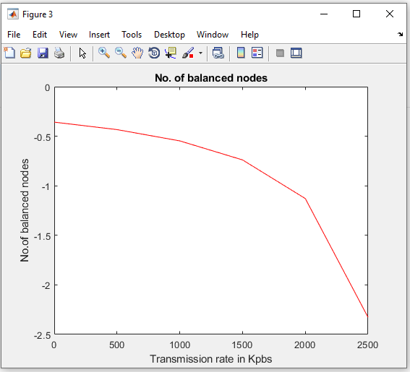
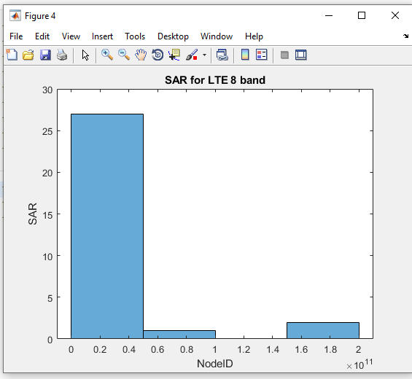
Results
Figure: 4
Figure: 3

Slide 16
Conclusion
Here in this project we are introducing a novel technique. In this paper, we proposed an elegant method of band selection with appropriate data rate for multi-hop packet routing, to minimize and also to balance the transmission power and hence the associated EMF effect on us in terms of the Specific Absorption Rate (SAR). Theoretical analysis has been presented for linear networks that results an upper bound on the number of hops permitted for a given spectrum band. Simulation results on random networks show that the proposed technique achieves a better improvement in terms of SAR, compared to the conventional direct communication via base station.

Slide 17
References:
[1] B. O. Anyaka and U. B. Akuru, “Electromagnetic wave effect on human health: Challenges for developing countries,” in 2012 International Conference on Cyber-Enabled Distributed Computing and Knowledge Discovery, Oct 2012, pp. 447–452.
[2] K. Megha, P. S. Deshmukh, B. D. Banerjee, A. K. Tripathi, and M. P. Abegaonkar, “Microwave radiation induced oxidative stress, cognitive impairment and inflammation in brain of fischer rats,” 2012.
[3] L. Gherardini, G. Ciuti, S. Tognarelli, and C. Cinti, “Searching for the perfect wave: the effect of radiofrequency electromagnetic fields on cells,” International journal of molecular sciences, vol. 15, no. 4, pp. 5366–5387, 2014.
[4] A. Das and S. Kundu, “To protect ecological system from electromagnetic radiation of mobile communication,” in Proceedings of the 20th International Conference on Distributed Computing and Networking, ICDCN 2019, Bangalore, India, January 04-07, 2019, 2019, pp. 469– 473.
[5] J. Gui and J. Deng, “Multi-hop relay-aided underlay D2D communications for improving cellular coverage quality,” IEEE Access, vol. 6, pp. 14 318–14 338, 2018.

