Slide 1
Nutrimate
CAPSTONE PROJECT
Presented By:
Mannat Trivedi
MANIT , Bhopal

Slide 2
OUTLINE
Problem Statement
Proposed System/Solution
System Development Approach (Technology Used)
Algorithm & Deployment
Result (Output Image)
Conclusion
Future Scope
References

Slide 3
Problem Statement
Problem statement – 8
Nutrition AI
Generic diet apps deliver one-size-fits-all plans that don’t adapt in real time.
Nutritionists can’t scale highly personalized counseling to more clients.
Users need holistic plans that consider health conditions, cultural preferences, allergies,
evolving goals, and actual meals.
Challenge: Build an AI agent that thinks, learns, and advises like a human nutritionist—24/7.

Slide 4
Proposed Solution
NutriMate will:
Ingest multimodal input: text queries
Personalize meal plans by health profile: goals (weight loss, muscle gain), medical conditions (diabetes, hypertension), dietary restrictions, fitness routines.
Explain recommendations: “Quinoa > white rice because lower GI for stable blood sugar.”
Adapt dynamically via continuous feedback loops and wearable integrations.

Slide 5
System Approach
1.IBM Cloud & Watsonx.ai
Create sandbox project → Watsonx AI Agent → Associate runtime service
Select Mistral-large foundation model
2.IBM Granity for LLM orchestration & reasoning
3.Watson Assistant for text dialog management
4.IBM Cloud Functions for serverless back-end logic
5.IBM Cloudant / Db2 for user profile & meal plan storage

Slide 6
Algorithm & Deployment
Algorithms & Workflows
Input Processing
Text → NLP intent/entity extraction
Voice → STT → NLP
Image → Visual Recognition → food identification
Meal Plan Generation
LLM prompt template with user profile → Granity-powered reasoning
Explanation Engine
Rule-based nutrient comparisons + LLM summarization
Feedback Loop
User ratings/logs → incremental profile update
Deployment Steps
Follow IBM Cloud Demo steps:
Login to IBM Cloud
Create Watsonx sandbox & AI Agent
Associate Watsonx Runtime, select Mistral model
Add Watson Assistant, STT, Visual Recognition tools
Build, test (“Send” queries), save & deploy
Generate API key → New deployment space → Deploy agent → Preview

Slide 7
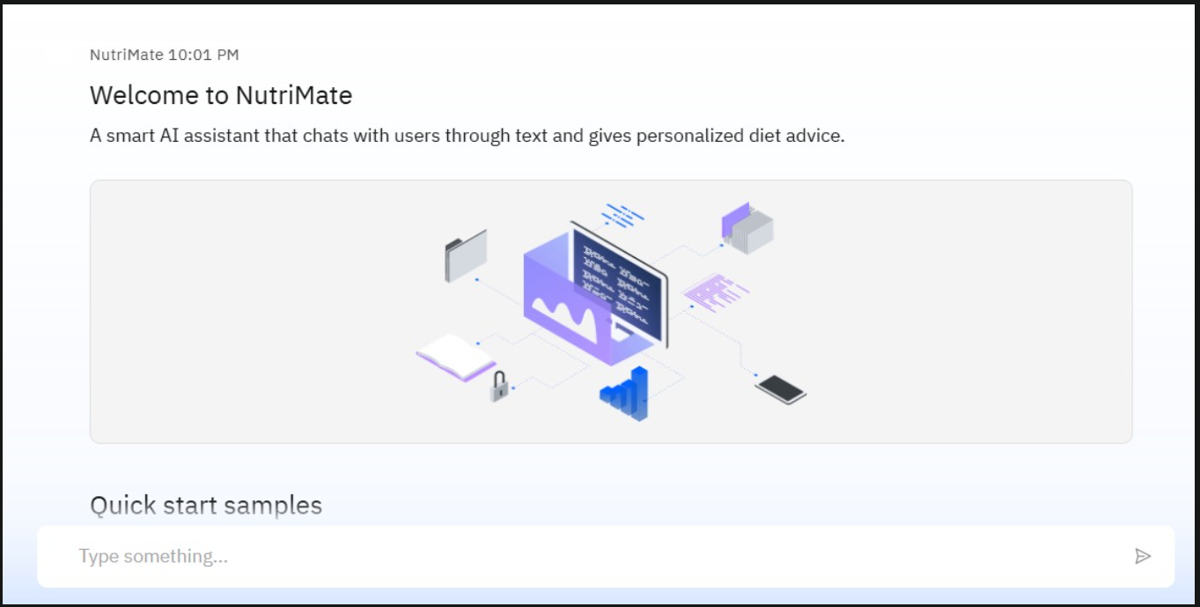
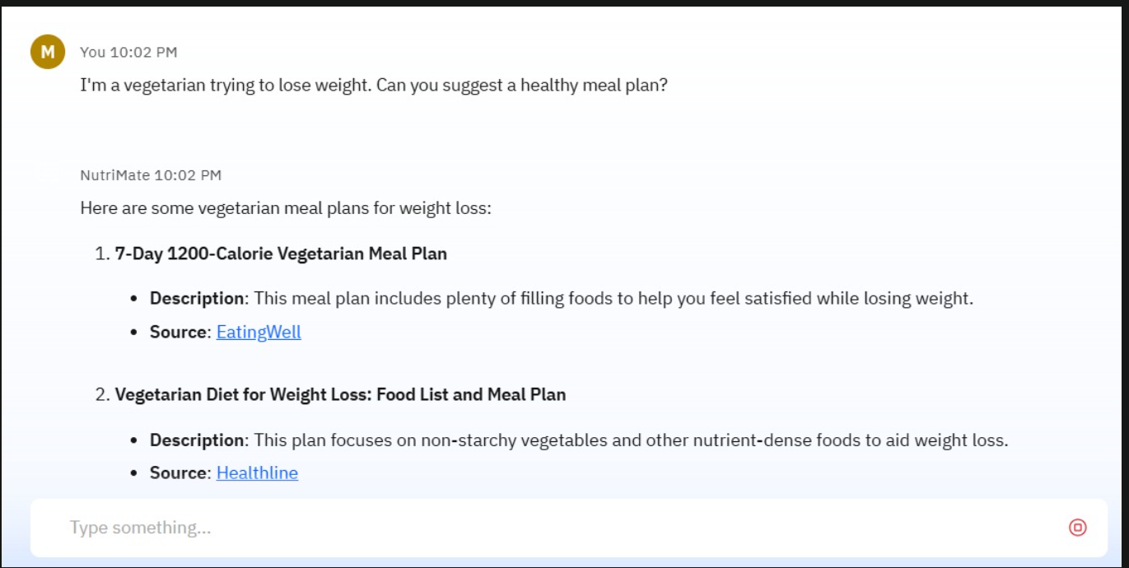
Result

Slide 8
Conclusion
NutriMate bridges the gap between generic apps and 1:1 counseling.
Combines multimodal inputs, LLM-driven personalization, and explainable choices.
Scalable via IBM Cloud’s serverless and agentic AI platform.
Provides adaptive, 24/7 nutrition guidance at scale.

Slide 9
Future scope
Wearable integration: Auto-ingest fitness & sleep data.
Grocery shopping assistant: Scan barcodes, suggest swaps in real time.
Voice-only mode: For hands-free kitchen guidance.
Reinforcement learning: Optimize suggestions by measured health outcomes.
Multi-language support: Serve culturally diverse user bases.

Slide 10
References
IBM Cloud – Watsonx.ai Agentic Lab Quickstart Guide
IBM Watson Assistant, Speech-to-Text, Visual Recognition Docs
USDA FoodData Central
“AI in Personalized Nutrition,” International Journal of AI, 2024
IBM Granity documentation

Slide 11
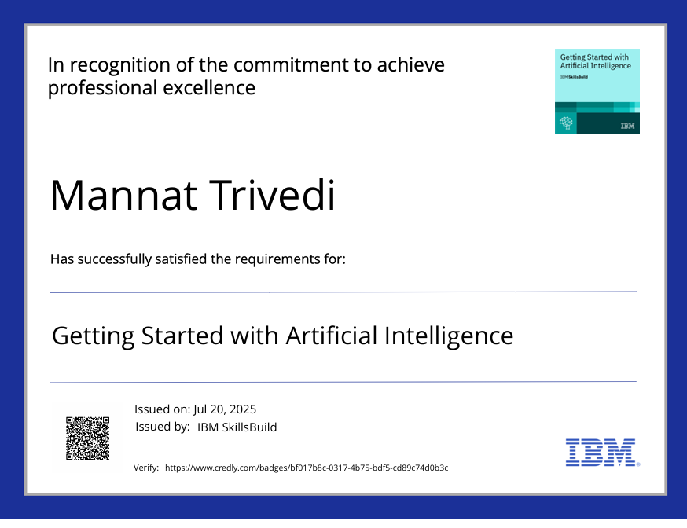
IBM Certifications

Slide 12
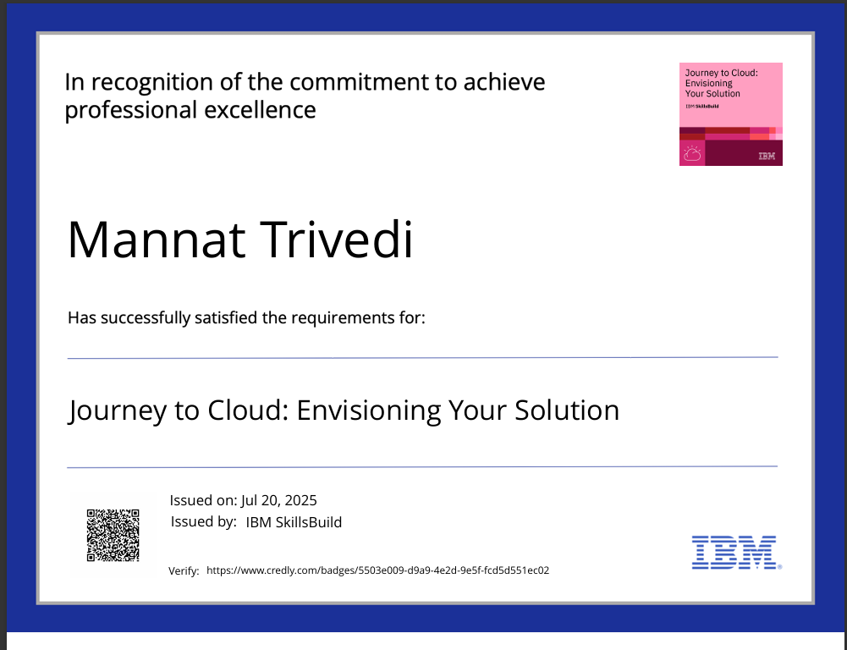
IBM Certifications

Slide 13
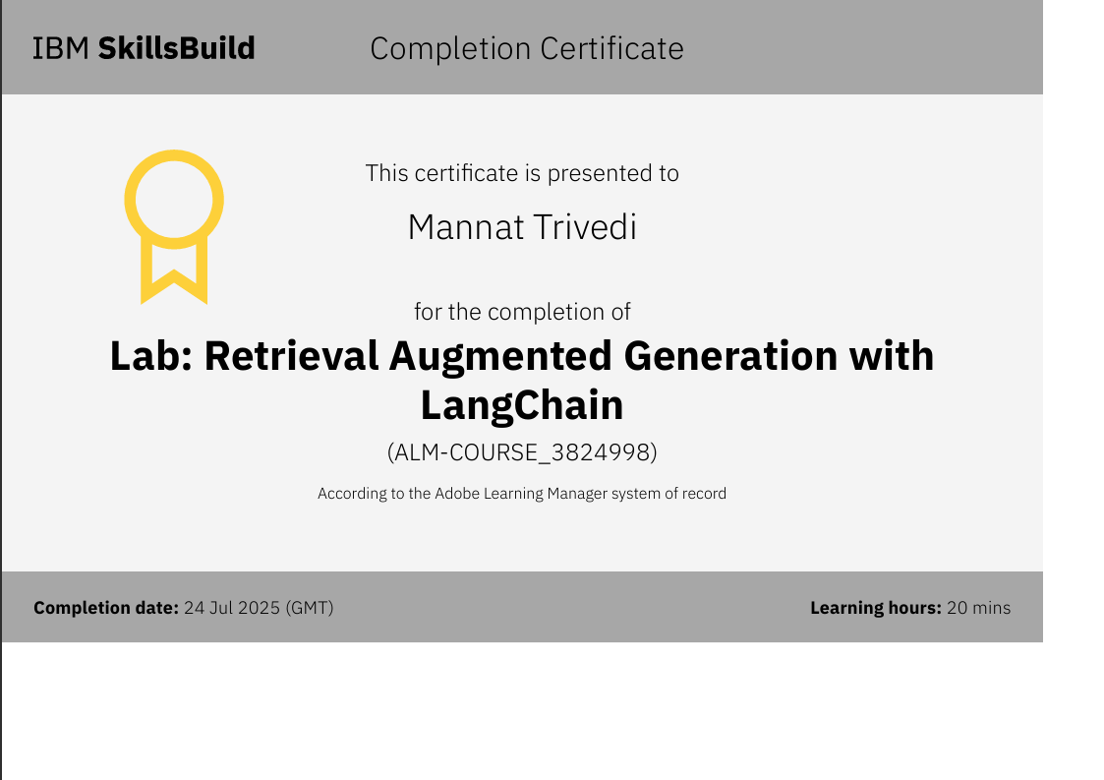
IBM Certifications

Slide 14
THANK YOU

