Slide 1

Intelligent E-Commerce Product Sales Forecasting
A Machine Learning Approach to Demand Prediction
Presenter: Mannat (MCA Data Science)
Institution: Lovely Professional University

Slide 2

Project Objective & Business Problem
The Problem
E-commerce platforms struggle with overstocking and understocking due to unpredictable consumer demand.
The Solution
Developing an automated, data-driven machine learning model to accurately forecast future product sales.
The Goal
Optimize supply chain operations, reduce inventory costs, and ensure high-demand products remain in stock.

Slide 3
The Technology Stack
Core Language
Data Processing
Python.
Data manipulation utilizing pandas and numpy.
Machine Learning
Visualization
Predictive modeling driven by the catboost algorithm.
Advanced graphing and interactive plotting using matplotlib, plotly, and graphviz.

Slide 4
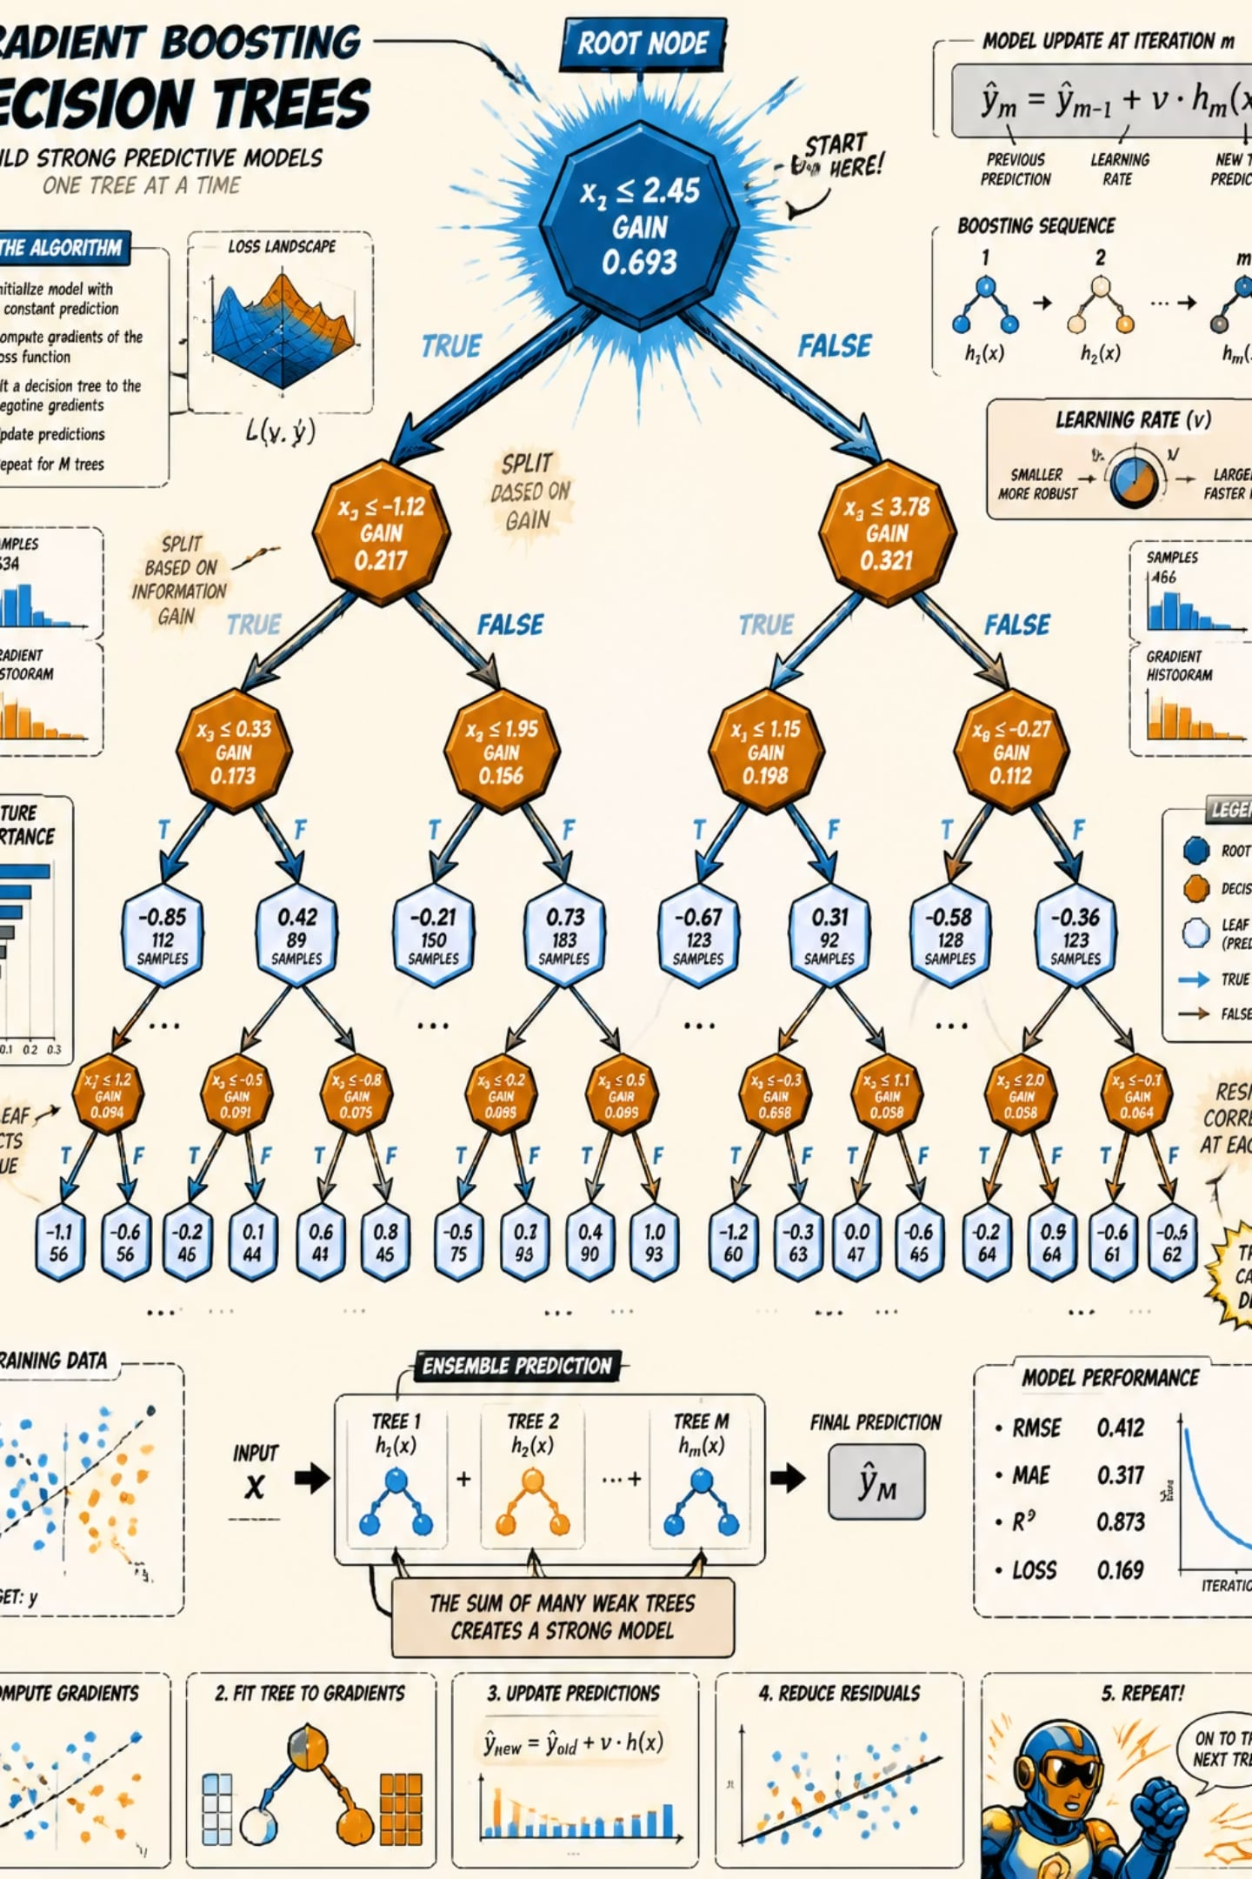
Why CatBoost?
1
Highly Efficient Gradient Boosting
CatBoost (Categorical Boosting) is a highly efficient, open-source gradient boosting algorithm.
2
Native Categorical Handling
It natively handles categorical variables without requiring extensive data preprocessing like one-hot encoding.
3
Symmetric Trees
It utilizes symmetric trees to prevent overfitting and improve prediction speed.

Slide 5
Model Training & Experimentation
01
02
03
Iterative Experiments
Training Cycles
Continuous Monitoring
Multiple iterative experiments were conducted, tracking different feature sets, including the baseline ProductSalesModel and iterations like new_features_1.
The models were configured to train over extensive cycles, specifically utilizing 500 to 1000 total iterations.
Training involved continuous monitoring of learning rates and elapsed time to balance accuracy with computational efficiency.

Slide 6
Evaluation Metric (RMSE)
What is RMSE?
Results
The primary evaluation metric utilized for optimizing the model was Root Mean Squared Error (RMSE).
RMSE was strictly monitored across both the learning sets and the testing sets.
Across the experiments, the model demonstrated strong convergence, achieving test RMSE scores in the ~35.7 to ~38.6 range, indicating reliable prediction accuracy.

Slide 7

Explainable AI (XAI) Integration
The Challenge
Machine learning models are often "black boxes," but this project prioritizes transparency.
The Pipeline
The pipeline integrates an AdditiveForceVisualizer to break down how individual features influence the final prediction.
Stakeholder Visibility
This allows stakeholders to see exactly which variables are driving sales up or down for any given product.

Slide 8
Interactive Feature Visualization
Feature Effects Mapping
Contrasting Color Maps
Dynamic Scaling
The visualizer maps feature effects against a centralized base value.
It utilizes contrasting color maps (such as Red/Blue distributions) to clearly delineate positive and negative impacts on the sales forecast.
The custom interface scales dynamically, providing precise numeric formatting for the effect of each feature.

Slide 9
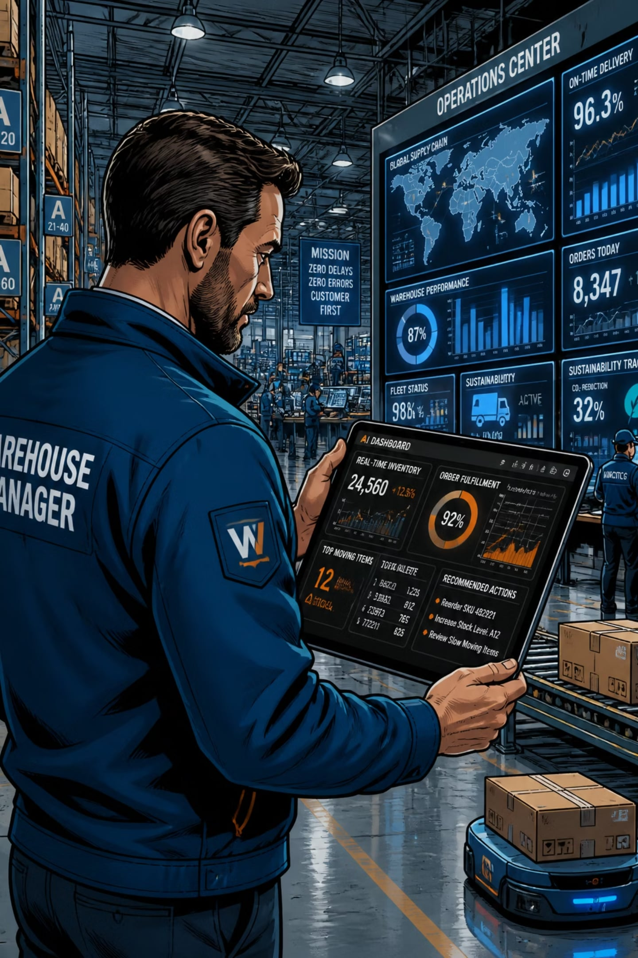
Business Value & Application
Proactive Planning
Allows warehouse managers to adjust stock levels weeks in advance based on the AI's numerical outputs.
Marketing Alignment
Helps teams understand which specific features (identified by the force visualizer) are correlating with sales spikes.
Scalability
The pipeline can be scaled across thousands of unique stock codes.

Slide 10

Conclusion & Q&A
1
2
Accurate & Scalable Framework
Bridging the Gap
CatBoost provides a highly accurate and scalable framework for e-commerce forecasting.
Integrating force visualization bridges the gap between complex mathematical outputs and actionable business insights.
Questions?

