Slide 1
What is the role of tertiary education in countries’ labor productivity?
Manna Tóth
26/03/2019

Slide 2

Labor (force) productivity
2
Economic Development
$$Labor \left(force\right) productivity$$
Driving forces
Key measure
Policies for economic growth
Growth
Competitiveness
Higher Living Standards
Machinery, equipment
Technology
Organizational infrastructure
Human capital
Indicator:
Efficiency and quality of human capital
Other complementary inputs (innovation)
Assumption: “High labor productivity is associated with high levels human capital
(specific education and training policies)” (ILO)
Tertiary education
(enrollment)
Notes:
Labor force productivity: total volume of output produced per unit of (potential) labors
Key measure of economic development:
Understanding the driving forces behind it is important for formulating policies that aim economic growth

Slide 3
Question
3
Do countries with higher enrollment rates in tertiary education have higher labor productivity?
If yes: countries should invest more into tertiary education in order to promote economic growth
If no: there may be other important factors that needed to be taken into account.
Relevance in Hungary:
Compulsory schooling age was reduced to 16-years from 18-years in 2012.
Ratio of Hungarians with university degree has been constantly decreasing since 2014.
Notes:
Average yearly rate of decrease: 1,8% point,
25-34-year-old Hungarians with tertiary education in 2017: 8.8%point less than EU average.

Slide 4
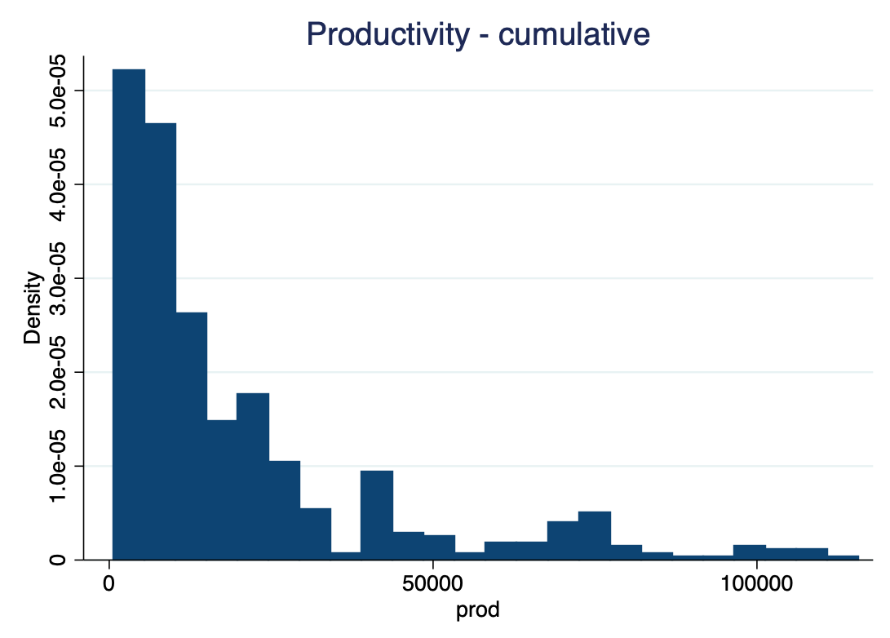
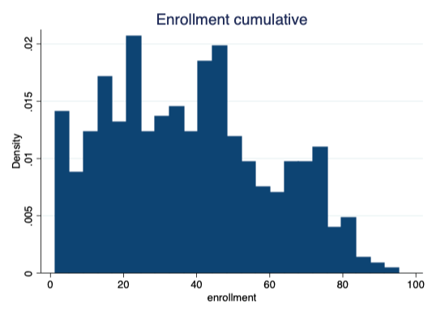
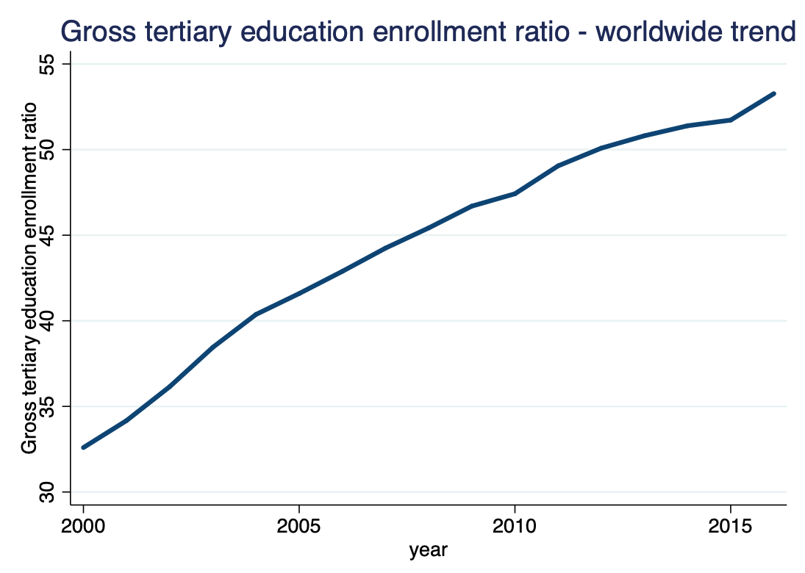
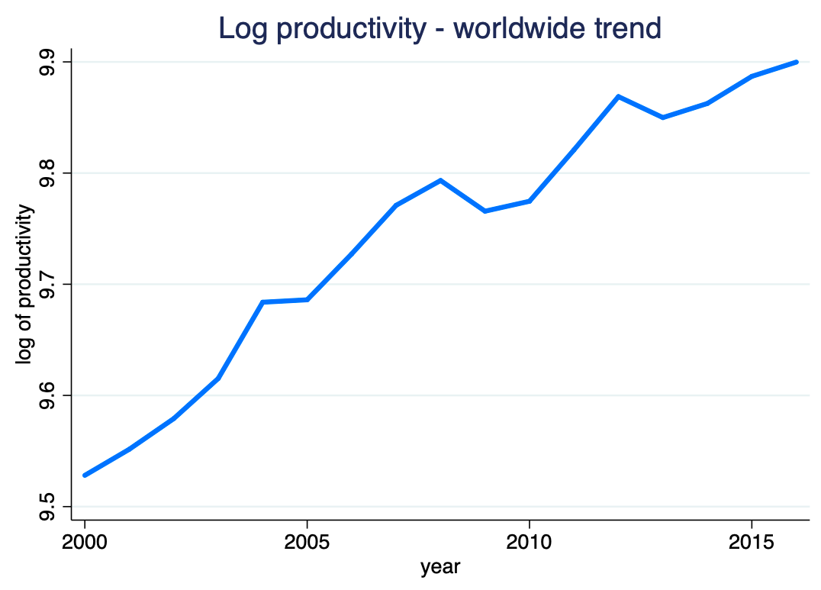
Data
4
Source: World Bank
Development Indicators
UNESCO educational data
Original Sample:
267 countries
1990-2018
Deleted
Country&year missing values
Years with very few countries
Countries with data <16 years
Final sample:
73 countries
2000-2016 (17 years)
Unique observations: 1223
Unbalanced panel (17 countries)
Extreme valued observations
Enrollment rate >100% (Korea, Turkey, Cuba)
Tableau is very useful tool for getting to know your panel data:
https://public.tableau.com/profile/manna.toth#!/vizhome/DA4_productivity/Sheet3?publish=yes
https://public.tableau.com/profile/manna.toth#!/vizhome/DA4_enrollment/Sheet4?publish=yes

Slide 5
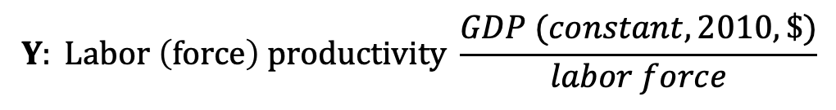
Identification Strategy
5
Z: Ratio of urban population
$$Y: Labor \left(force\right) productivity \frac{GDP (constant, 2010, \$)}{labor force}$$
X: Gross tertiary education enrollment ratio
Models
OLS | Cross-sectional, finding well-established long-term casual effect is not possible this way Does not treat unobserved heterogeneity
Long
First Difference + lags +country dummies | Changes between years in enrollment ratio Increasing in enrollment may have an effect in few years later
Fixed Effect +year dummies | Long-term trends, country-specific characteristics that are not Subject to change
Parallel trends assumption: in countries where the change in enrollment ratio was different, labor productivity would have changed the same way, on average, if they experienced the same change in enrollment ratio.
Notes:
https://public.tableau.com/profile/manna.toth#!/vizhome/DA4_productivity/Sheet3?publish=yes
https://public.tableau.com/profile/manna.toth#!/vizhome/DA4_enrollment/Sheet4?publish=yes
Decide upon your main regression that you hope would identify the effect you are after (or gets closest to that affect or the association you aim to measure). Explain what you are going to estimate and why. (10%)

Slide 6
 | No controls |  |  |  | Control for urban population |  |  |  | Control for urban population and country dummies
VARIABLES | FD(4) | FD(11) | FE | LONG | FD(4) | FD(11) | FE | LONG | FD(4) | FD(11)
enrollment |  |  | 0.002* | 0.01 |  |  | 0.00 | 0.01**
 |  |  | (0.001) | (0.004) |  |  | (0.001) | (0.004)
D.enrollment | 0.00 | -0.00 |  |  | 0.00 | 0.00 |  |  | 0.00 | 0.00
 | (0.001) | (0.001) |  |  | (0.001) | (0.001) |  |  | (0.001) | (0.001)
LD.enrollment | 0.00 | 0.00 |  |  | 0.00 | 0.00 |  |  | 0.00 | -0.00
 | (0.001) | (0.001) |  |  | (0.001) | (0.001) |  |  | (0.001) | (0.001)
L2D.enrollment | 0.00 | -0.00 |  |  | 0.00 | -0.00 |  |  | 0.00 | -0.00
 | (0.000) | (0.001) |  |  | (0.000) | (0.001) |  |  | (0.000) | (0.001)
L3D.enrollment | 0.00 | 0.00 |  |  | 0.00 | 0.00 |  |  | 0.00 | 0.00
 | (0.001) | (0.002) |  |  | (0.001) | (0.002) |  |  | (0.001) | (0.002)
L4D.enrollment | -0.001* | -0.00* |  |  | -0.00 | -0.00* |  |  | -0.001* | -0.00
 | (0.001) | (0.001) |  |  | (0.001) | (0.001) |  |  | (0.001) | (0.001)
L5D.enrollment |  | 0.00 |  |  |  | 0.00 |  |  |  | 0.00
 |  | (0.001) |  |  |  | (0.001) |  |  |  | (0.002)
L6D.enrollment |  | 0.00 |  |  |  | 0.00 |  |  |  | 0.00
 |  | (0.001) |  |  |  | (0.001) |  |  |  | (0.001)
L7D.enrollment |  | -0.00 |  |  |  | -0.00 |  |  |  | -0.00
 |  | (0.001) |  |  |  | (0.001) |  |  |  | (0.002)
L8D.enrollment |  | -0.00 |  |  |  | -0.00 |  |  |  | -0.00
 |  | (0.001) |  |  |  | (0.001) |  |  |  | (0.001)
L9D.enrollment |  | -0.00 |  |  |  | 0.00 |  |  |  | 0.00
 |  | (0.001) |  |  |  | (0.001) |  |  |  | (0.001)
L10D.enrollment |  | 0.00 |  |  |  | 0.00 |  |  |  | 0.00
 |  | (0.001) |  |  |  | (0.001) |  |  |  | (0.002)
L11D.enrollment |  | 0.002** |  |  |  | 0.003*** |  |  |  | 0.004**
 |  | (0.001) |  |  |  | (0.001) |  |  |  | (0.002)
Constant | 0.02*** | 0.01* | 9.48*** | 0.26*** | 0.05*** | 0.06*** | 9.10*** | 0.89*** | -0.02 | 0.05
 | (0.003) | (0.006) | (0.043) | (0.088) | (0.008) | (0.008) | (0.631) | (0.143) | (0.085) | (0.221)
Observations | 832 | 323 | 1,224 | 56 | 832 | 323 | 1,224 | 56 | 832 | 323
R-squared | 0.201 | 0.053 | 0.521 | 0.041 | 0.252 | 0.205 | 0.524 | 0.340 | 0.428 | 0.537
Robust standard errors in parentheses*** p<0.01, ** p<0.05, * p<0.1
LONG - long difference: change
of 2000 to 2016
6
Notes:
Present your results. Show the main result and emphasize it. Interpret the parameter(s) of interest of your main model. You may estimate a few versions of your model and argue for the choice of preferred specification. (20%)

Slide 7
Discussion
7
There are significant coefficients (enrollment and productivity), BUT it does not prove causal effect (tertiary education and productivity)
Gross tertiary enrollment ratio is not necessarily the best explanatory variable capturing this effect
Graduation?
Quality of education? (vs. Expansion of education)
This model does not control for other driving forces of productivity (machinery, equipment, technology, organizational infrastructure)
Human capital and tertiary education can have different effect on productivity in different countries

Slide 8
Robustness and heterogeneity
8
Heterogeneity
4 income groups (Low, Lower-middle, Upper-Middle, High – World Bank GNI)
After and before the financial crisis (2009)
Robustness
Natural resource-dependent countries (Venables, 2016)
Countries where high-tech industry is important (ratio of High-tech industry is at least 30% in manufacturing value-added – World Bank)
Notes:
Robustness checks: if there are multiple good ways of estimating the effect tell about those and show the results of some of those. (10%)
o Heterogeneity: your answer may be different for different countries or different times. You may show results showing such differences and discuss them. (for instance, by cutting the sample into two groups) (10%)
There is NO general casual effect between tertiary education enrollment rate and productivity among all the countries finmitsam, találtam szignifikáns paramétert de ez nem jelent feltétlenül okságot
X nem jó
Does it show the causal effect? Why or why not? If not, which way it is different from a causal effect? (10%) (mit jelent ez a kérdés)
Countries are very different and opposit, it does not have an obvious effect, and it is not significant or weekly significant, and from the driving forces of labor productivity (Machinery, equipment, Technology, Organizational infrastructure, Human Capital) human capital probably have an effect only in certain group of countries
Or it can have different effects on countries at a different level of development, or different characteristics (natural resource rich)

Slide 9
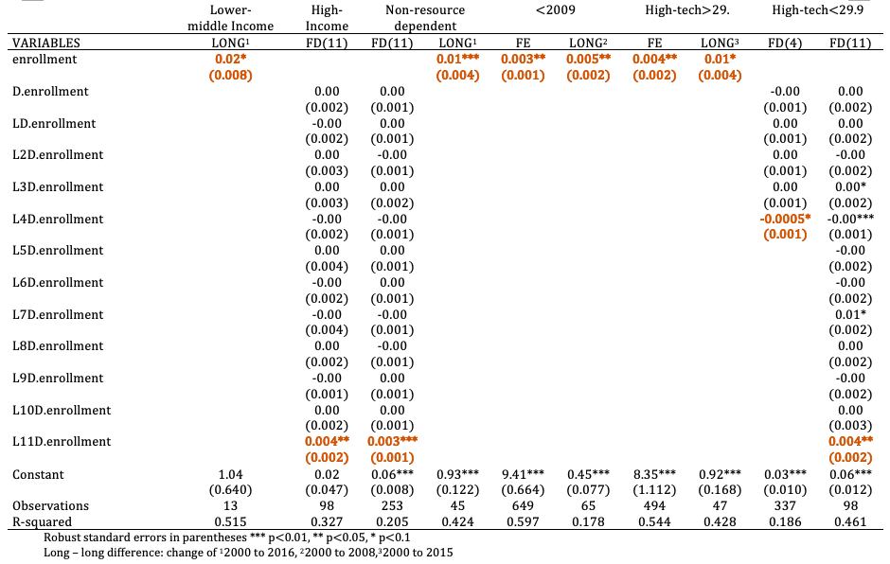
9

Slide 10
Conclusion
10
1. There were significant coefficients between tertiary enrollment ration and productivity (FE, FD(11))
Increasing enrollment will have a positive effect on productivity 11 years later.
2. There is great heterogeneity among countries, some part of this could be treated by the models (FE, country
dummies), BUT result are not robust.
3. Policy suggestions: increasing enrollment will have a positive relationship on productivity (economic growth)
This model did not prove it with complete certainty.
4. Further adjustments:
Longer time period (30-40 years)
More homogenous country groups (EU, OECD)
Other explanatory variables (tertiary graduation rate, mean years of schooling)
Other control variables (democracy capital)
Causal effect with biased results?
Notes:
Conclude for policy. If applicable, give policy recommendations to your own country based on the evidence you provided. (10%)

Slide 11
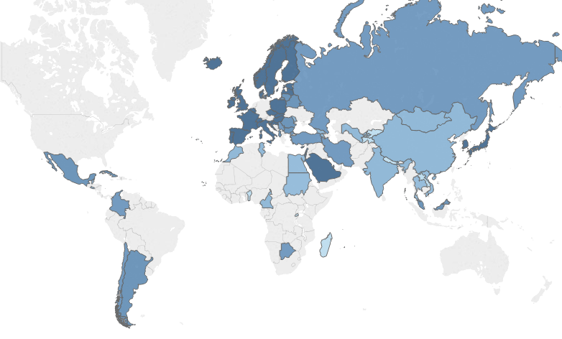
Countries in the dataset (by income groups in 2009)
11

Slide 12
Table 2. – distribution of variables in 2006
12
Extreme valued observations
year enrollment urb_pop CountryCode
2011 100.45071 81.923 KOR
2007 101.88102 81.631 KOR
2010 102.76127 81.936 KOR
2016 103.74508 74.134 TUR
2008 104.02476 81.733 KOR
2009 104.21352 81.835 KOR
2007 106.54382 76.32 CUB
2009 115.00933 76.505 CUB
2008 118.33373 76.413 CUB
Stats enrollment ratio productivity
mean 43 34463
min 3 872
p10 10 1901
p25 23 7241
p50 44 19390
p75 62 49364
p90 78 93035
max 97 169889
N 73 73
Coverage after data cleaning
Freq | % | 00 | 01 | 02 | 03 | 04 | 05 | 06 | 07 | 08 | 09 | 10 | 11 | 12 | 13 | 14 | 15 | 16
56 | 76.7
5 | 6.85
3 | 4.11
2 | 2.74
2 | 2.74
1 | 1.37
1 | 1.37
1 | 1.37
1 | 1.37
1 | 1.37

Slide 13
World Bank income classification
13
Data for calendar year : | 2000 | 2009
Low income (L) | <= 755 | <= 995
Lower middle income (LM) | 756-2,995 | 996-3,945
Upper middle income (UM) | 2,996-9,265 | 3,946-12,195
High income (H) | > 9,265 | > 12,195

