Slide 1
Smart Healthcare
Appointment System
FINAL PROJECT PRESENTATION · END TERM
Presented by: Mannat Vij
Under the Guidance of: Dr. Krishna Kumar
Computer Science & Engineering | 2024–25

Slide 2
Index
Presentation Overview
01
Introduction
04
Present Status & Features
Why this project & what it does
What is live and working today
02
Objectives
05
Project Snapshots
Five goals of the system
Live screenshots of every module
03
Methodology
06
Future Scope
Approach, flow, tools used
What comes next
Smart Healthcare Appointment System | Mannat Vij | Final End-Term Presentation

Slide 3
Introduction
About the Project
Healthcare today is held back by manual phone-bookings, paper prescriptions, missed reminders, and disconnected payment systems — patients struggle to find the right doctor and doctors lose time managing schedules and queues. The Smart Healthcare Appointment System unifies the entire patient journey on a single platform: an AI symptom-checker triages the patient, search and filter surface the right specialist, a visual slot-picker books the appointment, Razorpay handles online payment, Mailtrap delivers booking / cancellation / 24-hour reminder emails, calendar files (.ics) sync to Google or Outlook, doctors write digital prescriptions that auto-email to the patient, and patients leave star-rated reviews. Admins oversee the platform with live KPI charts, doctor-approval workflows, system-health checks, and CSV exports. It is a full-stack web app — React 19 + Material-UI on the front, Spring Boot 3 + MongoDB on the back, a Python Flask + scikit-learn microservice for ML triage (with a Java rule-based fallback), and a Playwright end-to-end suite that exercises the entire workflow.
React 19
Spring Boot 3.2
MongoDB
JWT
Material-UI
Mailtrap SMTP
Razorpay
Flask + scikit-learn
Recharts
Playwright
Smart Healthcare Appointment System | Mannat Vij | Final End-Term Presentation

Slide 4
Objectives
Goals of the System
Unify the Full Healthcare Lifecycle on One Platform
01
Register, triage, find a doctor, book a slot, pay online, attend, receive a digital prescription and leave a review — all in one web app, no external tools or paperwork.
Three-Role Access with Scalable RESTful Backend
02
Patient / Doctor / Admin portals over a Spring Boot 3 + MongoDB backend, documented live via Swagger UI as the single source of truth for every endpoint.
AI-Assisted Symptom Triage
03
Flask ML microservice (TF-IDF + RandomForest) recommends a specialisation through a multi-turn chat with red-flag detection; a Java rule-based fallback keeps chat alive when ML is offline.
Reliable Communication & Calendaring
04
Async Mailtrap email for booking / cancellation / 24-hour reminders + downloadable .ics file and Google / Outlook deep-links pre-filled with date and doctor info.
Admin Oversight & Analytics
05
KPI dashboard with Recharts (7/30/60-day trends), doctor-approval workflow, system-health panel, and one-click CSV exports for users, appointments, payments and reviews.
Smart Healthcare Appointment System | Mannat Vij | Final End-Term Presentation

Slide 5
Methodology
Development Approach, Flow & Tools
Plan
Design DB & APIs
Backend (Spring)
Frontend (React)
ML Service (Flask)
Email & Payments
Admin & Analytics
E2E Test
Requirement Analysis
Frontend SPA
1
Three roles (Patient / Doctor / Admin), use-cases, ER design, API contracts.
5
React with protected routes, Axios JWT interceptors, dark/light theme context, responsive layout.
Environment Setup
Email · Payments · Reminders
2
Java 17 · Spring Boot 3.2 · React 19 · MongoDB · Node 18 · Python 3 / Flask.
6
Mailtrap SMTP with @Async; Razorpay checkout; @Scheduled cron at 09:00 daily for 24-hr reminders.
Database Design
ML Chatbot (with fallback)
3
Collections: users, appointments, prescriptions, reviews, payments, reminders, chat_sessions.
7
Flask multi-turn FSM, red-flag detection; Java SymptomMatcher activates if Flask is offline.
Backend REST APIs + Swagger UI
Testing
4
Auth, Users, Doctors, Appointments, Prescriptions, Reviews, Payments — all live at /swagger-ui.
8
Postman + Swagger for API; Playwright single full-session E2E spec exercising every flow.
Secured with JWT (HMAC-SHA256) · BCrypt password hashing · Spring Security role guards
Smart Healthcare Appointment System | Mannat Vij | Final End-Term Presentation

Slide 6
Present Status & Features — Part 1
Patient-Side
✔
Three-role JWT auth
✔
Prescription viewer
Separate signup/login flows for Patient, Doctor, Admin; HMAC-SHA256 tokens, BCrypt passwords.
See every prescription from doctor: medications, dosage, frequency, advice, date.
✔
AI Symptom Checker
✔
Reviews & 5-star ratings
Multi-turn chat (symptom → severity → duration → red-flag) recommends a specialisation.
Submit a rating + comment after a completed visit; aggregated on doctor profile.
✔
Doctor discovery
✔
Profile & password
Full-text name search + specialisation filter + paginated results + per-doctor profile pages.
Edit personal info; change password with old-password verification.
✔
Visual slot picker
✔
Notification bell
Live availability per doctor; only open slots are clickable in the booking form.
Live badge for booking confirmations, cancellations, reminders, prescriptions.
✔
Razorpay online payment
✔
Dark / Light theme
Pay before confirmation; payment record persisted and visible in patient history.
Toggle in app bar; preference saved to localStorage; respects OS preference initially.
✔
Calendar export
✔
Responsive UI
One-click .ics download + Google / Outlook deep-links pre-filled with date & doctor.
Desktop sidebar + mobile bottom nav; Material-UI breakpoints throughout.
Smart Healthcare Appointment System | Mannat Vij | Final End-Term Presentation

Slide 7
Present Status & Features — Part 2
Doctor · Admin · System
✔
Doctor schedule management
✔
CSV exports
Add or remove time slots dynamically; bulk weekly templates; one-click 'Out of Clinic'.
One-click export for Users, Appointments, Payments, Reviews.
✔
Doctor appointments queue
✔
System-health panel
Filter by status (Pending / Confirmed / Completed / Cancelled); accept / reject in a click.
Live indicators for Mongo, Mailer, ML service, Razorpay; live activity feed below.
✔
Write prescription
✔
Mailtrap email pipeline
Structured form: medications, dosage, frequency, duration, advice — auto-emailed to patient.
Async @Async-driven booking confirmation, cancellation notice, 24-hr reminder mails.
✔
Doctor profile page
✔
24-hour automated reminders
Public bio + cumulative rating + full review list visible to patients.
@Scheduled cron at 09:00 daily; Reminders collection prevents duplicates.
✔
Admin dashboard
✔
Cancellation flow
KPI cards (users, doctors, appointments, revenue) + Recharts line / bar / pie charts.
Slot auto-released back into availability + email sent to the patient.
✔
Admin user management
✔
Swagger UI live API docs
Searchable user table; activate, deactivate, delete; role and status filters.
/swagger-ui.html — single source of truth for every endpoint, interactively testable.
✔
Doctor approval workflow
✔
Playwright E2E suite
Smart Healthcare Appointment System | Mannat Vij | Final End-Term Presentation
New doctors stay invisible until admin approves; rejection toggles active flag.
Full-session spec: register → triage → book → pay → accept → prescribe → review → admin.

Slide 8
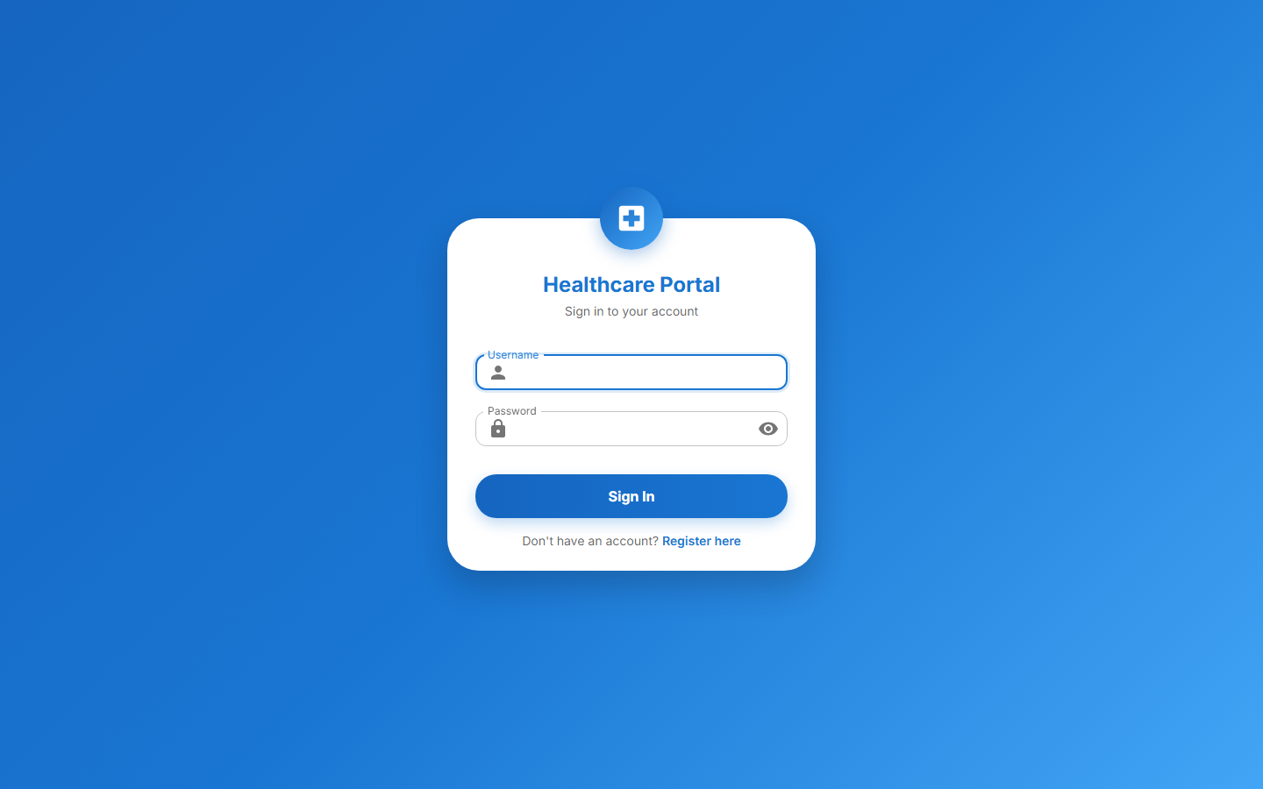
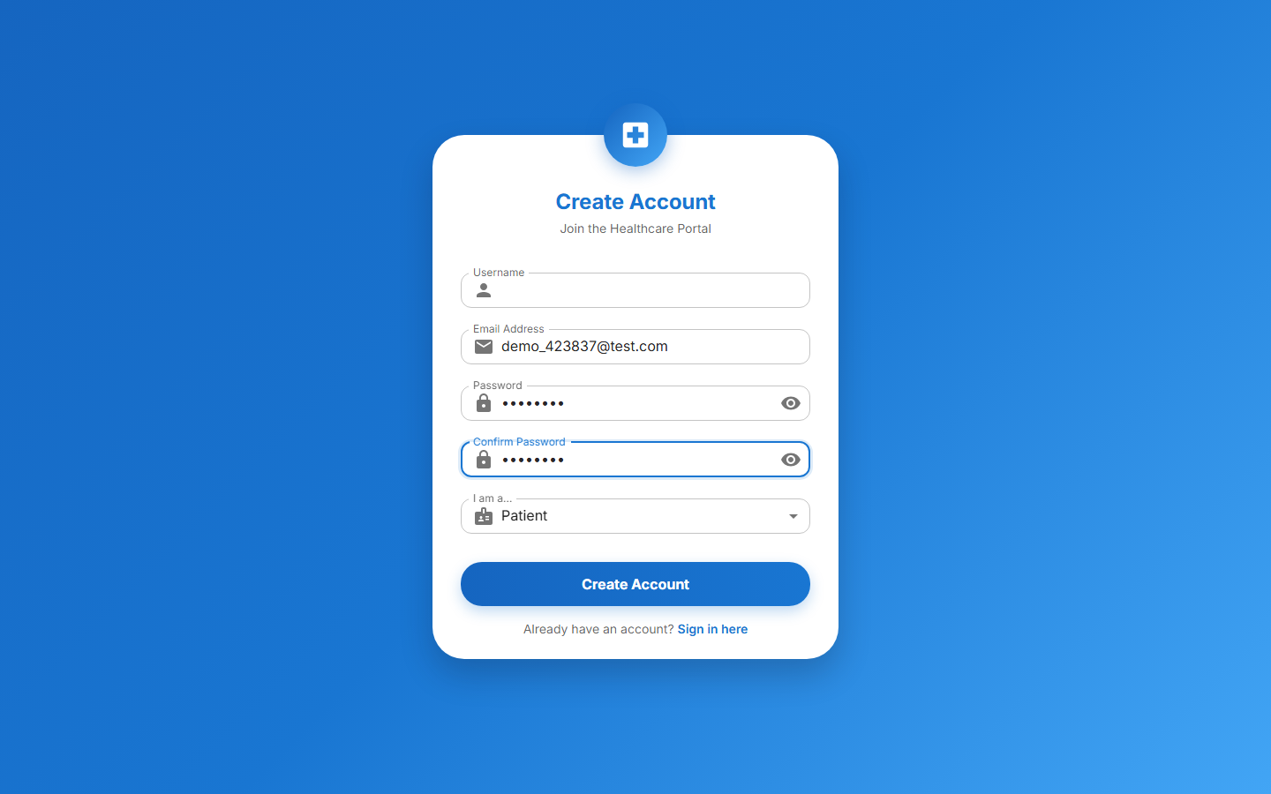
Project Snapshots
Authentication & Onboarding
Login Page
Register Page
Smart Healthcare Appointment System | Mannat Vij | Final End-Term Presentation

Slide 9
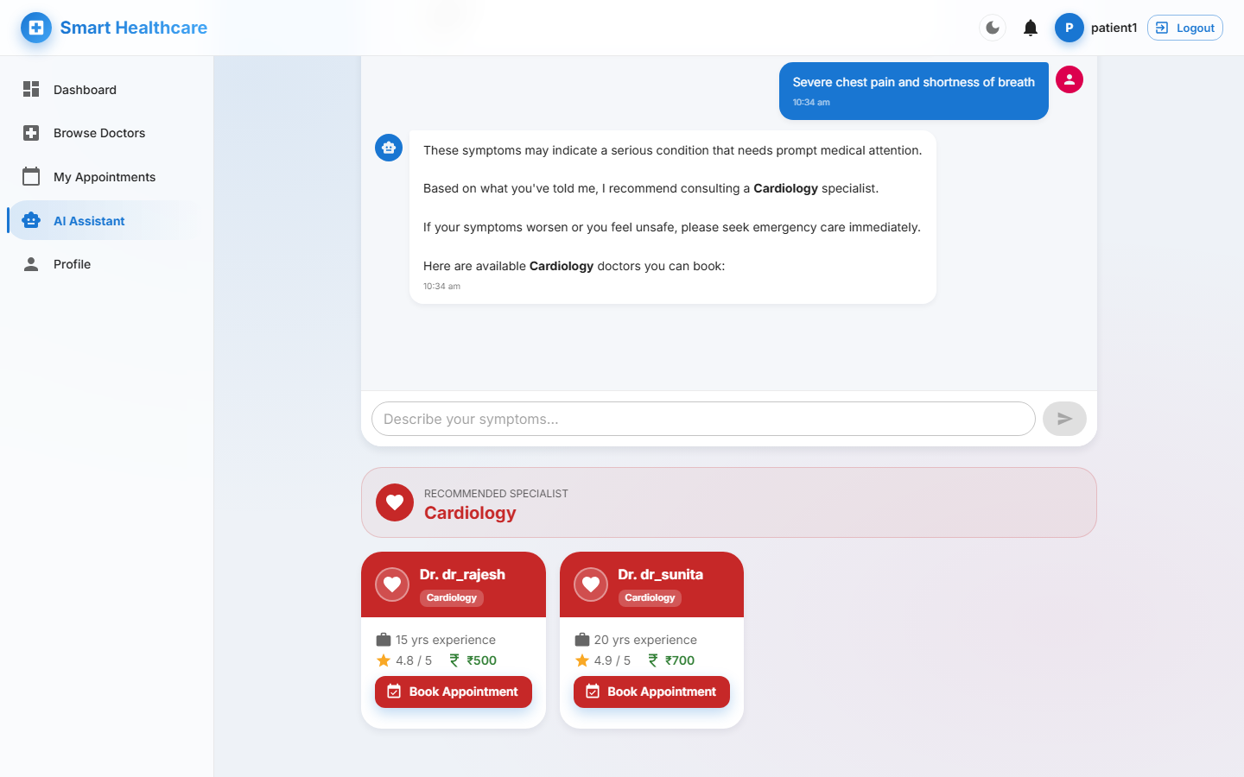
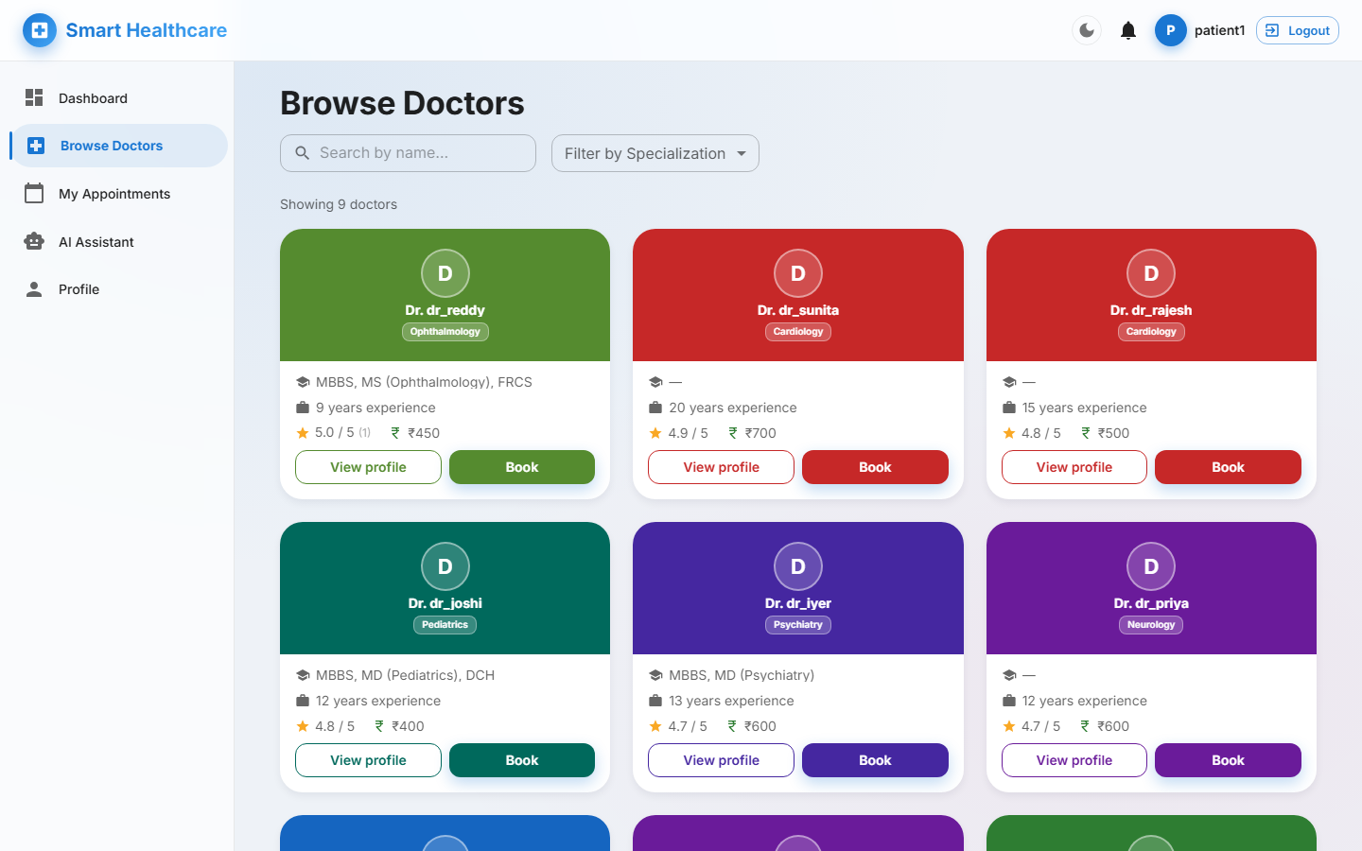
Project Snapshots
AI Triage & Doctor Discovery
AI Symptom Checker Chatbot
Browse Doctors
Smart Healthcare Appointment System | Mannat Vij | Final End-Term Presentation

Slide 10
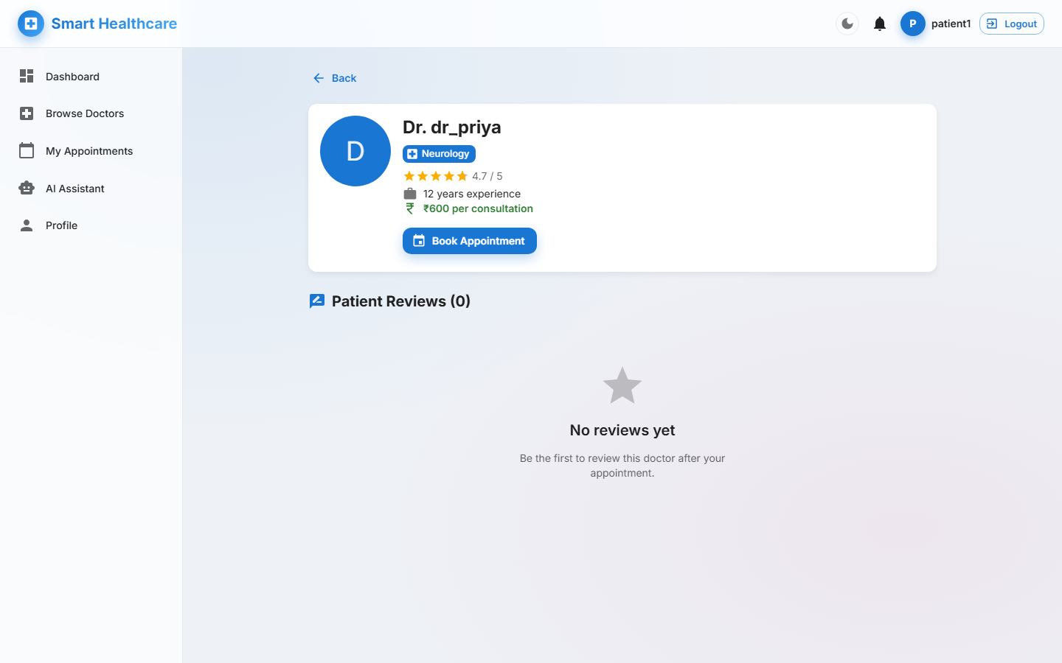
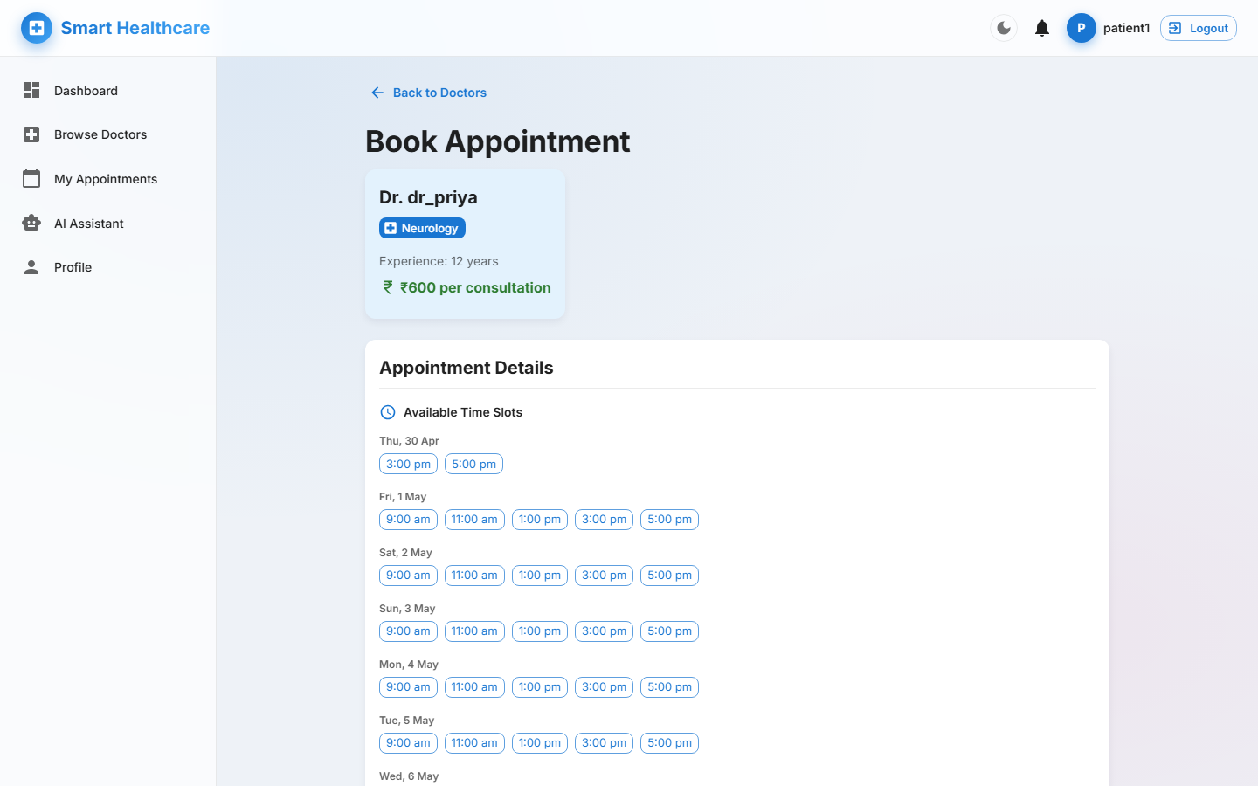
Project Snapshots
Doctor Profile & Booking
Doctor Profile + Reviews
Booking · Slot Picker
Smart Healthcare Appointment System | Mannat Vij | Final End-Term Presentation

Slide 11
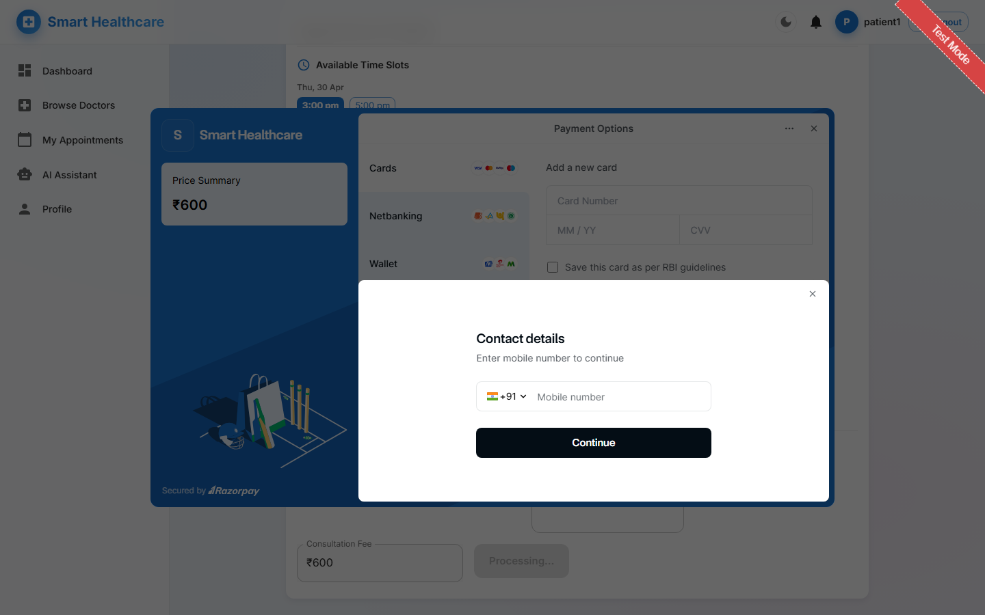
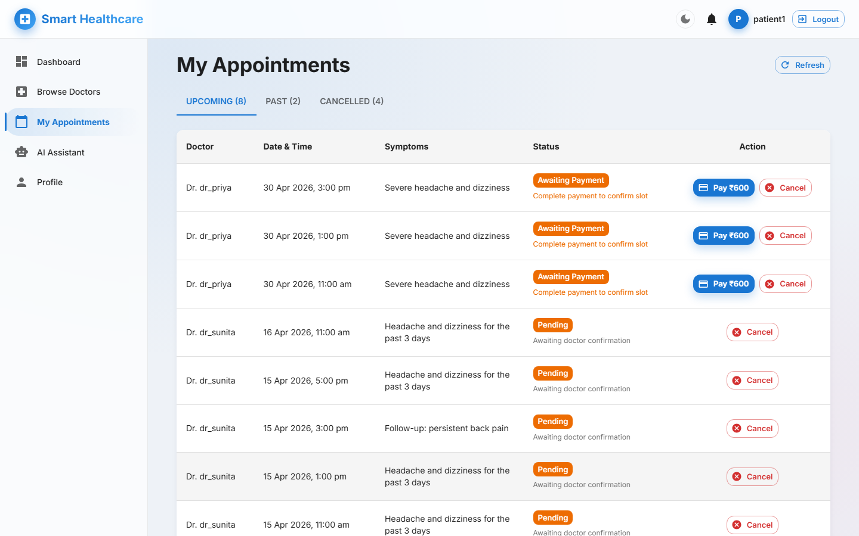
Project Snapshots
Payment & My Appointments
Razorpay Online Payment
Patient Appointments
Smart Healthcare Appointment System | Mannat Vij | Final End-Term Presentation

Slide 12
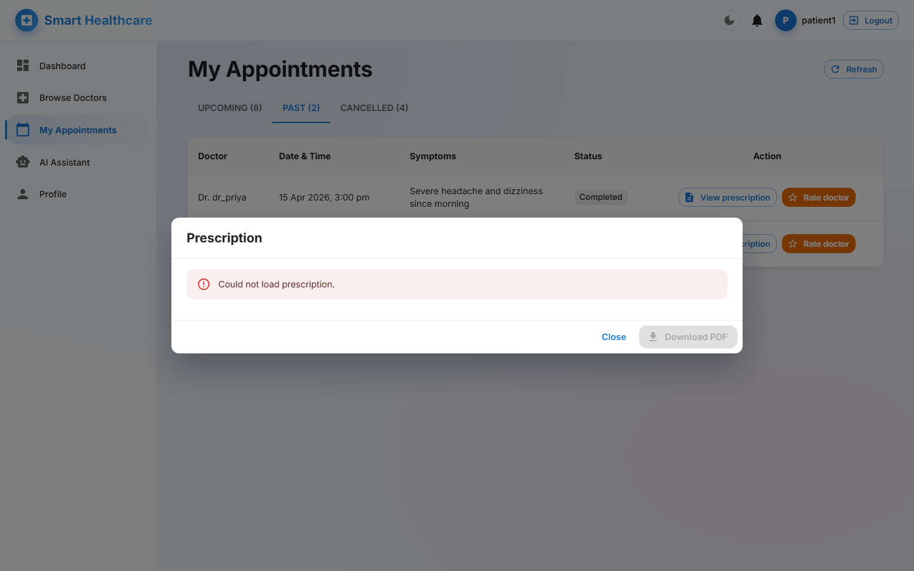
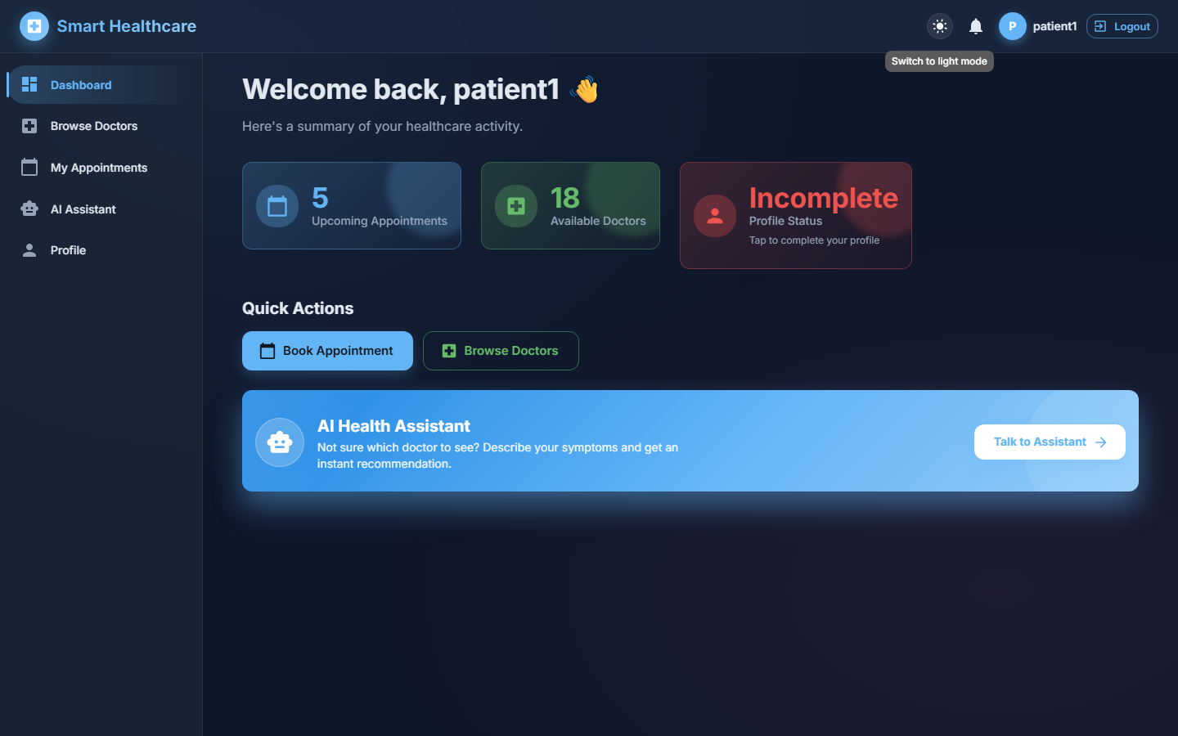
Project Snapshots
Notifications, Prescriptions & Dark Mode
Prescription Viewer
Dark Mode
Smart Healthcare Appointment System | Mannat Vij | Final End-Term Presentation

Slide 13
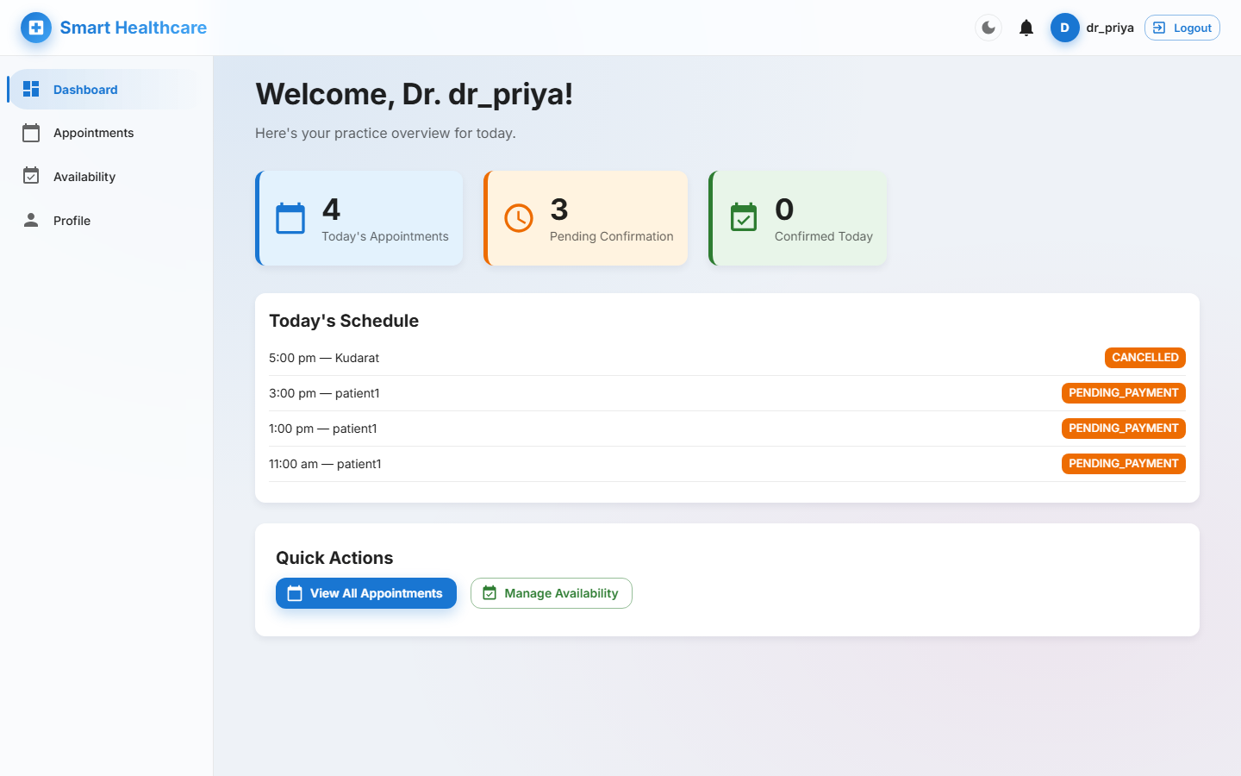
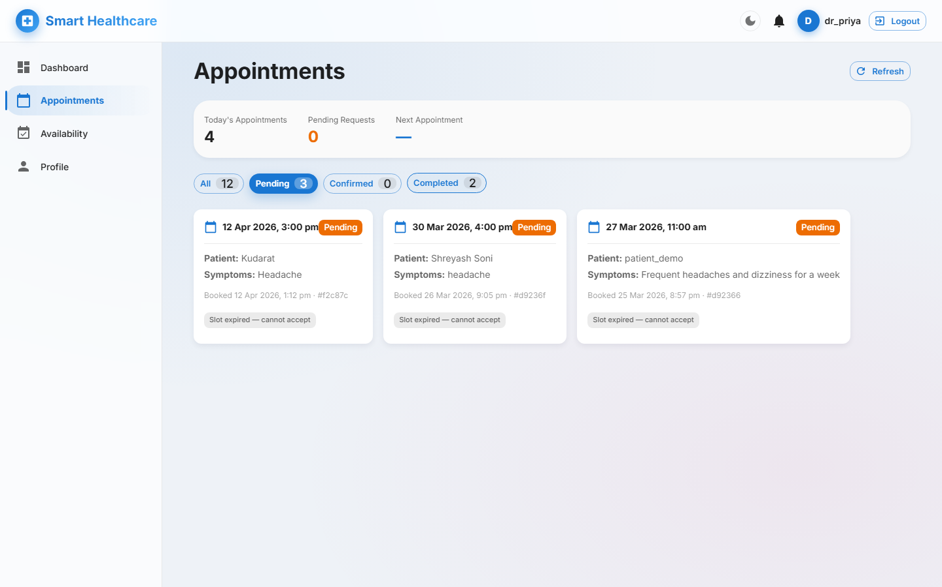
Project Snapshots
Doctor Workspace
Doctor Dashboard
Doctor Appointments Queue
Smart Healthcare Appointment System | Mannat Vij | Final End-Term Presentation

Slide 14
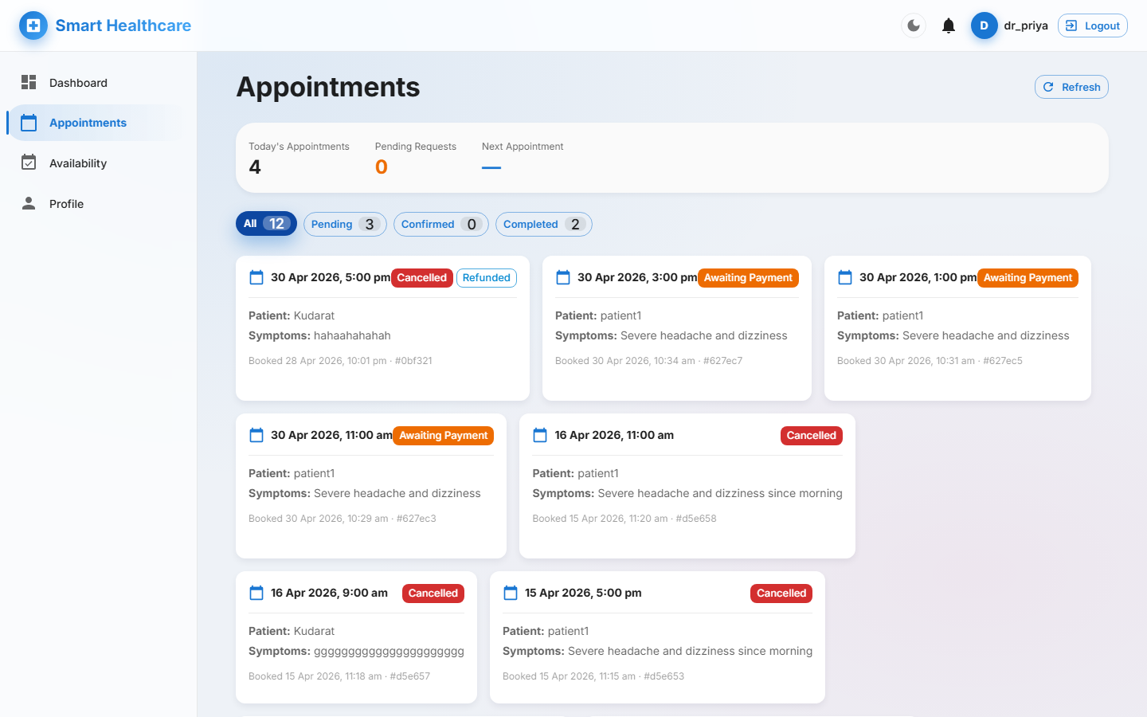
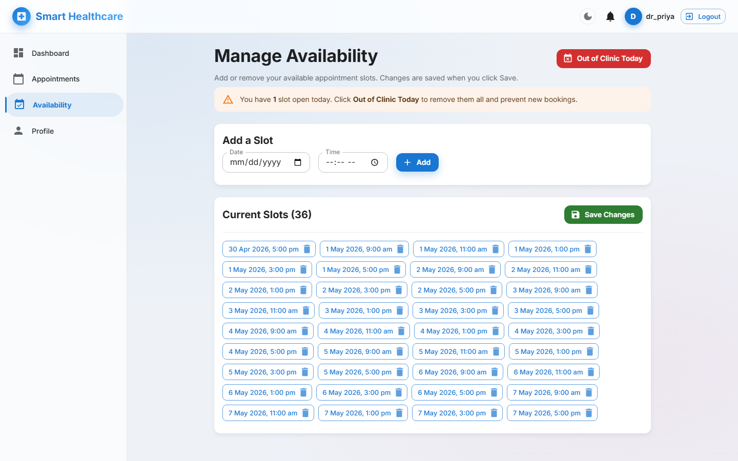
Project Snapshots
Doctor Tools — Prescription & Availability
Writing a Prescription
Schedule Management
Smart Healthcare Appointment System | Mannat Vij | Final End-Term Presentation

Slide 15
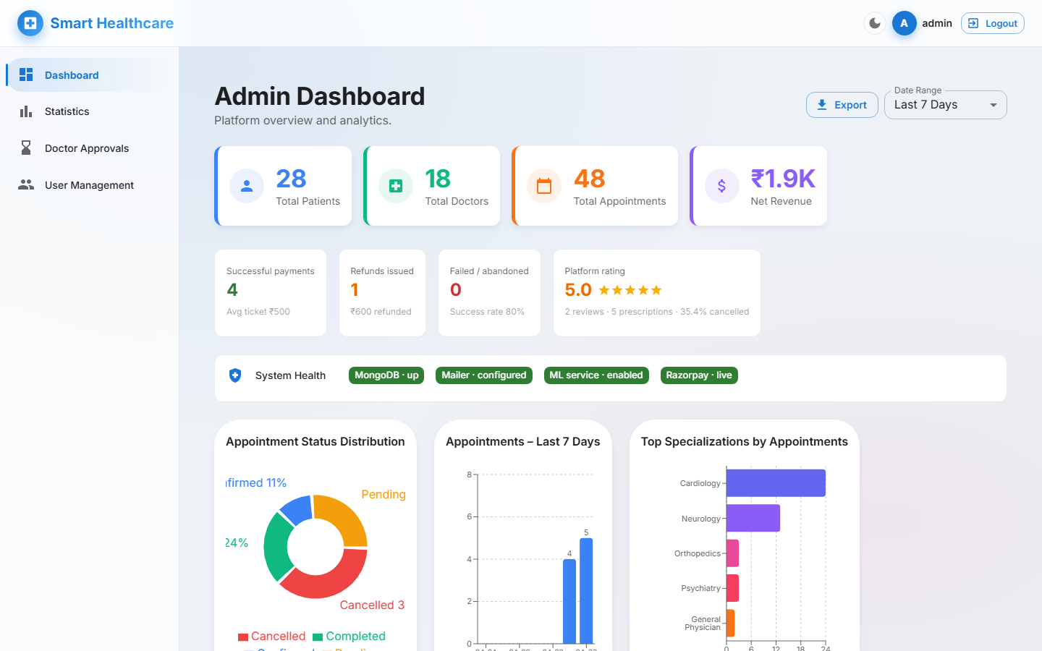
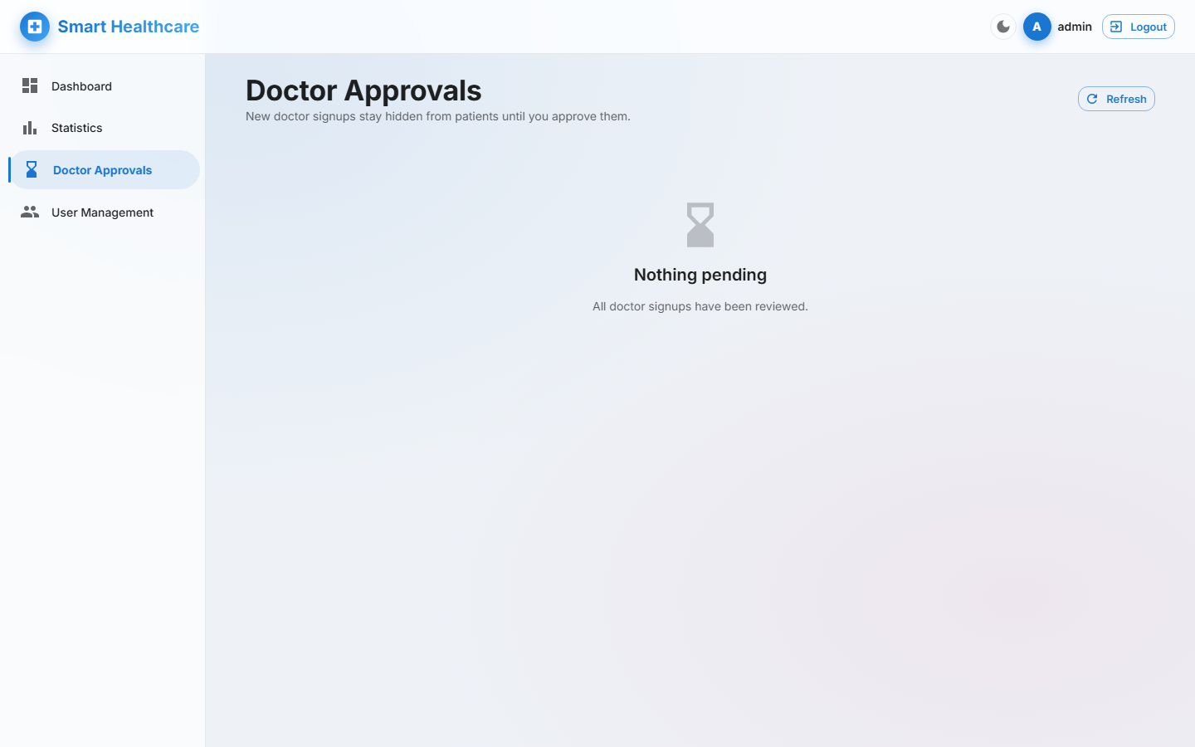
Project Snapshots
Admin Portal & API Docs
Admin Dashboard · KPIs & Charts
Doctor Approvals
Smart Healthcare Appointment System | Mannat Vij | Final End-Term Presentation

Slide 16
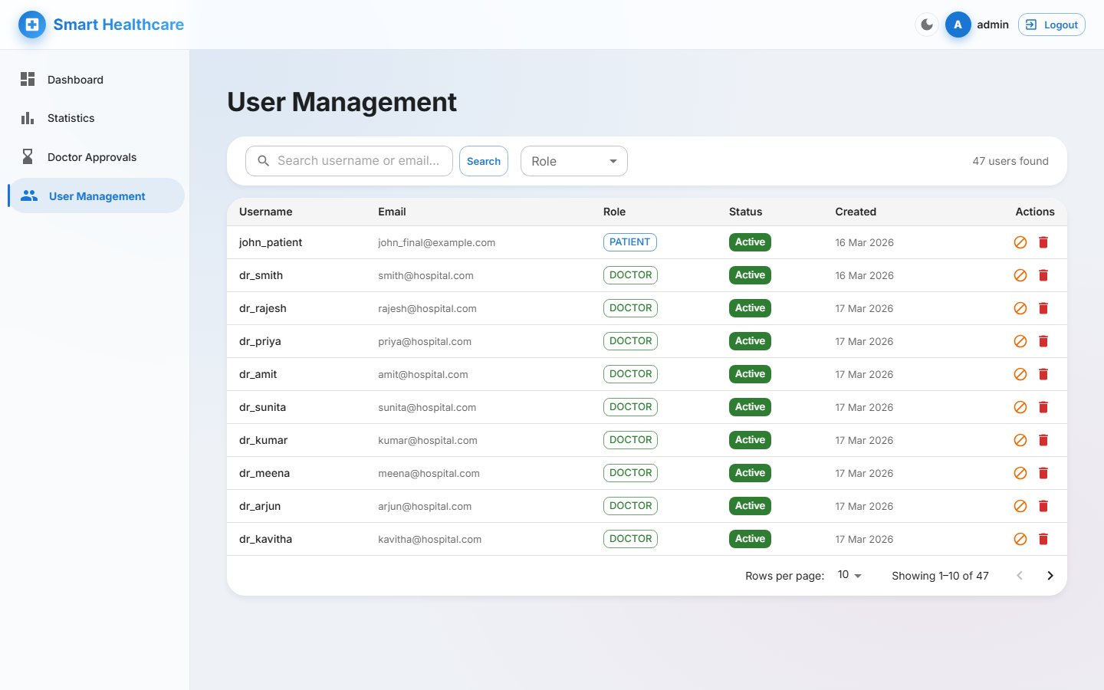
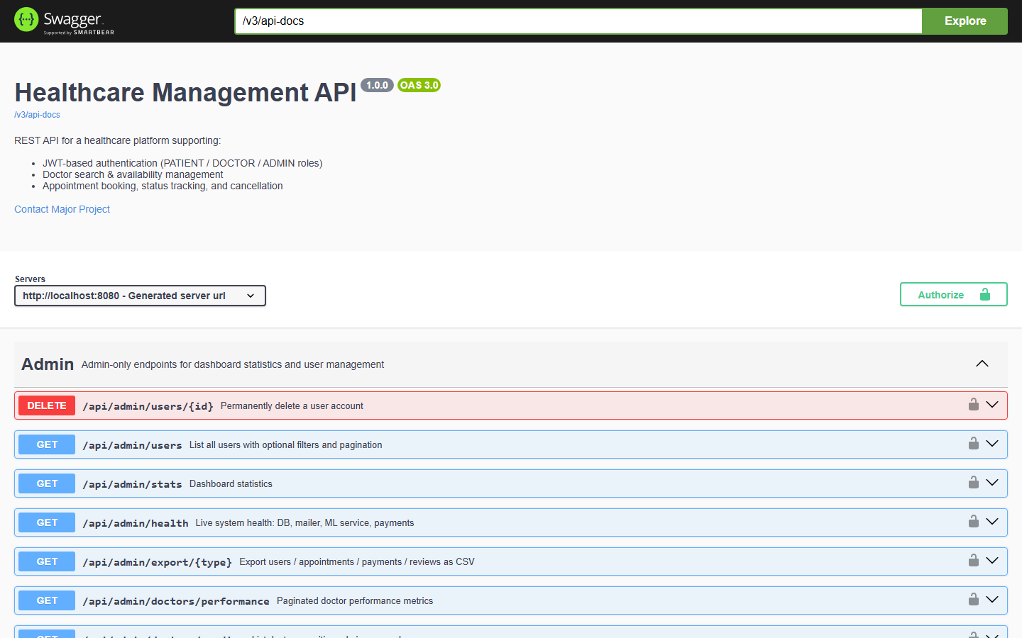
Project Snapshots
Admin Operations & Swagger
User Management
Swagger UI · Live API Docs
Smart Healthcare Appointment System | Mannat Vij | Final End-Term Presentation

Slide 17
Future Scope
Planned Enhancements
Video Consultation (WebRTC)
In-platform virtual visits with screen-share and optional session recording — patients consult without ever leaving the portal.
Mobile App (React Native)
Native iOS / Android client with push notifications, offline-cached prescriptions, biometric login and native calendar sync.
Predictive Analytics & EHR Interop
Forecast appointment volumes, predict no-shows, and export records to hospital EHRs via the FHIR standard for hospital-wide integration.
Smart Healthcare Appointment System | Mannat Vij | Final End-Term Presentation

Slide 18
Thank You
Smart Healthcare Appointment System
Mannat Vij | Under the Guidance of Dr. Krishna Kumar
Computer Science & Engineering | 2024–25

