Slide 1
Smart Healthcare
Appointment System
MAJOR PROJECT PRESENTATION
Presented by: Mannat Vij
Under the Guidance of: Dr. Krishna Kumar

Slide 2
Index
Presentation Overview
01
Introduction
04
Progress & Status
What the project is & why it matters
Planned vs. completed features
02
Objectives
05
Project Snapshots
Goals and purpose of the system
Live screenshots from the running application
03
Methodology
06
Future Scope
Development approach, APIs & tools used
Planned enhancements and extensions
Smart Healthcare Appointment System

Slide 3
Introduction
About the Project
In today's fast-paced world, the healthcare sector faces a critical challenge — the growing gap between patients seeking timely medical care and doctors managing overwhelming schedules through outdated, manual processes. Phone-based bookings, long waiting queues, and fragmented paper records result in missed consultations and poor patient experiences. The Smart Healthcare Appointment System is a robust, full-stack web application engineered to digitise and streamline the complete appointment lifecycle. Built on a React.js frontend (Material-UI), a Spring Boot RESTful backend, and MongoDB as a flexible NoSQL data store, the platform empowers patients to discover specialist doctors, check real-time availability, have AI assistance and book appointments instantly — while giving doctors full control over their schedules and patient queues. Secured by industry-standard JWT-based authentication and role-based access control, the system represents a scalable, modern solution to one of healthcare's most persistent operational challenges.
React.js
Spring Boot 3
MongoDB
JWT Auth
UI
REST API
Smart Healthcare Appointment System

Slide 4
Objectives
Goals & Purpose of the System
Digitise Healthcare Access
01
Design a secure, role-based platform (Patient / Doctor / Admin) that eliminates manual appointment booking and centralises healthcare management in a single portal.
Scalable Backend Architecture
02
Develop a production-grade RESTful API using Spring Boot 3 and MongoDB, with Swagger UI for centralised, interactive API documentation and endpoint management.
Industry-Standard Security
03
Implement JWT-based stateless authentication (HMAC-SHA256, 24-hr tokens) with BCrypt password hashing and Spring Security role guards to ensure data confidentiality.
Intelligent Doctor Discovery
04
Enable real-time doctor search with specialisation-based filtering, paginated results, live availability slots, and a visual time-slot booking interface for patients.
End-to-End Appointment Lifecycle
05
Allow doctors to manage consultation queues (Pending → Confirmed → Completed / Cancelled), update schedules dynamically, and maintain professional profiles.
Smart Healthcare Appointment System

Slide 5
Methodology
Development Approach, APIs & Tools Used
Requirement Analysis & Planning
API Documentation — Swagger UI
1
Identified 3 user roles (Patient, Doctor, Admin), defined use cases, system architecture, API contracts, and data models.
5
Integrated Springdoc OpenAPI; all endpoints centralised & testable at /swagger-ui.html — served as the single source of truth throughout development.
Environment Setup
Security Layer
2
Java 17 · Spring Boot 3.2.3 · React 19 + Material-UI · MongoDB · Maven · Node.js 18
6
JWT (HMAC-SHA256, 24 hr expiry) · BCrypt password hashing · Spring Security filter chain · @PreAuthorize role-based guards per endpoint.
Database Design
Frontend Development
3
MongoDB collections: users, appointments, chat_sessions; Indexes: patientId, doctorId, email, username.
7
React SPA with protected routes · Role-aware dashboards · Responsive layout (desktop sidebar + mobile bottom nav).
Backend API Development (Spring Boot REST)
Testing at Each Stage
4
Auth: POST /api/auth/register, /api/auth/login | Users: GET/PUT /api/users/profile, PUT /api/users/password | Doctors: GET /api/doctors, /api/doctors/search, /api/doctors/available, PUT /api/doctors/availability | Appointments: POST /api/appointments, GET /api/appointments, PUT /api/appointments/{id}/status, DELETE /api/appointments/{id}
8
Postman collection for manual API testing · Swagger UI for live verification · Playwright E2E test suite (153 test cases) for full-flow validation.
Smart Healthcare Appointment System

Slide 6
Progress & Current Status
What Was Planned vs. What Is Done
PLANNED
COMPLETED / STATUS
› User registration & login
✔ JWT-based auth (Patient & Doctor)
› Doctor search & specialisation filter
✔ Search by name + filter by specialisation
› Appointment booking with time-slot picker
✔ Visual slot picker + booking form
› Doctor availability management
✔ Add / remove slots dynamically
› Role-based dashboards (Patient & Doctor)
✔ Separate Patient & Doctor dashboards
› Profile management (edit + password change)
✔ Edit profile + change password
› Appointment status lifecycle
✔ Pending → Confirmed → Completed / Cancelled
› Responsive UI (desktop + mobile)
✔ Desktop sidebar + mobile bottom nav
› AI chatbot triage
~ Data models ready, integration pending
› SMS / Email notifications
✗ Planned for next phase
Smart Healthcare Appointment System

Slide 7
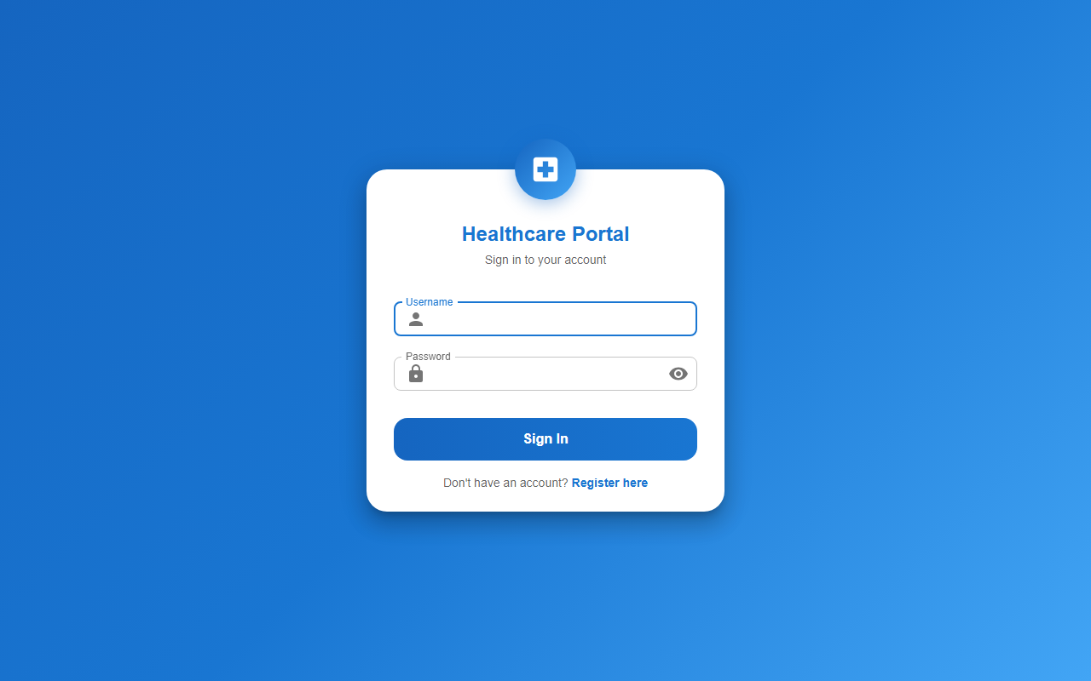
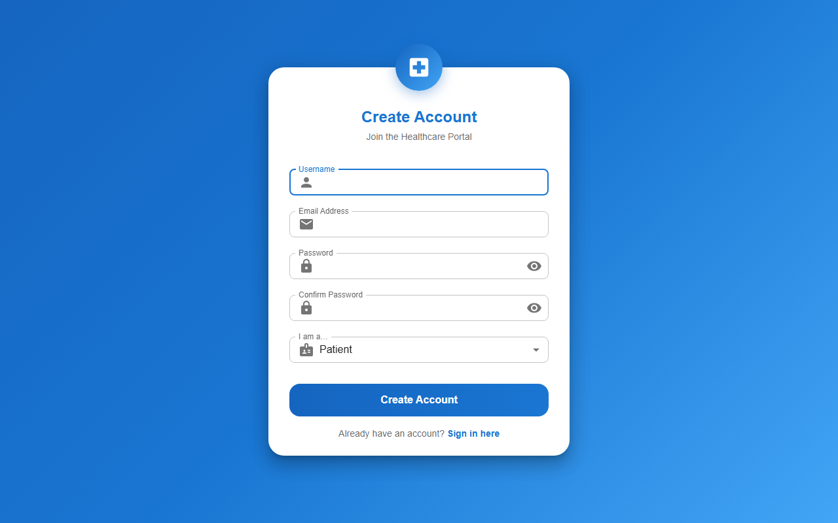
Project Snapshots
Login & Registration
Login Page
Register Page
Smart Healthcare Appointment System

Slide 8
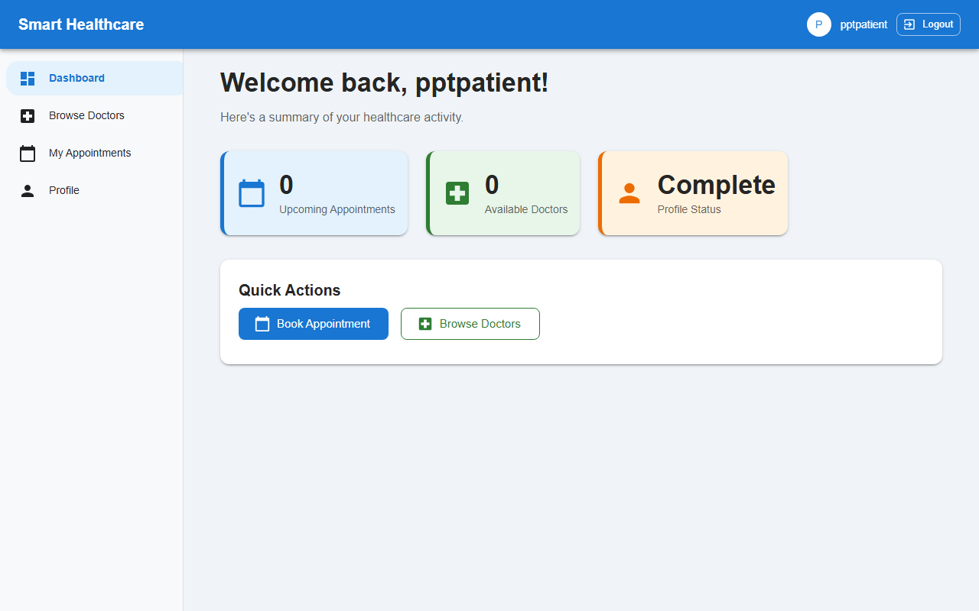
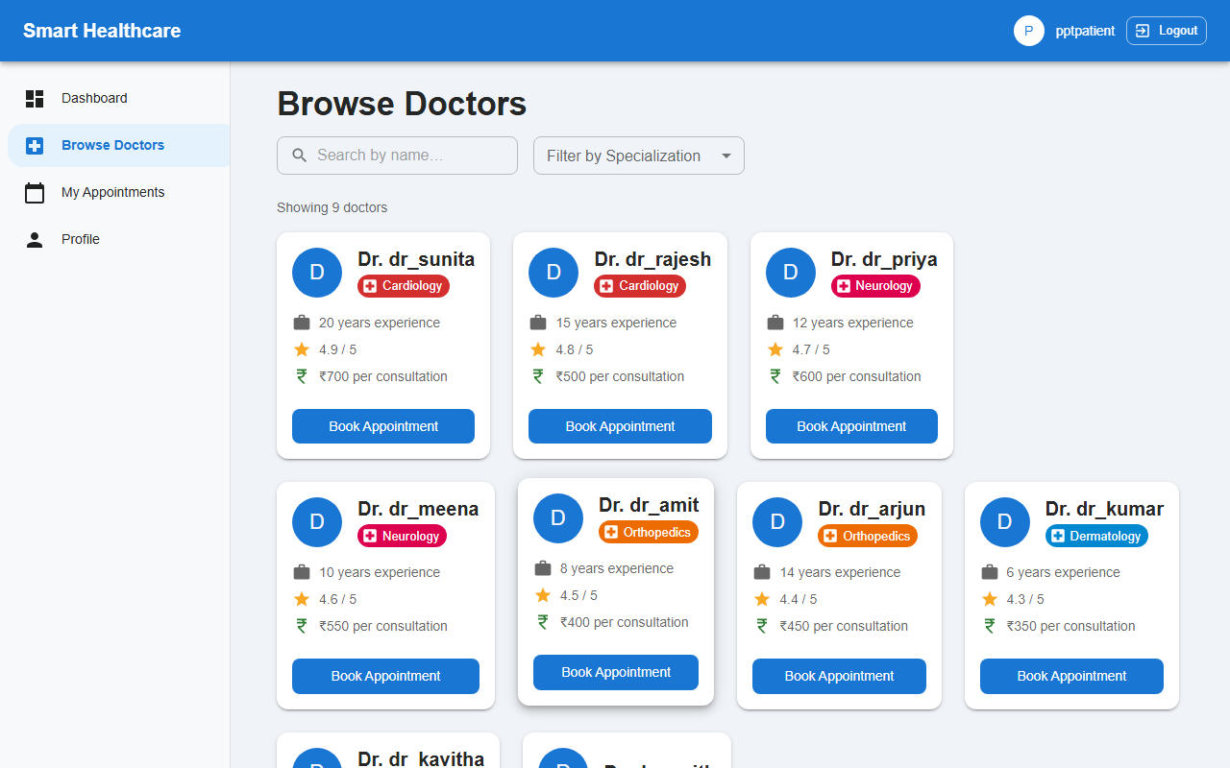
Project Snapshots
Patient Dashboard & Doctor Discovery
Patient Dashboard
Browse Doctors
Smart Healthcare Appointment System

Slide 9
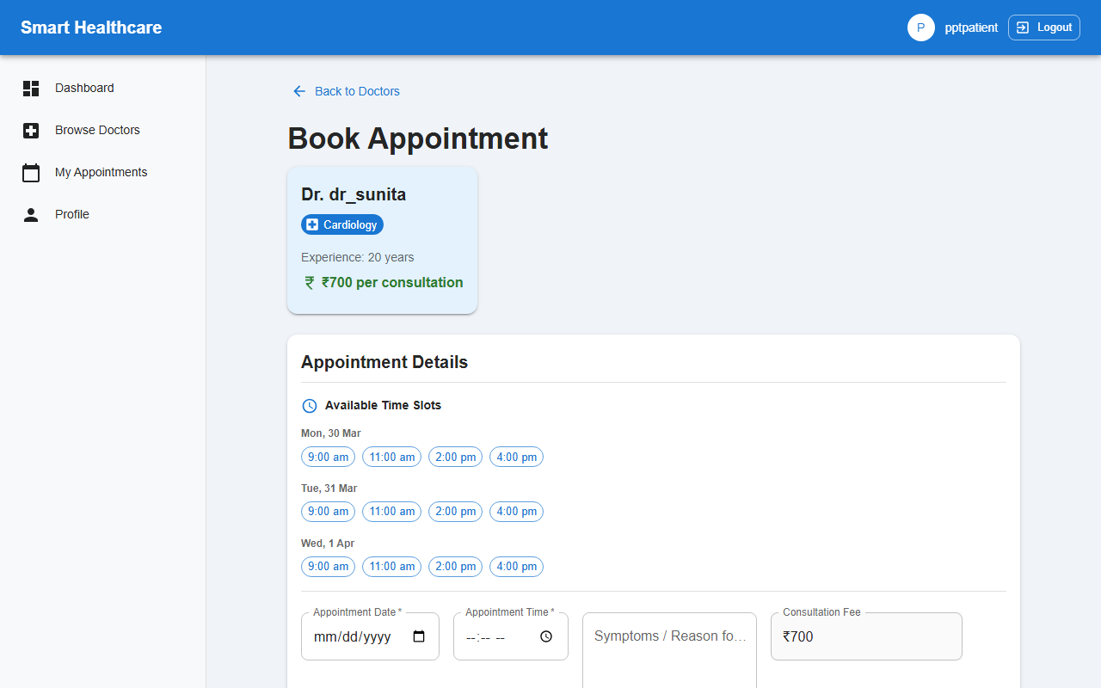
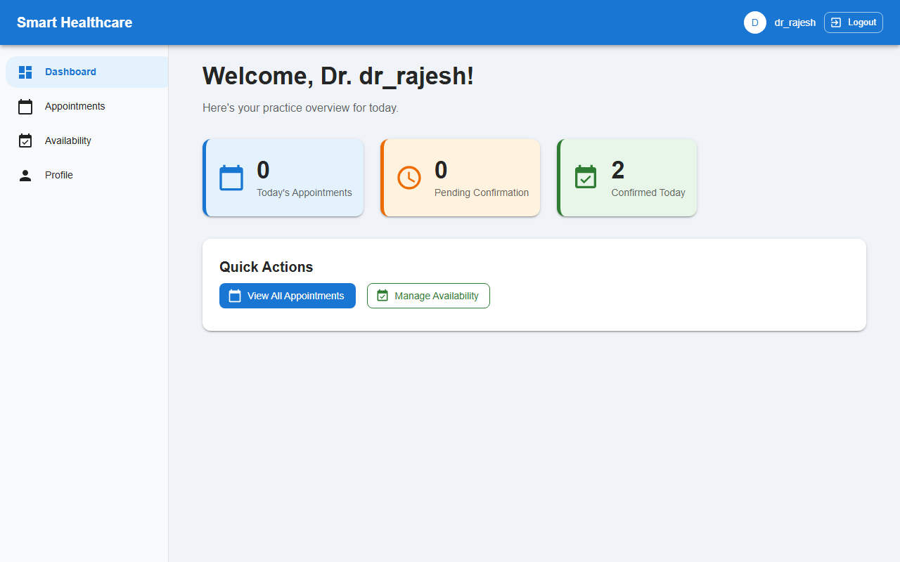
Project Snapshots
Appointment Booking & Doctor Dashboard
Book Appointment
Doctor Dashboard
Smart Healthcare Appointment System

Slide 10
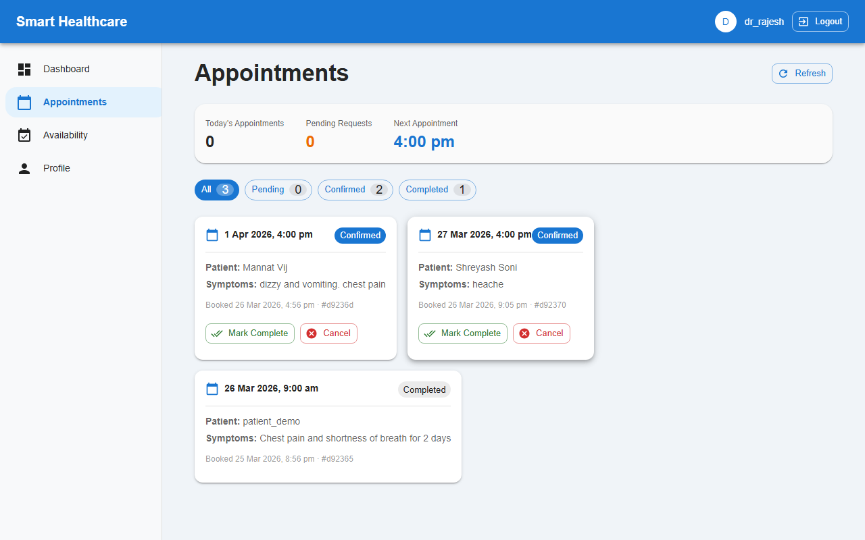
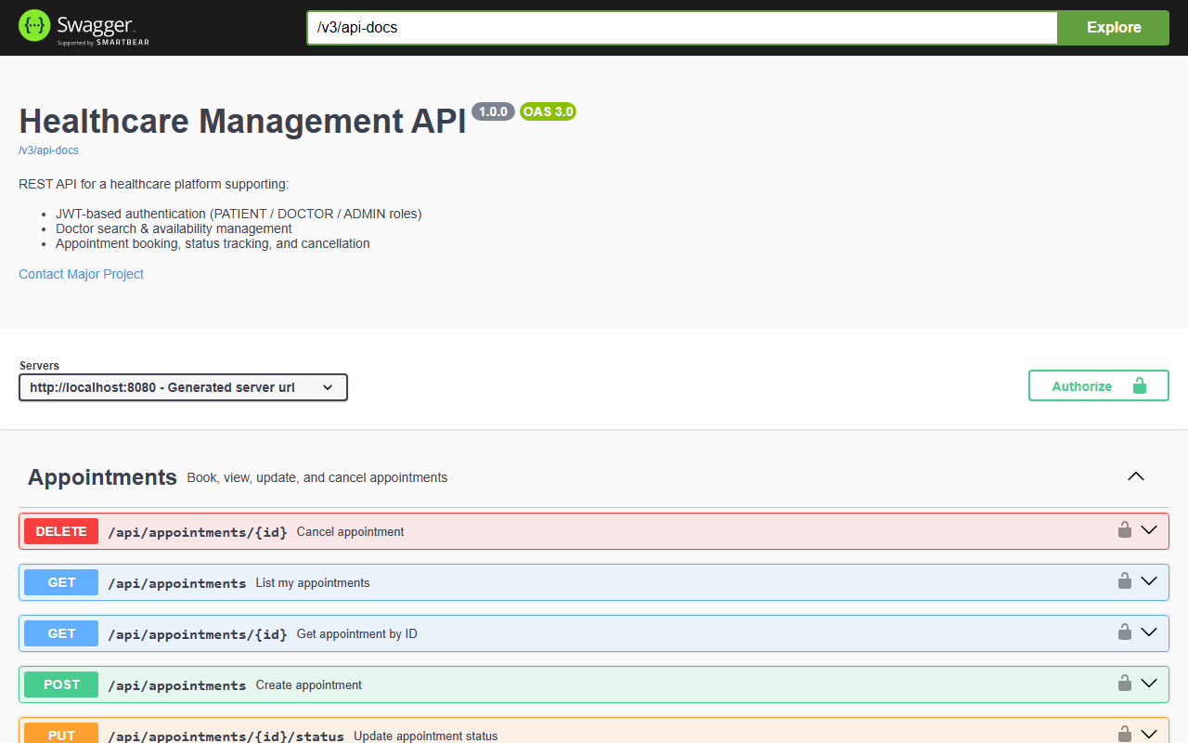
Project Snapshots
Doctor Management & Swagger API Docs
Doctor Appointments
Swagger UI — API Docs
Smart Healthcare Appointment System

Slide 11
Future Scope
Planned Enhancements & Extensions
SMS & Email Notifications
Video Consultation (WebRTC)
Automated alerts to patients & doctors on booking, confirmation, and cancellation via SMS and email.
Built-in virtual appointment feature for remote consultations without leaving the platform.
AI Symptom Checker Chatbot
Calendar Sync & Reminders
Patient describes symptoms; AI engine recommends the appropriate doctor specialisation before booking.
Google Calendar / iCal export so patients and doctors receive appointment reminders on their devices.
Prescription Management Portal
Admin Analytics Dashboard
Doctors upload digital prescriptions post-consultation; patients access complete prescription history in one place.
Visual reports on appointment trends, doctor performance metrics, and user growth statistics.
Smart Healthcare Appointment System

Slide 12
Thank You
Smart Healthcare Appointment System

