Slide 1
Game of Life
Maha Lakshmi Annavarapu
Soumya Darbha
Sri Himaja Bharthepudi

Slide 2
Description of the Project
The Game of Life is an infinite, two-dimensional orthogonal grid of square cells, each of which is in one of two possible states, live or dead, (or populated and unpopulated, respectively). Every cell interacts with its eight neighbours, which are the cells that are horizontally, vertically, or diagonally adjacent.
The user/player interacts with the Game of Life by creating an initial configuration and observes how it evolves

Slide 3
Rules
Any live cell with fewer than two live neighbours dies, which is caused by under population.
Any live cell with more than three live neighbours dies, as if by overcrowding.
Any live cell with two or three live neighbours lives on to the next generation.
Any dead cell with exactly three live neighbours becomes a live cell.
If a dead cell has exactly three live neighbours, it comes to live
If a live cell has less than two live neighbours, it dies
If a live cell has more than three live neighbours, it dies
If a live cell has two or three live neighbours, it continues living life - Therefore by repeating the cycle over and over, these simple rules create interesting, often unpredictable pattern

Slide 4
Patterns
Still Life
Oscillators
Gliders and Spaceship
Gosper Glider Gun

Slide 5
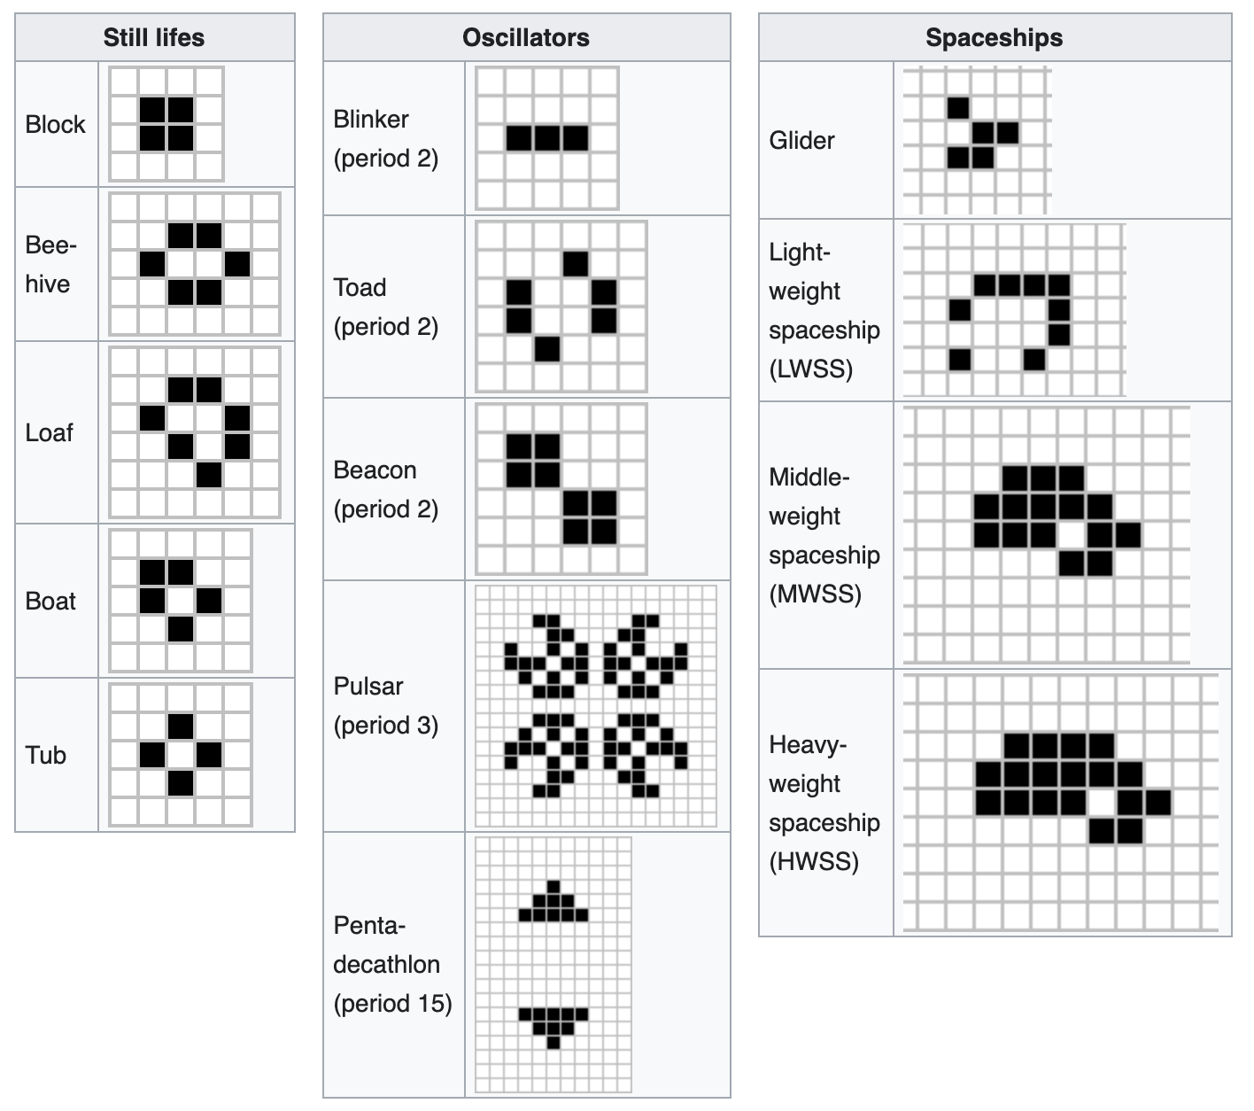
Pattern Examples

Slide 6
UML Diagram
Alive
Start
yes
Are there exactly 3 adjacent living cells?
Select the grid size size
Play
no
kill cell
User initializes living cell coordinates
no
Create living cell
yes
yes
Any cells remaining?
Is current cell living
Begin simulation
Check next cell
yes
no
Are there 2-3 adjacent living cells?
Print generation
Stop
Create live cell
no
no
Dead cell

Slide 7
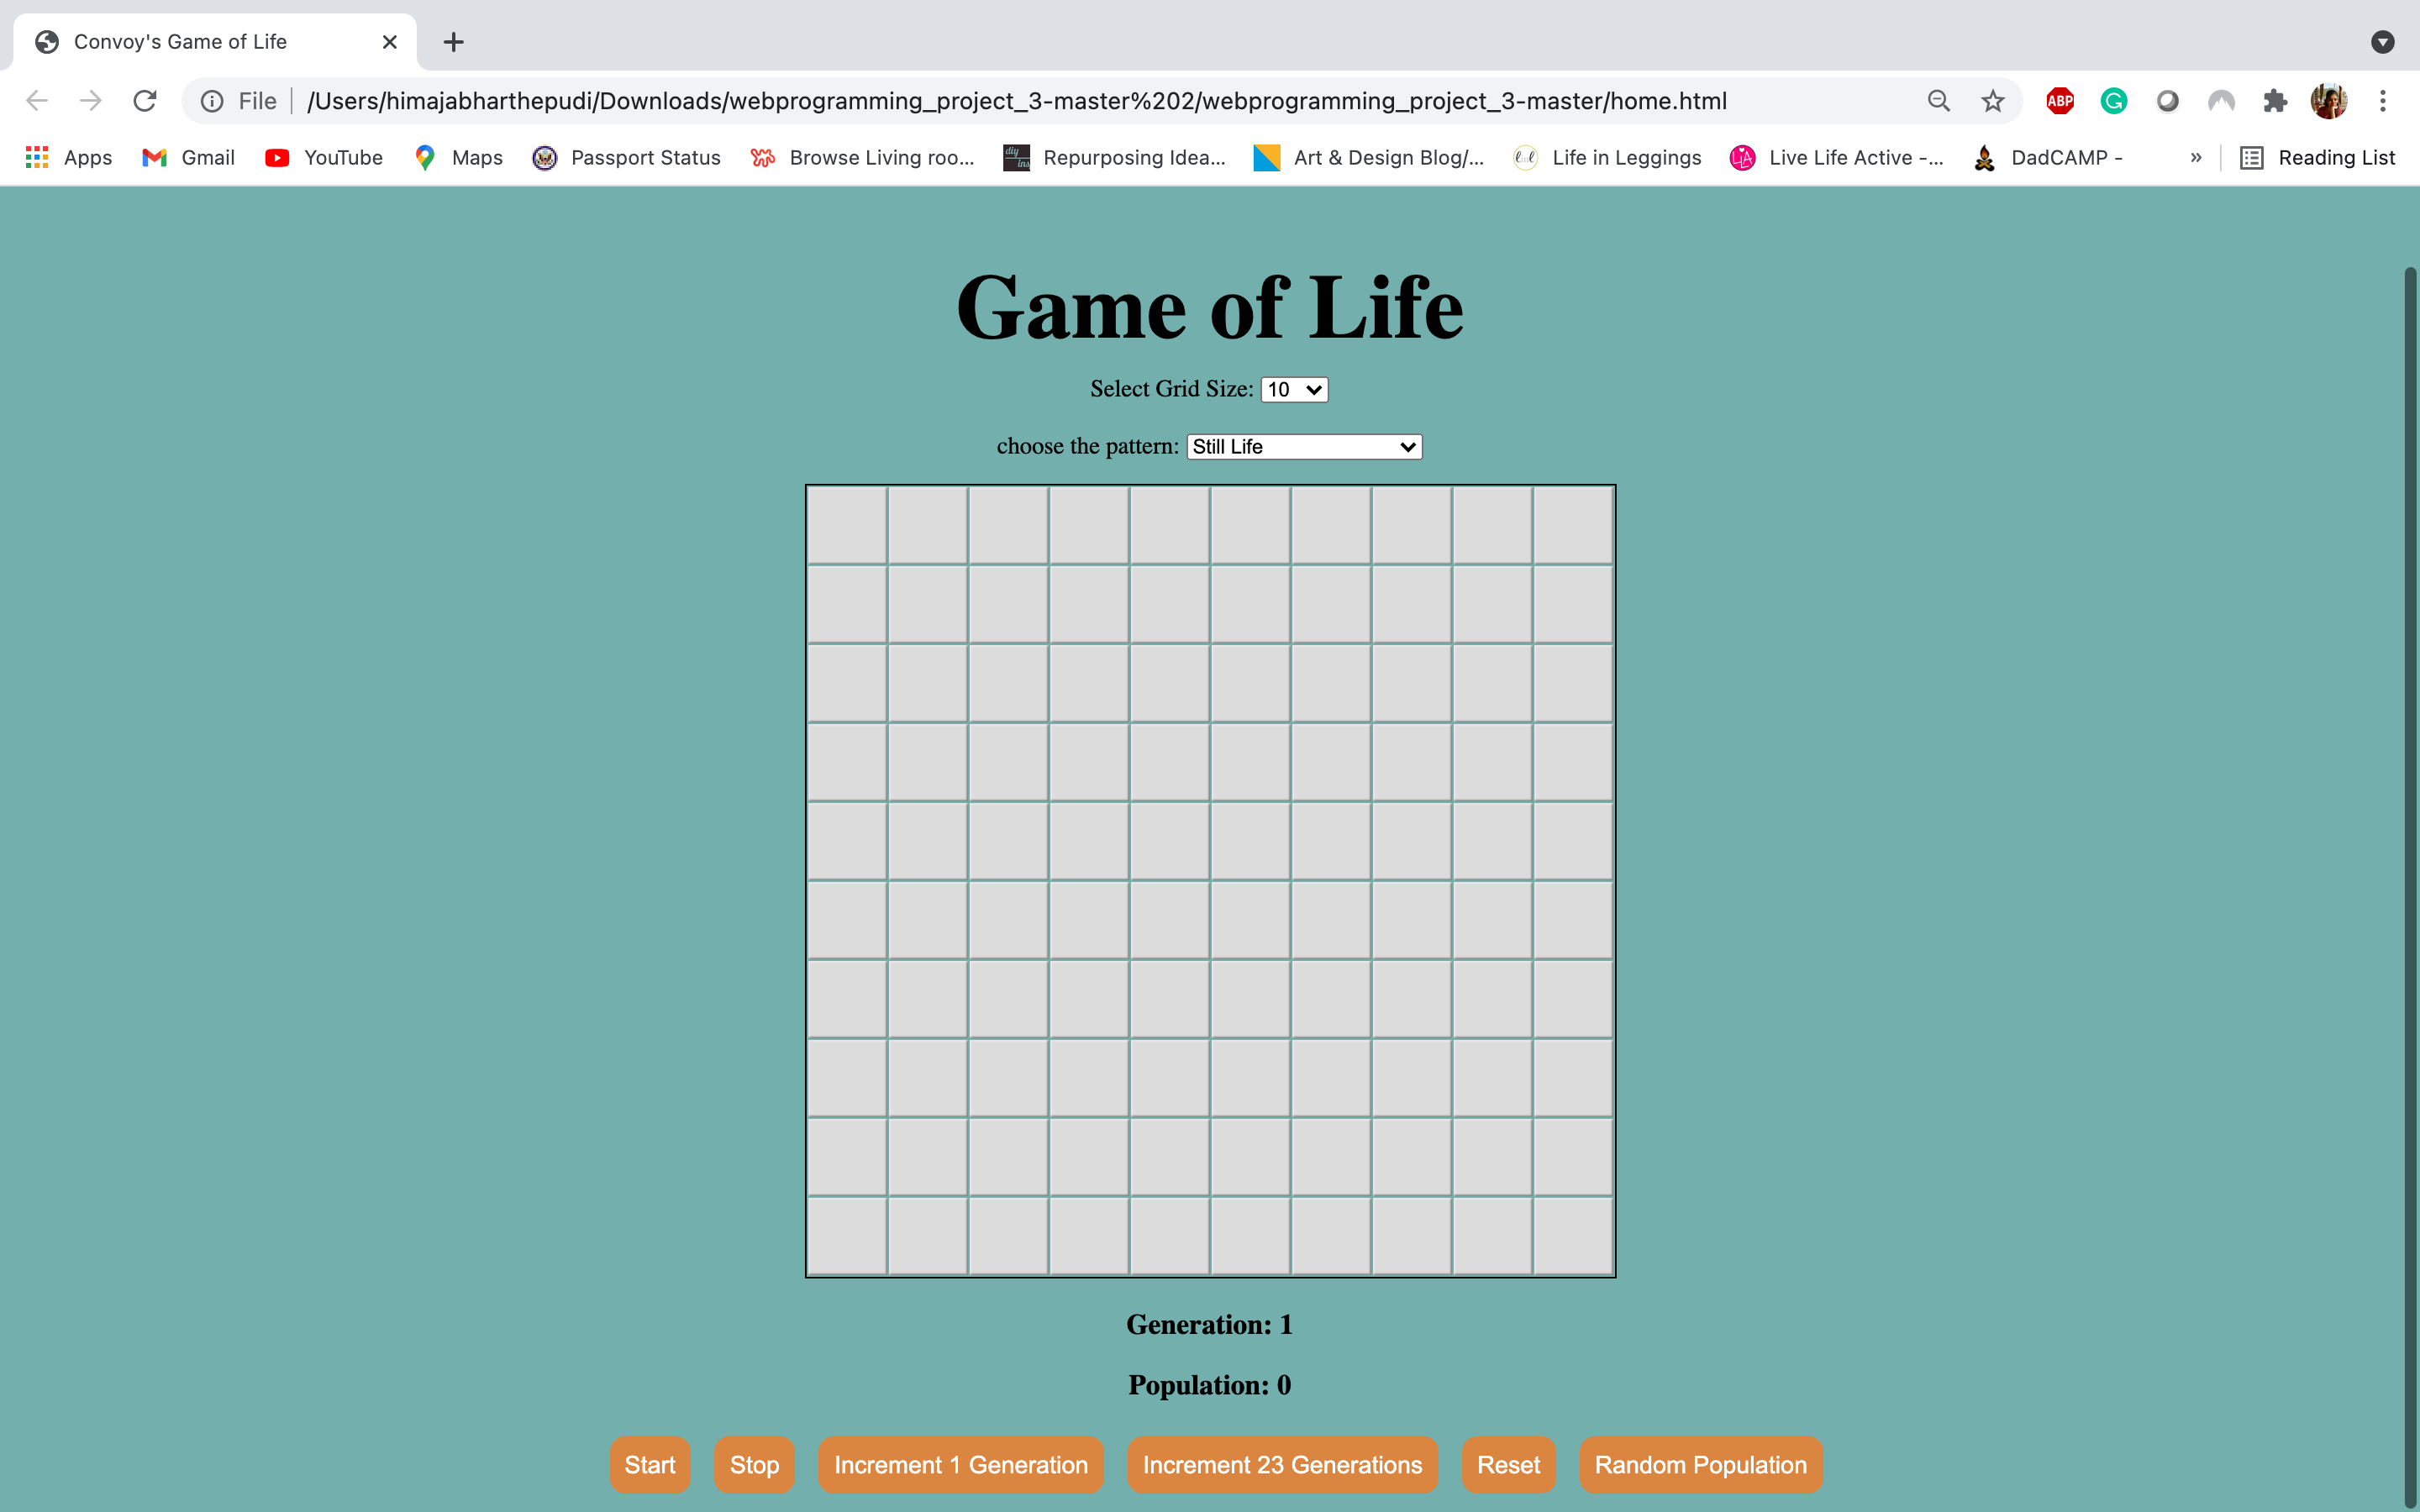
Main Page
In this Page we provided the following options for the user:
Select Grid Size
Choose the Pattern
Initialize the live cells/ select random population
Start
Stop
Increment 1 Generation
Increment 23 Generations
Reset

Slide 8
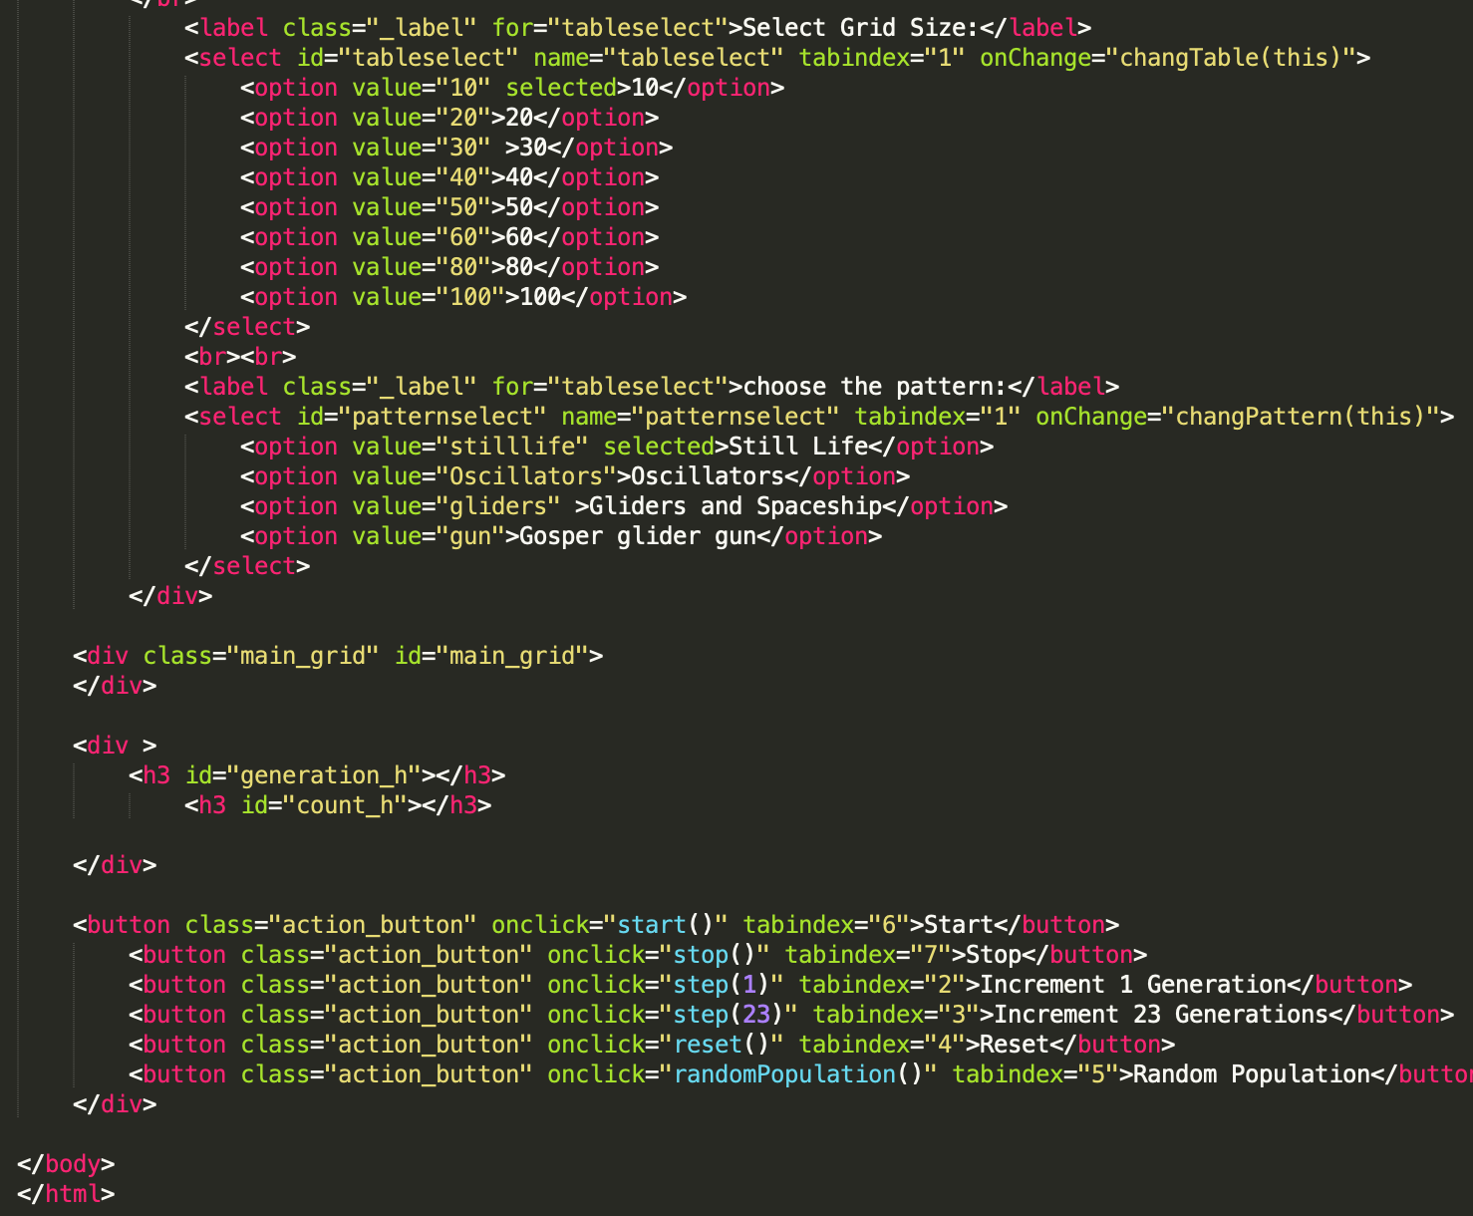
Code
Grid size
Action Buttons

Slide 9
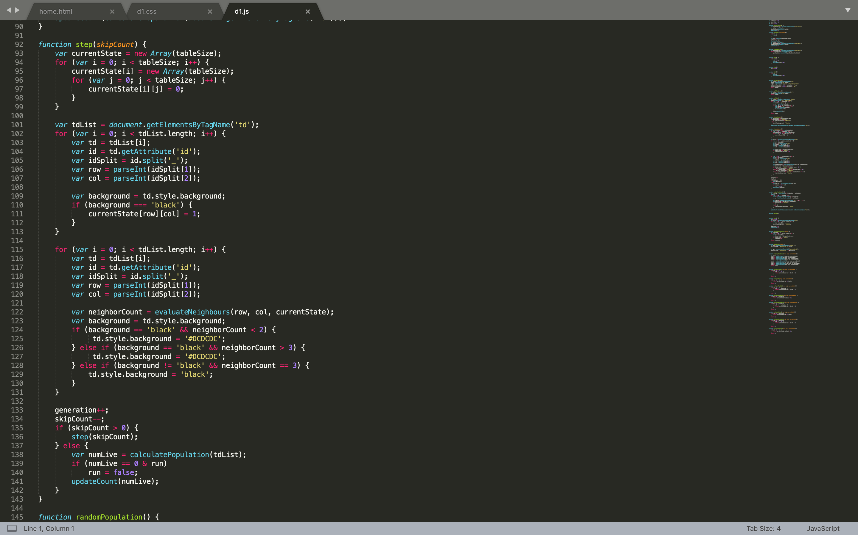
Code
Increment the generations

Slide 10
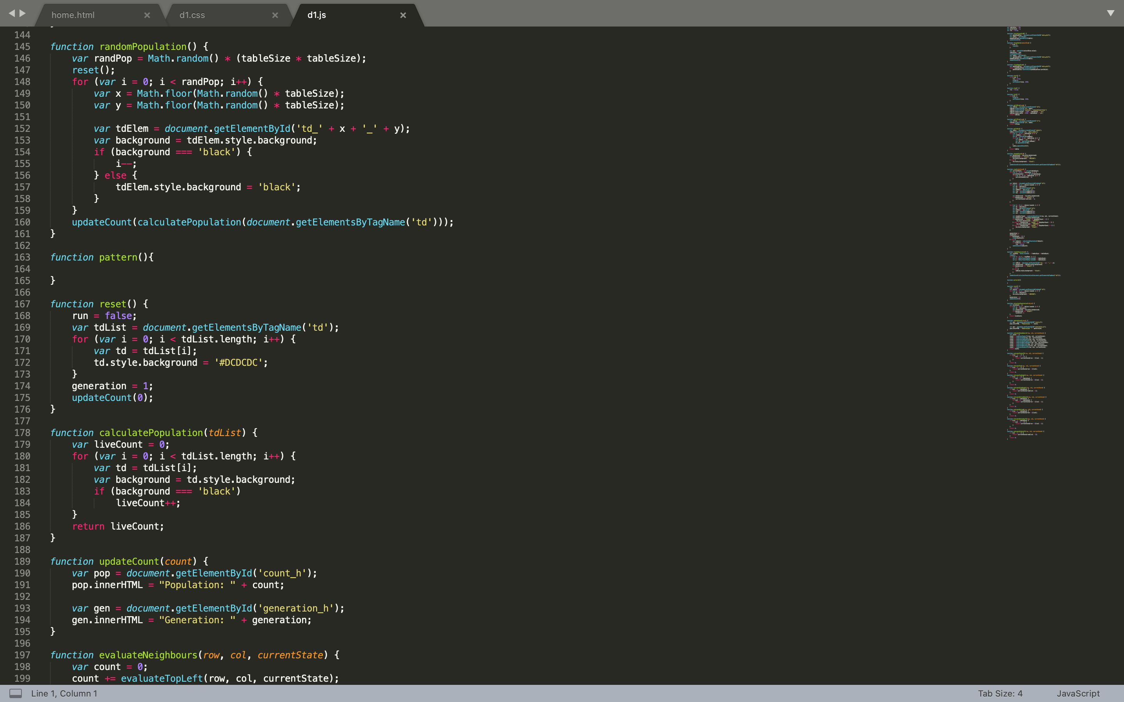
Code
To generate a Random Population

Slide 11
Code
Reset
Calculate Population
Update Count

Slide 12
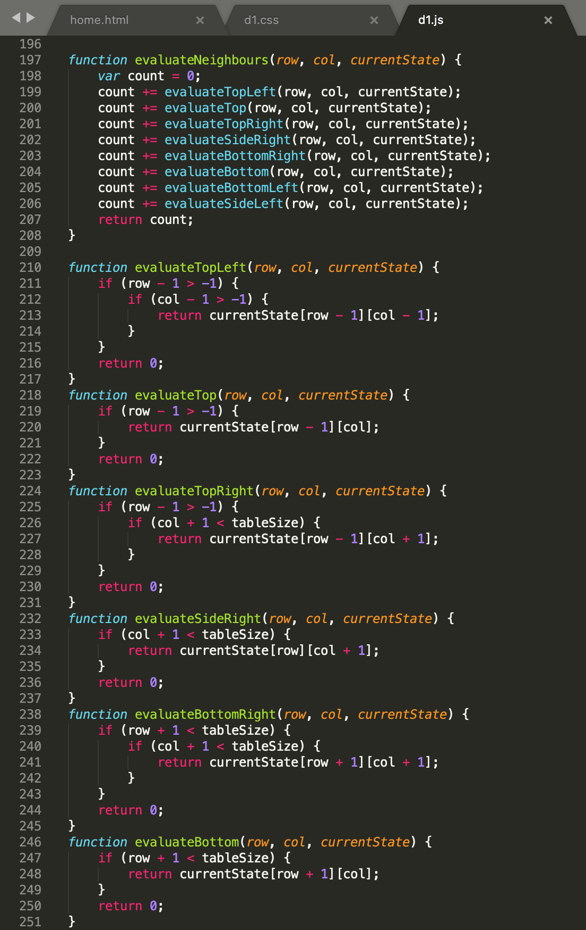
Code
Evaluate Neighbors to update the current state

Slide 13
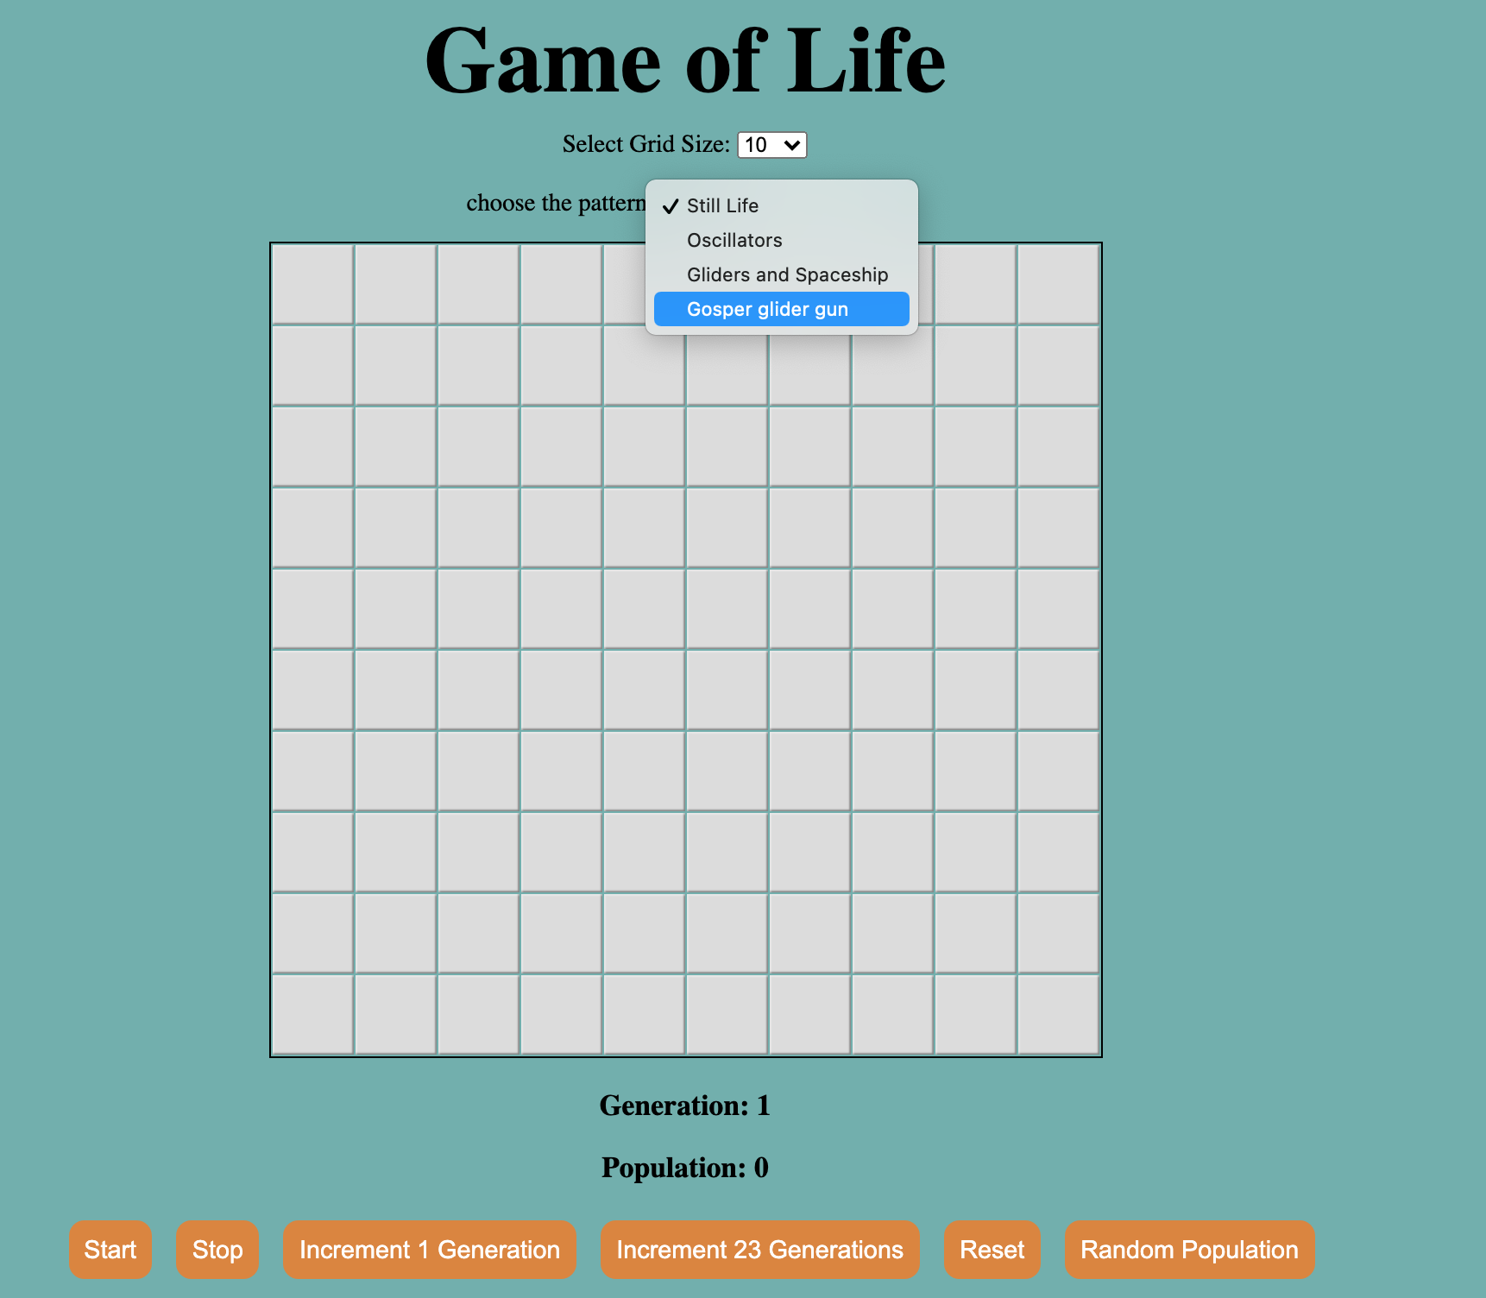
Drop down menu to select Patterns

Slide 14
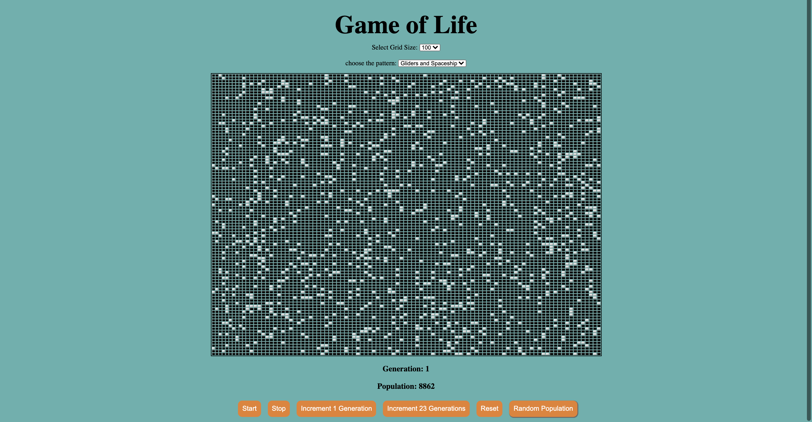
Game after a random population is generated

Slide 15
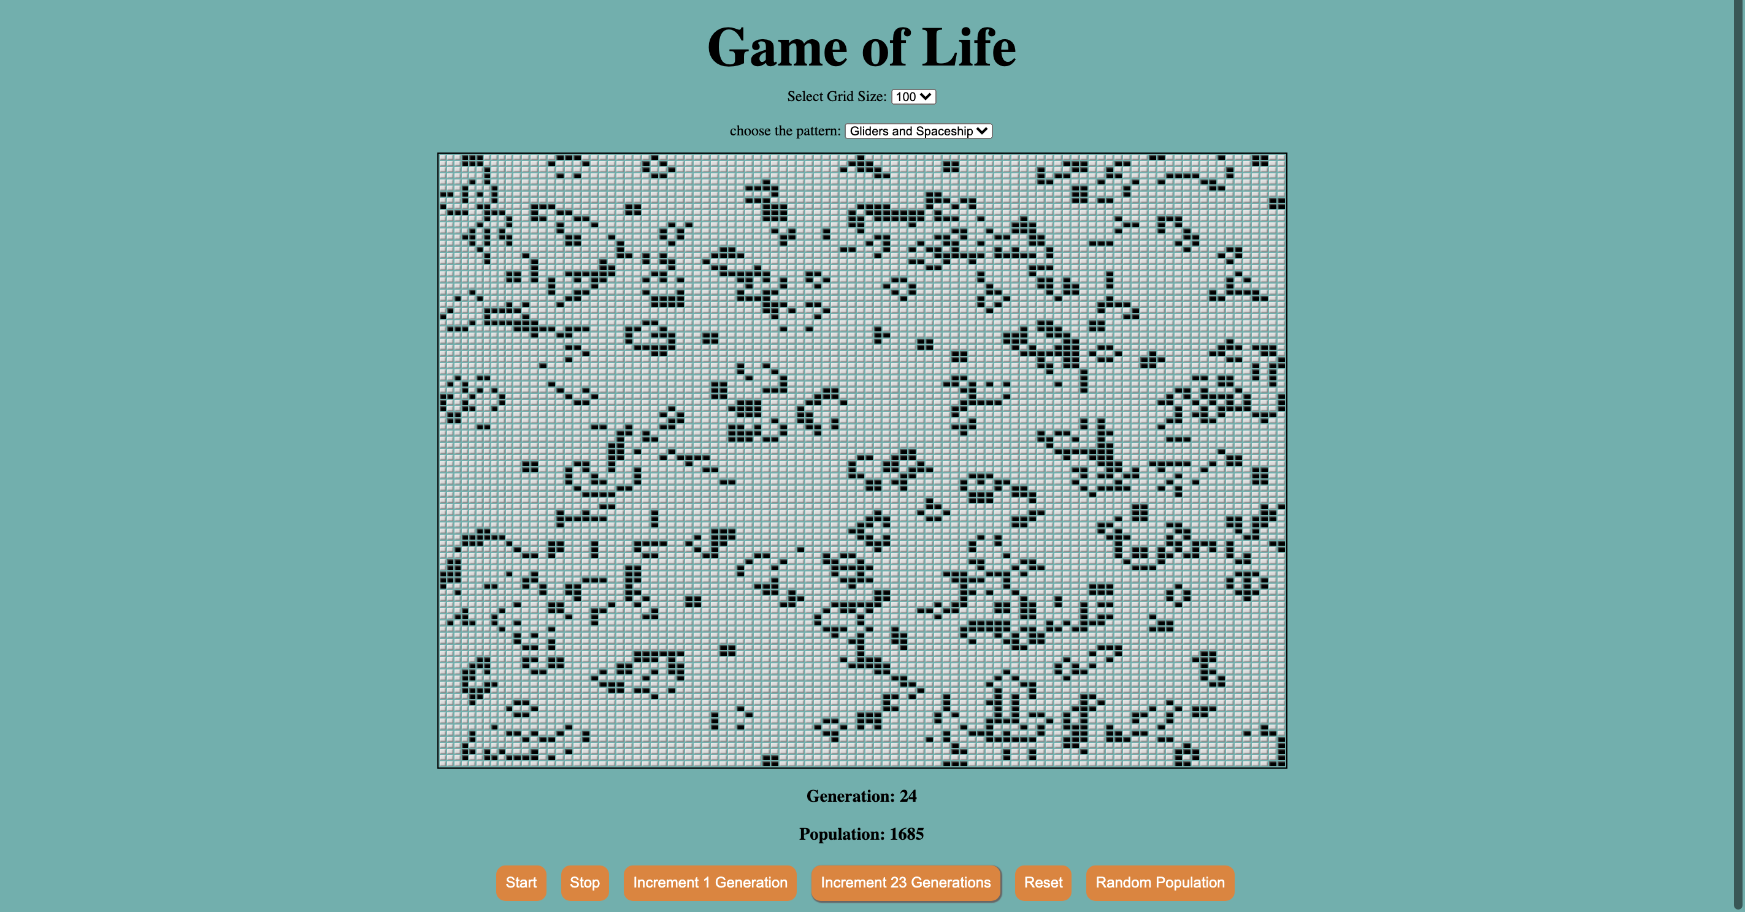
Game after 23rd Increment

Slide 16

References
https://en.wikipedia.org/wiki/Conway%27s_Game_of_Life

Slide 17
Testing
ExtendsClass (JavaScript Validator)
W3C Markup Validation Service
W3C CSS Validation Service

