Slide 1

DATT Assessment
A presentation by group 27

Slide 2

Business Case for the Cosmetics Sales Training Course
Context A UK department store chain piloted a training course for cosmetics sales staff to assess if training improves sales performance.
Objective To statistically compare sales receipts for trained (Take1) and untrained (Take2) salespersons and advise on the training’s effectiveness.
Analysis approach
Descriptive statistics
Normality assessment using visualizations
Parametric and non-parametric hypothesis
and finally
What recommendations can be made based on the results?

Slide 3
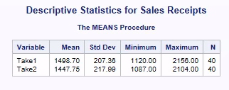
Descriptive statistics
On conducting the SAS Means procedure on the dataset provided, details gathered are shown in Table 1.1 in the appendix file:
Interpretations:
Trained salespersons show an average increase of about £50.95 compared to untrained salespersons.
Initial observation: Training may have a small positive effect
Variability (standard deviation) is similar across both groups.
Table 1.1

Slide 4
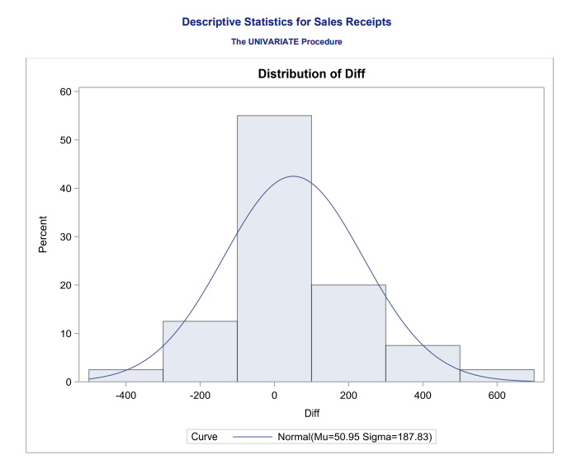
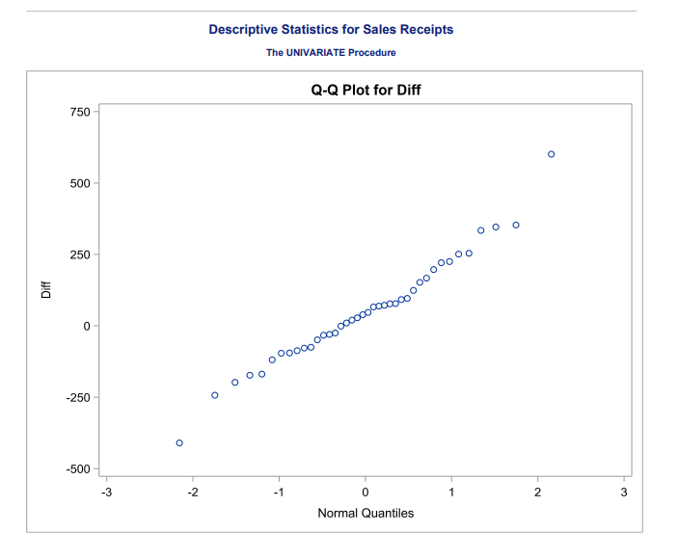
Normality assessment
Objective
Investigate the distributional assumptions needed for a parametric test (i.e., paired t-test).
Assumption
“For the paired t-test to be valid, the differences between sales must follow a normal distribution.”
How ?
Histogram and QQ Plot of Differences
Histogram
Shape: Approximately symmetric and bell-shaped.
Outliers: Minor deviations in tails (e.g., left tail at -£410, right tail at £601).
Conclusion: Visual alignment with the overlaid normal curve (μ = £50.95, σ = £187.83) supports normality.
QQ Plot
Central Quantiles: Points closely follow the reference line
Tails: Slight deviations at extremes (observed 99th percentile = £601 vs. estimated £488).
Conclusion: Majority of data aligns with normality; minor tail deviations are acceptable for large samples.
Tenability of Assumption:
Supported by both graphical tests
Moderately large sample size makes t-test tolerant to minor deviations in tails.
Limitations:
Slight skewness in tails suggests potential outliers
Impact on results? Minimal, as central tendency aligns with normality.
Conclusion: Normality assumption is reasonably tenable → parametric test is valid.
Diagram 1.1 - QQ Plot and Histogram

Slide 5
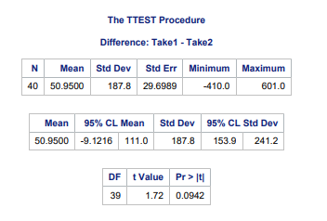
Suitable Parametric test
Objective
Determine if sales training significantly impacts performance.
Justify test selection and interpret results for business decisions.
Suitable test: Paired T-Test
A parametric test comparing means of two groups. This test is performed on an assumption that the two groups are logically related.
Why paired T-Test?
T-test’s heavier tails give more conservative confidence intervals when σ is estimated.
Z-test would underestimate uncertainty by assuming σ is known.
Matched Pairs: Each trained salesperson is compared to their untrained counterpart in the same store. Hence the two groups are logically related.
How?
Null hypotheses:
Training has no effect on sales
Alternative Hypothesis:
Training is significantly effective
Interpretations
T-Test results summary
P-value is less than 0.05 which means that we fail to reject the initial hypotheses that training is ineffective at a 95% confidence level.
Confidence interval is -£9.12 to £111.00 — Includes £0, meaning the training’s impact is uncertain (could range from a slight loss to a significant gain)
The findings of t-test are shown in table 1.2 of the appendix file
Practically, a £50.95 average increase for trained salespersons suggests a potential positive trend, but variability in results (wide CI) means this could range from a £9.12 loss to a £111.00 gain.
Borderline significance (p ≈ 0.09) warrants further investigation.
Table 1.2

Slide 6
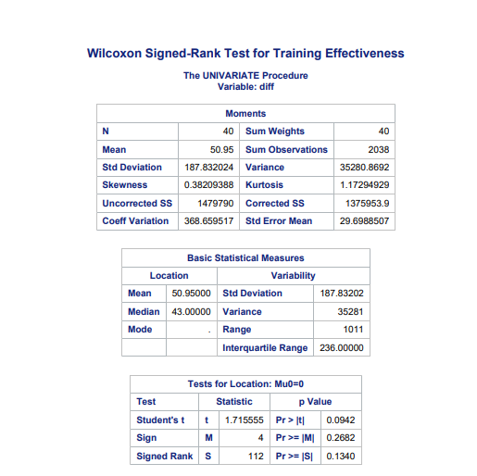
Wilcoxon Signed-Rank Test Results & Critical Comparison
Interpretation:
Fail to reject H0​ at 5% significance (p=0.134>0.05p=0.134>0.05).
No statistically significant evidence that training improves median sales.
Aspect | Paired t-test | Wilcoxon Test
Assumptions | Normality of differences | No distributional assumptions
Central Tendency | Mean difference = £50.95 | Median difference = £43.00
p-value | 0.094 (borderline) | 0.134 (clear non-significant)
Sensitivity | Sensitive to outliers | Robust to outliers

Slide 7
Business Recommendations
Both parametric (paired t-test) and non-parametric (Wilcoxon signed-rank test) yielded p-values above the 5% significance level, indicating no statistically significant difference in sales.
Recommendation to the Manager
Do not implement the training course chain-wide based solely on this pilot study
Further Considerations
Cost–benefit analysis: Weigh training expenses against marginal sales increase.
Control for confounders: Consider additional variables such as salesperson experience, seasonal trends, and long-term customer behavior.
A regression model (or a more advanced multilevel approach) could help isolate the training effect.
Longer-term / Larger-scale study: Increases sample size and statistical power, potentially revealing a significant (though possibly modest) effect if it truly exists.
Model Diagnostics: Future analyses should incorporate residual plots, R² comparisons, and robustness checks to validate model accuracy.
Confidence intervals for the mean difference straddle zero, reinforcing the null hypothesis. Statistical power may be insufficient to detect a small but real effect.
Statistical Insight

Slide 8
Data-Driven Investment Strategy for Suburban Licensed Properties
Context: The Pub and Restaurant Group aims to expand its portfolio of suburban licensed properties cost-effectively. With expensive structural surveys and architect consultations limiting in-depth investigations, the group needs a predictive model to assess potential investment value quickly.
Objective: Develop a robust regression model using readily available physical, socio-economic, and geographical data to estimate each property's average weekly income (£000's). This model will identify the key drivers of income, enabling the company to make informed investment decisions.
Analysis Approach
Initial Analysis: Examine multicollinearity among potential predictors to ensure reliable model estimates.
Model Building: Employ both forward selection and backward elimination techniques to construct multiple regression models.
Model Selection & Diagnostics: Use Mallows’ Cp to compare all possible models and select the optimal reduced model.
Model Interpretation & Business Application: Interpret the final model coefficients, assess its overall validity via diagnostic checks, and apply it to the "The Good King James" case study to guide investment decisions.

Slide 9
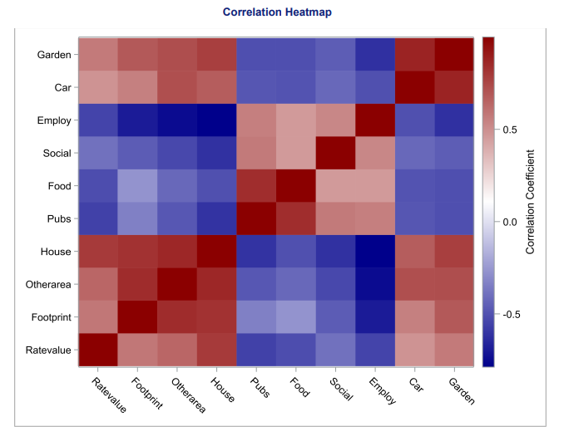
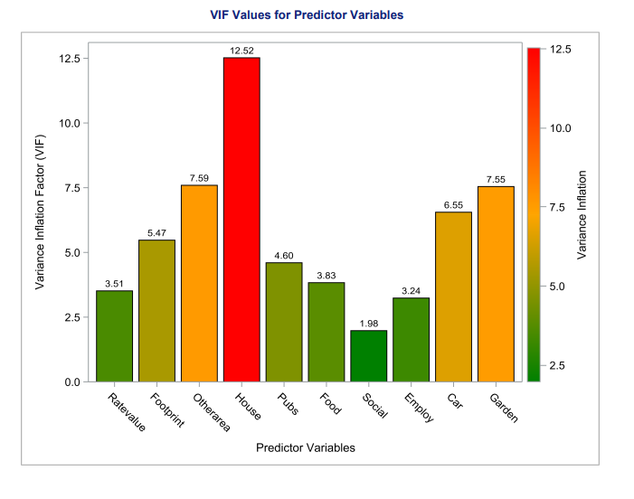
Multicollinearity & Business Impact
What it is?
Multicollinearity happens when two or more factors in a model are too closely related. This makes it harder to understand which factor truly drives outcomes, leading to unreliable predictions.
How to find?
Our analysis used two methods:
Correlational matrix:
High correlations observed among House, Otherarea, and Footprint, with the strongest correlation between House and Otherarea (0.863).
Suggest potential redundancy among these variables.
VIF Test
House (VIF = 12.52) and Otherarea (VIF = 7.59) exceed the threshold of 5, indicating severe multicollinearity.
High VIF values suggest that these variables provide overlapping information, leading to unreliable regression coefficients.
Note: The output and code for both procedures can be found in Appendix 1.2 and 2.2 respectively.
Business Implications
Including highly collinear variables increases the variance of estimated coefficients, making predictions less stable.
Recommendation:
To improve model reliability, avoid including redundant predictors such as House, Otherarea, or Footprint together in the final model.
Removing collinear variables allows the model to focus on more independent predictors, leading to better generalization for investment decision-making.
Figure - Heatmap and bar graph showing correlational pairs and inflated variables.

Slide 10
Property Value Modeling
Context:
Assessing the potential for a flat-rate travel insurance plan targeted at claimants aged 50–85.
Objective Investigate how claimant age influences claim amounts to refine pricing strategies and risk management.
Analysis approach
Initial Analysis – Claim vs. Age
Improved Model – LnClaim vs. Age (Log-Linear Model)
Model Interpretation & Prediction for business

Slide 11
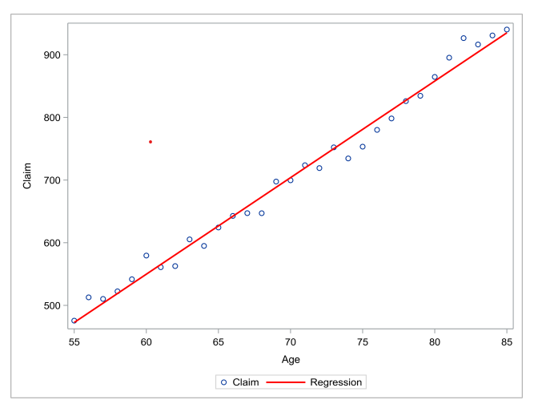
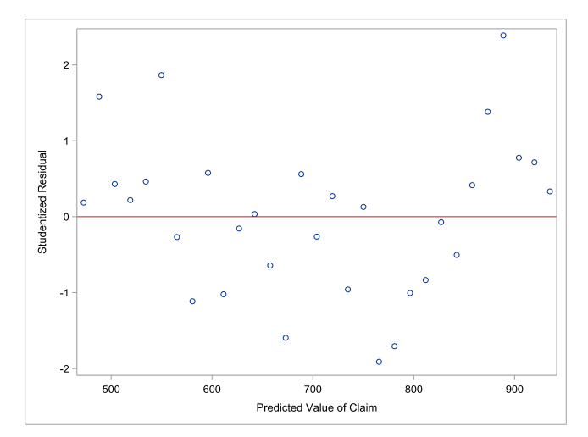
Initial analysis – claim vs age
Using the SAS code presented in Appendix 1.3, a linear regression model was derived to examine the dependency of Claim on Age. This presentation provides insights from:
The scatterplot analysis, which assesses the model’s fit and trend.
The residual diagnostics, which evaluate the model’s assumptions.
All supporting output and statistical calculations are available in Appendix 2.3 for reference.
Insights from scatterplot
A strong positive correlation exists between Age and Claim values.
The regression model C = (-374.86 + 15.41 × A) aligns well with the data.
R² = 98.67%, demonstrating exceptional explanatory power i.e Age is a primary driver of Claim variation
Potential Risks & Limitations:
Intercept issue – The negative intercept (-374.86) suggests unrealistic claims at Age = 0, though this does not affect real-world forecasts.
Insights from residual analysis
U-shaped residual pattern signals a mis specified relationship—Age alone may not fully explain Claim variations.
Heteroscedasticity detected – Increasing variance at higher fitted values suggests reduced precision in higher claims.
Potential inefficiencies – If left unaddressed, misestimated claim amounts could impact financial forecasting and pricing strategies.
Figure 3.1 – Scatterplot and residual analysis of Claim vs Age model

Slide 12
Initial analysis – claim vs age
What works well?
Demonstrates exceptional predictive accuracy, as reflected by the R² value of 98.67.
Confirms Age as a significant predictor of claim values, making it a reliable input for underwriting and pricing strategies.
Areas for improvement
Reveals issues with linearity and heteroscedasticity, indicating that the constant variance assumption is violated. These assumption breaches can affect the model’s reliability in predicting claims, particularly for older age groups.
This suggests a need for model enhancement to more accurately reflect the complexities of claim behavior.
What needs to change?
To address the non-linearity and improve model fit, log-transformation of the dependent variable or the inclusion of quadratic terms (Age²) should be considered. This would better capture the increasing rate of claim growth with Age and stabilize variance across different age groups.
Figure 3.1 – Scatterplot and residual analysis of Claim vs Age model

Slide 13
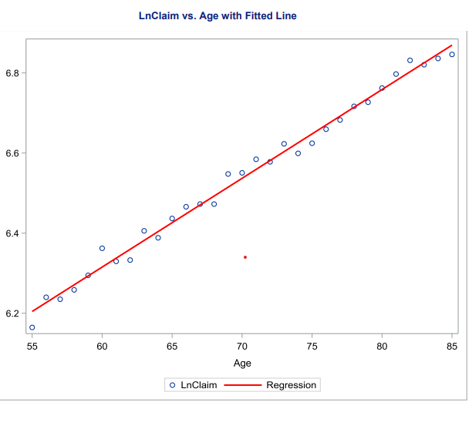
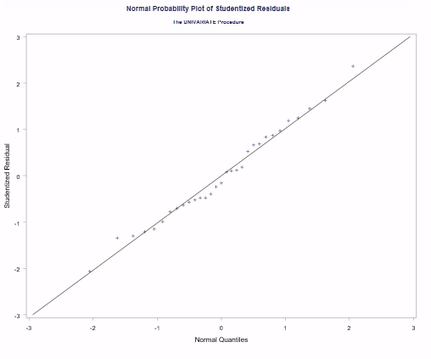
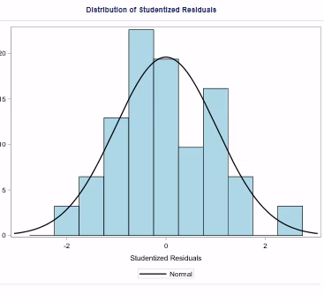
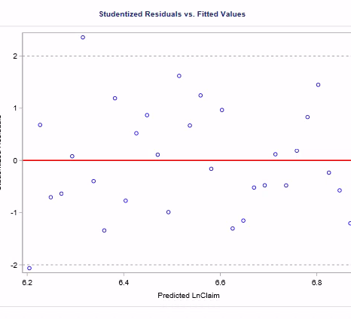
Improved Model – LnClaim vs. Age
This analysis employs a bivariate regression model with a log-transformed claim amount (LnClaim) as the dependent variable and Age as the predictor. The transformation ensures statistical validity, addressing non-linearity and variance inconsistencies observed in the original model.
Insights from scatterplot
Age explains 99% of the variance in log-transformed claim values (R² = 0.99), indicating a robust predictive relationship.
Model Equation: LnClaim=4.9855+0.02216×Age
Slope = 0.02216 (p < 0.0001)
Each additional year increases the log-transformed claim amount by 2.2%
Insights from residual analysis
Random scatter around zero → No evidence of heteroscedasticity (improved vs. original model’s funnel shape).
No extreme outliers →Almost all residuals lie within ±2 standard deviations.
Insights from Histogram & QQ Plot
Confirms normality assumption. Linear alignment with reference line → No significant skewness or heavy tails.

Slide 14
Improved Model – LnClaim vs. Age
Adequacy of the Fitted Regression Model The model LnClaim = 4.9855 + 0.02216 × Age explains 99% of the variation (R² = 0.99), confirming strong predictive power. Residual analysis supports its validity:
Linearity: Log transformation ensures a linear relationship.
Homoscedasticity: Residuals are evenly spread, fixing variance issues.
Normality: Residuals follow a normal distribution, ensuring reliable confidence intervals.
Thus, the log-linear model is a statistically robust choice for predicting claim amounts.
Model Recommendation: Log-Linear Regression (LnClaim ~ Age)
Why?
Statistical Superiority: Meets regression assumptions, higher R² (0.99 vs. 0.98).
Business Fit: Captures exponential risk growth (+2.2% per year), avoids claim underestimation.
Actionable Insights: Provides accurate pricing and back-transformed financial estimates.

Slide 15
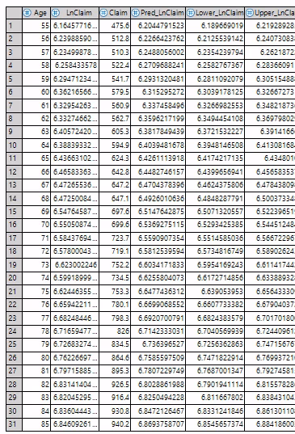

CONCLUSION
The mean values and confidence intervals are presented in the table, with the corresponding code available in Appendix 1.
Fitted Model (Log-Linear Regression) → LnClaim = 4.9855 + 0.02216 × Age
Slope Interpretation: 0.02216 is highly significant (p < 0.0001), meaning for each additional year of age, the natural logarithm of the claim amount increases by 0.02216.
When back-transformed, this reflects an approximate 2.2% annual increase in the claim amount.
Business Implication:
Age is a strong driver of travel insurance claim costs, supporting the use of age-adjusted pricing.
Further Information to Investigate:
Claim Frequency: How often do claims occur for each age group?
Travel Destination Risk: Are there differences in risk by travel region or destination?
Pre-Existing Medical Conditions: How do underlying health factors affect claim amounts?
Policy Coverage Limits: How do different coverage levels impact the average claim?
Travel Duration: Longer trips may correlate with higher claims.
Claim estimation for Age 70 (Appendix):
Predicted LnClaim: ≈ 6.5148
95% CI for LnClaim: [6.5071, 6.5224]
On performing back-transformation, we predict, for a 70-year-old claimant, we are 95% confident that the true mean claim lies between approximately £684.95 and £695.42.

