Slide 1
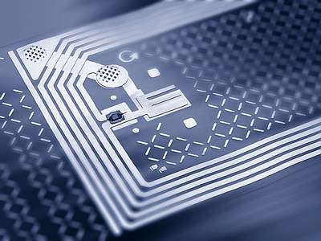
FUTURE IS “RFID”
M. Raja jaya chandra
T. Srihari
Presented by

Slide 2
What are we trying to acheive today..
What is RFID technology
RFID Technology overview
What’s inside
-The TAG
-The READER
How does it work
RFID Differentiators
-Energy Source
-Frequency & Memory
-Standards
Typical RFID Applications

Slide 3
History
Transponder used by the allies in World War II to identify aircraft as friend or foe
Léon Theremin invented an espionage tool for the Soviet Union in 1946
Mario Cardullo's registered the first U.S. Patent in 1973 to be the first true ancestor of modern RFID
RFID abbreviation was granted to Charles Walton in 1983 by a US patent

Slide 4
What is RFID

Slide 5
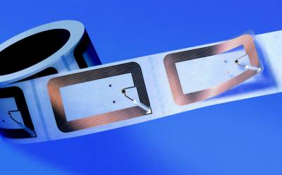
What is RFID
RFID = Radio Frequency Identification
RFID is an ADC technology that uses radio-frequency waves to transfer data between a reader and a movable item to identify, categorize, track...
RFID is fast, reliable, and does not require physical sight or contact between reader/scanner and the tagged item
Notes:
From Wikipedia

Slide 6
RFID tags contain a microchip and antenna to receive and respond to radio-frequency queries over wireless means in an automated fashion
Notes:
From Wikipedia

Slide 7
Technical overview

Slide 8
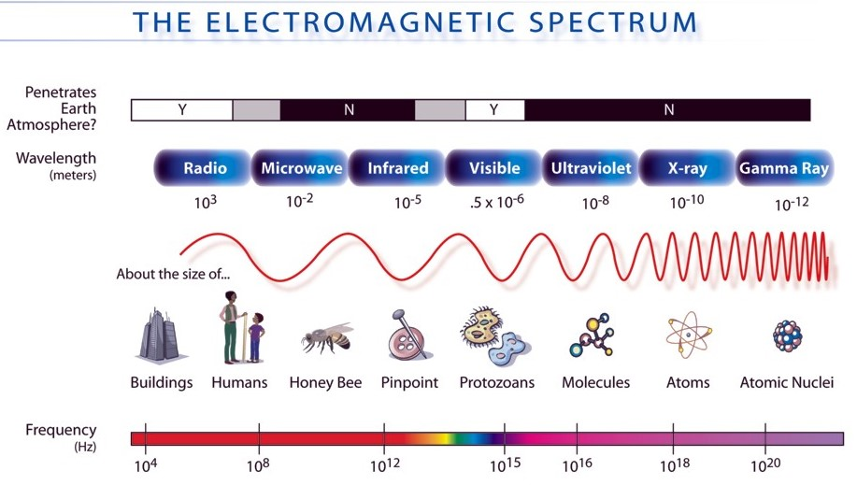
Frequency range:
300 Hz to 3000 GHz
Notes:
From Wikipedia

Slide 9
Whats inside

Slide 10
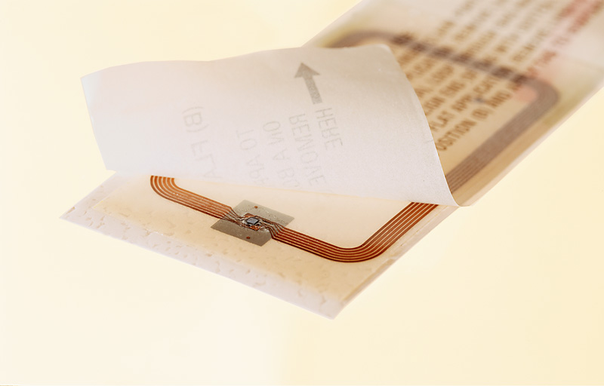
The RFID TAG
A paper label
with RFID inside
an antenna,
printed, etched
or stamped ...
… and a silicon
chip
attached to it
… on a substrate
e.g. a plastic
foil ...
Notes:
From Wikipedia

Slide 11
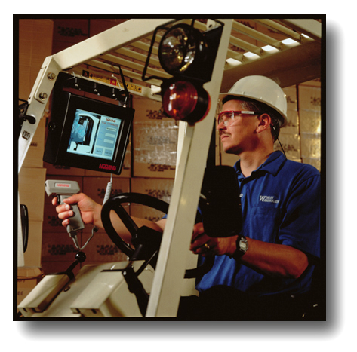
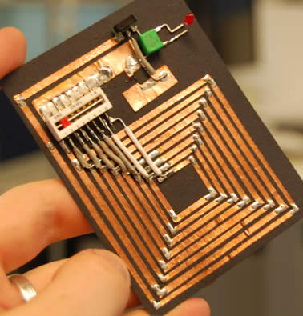
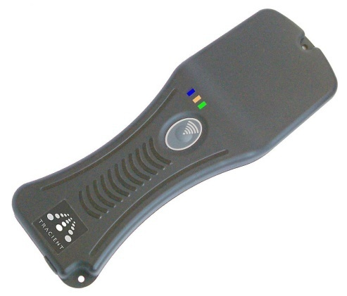
The RFID READER
Readers (interrogators) can be at a fixed point such as
  Entrance/exit
  Point of sale
  Warehouse
Readers can also be
mobile -- tethered,
hand-held, or wireless
Notes:
From Wikipedia

Slide 12
Notes:
From Wikipedia

Slide 13
How does it work

Slide 14
What Constitutes an RFID System
One or more RF tags
Two or more antennas
One or more interrogators
One or more host computers
Notes:
From Wikipedia

Slide 15
RFID Diagram
Antenna
RF Module
Reader
Host Computer
Note: The host is the software database...
Notes:
From Wikipedia

Slide 16
RFID Diagram
Antenna
RF Module
Reader
Host Computer
Note: The Reader interprets radio frequency into digital information.…...
Notes:
From Wikipedia

Slide 17
RFID Diagram
Antenna
RF Module
Reader
Host Computer
Note: The RF module creates radio frequency (RF). It receives and transmits RF through the antenna…
Notes:
From Wikipedia

Slide 18
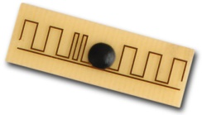
RFID Diagram
Antenna
RF Module
Tag
Reader
Note: Tag (transponder) is interrogated by the antenna....
Notes:
From Wikipedia

Slide 19
RFID Diagram
(Tag ID Communication)
Antenna
RF Module
Reader
Tag
Note: The antenna captures the tag ID number…first as analog RF waves, then it is converted to digital information.
Notes:
From Wikipedia

Slide 20
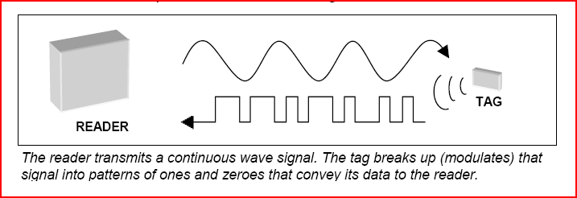
A RFID Tag is a portable Database
Interrogation Unit
Micro
Tx/Rx
Antenna
Tag
Computer
CPU
I/O
RAM
ROM
Radio Tx/Rx
Pwr Supply
Computer Network
CPU
I/O
RAM
ROM
Radio Tx/Rx
Pwr Supply
Notes:
From Wikipedia

Slide 21
A RFID Tag is a portable Database
11
Product Information (PML Format)
ONS Server
12
Internet
Internet
Write data to RF tags
Items with RF Tags
Antenna
Read
Manager
Transaction
Data Store
Reader
Application Systems
RF
Antenna
Trading Partner Systems
1
2
3
4
5
6
7
8
EDI /
XML
Tag/Item Relationship Database
10
9
Notes:
From Wikipedia

Slide 22
RFID differentiators

Slide 23
RFID Tags based on energy source
Three Basic Types:
  Active
    Battery powered memory, radio & circuitry
    Tag transmits radio signal
    High Read Range (300 feet)
  Active Backscatter
    Battery powered memory and circuitry
    Tag reflects radio signal from reader
    Medium Read Range (10 - 50 feet)
  Passive Backscatter
    Reader powered
    Tag reflects radio signal from reader
    Shorter Read Range (4 inches - 15 feet)
Notes:
From Wikipedia

Slide 24
RFID Tags - Frequency
???
915 MHz
5.8 GHz
2.45 GHz
27.1 MHz
315 MHz
433 MHz
Notes:
From Wikipedia

Slide 25
RFID Tags - Frequency
RFID:
Access Control
Animal ID
Inductive Magnetic
Field Coupling:
<150 kHz
(125 kHz & 134 kHz)
Low Freq. EAS
Data
Modem
10 kHz
100 kHz
Notes:
From Wikipedia

Slide 26
RFID Tags - Frequency
Inductive Magnetic
Field Coupling:
13.56 MHz
(Popular Smart Card
Frequency)
RFID:
Smart Cards
Mid. Freq.
EAS
AM
CB
1 MHz
10 MHz
Notes:
From Wikipedia

Slide 27
RFID Tags - Frequency
RFID:
Toll Roads
Electromagnetic Field
Coupling: UHF
>300 MHz <1 GHz
(862-928 MHz
ANSI MH10.8.4 & GTAG)
Data
Terminal
Cell Phone
1000 MHz
Notes:
From Wikipedia

Slide 28
RFID Tags - Frequency
Electromagnetic
Field Coupling:
2.45 GHz
RFID:
Item Management
Microwave
EAS
2.45 GHz
Notes:
From Wikipedia

Slide 29
RFID Tags – Transmission modes
Inductive (E-Field)
Electromagnetic (H-Field)
  Narrowband
  Spread Spectrum
    Frequency Hopping
    Direct Sequence
Notes:
From Wikipedia

Slide 30
RFID Tags - Memory
Type
Data Capacity
Write/Read
Program by
Application
EAS
1 bit
read-only
user
Retail Security
SAW
4 to 16 bits
read-only
manufacturer
Proprietary
Technology
Inductive
2 to 32 bytes
read-only
manufacturer
License Plate
Ignition Key
Modulated
Backscatter
32 to 2K bytes
write/read
user
(tag ID may be by manufacturer)
Portable Data File
Active/
Modulated
Backscatter
32 to 2K bytes
write/read
user
(tag ID may be by manufacturer)
Portable Data File
Active
2K bytes to
16 Mbytes
write/read
interrogate/
modify/read
user
(tag ID may be by manufacturer)
Dynamic Data File
Notes:
From Wikipedia

Slide 31
RFID Tags – Memory Segmentation
Read Only (Factory Programmed)
WORM - Write Once, Read Many times
Reprogrammable (Field Programmable)
Read/Write (In-Use Programmable)
Notes:
From Wikipedia

Slide 32
Standardization
Standardization in the area of identification
cards and related devices for use in
inter-industry applications and
international interchange.”
This is interpreted to cover all
standardization concerning
personal identification
and/or cards.
ISO/IEC 15693 is an I.C. Card standard for 13.56 MHz, NOT an RFID standard
The 13.56 MHz standard for RFID is ISO/IEC 18000, Part 3.
Notes:
From Wikipedia

Slide 33
Typical RFID applications

Slide 34

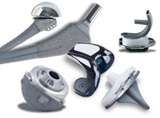
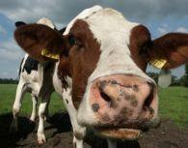
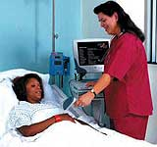
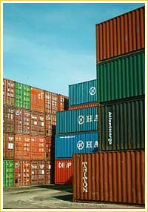
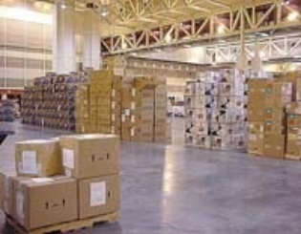
RFID Applications
Assembly
Aircraft Assembly
Repair
Medical Devices
Tracking and Tracing of Assembly kits
Food Chain
Track food chain
Supply Chain
Warehouse management, inventory tracking, retail stock management
Notes:
From Wikipedia

Slide 35
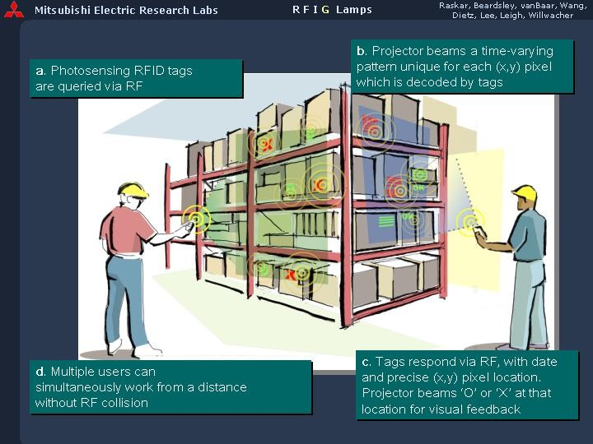
RFID Applications
Notes:
From Wikipedia

Slide 36
RFID Applications



⬥




















































Notes:
From Wikipedia

Slide 37
RFID Applications
Instant check out
Notes:
From Wikipedia

Slide 38
RFID Applications
Vehicle Identification
Access Control
Electronic Article
Surveillance
Livestock Tracking
Production Control
Notes:
From Wikipedia

Slide 40

Questions?
Questions?

